Slide 1
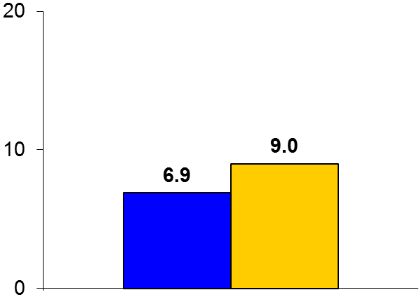
BRAVO-3
Trial design: Patients undergoing transfemoral TAVR were randomized in a 1:1 fashion to bivalirudin or UFH. They were followed for 30 days.
Results
(p = 0.27)
Co-primary endpoints: Major bleeding for bivalirudin vs. UFH at 48 hours: 6.9% vs. 9.0%, p = 0.27; net adverse CV events at 30 days: 14.4% vs. 16.1%, p for noninferiority < 0.01, p for superiority = 0.5
48-hour mortality: 1.5% vs. 1.8%, p = 0.76; stroke: 2.0% vs. 2.0%, p = 0.98
%
Conclusions
Bivalirudin was not superior to UFH as the anticoagulant of choice for transfemoral TAVR procedures
There was no significant difference in bleeding events or in adverse cardiovascular events at 48 hours and 30 days
Major bleeding
Bivalirudin
(n = 404)
UFH
(n = 398)
Dangas GD, et al. J Am Coll Cardiol 2015;66:2860-8

