Slide 1
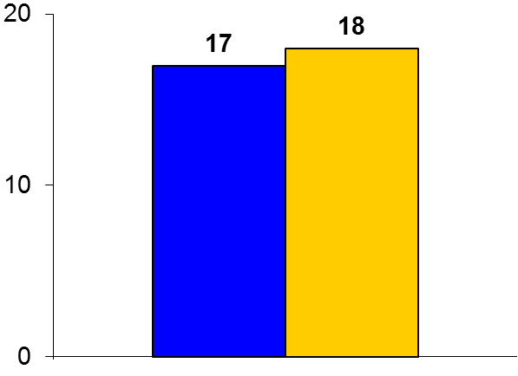
DANAMI 3-DEFER
Trial design: Patients presenting with STEMI and in whom the operators could establish TIMI 2-3 flow without stenting or those presenting with TIMI 2-3 flow were randomized to stent implantation after 48 hours or immediate stenting. They were followed for 42 months.
Results
(p = 0.92)
The primary outcome, MACE, for deferred vs. immediate stenting: 17% vs. 18%; HR 0.99, 95% CI 0.75-1.29, p = 0.92
All-cause mortality: 7% vs. 9%, p = 0.37; MI: 7% vs. 7%, p = 0.77; unplanned target vessel revascularization (TVR): 7% vs. 4%, p = 0.03
LVEF at 18 months: 60% vs. 57%, p = 0.04
%
Conclusions
Deferred stenting at the time of primary PCI in STEMI patients was not superior for adverse CV outcomes compared with immediate stenting (which is conventional practice)
Deferred stenting was associated with a higher risk of unplanned TVR
Primary endpoint
Deferred stenting
(n = 603)
Immediate
PCI
(n = 612)
Kelbæk H, et al. Lancet 2016;387:2199-2206

