Slide 1
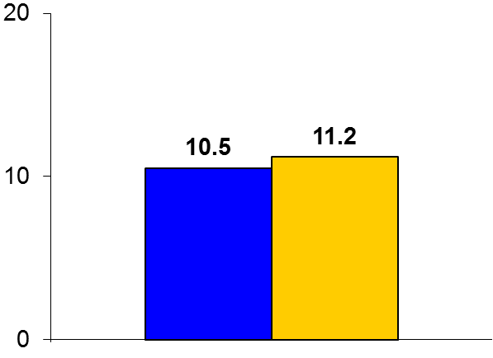
DANAMI 3-iPOST
Trial design: Patients presenting with STEMI and undergoing primary PCI with TIMI 0-1 flow in the infarct vessel were randomized to ischemic postconditioning or conventional PCI. They were followed for 37.5 months.
Results
(p = 0.66)
The primary outcome, MACE, for ischemic postconditioning vs. conventional PCI: 10.5% vs. 11.2%, HR 0.93, 95% CI 0.66-1.30, p = 0.66
All-cause mortality: 6.2% vs. 8.1%, p = 0.18; recurrent MI: 5.4% vs. 4.7%, p = 0.64
LVEF at 18 months: 52.7% vs. 50.8%, p < 0.05
%
Conclusions
Ischemic postconditioning (with short bursts of balloon occlusion immediately after establishing perfusion) was not superior to conventional primary PCI in patients with STEMI
Largest trial on this topic; clinical utility of ischemic postconditioning during routine primary PCI appears low
Primary endpoint
Ischemic Postconditioning
(n = 617)
Conventional PCI
(n = 617)
Presented by Dr. Thomas Engstrøm at ACC 2016

