Slide 1
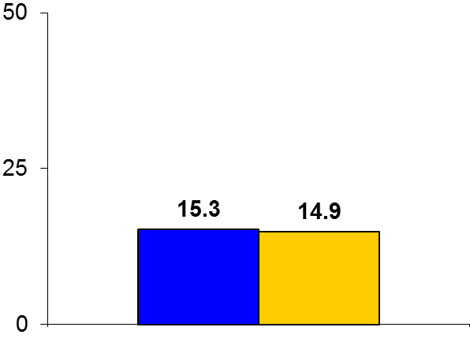
EARLY-BAMI
Trial design: Patients presenting with STEMI with a plan for primary PCI, and without evidence of cardiogenic shock, were randomized to either intravenous bolus metoprolol 5 mg x 2 or matching placebo. They were followed for 30 days.
Results
(p = 0.61)
Primary endpoint, infarct size on delayed enhancement CMR at 30 days, for metoprolol vs. placebo: 15.3% vs. 14.9%, p = 0.61
LVEF on CMR: 51% vs. 51.7%, p = 0.68
Severe bradycardia: 1.5% vs. 0.6%, p = 0.28; cardiogenic shock: 0.6% vs. 0.3%, p = 0.62; ventricular arrhythmia: 3.6% vs. 6.9%, p = 0.05
%
Conclusions
Early routine administration of intravenous metoprolol is not beneficial in reducing infarct size in patients presenting with STEMI and undergoing primary PCI, similar to what has been observed in other trials
Small study, but no clear safety signal with early administration of intravenous beta-blockers
Primary endpoint
Metoprolol
(n = 336)
Placebo
(n = 347)
Roolvink V, et al. J Am Coll Cardiol 2016;67:2705-15

