Slide 1
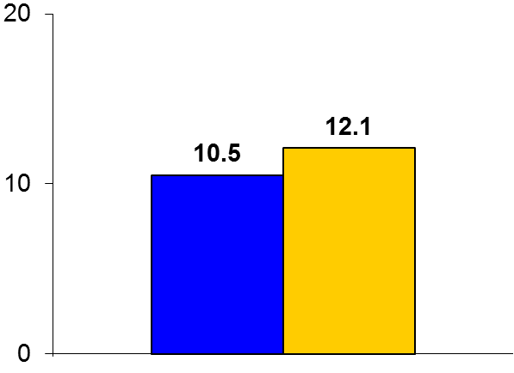
EMPA-REG OUTCOME
Trial design: Patients with type 2 diabetes mellitus (DM2) at high risk for CV events were randomized to receive in a 1:1:1 fashion either empaglifozin 10 or 25 mg, or placebo. They were followed for 3.1 years.
Results
(p_{noninferiority} < 0.001)
(p_{superiority}= 0.04)
Primary outcome, CV death/MI/stroke for empaglifozin vs. placebo: 10.5% vs. 12.1%, p < 0.001 for noninferiority; p = 0.04 for superiority
CV death: 3.7% vs. 5.9%, p < 0.001; MI: 4.8% vs. 5.4%, p = 0.23; all stroke: 3.5% vs. 3.0%, p = 0.26; CHF hospitalization: 2.7% vs. 4.1%, p = 0.002
HbA1c for 10 and 25 mg vs. placebo at 206 weeks: -0.24%, -0.36%, respectively
One of the first large-scale DM2 trials to show an improvement in hard CV outcomes with simultaneous improvements in glycemic control
%
Conclusions
Empaglifozin, a SGLT2 inhibitor, is superior to placebo in improving glycemic control and reducing CV events in patients with DM2 and established CVD, including mortality benefit
Primary endpoint
Empaglifozin
(n = 4,687)
Placebo
(n = 2,333)
Zinman B, et al. N Engl J Med 2015;373:2117-28

