Slide 1
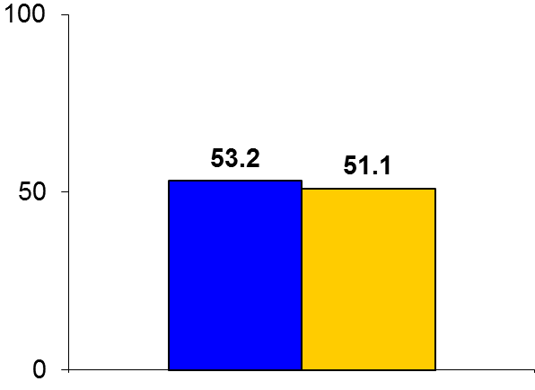

ENCHANTED
Trial design: Patients with acute ischemic stroke were randomized to either low-dose or standard-dose alteplase. They were followed for 90 days.
Results
(p_{noninferiority} = 0.51)
Primary outcome, combined mortality or disability scores 2-6 on mRS for low-dose vs. standard-dose alteplase: 53.2% vs. 51.1%; OR 1.09, 95% CI 0.95-1.25; p for noninferiority = 0.51
Death within 90 days: 8.5% vs. 10.3%, p = 0.07
Symptomatic intracerebral hemorrhage (NINDS criteria): 5.9% vs. 8.0%, p = 0.02; fatal cerebral hemorrhage: 1.3% vs. 2.5%, p = 0.02
%
Conclusions
Low-dose alteplase did not meet criteria for non-inferiority of death or major disability compared with standard-dose alteplase in patients with acute ischemic stroke receiving thrombolytic therapy within the 4.5-hour window
Intracerebral hemorrhage was significantly lower with the low-dose protocol, irrespective of the definition
Primary outcome
Low-dose alteplase
(n = 1,654)
Tight control
(n = 1,643)
Anderson CS, et al. N Engl J Med 2016;May 10:[Epub]

