Slide 1
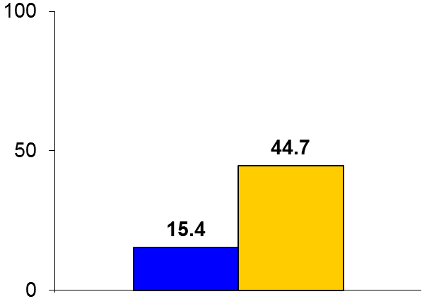
FAIR
Trial design: Patients with SFA in-stent restenosis (ISR) were randomized to either a paclitaxel-coated balloon (DCB) (dose 3.5 μg/mm²) or routine balloon angioplasty (BA). They were followed for 12 months.
Results
(p = 0.002)
Primary endpoint, binary recurrent ISR by ultrasound (US) at 6 months for DCB vs. BA: 15.4% vs. 44.7%; p = 0.002
Recurrent ISR by US at 12 months: 29.5% vs. 62.5%, p = 0.004; freedom from TLR: 90.8% vs. 52.6%, p < 0.0001
Thrombosis at 12 months: 2.1% vs. 4.5%, p = 0.52
%
Conclusions
DCB is safe and effective for the treatment of ISR in the superficial femoral arteries. At 12 months, binary restenosis was close to 30% with DCB, but clinical TLR was <10%. These outcomes are fairly similar to those observed with DCBs in de novo lesions
Important trial since long-term patency following SFA ISR treatment remains poor
Primary endpoint
DCB
(n = 62)
BA
(n = 57)
Krankenberg H, et al. Circulation 2015;132:2230-6

