Slide 1
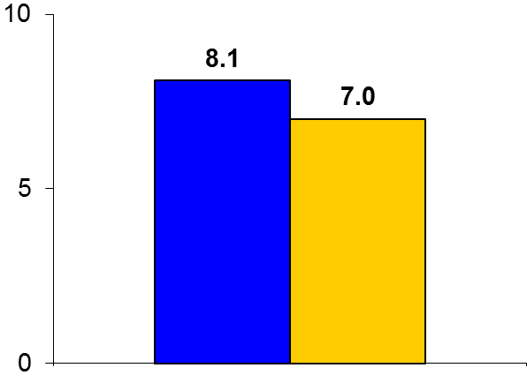
LATITUDE-TIMI 60
Trial design: Patients hospitalized with AMI on guideline-recommended therapy were randomized in a 1:1 fashion to either losmapimod 7.5 mg BID or placebo. They were followed for 12 weeks.
Results
(p = 0.24)
Primary outcome, CV death/MI/recurrent ischemia requiring revascularization at 12 weeks, for losmapimod vs. placebo: 8.1% vs. 7.0%, p = 0.24
CV death: 2.1% vs. 2.5%; MI: 5.3% vs. 4.3%, stroke: 0.8% vs. 0.9%
Definite or probable stent thrombosis: 0.9% vs. 1.5%
%
Conclusions
Losmapimod, a selective and reversible p38 MAP kinase inhibitor, was not superior to placebo in reducing adverse CV events at 12 weeks in patients hospitalized with an AMI and on OMT; the trial had to be terminated early due to futility
Losmapimod reduced hs-CRP levels, but this did not translate into a clinical benefit at 12 weeks
Primary outcome
Losmapimod
(n = 1,738)
Placebo
(n = 1,765)
Presented by Dr. O’Donoghue at ACC 2016

