Slide 1
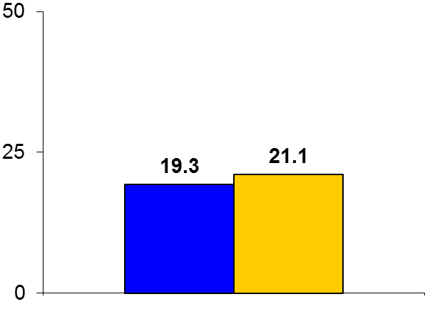
PARTNER 2A
Trial design: Intermediate-risk patients with aortic stenosis (STS PROM score 4-8%) were randomized to undergo either TAVR or SAVR, stratified by access route. They were followed for 2 years.
Results
p_{noninferiority} = 0.001
p_{superiority} = 0.33
Primary endpoint: All-cause mortality or disabling stroke for TAVR vs. SAVR: 19.3% vs. 21.1%, p = 0.001 for noninferiority, p = 0.33 for superiority
CV mortality: 10.1% vs. 11.3%, p = 0.38; disabling stroke: 6.2% vs. 6.4%, p = 0.83
Major vascular complication at 30 days: 7.9% vs. 5.0%, p = 0.008; new AF at 30 days: 9.1% vs. 26.4%, p < 0.001
%
Conclusions
Landmark trial; indicates that TAVR is noninferior to SAVR for mortality/disabling stroke at 2 years for the treatment of severe symptomatic aortic stenosis in intermediate-risk patients
Vascular complications were higher in TAVR arm; new-onset AF and bleeding were higher in the SAVR arm. Valve performance at 2 years was similar, but higher paravalvular regurgitation with TAVR
Primary endpoint
TAVR
(n = 1,011)
SAVR
(n = 1,021)
Leon MB, et al. N Engl J Med 2016;374:1609-20

