Slide 1
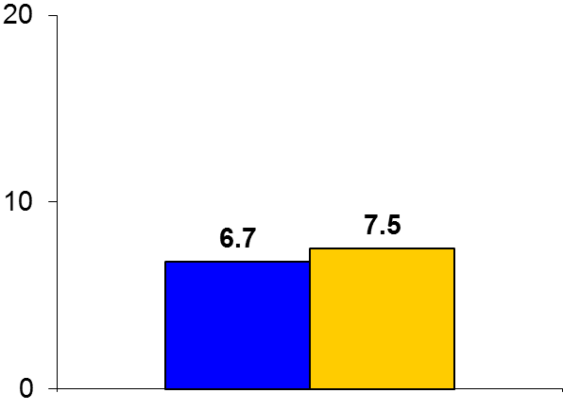

SOCRATES
Trial design: Patients with acute ischemic stroke were randomized in a 1:1 fashion to receive either ticagrelor 180 mg load + 90 mg BID or aspirin 300 mg load + 100 mg/day within 24 hours of presentation. They were followed for 3 months.
Results
p = 0.07
Primary outcome, death, MI or stroke, for ticagrelor vs. aspirin: 6.7% vs. 7.5%, HR = 0.89, 95% CI 0.78-1.01, p = 0.07
Death: 1.0% vs. 0.9%, p = 0.36; All strokes: 5.9% vs. 6.8%, p = 0.03; ischemic stroke: 5.8% vs. 6.7%, p = 0.046
Major bleeding: 0.5% vs. 0.6%, p = 0.45; intracranial hemorrhage: 0.2% vs. 0.3%, p = 0.3
%
Conclusions
Ticagrelor monotherapy was not superior to aspirin in reducing cardiovascular events in patients with low-acuity ischemic stroke or high-risk TIA
Major bleeding was similar
Unknown if a benefit may be observed on longer duration of follow-up, or in patients with proven ischemic stroke only
Primary endpoint
Ticagrelor
(n = 6,589)
Aspirin
(n = 6,610)
Johnston SC, et al. N Engl J Med 2016;May 10:[Epub]

