Slide 1
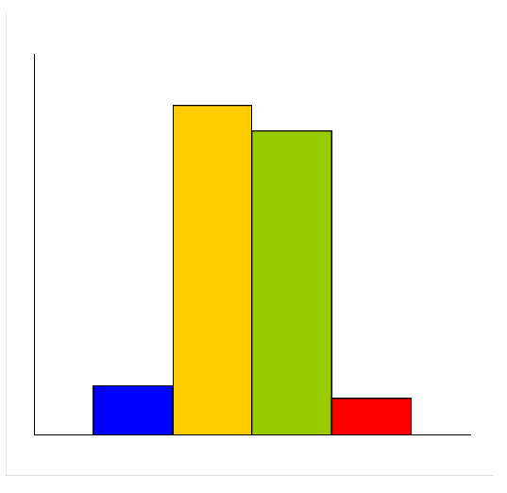

STOP-CHAGAS
Trial design: Asymptomatic patients with serological evidence of T. cruzi were randomized to posaconazole 400 mg BID, benznidazole 200 mg BID, posaconazole 400 mg BID + benznidazole 200 mg BID (n = 30), or placebo. They were followed for 360 days.
(p = 0.69)*
(p < 0.0001)**
Results
Primary outcome, proportion of patients with persistent negative RT-PCR by day 180 for posaconazole vs. benznidazole vs. posaconazole + benznidazole vs. placebo: 13.3% vs. 86.7% vs. 80% vs. 10%; p = 0.69 for posaconazole vs. placebo; p < 0.0001 for posaconazole vs. posaconazole + benznidazole
Cutaneous reactions: 6.3% vs. 60% vs. 42.9% vs. 6.3%, p = 0.01
100
86.7
80.0
%
50
13.3
Conclusions
10.0
Benznidazole monotherapy was superior to posaconazole either as monotherapy or as combination therapy in effecting a sustained serological response at 6 months in patients with asymptomatic T. cruzi infection
Dermatological and neurological side effects were higher in the benznidazole arm
0
Primary endpoint
Posaconazole
(n = 30)
benznidazole
(n = 30)
Posaconazole +
benznidazole
(n = 30)
Placebo
(n = 30)
* posaconazole vs. placebo ** posaconazole vs. posaconazole + benznidazole
Presented by Dr. Carlos A. Morillo at ACC 2016

