Slide 1
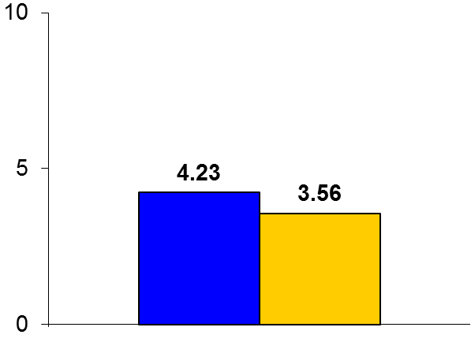

Chest Pain Choice
Trial design: Patients presenting to the ED with low risk chest pain were randomized to either use of a tailored decision aid or routine care. They were followed for 30 days.
Results
(p < 0.001)
Primary outcome, patient knowledge, for decision aid use vs. routine care: 4.23 vs. 3.56, p < 0.001
Patient engagement on OPTION scale: 18 vs. 8, p < 0.001
MACE at 30 days: 0% vs. 0%, p = 1.0; MI: 1% vs. 0%, p = 1.0; revascularization: 2% vs. 1%, p = 0.37
Conclusions
Use of a shared decision making aid among patients who presented to the ED with low risk chest pain increased patient knowledge and satisfaction and also reduced resource utilization
Event rates were low, but the trial was not powered to study clinical differences between the two groups
Primary endpoint
Decision aid
(n = 447)
Routine care
(n = 451)
Presented by Dr. Erik P. Hess at ACC 2016

