Slide 1
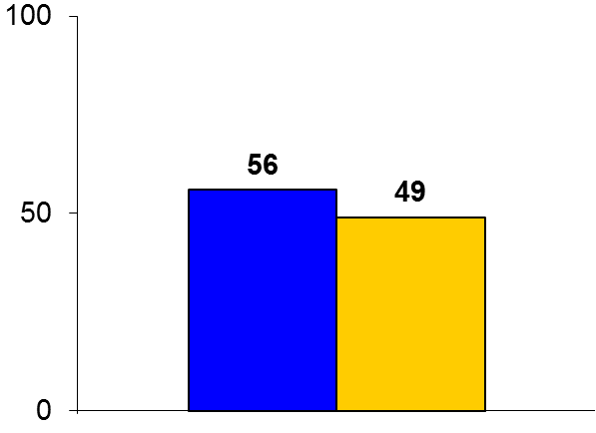
MAGIC-AF
Trial design: Patients with persistent atrial fibrillation (AF) and remaining in AF after pulmonary vein isolation alone were randomized to either intravenous ibutilide 0.25 mg or placebo. They were followed for 1 year.
Results
(p = 0.38)
Primary efficacy endpoint, freedom from recurrent atrial arrhythmia >30 seconds after one ablation procedure without use of AADs (3-month post-ablation blanking period), for ibutilide vs. placebo: 56% vs. 49%, p = 0.38
Endpoint with or without AAD use: 62% vs. 51%, p = 0.14
AF termination with CFAE ablation: 71% vs. 56%, p = 0.03
%
Conclusions
Ibutilide-guided CFAE ablation was not efficacious in improving procedural characteristics or freedom from atrial arrhythmias at 12 months in patients with persistent AF
However, ibutilide administration does reduce left atrial surface area with CFAE and is associated with greater AF termination rates during catheter ablation
Primary endpoint
Ibutilide
(n = 105)
Placebo
(n = 95)
Singh SM, et al. Eur Heart J 2016;Feb 4:[Epub]

