Slide 1
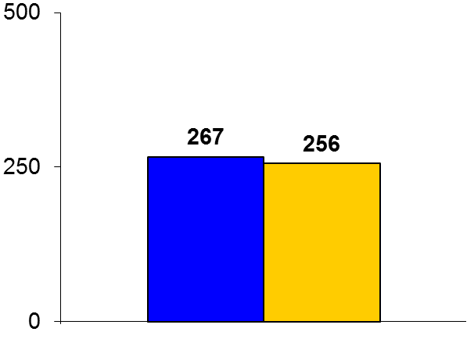
Metoprolol for AR
Trial design: Patients with chronic asymptomatic severe aortic regurgitation (AR) were randomized to metoprolol CR/XL 200 mg or matching placebo. They were followed for 6 months.
Results
(p = 0.32)
Primary endpoint, LVEDV on CMR at 6 months for metoprolol vs. placebo: 267 vs. 256 ml, p = 0.32
LVESV on CMR: 117 vs. 117 ml, p = 0.44; EF: 57 vs. 55%, p = 0.04; stroke volume: 151 vs. 139 ml, p = 0.04
Peak VO₂ at 6 months: 34.9 vs. 36.6 ml/kg/min, p = 0.08; NT-proBNP: 142 vs. 58 pg/ml, p < 0.001
ml
Conclusions
Long-acting metoprolol does not improve LVEDV or LVESV in asymptomatic patients with moderate to severe AR compared with placebo
On the one hand, some measures were better with beta-blocker use such as EF and stroke volume; on the other hand, peak VO₂ diminished and NT-proBNP levels went up, suggesting harm
Primary endpoint
Metoprolol
(n = 37)
Placebo
(n = 38)
Broch K, et al. Heart 2016;102:191-7

