Slide 1
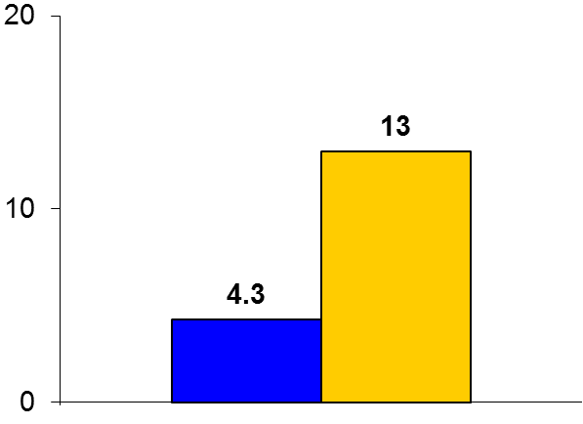
RIDDLE-NSTEMI
Trial design: Patients with NSTEMI were randomized to either immediate (within 2 hours) intervention or delayed (within 72 hours) intervention. They were followed for 1 year.
Results
(p = 0.008)
Primary endpoint, 30-day death or MI, for immediate vs. delayed intervention: 4.3% vs. 13.0%, p = 0.008
30-day death: 3.1% vs. 3.1%, p = 0.97; 30-day MI: 2.5% vs. 9.9%, p = 0.01
30-day recurrent ischemia: 3.7% vs. 15.5%, p = 0.001; 1-year death or MI: 6.8% vs. 18.8%, p = 0.002
%
Conclusions
Small, single-center study; suggests that an immediate invasive strategy (median time 1.4 hours) was superior in improving CV outcomes compared with delayed invasive strategy (median time 61.0 hours), mainly driven by a reduction in MI rates
Majority of patients in this trial were not high risk (GRACE score >140 present in approx. one-third)
Primary endpoint
Immediate
intervention
(n = 162)
Delayed intervention
(n = 161)
Milosevic A, et al. JACC Cardiovasc Interv 2016;9:541-9

