Slide 1
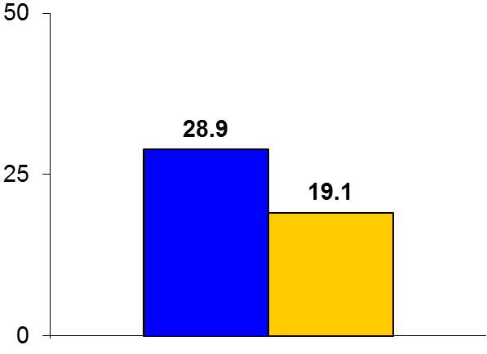

NOBLE
Trial design: Patients with unprotected left main disease were randomized to either PCI with a drug-eluting stent (DES) (88% biolimus) or CABG. They were followed for 5 years.
Results
(p = 0.0066)
Primary endpoint: Death/MI/stroke/repeat revasc: PCI vs. CABG: 28.9% vs. 19.1%, p = 0.0066
Death: 11.6% vs. 9.5%, p = 0.77; MI: 6.9% vs. 1.9%, p = 0.004; stroke: 4.9% vs. 1.7%, p = 0.07; repeat revasc: 16.2% vs. 10.4%, p = 0.03; de novo lesion revasc: 6% vs. 3%, p = 0.018
Stent thrombosis/graft occlusion: 3% vs. 4%, p = 0.22
%
Conclusions
DES-PCI was inferior to CABG for clinical outcomes at 5 years following revascularization of unprotected left main lesions
The hazard was highest with CABG in the first 30 days with better outcomes with PCI; between 30 days and 5 years, outcomes were inferior with PCI compared with CABG
Primary endpoint
DES-PCI
(n = 592)
CABG
(n = 592)
Mäkikallio T, et al. Lancet 2016;388:2743-52

