Slide 1
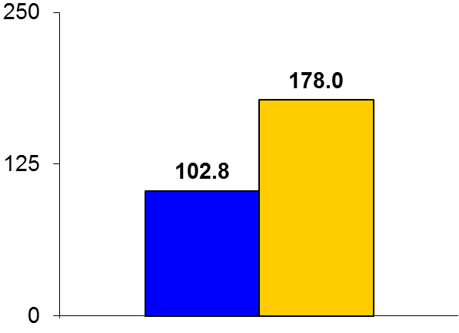

SENTINEL
Trial design: High-risk patients with severe aortic stenosis undergoing transcatheter aortic valve replacement (TAVR) were randomized in a 2:1 ratio to embolic protection with the Sentinel device or routine care. They were followed for 30 days.
Results
(p = 0.33)
Median total new lesion volume at day 2-7: Sentinel vs. control: 102.8 vs. 178.0 mm³, p = 0.33. Total new lesion volume: 294 vs. 309.8 mm³, p = 0.81
Major vascular complication: 8.6% vs. 5.9%, p = 0.53
30-day MACCE: 7.3% vs. 9.9%, p = 0.4; mortality: 1.3% vs. 1.8%, p = 0.65; all strokes: 5.6% vs. 9.1%, p = 0.25; disabling stroke: 0.9% vs. 0.9%, p = 1.0
mm³
Conclusions
Routine use of the Sentinel device did not result in reduction in new lesion volume on MRI or strokes within 30 days compared with routine care in patients undergoing TAVR
Adds to the total procedure and fluoroscopic times with a slight increase in vascular complication rates
Median total new lesion volume
Sentinel
(n = 244)
Control
(n = 119)
Kapadia SR, et al. J Am Coll Cardiol 2016;Nov 1:[Epub]

