Slide 1
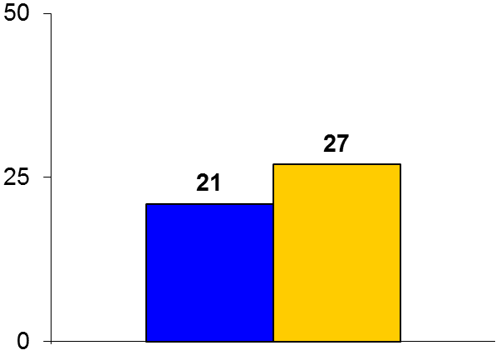
BBK II
Trial design: Patients undergoing a two-stent approach for a de novo bifurcation lesion were randomized in a 1:1 fashion to either culotte stenting or TAP stenting. They were followed for 12 months.
Results
(p = 0.038)
Primary outcome, maximal in-stent % diameter stenosis at 9-month angiographic follow-up: Culotte vs. TAP stenting: 21% vs. 27%; p = 0.038
Binary restenosis (≥50%): 6.5% vs. 17%, p = 0.006; TLR at 12 months: 6.0% vs. 12.0%, p = 0.069
Stent thrombosis at 12 months: 0.7% vs. 0%, p = 0.32
%
Conclusions
When a two-stent bifurcation strategy is necessary, culotte is superior to TAP stenting for angiographic outcomes at 9 months
This mirrors data from the NORDIC-II trial where culotte was superior to a crush technique, primarily due to a reduction in restenosis
Primary outcome
Culotte
(n = 150)
TAP
(n = 150)
Ferenc M, et al. Eur Heart J 2016;Aug 30:[Epub]

