Slide 1
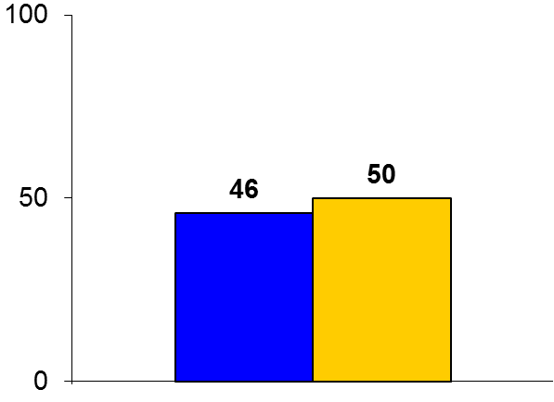

IMPRESS
Trial design: Patients undergoing primary PCI for STEMI and cardiogenic shock were randomized in a 1:1 to either Impella CP or IABP. They were followed for 30 days.
Results
(p = 0.92)
Primary outcome, all-cause mortality: Impella CP vs. IABP: 46% vs. 50%, p = 0.92
Major vascular complication: 4% vs. 0%, major bleeding: 33% vs. 8%, 30-day strokes: 4% vs. 4%
All-cause mortality at 6 months: 50% vs. 50%, p = 0.92
%
Conclusions
Small trial; indicates that outcomes following mechanical circulatory support were similar with both Impella CP and IABP among patients with STEMI and cardiogenic shock undergoing primary PCI
Vascular complications and bleeding were higher with Impella
Trial significantly underpowered for primary outcome
Primary outcome
Impella CP
(n = 24)
IABP
(n = 24)
Ouweneel DM, et al. J Am Coll Cardiol 2017;69:358-60

