Slide 1
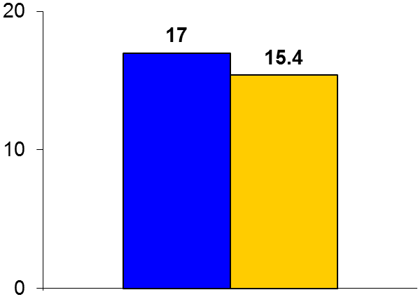

SAVE
Trial design: Patients with moderate to severe obstructive sleep apnea (OSA) and known CV disease were randomized in a 1:1 fashion to either CPAP + usual care or usual care alone. They were followed for a median of 3.7 years.
Results
(p = 0.34)
Primary outcome, CV death/MI/stroke/hospitalization for HF/CHF/TIA: CPAP + usual care vs. usual care: 17.0% vs. 15.4%; p = 0.34
Change in Epworth Sleepiness Scale score from baseline: -3.1 vs. -0.7, p < 0.0001
Newly diagnosed DM2: 4.9% vs. 5.7%, p = 0.35
%
Conclusions
CPAP as an addition to usual care was not superior to usual care alone for secondary prevention of CV events in patients with established CAD and CVD and moderate to severe OSA.
The use of CPAP did improve daytime sleepiness and health-related quality-of-life parameters
Primary outcome
CPAP +
usual care
(n = 1,346)
Usual care
(n = 1,341)
McEvoy RD, et al. N Engl J Med 2016;375:919-31

