Slide 1
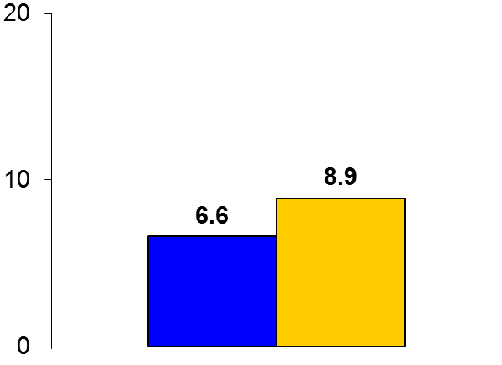
SUSTAIN-6
Trial design: Patients with DM2 at high risk for CV events were randomized in a 1:1:1:1 fashion to either semaglutide 0.5 mg, semaglutide 1 mg, or matching placebo. They were followed for a median of 2.1 years.
Results
p_{noninferiority} < 0.001 p_{superiority} = 0.02
Primary outcome, CV death/MI/stroke: semaglutide vs. placebo: 6.6% vs. 8.9%, HR 0.74, 95% CI 0.58-0.95, p < 0.001 for noninferiority; p = 0.02 for superiority
CV death: 2.7% vs. 2.8%, p = 0.92; all MI: 2.9% vs. 3.9%, p = 0.12; all stroke: 1.6% vs. 2.7%, p = 0.04
HbA1c at week 104: 7.6% vs. 7.3% vs. 8.3%
%
Conclusions
Injectable once a week semaglutide (GLP-1 agonist) was superior to placebo in improving glycemic control and ↓ CV events in high-risk patients with diabetes
There is also a significant reduction in stroke and new or worsening nephropathy with semaglutide, perhaps related to a concomitant reduction in BP, and also a reduction in body weight
Primary outcome
Semaglutide
(n = 1,648)
Placebo
(n = 1,649)
Marso SP, et al. N Engl J Med 2016;375:1834-44

