Slide 1
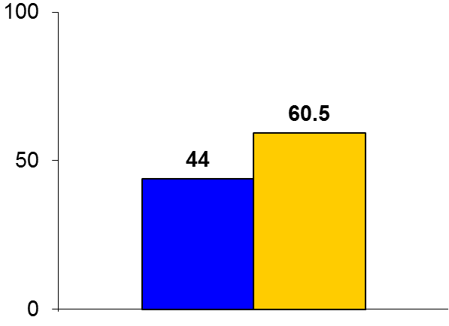
POST 2
Trial design: Patients with vasovagal syncope were randomized in a 1:1 open-label fashion to either oral fludrocortisone 0.2 mg daily or placebo. They were followed for a median of 364 days.
Results
(p = 0.069)
Primary outcome, 12-month syncope rates: fludrocortisone vs. placebo = 44% vs. 60.5%, p = 0.069
Restricting analysis only to syncope occurring after 2 weeks: HR = 0.62; p = 0.029
Further restricting to those who achieved stabilized dose of 0.2 mg, HR = 0.51, p = 0.019
%
Conclusions
Fludrocortisone does not reduce the risk of recurrent syncope at 12 months compared with placebo in patients with vasovagal syncope
Given the trend towards benefit though, it is unknown if a longer duration of follow-up in this trial or another trial with a larger sample size would show a significant benefit in favor of fludrocortisone
Primary outcome
Fludrocortisone
(n = 105)
Placebo
(n = 105)
Sheldon R, et al. J Am Coll Cardiol 2016;68:1-9

