Slide 1
2022 ACC/AHA Guideline for the Diagnosis and Management of Aortic Disease
Developed in Collaboration with and endorsed by the American Association for Thoracic Surgery, American College of Radiology, Society of Cardiovascular Anesthesiologists, Society for Cardiovascular Angiography and Interventions, Society of Thoracic Surgeons, and Society for Vascular Surgery.
Endorsed by Society for Interventional Radiology and Society for Vascular Medicine

Slide 2
Citation
This slide set is adapted from the 2022 ACC/AHA Guideline for the Diagnosis and Management of Aortic Disease. Published online ahead of print October 31, 2022, available at: Circulation. https://www.ahajournals.org/doi/10.1161/CIR.0000000000001106 and Journal of the American College of Cardiology published online ahead of print November 2, 2022. J Am Coll Cardiol. https://www.jacc.org/doi/10.1016/j.jacc.2022.08.004

Slide 3
2022 Writing Committee Members*
Eric M. Isselbacher, MD, MSc, FACC, Chair
Ourania Preventza, MD, MBA, FAHA, Vice Chair
James Hamilton Black III, MD, DFSVS, Vice Chair
John G. Augoustides, MD, FAHA†
Adam W. Beck, MD, DFSVS
Michael A. Bolen, MD‡
Alan C. Braverman, MD, FACC
Bruce E. Bray, MD, FACC§
Maya M. Brown-Zimmerman, MPH║
Edward P. Chen, MD, FAHA
Tyrone J. Collins, MD, MSCAI, FACC, FAHA, FSVM¶
Abe DeAnda Jr, MD, FAHA
Christina L. Fanola, MD, MSc
Leonard N. Girardi, MD#
Caitlin W. Hicks, MD, MS, SVS**
Dawn S. Hui, MD
William Schuyler Jones, MD, FACC ††
Vidyasagar Kalahasti, MD, FACC
Karen M. Kim, MD, MS‡‡
Dianna M. Milewicz, MD, PhD
Gustavo S. Oderich, MD
Laura Ogbechie, MSN
Susan B. Promes, MD, MBA
Elsie Gyang Ross, MD, MSc
Marc L. Schermerhorn, MD, DFSVS§§
Sabrina Singleton Times, DHSc, MPH║║
Elaine E. Tseng, MD, FAHA
Grace J. Wang, MD, MSCE
Y. Joseph Woo, MD, FACC, FAHA††
*Writing committee members are required to recuse themselves from voting on sections to which their specific relationships with industry may apply; see Appendix 1 for detailed information. †SCA representative. ‡ACR representative. §AHA/ACC Joint Committee on Clinical Data Standards (JCCDS) liaison. ║ Lay stakeholder representative. ¶ SCAI representative. # AATS representative. ** ACC/AHA Joint Committee on Performance Measures (JCPM) liaison. ††Joint Committee on Clinical Practice Guidelines (JCCPG) liaison. ‡‡ STS representative. §§ SVS representative. ║║ Joint ACC/AHA staff representative. ¶ ¶ SVM representative. ##Former Joint Committee member, current member during the writing effort. ***SIR representative.

Slide 4
Top 10 Take-Home Messages
2022 Guideline for the Diagnosis and Management of Aortic Disease

Slide 5
Top 10 Take Home Messages
1. Because outcomes for patients with aortic disease are enhanced at programs with higher volumes, experienced practitioners, and extensive management capabilities, Multidisciplinary Aortic Team care is considered in determining the appropriate timing of intervention.

Slide 6
Top 10 Take Home Messages
2. Shared decision-making involving the patient and a multidisciplinary team is highly encouraged to determine the optimal medical, endovascular, and open surgical therapies. In patients with aortic disease who are contemplating pregnancy or who are pregnant, shared decision-making is especially important when considering the cardiovascular risks of pregnancy, the diameter thresholds for prophylactic aortic surgery, and the mode of delivery.

Slide 7
Top 10 Take Home Messages
3. Computed tomography, magnetic resonance imaging, and echocardiographic imaging of patients with aortic disease should follow recommended approaches for image acquisition, measurement and reporting of relevant aortic dimensions, and the frequency of surveillance before and after intervention.

Slide 8
Top 10 Take Home Messages
4. At centers with Multidisciplinary Aortic Teams and experienced surgeons, the threshold for surgical intervention for sporadic aortic root and ascending aortic aneurysms has been lowered from 5.5 cm to 5.0 cm in selected patients, and even lower in specific scenarios among patients with heritable thoracic aortic aneurysms.

Slide 9
Top 10 Take Home Messages
5. In patients who are significantly smaller or taller than average, surgical thresholds may incorporate indexing of the aortic root or ascending aortic diameter to either patient body surface area or height, or aortic cross-sectional area to patient height.

Slide 10
Top 10 Take Home Messages
6. Rapid aortic root growth or ascending aortic aneurysm growth, an indication for intervention, is defined as ≥0.5 cm in 1 year or ≥0.3 cm per year in 2 consecutive years for those with sporadic aneurysms and ≥0.3 cm in 1 year for those with heritable thoracic aortic disease or bicuspid aortic valve.

Slide 11
Top 10 Take Home Messages
7. In patients undergoing aortic root replacement surgery, valve-sparing aortic root replacement is reasonable if the valve is suitable for repair and when performed by experienced surgeons in a Multidisciplinary Aortic Team.

Slide 12
Top 10 Take Home Messages
8. Patients with acute type A aortic dissection, if clinically stable, should be considered for transfer to a high-volume aortic center to improve survival. The operative repair of type A aortic dissection should entail at least an open distal anastomosis rather than just a simple supracoronary interposition graft.

Slide 13
Top 10 Take Home Messages
9. There is an increasing role for thoracic endovascular aortic repair in the management of uncomplicated type B aortic dissection. Clinical trials of repair of thoracoabdominal aortic aneurysms with endografts are reporting results that suggest endovascular repair is an option for patients with suitable anatomy.

Slide 14
Top 10 Take Home Messages
10. In patients with aneurysms of the aortic root or ascending aorta, or those with aortic dissection, screening of first-degree relatives with aortic imaging is recommended.

Slide 15
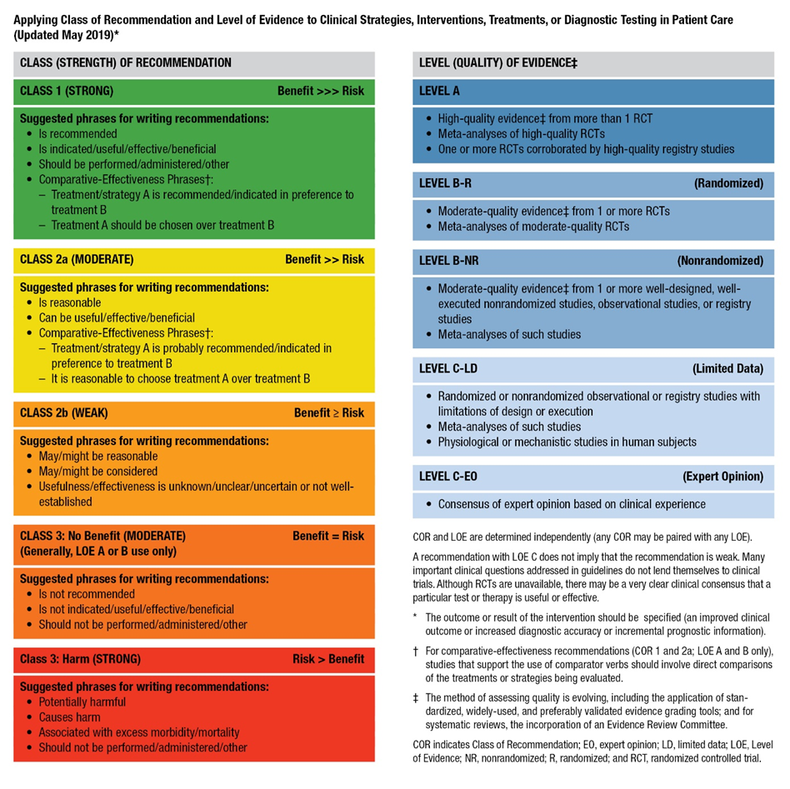
Table 2. Applying American College of Cardiology/American Heart Association Class of Recommendation and Level of Evidence to Clinical Strategies, Interventions, Treatments, or Diagnostic Testing in Patient Care* (Updated May 2019)

Slide 16
Normal Anatomy, Abnormal Anatomy, and Definitions

Slide 17
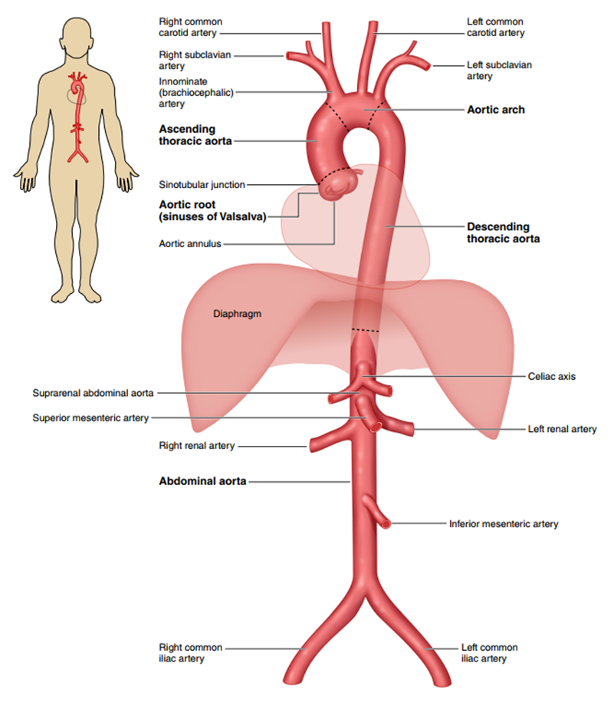
Figure 1. The Anatomy of the Aorta and Its Main Branches.

Slide 18
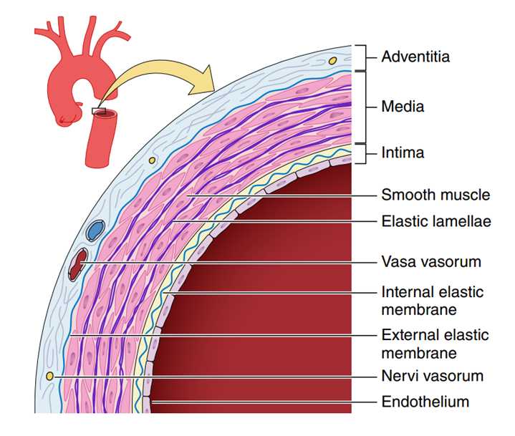
Figure 2. A Simplified Diagram Depicting the Key Histologic Components of the Aortic Wall.

Slide 19
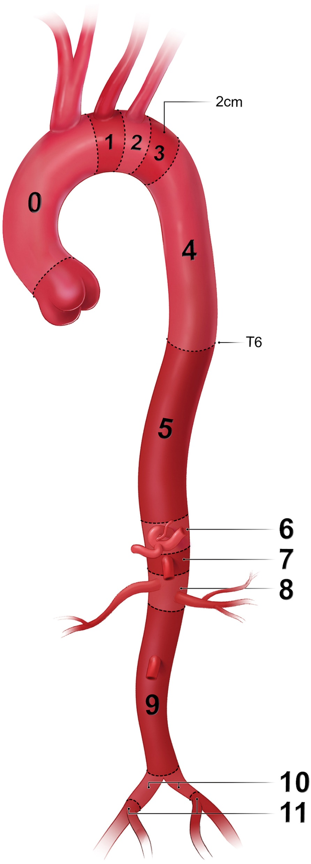
Figure 3. Classification of Aortic Anatomic Segments by 11 Landing Zones.
Zone 0 (involves the ascending to distal end of the origin of the innominate artery); Zone 1 (involves the origin of the left common carotid; between the innominate and the left carotid); Zone 2 (involves the origin of the left subclavian; between the left carotid and the left subclavian); Zone 3 (involves the proximal descending thoracic aorta down to the T4 vertebral body; the first 2 cm distal to the left subclavian); Zone 4 (the end of zone 3 to the mid-descending aorta – T6); Zone 5 (the mid-descending aorta to the celiac); Zone 6 (involves the origin of the celiac; the celiac to the superior mesenteric); Zone 7 (involves the origin of the superior mesenteric artery; the superior mesenteric to the renals); Zone 8 (involves the origin of the renal arteries; the renal to the infrarenal abdominal aorta); Zone 9 (the infrarenal abdominal aorta to the level of aortic bifurcation ); Zone 10 (the common iliac); Zone 11 (involves the origin of the external iliac arteries).

Slide 20
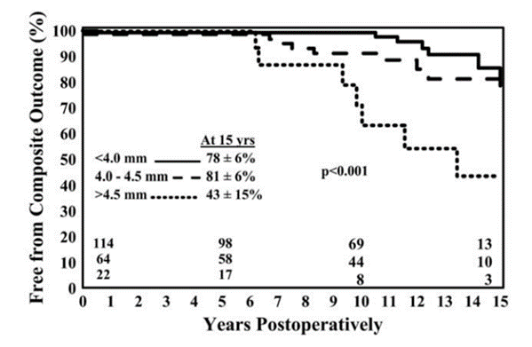
Figure 4. Freedom From Ascending Aortic Complications for Patients With Bicuspid Aortic Valve Disease.

Slide 21
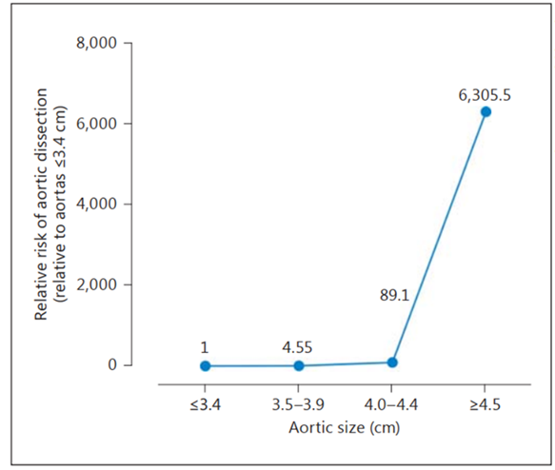
Figure 5. Relative Risk of Aortic Dissection by Size Range.

Slide 22
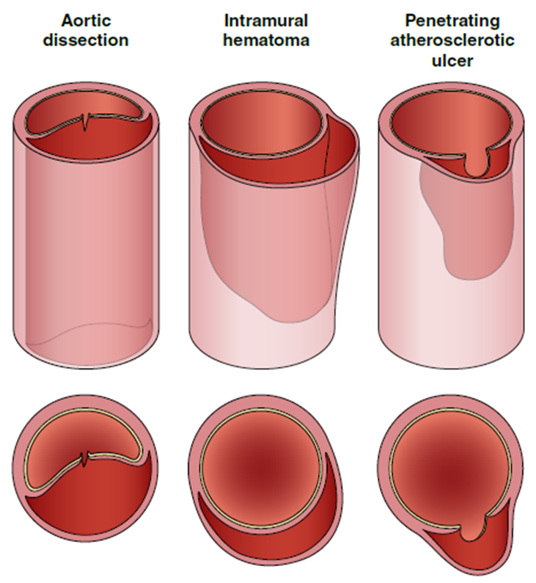
Figure 6. Acute Aortic Syndromes.

Slide 23
Table 3. Classification of Aortic Dissection Chronicity Based on the 2020 SVS/STS Reporting Standards
Chronicity | Time From Onset of Symptoms
Hyperacute | <24 h
Acute | 1–14 d
Subacute | 15–90 d
Chronic | >90 d
STS indicates Society of Thoracic Surgeons; and SVS, Society for Vascular Surgery.

Slide 24
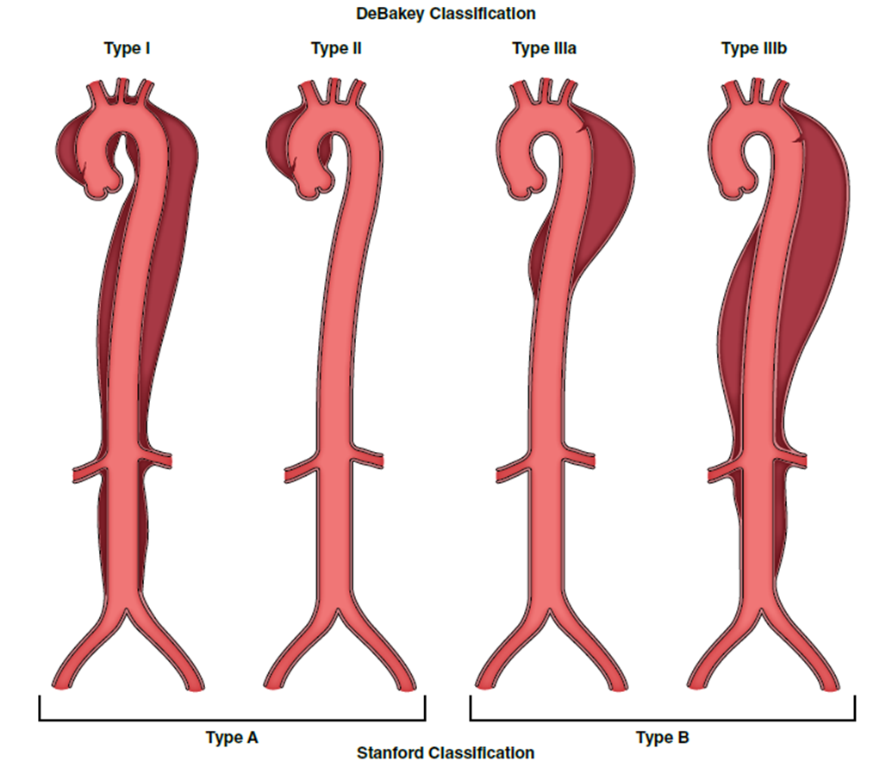
Figure 7. Classification of Acute Aortic Dissection.

Slide 25
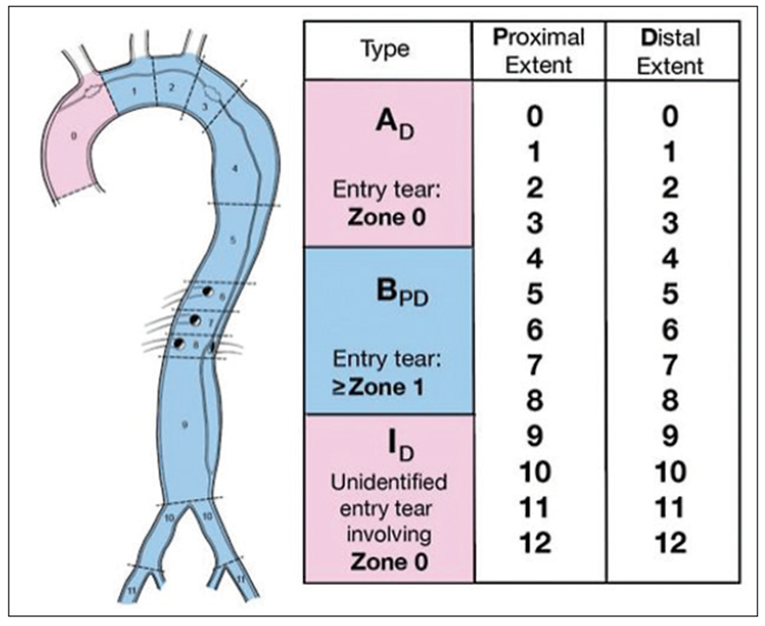
Figure 8. Anatomic Reporting of Aortic Dissection Based on the 2020 SVS/STS Reporting Standards.

Slide 26
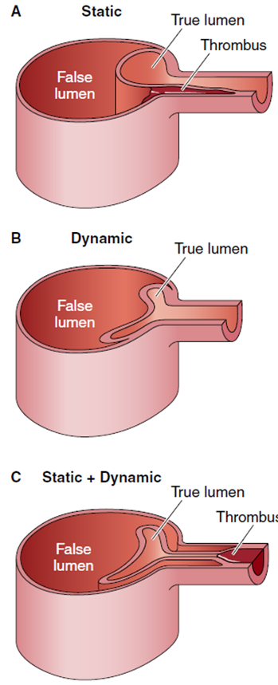
Figure 9. Mechanisms of Dynamic and Static Obstruction in Aortic Dissection.

Slide 27
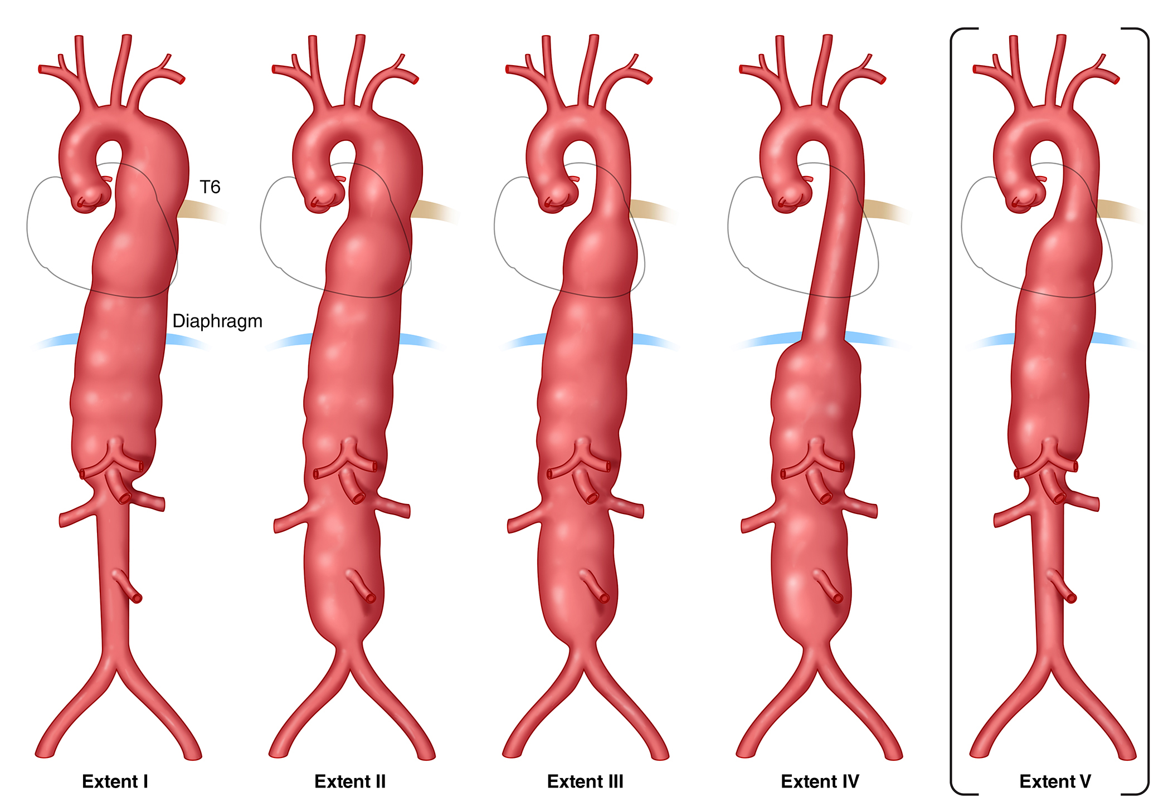
Figure 10. Classification of Thoracoab-dominal Aortic Aneurysms.

Slide 28
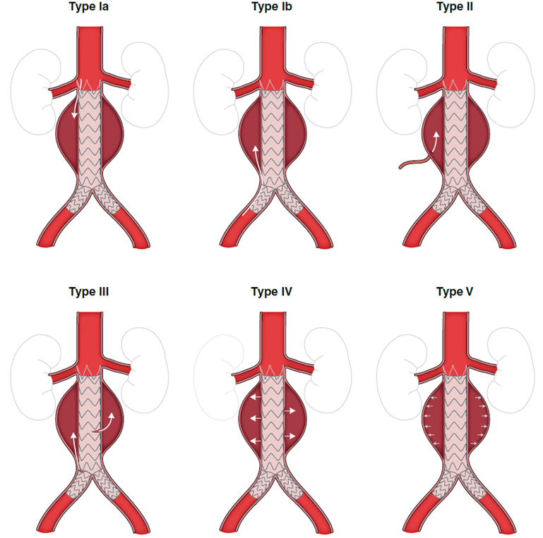
Figure 11. Classification of Endoleak Types.

Slide 29
Imaging and Measurements

Slide 30
Aortic Imaging Techniques to Determine Presence and Progression of Aortic Disease
Recommendations for Aortic Imaging Techniques to Determine Presence and Progression of Aortic Disease Referenced studies that support the recommendations are summarized in the Online Data Supplement. | Recommendations for Aortic Imaging Techniques to Determine Presence and Progression of Aortic Disease Referenced studies that support the recommendations are summarized in the Online Data Supplement.
COR | LOE | Recommendations
1 | B-NR | In patients with known or suspected aortic disease, aortic diameters should be measured at reproducible anatomic landmarks perpendicular to axis of blood flow, and these measurement methods should be reported in a clear and consistent manner. In cases of asymmetric or oval contour, the longest diameter and its perpendicular diameter should be reported.
1 | C-LD | In patients with known or suspected aortic disease, episodic and cumulative ionizing radiation doses should be kept as low as feasible while maintaining diagnostic image quality.

Slide 31
Aortic Imaging Techniques to Determine Presence and Progression of Aortic Disease (con’t.)
1 | C-EO | In patients with known or suspected aortic disease, when performing CT or MR imaging, it is recommended that the root and ascending aortic diameters be measured from inner-edge to inner-edge, using an electrocardiographic-synchronized technique. If there are aortic wall abnormalities, such as atherosclerosis or discrete wall thickening (more common in the distal aorta), the outer-edge to outer-edge diameter should be reported (Table 4).
1 | C-EO | In patients with known or suspected aortic disease, the aortic root diameter should be recorded as maximum sinus to sinus measurement. In the setting of known asymmetry, multiple measurements should be reported, and both short- and long-axis images of the root should be obtained to avoid underestimation of the diameter.
2a | C-LD | In patients with known or suspected aortic disease, it is reasonable that a dilated root or ascending aorta be indexed to patient height or BSA in the report, to aid in clinical risk assessment.
2a | C-EO | In patients with known or suspected aortic disease, when performing echocardiography, it is reasonable to measure the aorta from leading-edge to leading-edge, perpendicular to the axis of blood flow. Using inner-edge to inner-edge measurements may also be considered, particularly on short-axis imaging.

Slide 32
Table 4. Essential Elements of CT and MRI Aortic Imaging Reports
Maximum aortic diameter at each level of dilation, perpendicular to the axis of blood flow. In cases of asymmetric or oval contour, the longest diameter and its perpendicular diameter should be reported. Standard measurement levels may be included, even when normal.
Wall changes suggestive of atherosclerosis, diffuse thickening (eg, aortitis), or mural thrombus.
Evidence of luminal stenosis/occlusion, including location, severity, and length.
Findings suggestive of acute aortic syndrome (eg, communicating dissection, intramural hematoma, penetrating atherosclerotic ulcer, focal intimal tear), including proximal/distal extension (Figure 7), suspected entry tear site (if visible), and complications (eg, active contrast extravasation, rupture, contained rupture, rupture including periaortic hemorrhage, pericardial and pleural fluid, mediastinal stranding).
CT indicates computed tomography; and MRI, magnetic resonance imaging.

Slide 33
Table 4. Essential Elements of CT and MRI Aortic Imaging Reports (con’t.)
Extension of aortic disease process (acute or chronic) into branch vessels, findings suggestive of end-organ injury, and suspected malperfusion.
Direct comparison with previous examinations should be detailed to identify pertinent changes.
Presence and extent of repair (eg, interposition graft, endovascular stent graft), as well as any evidence of complication.
Impression regarding disease classification (eg, acute aortic syndrome, aneurysm/pseudoaneurysm, luminal stenosis, atherosclerotic aortic disease).
Relevant details regarding method of image acquisition (eg, use of electrocardiographic-gating and phase of acquisition) and measurement (eg, axial versus double oblique, inner-edge versus outer-edge) should be included.
CT indicates computed tomography; and MRI, magnetic resonance imaging.

Slide 34
Table 5. Diagnostic Performance of Aortic Imaging Modalities
Parameter | CT | MRI | TTE | TEE | US
Availability | +++ | ++ | +++ | ++ | +++
Portability | - | - | +++ | +++ | +++
Speed of acquisition | +++ | + | ++ | ++ | ++
Spatial resolution | +++ | ++ | ++ | +++ | ++
Temporal resolution | + | ++ | +++ | +++ | +++
Three-dimensional data set | +++ | ++ | + | + | +
Arch branch vessel evaluation | +++ | +++ | ++ | + | NA
Evaluation of valve and ventricular function | + | ++ | +++ | +++ | NA
CT indicates computed tomography; MRI, magnetic resonance imaging; NA, not applicable; TEE, transesophageal echocardiography; TTE, transthoracic echocardiography; US, abdominal aortic ultrasound; +++ excellent results; ++ good results; + fair results; and -, not available.

Slide 35
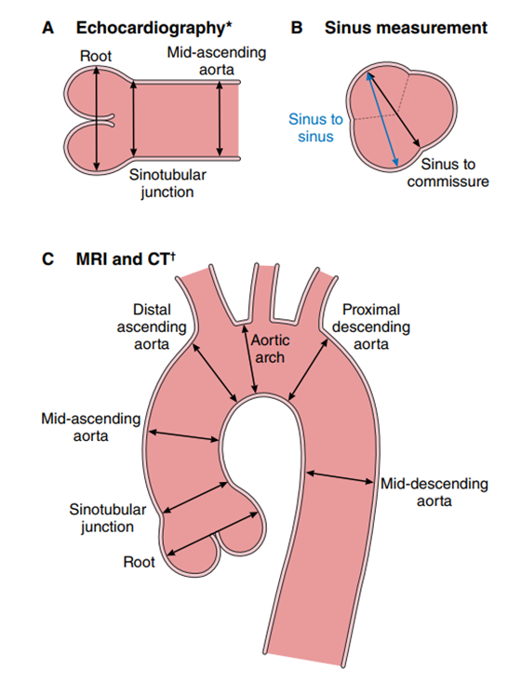
Figure 12. Aortic Imaging Techniques to Determine the Presence and Progression of Aortic Disease.
*Leading-edge to leading-edge. †Inner-wall to inner-wall.

Slide 36
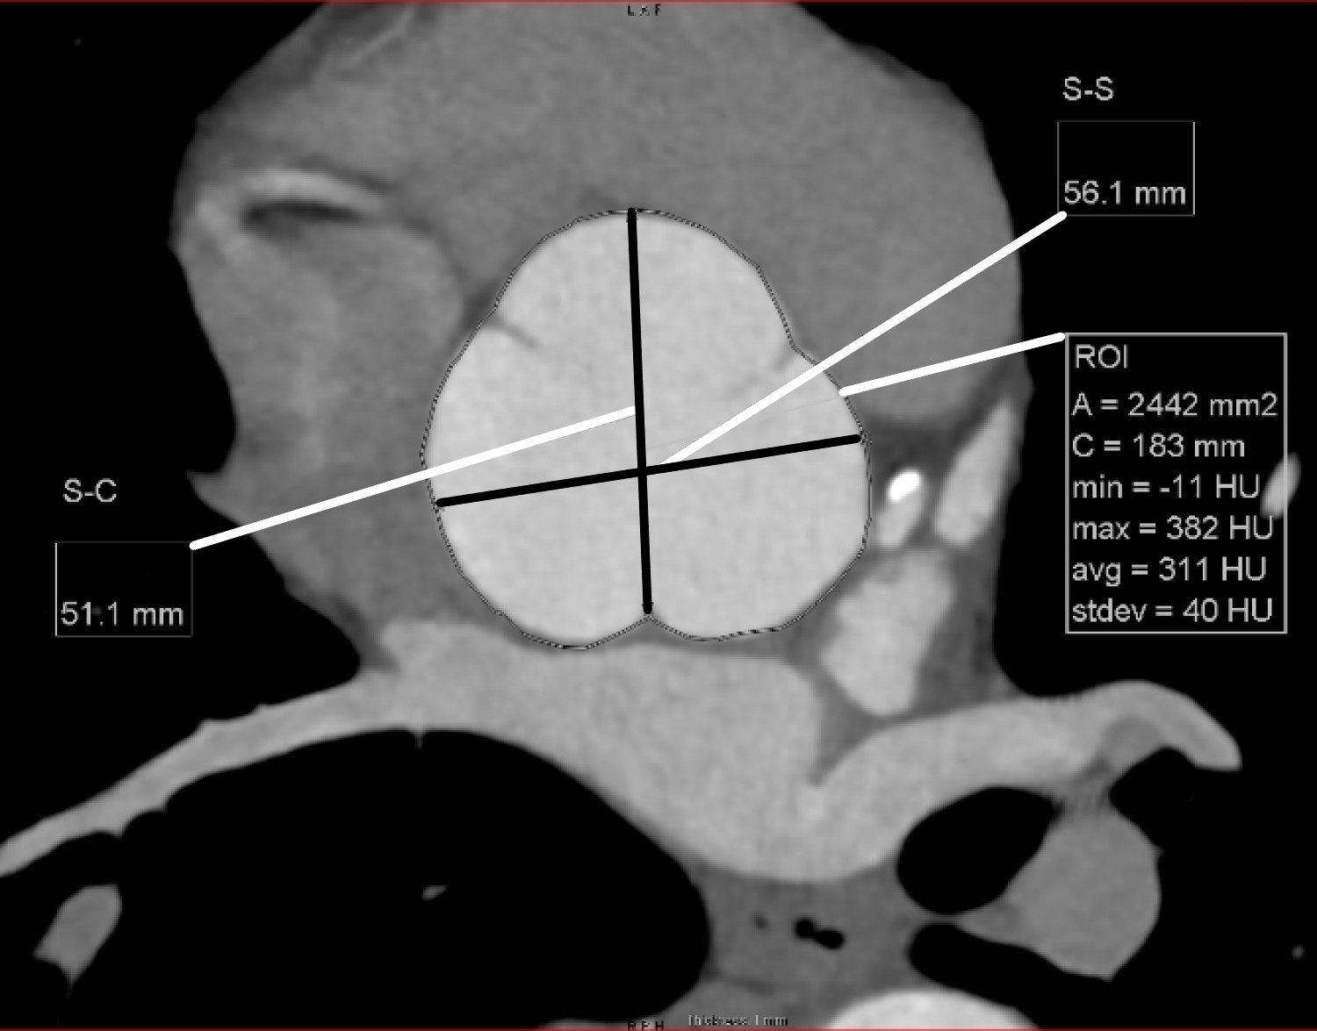
Figure 13. Reformatted CT Image Orthogonal to the Aortic Root at the Level of the Sinuses of Valsalva.

Slide 37
Multidisciplinary Aortic Teams

Slide 38
Multidisciplinary Aortic Teams
Recommendations for Multidisciplinary Aortic Teams | Recommendations for Multidisciplinary Aortic Teams
COR | LOE | Recommendations
1 | C-EO | For patients with acute aortic disease that requires urgent repair, a multidisciplinary team should determine the most suitable intervention.
2a | C-LD | For patients who are asymptomatic with extensive aortic disease, or who may benefit from complex open and endovascular aortic repairs, or with multiple comorbidities for whom intervention is considered, referral to a high-volume center (performing at least 30-40 aortic procedures annually) with experienced surgeons in a Multidisciplinary Aortic Team is reasonable to optimize treatment outcomes.

Slide 39
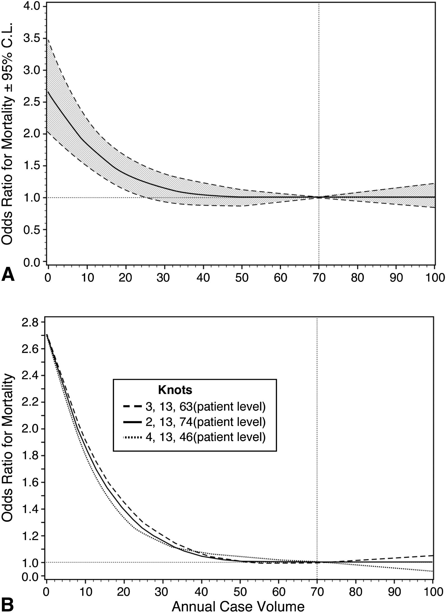
Figure 14. Observed Relationship Between Annual Institutional Case Volume and Risk-Adjusted Odds Ratio for Operative Mortality ±2 Standard Deviations as Assessed With Regression Analysis.

Slide 40
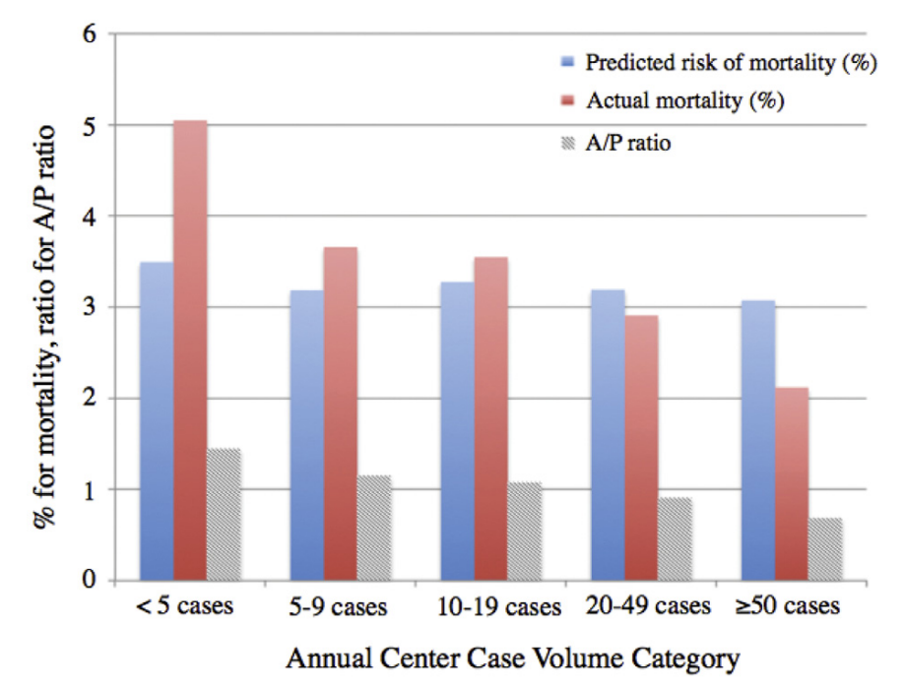
Figure 15. Predicted Risk of Mortality Derived From the Logistic Regression Model Without Center Case Volume as a Covariate.

Slide 41
Shared Decision-Making

Slide 42
Shared Decision-Making
Recommendations for Shared Decision-Making | Recommendations for Shared Decision-Making
COR | LOE | Recommendations
1 | C-LD | In patients with aortic disease, shared decision-making is recommended when determining the appropriate thresholds for intervention, deciding on the type of surgical repair, choosing between open surgical versus endovascular approaches, and in medical management and surveillance.
1 | C-EO | In patients with aortic disease who are contemplating pregnancy or who are pregnant, shared decision-making is recommended when considering the cardiovascular risks of pregnancy, the diameter thresholds for prophylactic aortic surgery, and the mode of delivery.

Slide 43
Aneurysms

Slide 44
Figure 16. Recommendations for Management of Aneurysms of the Aortic Root and Ascending Aorta According to Known Causative Factors.

Slide 45
Table 6. Cause of TAA
HTAD (see Table 7): syndromic Marfan syndrome Loeys-Dietz syndrome Vascular Ehlers-Danlos syndrome Smooth muscle dysfunction syndrome Others: attributable to pathogenic variants in FLNA, BGN, LOX
HTAD (see Table 7): nonsyndromic ACTA2, MYH11, PRKG1, MYLK, and others Familial thoracic aortic aneurysm without identified pathogenic variants in a known gene for HTAD
HTAD indicates heritable thoracic aortic diseases; and TAA, thoracic aortic aneurysms.

Slide 46
Table 6. Cause of TAA (con’t.)
Congenital conditions Bicuspid aortic valve Turner syndrome Coarctation of the aorta Complex congenital heart defects (tetralogy of Fallot, transposition of the great vessels, truncus arteriosus)
Hypertension
Atherosclerosis
Degenerative
Previous aortic dissection

Slide 47
Table 6. Cause of TAA (con’t.)
Inflammatory aortitis Giant cell arteritis Takayasu arteritis Behçet disease Immunoglobulin G4-related disease, antineutrophil cytoplasmic antibody-related, sarcoidosis
Infectious aortitis Bacterial, fungal, syphilitic
Previous traumatic aortic injury

Slide 48
Table 7. TAA Syndromes and Conditions Attributable to a Heritable or Genetic Cause
Condition | Gene | Clinical Features
Syndromic HTAD*
Marfan syndrome | FBN1 | Aortic root aneurysm, aortic dissection, TAA, MVP, long bone overgrowth, arachnodactyly, dolichostenomelia, scoliosis, pectus deformities, ectopia lentis, myopia, tall stature, pneumothorax, dural ectasia
Loeys-Dietz syndrome | TGFBR1, TGFBR2, SMAD3,† TGFB2, TGFB3 | TAA, branch vessel aneurysms, aortic dissection, arterial tortuosity, MVP, craniosynostosis, hypertelorism, bluish sclera, bifid/broad uvula, translucent skin, visible veins, club feet, dural ectasia, and premature osteoarthritis and peripheral neuropathy†
*Some individuals with pathogenic variants in a gene that can lead to syndromic HTAD have very few or no syndromic features, and variants in some genes causing syndromic HTAD may also lead to nonsyndromic HTAD. †SMAD3 premature osteoarthritis and peripheral neuropathy.
AAA indicates abdominal aortic aneurysm; AS, aortic stenosis; BAV, bicuspid aortic valve; CAD, coronary artery disease; CoA, coarctation of the aorta; EDS, Ehlers-Danlos syndrome; FTAA, familial thoracic aortic aneurysm (and dissection) syndrome; HTAD, heritable thoracic aortic disease; MV, mitral valve; MVP, mitral valve prolapse; PDA, patent ductus arteriosus; TAA, thoracic aortic aneurysm; and VSD, ventricular septal defect.

Slide 49
Table 7. TAA Syndromes and Conditions Attributable to a Heritable or Genetic Cause (con’t.)
Vascular Ehlers-Danlos syndrome | COL3A1 | TAA, AAA, arterial rupture, aortic dissection, MVP, bowel and uterine rupture, pneumothorax, translucent skin, atrophic scars, small joint hypermobility, easy bruising, carotid-cavernous fistula
Arterial tortuosity syndrome | SLC2A10 | Tortuous large and medium sized arteries, aortic dilation, craniofacial, skin and skeletal features
Shprintzen-Goldberg syndrome | SKI | Craniosynostosis, skeletal features, aortic dilation
Ehlers-Danlos syndrome with periventricular nodular heterotopia | FLNA | X-linked, periventricular nodular heterotopia, TAA, BAV, MV disease, PDA, VSD, seizures, joint hypermobility
*Some individuals with pathogenic variants in a gene that can lead to syndromic HTAD have very few or no syndromic features, and variants in some genes causing syndromic HTAD may also lead to nonsyndromic HTAD. †SMAD3 premature osteoarthritis and peripheral neuropathy.
AAA indicates abdominal aortic aneurysm; AS, aortic stenosis; BAV, bicuspid aortic valve; CAD, coronary artery disease; CoA, coarctation of the aorta; EDS, Ehlers-Danlos syndrome; FTAA, familial thoracic aortic aneurysm (and dissection) syndrome; HTAD, heritable thoracic aortic disease; MV, mitral valve; MVP, mitral valve prolapse; PDA, patent ductus arteriosus; TAA, thoracic aortic aneurysm; and VSD, ventricular septal defect.

Slide 50
Table 7. TAA Syndromes and Conditions Attributable to a Heritable or Genetic Cause (con’t.)
Meester-Loeys syndrome | BGN | X-linked, TAA, aortic dissection, MV disease
LOX-related TAA | LOX | TAA, BAV, aortic dissection, Marfanoid habitus in some
Smooth muscle dysfunction syndrome | ACTA2 | TAA, moyamoya-like cerebrovascular disease, pulmonary hypertension, pulmonary disease, hypoperistalsis, hypotonic bladder, congenital mydriasis
Nonsyndromic HTAD (Familial TAA)
FTAA | ACTA2 | TAA, aortic dissection, premature CAD and moyamoya-like cerebrovascular disease, livedo reticularis, iris flocculi
FTAA | MYH11 | TAA, aortic dissection, PDA
FTAA | MYLK | Aortic dissection at relatively small aortic size
FTAA | PRKG1 | Aortic dissection at young ages at small aortic sizes
*Some individuals with pathogenic variants in a gene that can lead to syndromic HTAD have very few or no syndromic features, and variants in some genes causing syndromic HTAD may also lead to nonsyndromic HTAD. †SMAD3 premature osteoarthritis and peripheral neuropathy.
AAA indicates abdominal aortic aneurysm; AS, aortic stenosis; BAV, bicuspid aortic valve; CAD, coronary artery disease; CoA, coarctation of the aorta; EDS, Ehlers-Danlos syndrome; FTAA, familial thoracic aortic aneurysm (and dissection) syndrome; HTAD, heritable thoracic aortic disease; MV, mitral valve; MVP, mitral valve prolapse; PDA, patent ductus arteriosus; TAA, thoracic aortic aneurysm; and VSD, ventricular septal defect.

Slide 51
Table 7. TAA Syndromes and Conditions Attributable to a Heritable or Genetic Cause (con’t.)
FTAA | MAT2A | TAA, aortic dissection, BAV
FTAA | MFAP5 | TAA, aortic dissection, skeletal features may be present
FTAA | FOXE3 | TAA, aortic dissection
FTAA | THSD4 | TAA, aortic dissection
Bicuspid Aortic Valve–Associated Ascending Aortic Aneurysm
Familial BAV/AS and TAA | NOTCH1 | Aortic valve stenosis, TAA
*Some individuals with pathogenic variants in a gene that can lead to syndromic HTAD have very few or no syndromic features, and variants in some genes causing syndromic HTAD may also lead to nonsyndromic HTAD. †SMAD3 premature osteoarthritis and peripheral neuropathy.
AAA indicates abdominal aortic aneurysm; AS, aortic stenosis; BAV, bicuspid aortic valve; CAD, coronary artery disease; CoA, coarctation of the aorta; EDS, Ehlers-Danlos syndrome; FTAA, familial thoracic aortic aneurysm (and dissection) syndrome; HTAD, heritable thoracic aortic disease; MV, mitral valve; MVP, mitral valve prolapse; PDA, patent ductus arteriosus; TAA, thoracic aortic aneurysm; and VSD, ventricular septal defect.

Slide 52
Table 7. TAA Syndromes and Conditions Attributable to a Heritable or Genetic Cause (con’t.)
BAV with TAA | TGFBR2, MAT2A, GATA5, SMAD6, LOX, ROBO4, TBX20 | Syndromic and nonsyndromic HTAD and FTAA with an increased frequency of BAV
Turner syndrome | XO, Xp | BAV, CoA, TAA, aortic dissection, short stature, lymphedema, webbed neck, premature ovarian failure
*Some individuals with pathogenic variants in a gene that can lead to syndromic HTAD have very few or no syndromic features, and variants in some genes causing syndromic HTAD may also lead to nonsyndromic HTAD. †SMAD3 premature osteoarthritis and peripheral neuropathy.
AAA indicates abdominal aortic aneurysm; AS, aortic stenosis; BAV, bicuspid aortic valve; CAD, coronary artery disease; CoA, coarctation of the aorta; EDS, Ehlers-Danlos syndrome; FTAA, familial thoracic aortic aneurysm (and dissection) syndrome; HTAD, heritable thoracic aortic disease; MV, mitral valve; MVP, mitral valve prolapse; PDA, patent ductus arteriosus; TAA, thoracic aortic aneurysm; and VSD, ventricular septal defect.

Slide 53
HTAD: Genetic Testing and Screening of Family Members for TAD
Recommendations for HTAD: Genetic Testing and Screening of Family Members for TAD Referenced studies that support the recommendations are summarized in the Online Data Supplement. | Recommendations for HTAD: Genetic Testing and Screening of Family Members for TAD Referenced studies that support the recommendations are summarized in the Online Data Supplement.
COR | LOE | Recommendations
1 | B-NR | In patients with aortic root/ascending aortic aneurysms or aortic dissection, obtaining a multigenerational family history of TAD, unexplained sudden deaths, and peripheral and intracranial aneurysms is recommended.
1 | B-NR | In patients with aortic root/ascending aortic aneurysms or aortic dissection and risk factors for HTAD (Table 8, Figure 17), genetic testing to identify pathogenic/likely pathogenic variants (ie, mutations) is recommended.
1 | B-NR | In patients with an established pathogenic or likely pathogenic variant in a gene predisposing to HTAD, it is recommended that genetic counseling be provided and the patient’s clinical management be informed by the specific gene and variant in the gene.

Slide 54
HTAD: Genetic Testing and Screening of Family Members for TAD (con’t.)
1 | B-NR | In patients with TAD who have a pathogenic/likely pathogenic variant, genetic testing of at-risk biological relatives (ie, cascade testing) is recommended. In family members who are found by genetic screening to have inherited the pathogenic/likely pathogenic variant, aortic imaging with TTE (if aortic root and ascending aorta are adequately visualized, otherwise with CT or MRI) is recommended.
1 | B-NR | In a family with aortic root/ascending aortic aneurysms or aortic dissection, if the disease-causing variant is not identified with genetic testing, screening aortic imaging (as per recommendation 4) of at-risk biological relatives (ie, cascade testing) is recommended.
1 | C-LD | In patients with aortic root/ascending aortic aneurysms or aortic dissection, in the absence of either a known family history of TAD or pathogenic/likely pathogenic variant, screening aortic imaging (as per recommendation 4) of first-degree relatives is recommended.
1 | C-EO | In patients with acute type A aortic dissection, the diameter of the aortic root and ascending aorta should be recorded in the operative note and medical record to inform the management of affected relatives.

Slide 55
Table 8. Risk Factors for Familial TAD
TAD and syndromic features of Marfan syndrome, Loeys-Dietz syndrome, or vascular Ehlers-Danlos syndrome
TAD presenting at age <60 y
A family history of either TAD or peripheral/intracranial aneurysms in a first- or second-degree relative
A history of unexplained sudden death at a relatively young age in a first- or second-degree relative
TAD indicates thoracic aortic disease.

Slide 56
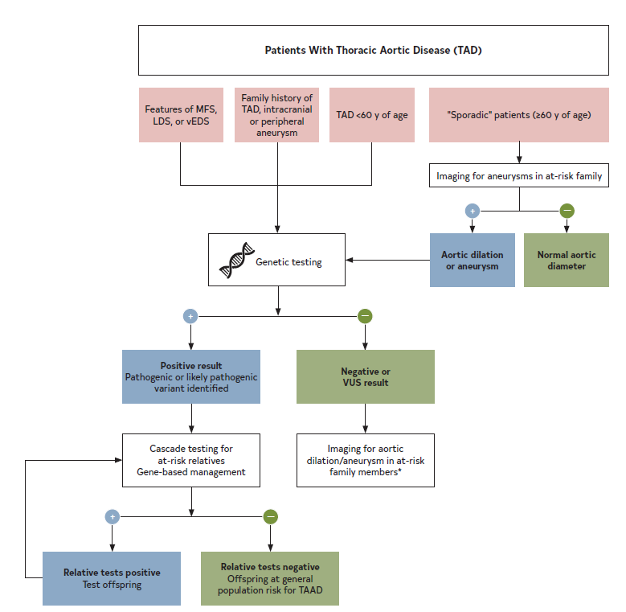
Figure 17. Evaluation and Genetic Testing Protocol for Patients With TAD.
Blue (+) indicates positive; green (–), negative; LDS, Loeys-Dietz syndrome; MFS, Marfan syndrome; TAAD, thoracic aortic aneurysm and dissection; TAD, thoracic aortic disease; and VUS, variants of unknown significance.
*Aneurysms are typically asymptomatic.

Slide 57
Surgical Considerations for Nonsyndromic Heritable TAAs and No Identified Genetic Cause
Recommendations for Surgical Considerations for Nonsyndromic Heritable TAA and No Identified Genetic Cause | Recommendations for Surgical Considerations for Nonsyndromic Heritable TAA and No Identified Genetic Cause
COR | LOE | Recommendations
1 | C-LD | In asymptomatic patients with aneurysms of the aortic root or ascending aorta with nonsyndromic heritable thoracic aortic disease (nsHTAD) and no identified genetic cause, determining the timing of surgical repair requires shared decision-making and is informed by known aortic diameters at the time of aortic dissection, TAA repair, or both in affected family members.
1 | C-LD | In asymptomatic patients with aneurysms of the aortic root or ascending aorta with nsHTAD and no identified genetic cause but no information on aortic diameters at the time of dissection or aneurysm repair in affected family members and who have no high-risk features for adverse aortic events (Table 9) it is recommended to repair the aorta when the maximal diameter reaches ≥5.0 cm.
2a | C-LD | In patients with aneurysms of the aortic root or ascending aorta with nsHTAD and no identified genetic cause and a maximal aortic diameter of ≥4.5 cm, who have high-risk features for adverse aortic events (Table 9), or who are undergoing cardiac surgery for other indications, aortic repair is reasonable when performed by experienced surgeons in a Multidisciplinary Aortic Team.

Slide 58
Table 9. Features Associated With an Increased Risk of Aortic Dissection in Patients With Heritable Thoracic Aortic Aneurysms
Heritable Thoracic Aortic Aneurysms and No Identified Genetic Cause
Family history of aortic dissection at an aortic diameter <5.0 cm
Family history of unexplained sudden death at age <50 y
Rapid aortic growth (≥0.5 cm in 1 y or ≥0.3 cm/y in 2 consecutive y)

Slide 59
Diagnostic and Surveillance Aortic Imaging in Marfan Syndrome
Recommendations for Diagnostic and Surveillance Aortic Imaging in Marfan Syndrome Referenced studies that support the recommendations are summarized in the Online Data Supplement. | Recommendations for Diagnostic and Surveillance Aortic Imaging in Marfan Syndrome Referenced studies that support the recommendations are summarized in the Online Data Supplement.
COR | LOE | Recommendations
Initial Diagnosis and Surveillance Imaging
1 | C-EO | In patients with Marfan syndrome, a TTE is recommended at the time of initial diagnosis, to determine the diameters of the aortic root and ascending aorta, and 6 months thereafter, to determine the rate of aortic growth; if the aortic diameters are stable, an annual surveillance TTE is recommended. If the aortic root, ascending aorta, or both are not adequately visualized on TTE, a CT or MRI of the thoracic aorta is recommended.

Slide 60
Diagnostic and Surveillance Aortic Imaging in Marfan Syndrome (con’t.)
2a | C-EO | In adults with Marfan syndrome, after the initial TTE, a CT or MRI of the thoracic aorta is reasonable to confirm the aortic diameters and assess the remainder of the thoracic aorta.
Imaging After Aortic Root Replacement
1 | C-LD | In patients with Marfan syndrome who have undergone aortic root replacement, surveillance imaging of the thoracic aorta by MRI (or CT) is recommended to evaluate for distal TAD, initially annually and then, if normal in diameter and unchanged after 2 years, every other year.
2a | C-LD | In patients with Marfan syndrome who have undergone aortic root replacement, surveillance imaging every 3 to 5 years for potential AAA is reasonable.

Slide 61
Medical Therapy in Marfan Syndrome
Recommendations for Medical Therapy in Marfan Syndrome Referenced studies that support the recommendations are summarized in the Online Data Supplement. | Recommendations for Medical Therapy in Marfan Syndrome Referenced studies that support the recommendations are summarized in the Online Data Supplement.
COR | LOE | Recommendations
1 | A | In patients with Marfan syndrome, treatment with either a beta blocker or an ARB, in maximally tolerated doses (unless contraindicated), is recommended to reduce the rate of aortic dilation.
2a | C-LD | In patients with Marfan syndrome, the use of both a beta blocker and an ARB, in maximally tolerated doses (unless contraindicated), is reasonable to reduce the rate of aortic dilation.

Slide 62
Marfan Syndrome Interventions: Replacement of the Aortic Root in Patients With Marfan Syndrome
Recommendations for Replacement of the Aortic Root in Patients With Marfan Syndrome Referenced studies that support the recommendations are summarized in the Online Data Supplement. | Recommendations for Replacement of the Aortic Root in Patients With Marfan Syndrome Referenced studies that support the recommendations are summarized in the Online Data Supplement.
COR | LOE | Recommendations
1 | B-NR | In patients with Marfan syndrome and an aortic root diameter of ≥5.0 cm, surgery to replace the aortic root and ascending aorta is recommended.
2a | B-NR | In patients with Marfan syndrome, an aortic root diameter of ≥4.5 cm, and features associated with an increased risk of aortic dissection (see Table 10), surgery to replace the aortic root and ascending aorta is reasonable, when performed by experienced surgeons in a Multidisciplinary Aortic Team.

Slide 63
Marfan Syndrome Interventions: Replacement of the Aortic Root in Patients With Marfan Syndrome
2a | C-LD | In patients with Marfan syndrome and a maximal cross-sectional aortic root area (cm²) to patient height (m) ratio of ≥ 10, surgery to replace the aortic root and ascending aorta is reasonable, when performed by experienced surgeons in a Multidisciplinary Aortic Team.
2b | C-LD | In patients with Marfan syndrome and an aortic diameter approaching surgical threshold, who are candidates for valve-sparing root replacement (VSRR) and have a very low surgical risk, surgery to replace the aortic root and ascending aorta may be reasonable when performed by experienced surgeons in a Multidisciplinary Aortic Team.

Slide 64
Table 10. Features Associated With Increased Risk of Aortic Complications in Marfan Syndrome
Family history of aortic dissection
Rapid aortic growth (≥0.3 cm/y)
Diffuse aortic root and ascending aortic dilation
Marked vertebral arterial tortuosity

Slide 65
Marfan Syndrome Interventions: Replacement of Primary (Nondissected) Aneurysms of the Aortic Arch, Descending, and Abdominal Aorta in Patients With Marfan Syndrome
Recommendation for Replacement of Primary (Nondissected) Aneurysms of the Aortic Arch, Descending, and Abdominal Aorta in Patients With Marfan Syndrome | Recommendation for Replacement of Primary (Nondissected) Aneurysms of the Aortic Arch, Descending, and Abdominal Aorta in Patients With Marfan Syndrome
COR | LOE | Recommendation
2a | C-EO | In patients with Marfan syndrome and a nondissected aneurysm of the aortic arch, descending thoracic aorta, or abdominal aorta of ≥5.0 cm, surgical intervention to replace the aneurysmal segment is reasonable.

Slide 66
Imaging in Loeys-Dietz Syndrome
Recommendations for Imaging in Loeys-Dietz Syndrome
COR | LOE | Recommendations
1 | C-EO | In patients with Loeys-Dietz syndrome and a dilated or dissected aorta and/or arterial branches at baseline TTE is recommended to determine the diameters of the aortic root and ascending aorta, and 6 months thereafter to determine the rate of aortic growth; if the aortic diameters are stable, annual surveillance TTE is recommended.
1 | C-EO | In patients with Loeys-Dietz syndrome, a dilated or dissected aorta, and/or arterial branches at baseline, annual surveillance imaging of the affected aorta and arteries with MRI or CT is recommended.

Slide 67
Imaging in Loeys-Dietz Syndrome (con’t.)
1 | C-LD | In patients with Loeys-Dietz syndrome, a baseline MRI or CT from head to pelvis is recommended to evaluate the entire aorta and its branches for aneurysm, dissection, and tortuosity.
2a | C-EO | In patients with Loeys-Dietz syndrome without dilation of the aorta distal to the aortic root or ascending aorta and without dilated or dissected arterial branches, surveillance imaging from chest to pelvis with MRI (or CT) every 2 years is reasonable, but imaging may be more frequent depending on family history.
2a | C-EO | In patients with Loeys-Dietz syndrome without dilation of the cerebral arteries on initial screening, periodic imaging surveillance for cerebral aneurysms with MRI or CT every 2 to 3 years is reasonable.

Slide 68
Medical Therapy in Loeys-Dietz Syndrome
Recommendation for Medical Therapy in Loeys-Dietz Syndrome | Recommendation for Medical Therapy in Loeys-Dietz Syndrome
COR | LOE | Recommendation
2a | C-EO | In patients with Loeys-Dietz syndrome, treatment with a beta blocker or an ARB (unless contraindicated), or both, in maximally tolerated doses, is reasonable.

Slide 69
Loeys-Dietz Syndrome Surgical Interventions: Replacement of the Aorta in Patients With Loeys-Dietz Syndrome
Recommendations for Replacement of the Aorta in Patients With Loeys-Dietz Syndrome
COR | LOE | Recommendations
1 | C-LD | In patients with Loeys-Dietz syndrome and aortic dilation, the surgical threshold for prophylactic aortic root and ascending aortic replacement should be informed by the specific genetic variant, aortic diameter, aortic growth rate, extra-aortic features, family history, patient age and sex, and physician and patient preferences (see Table 11).
2b | C-EO | In patients with Loeys-Dietz syndrome attributable to a pathogenic variant in TGFBR1, TGFBR2, or SMAD3, surgery to replace the intact aortic arch, descending aorta, or abdominal aorta at a diameter of ≥4.5 cm may be considered, with the specific genetic variant, patient age, aortic growth rate, family history, presence of high-risk features (see Table 11), and surgical risk informing the decision.

Slide 70
Table 11. Surgical Thresholds for Prophylactic Aortic Root and Ascending Aortic Replacement in Loeys-Dietz Syndrome Based on Genetic Variant
*Aortic surgery may be recommended at smaller aortic diameters in Loeys-Dietz syndrome attributable to TGFBR1 and TGFBR2 pathogenic variants when there are features that associate with a higher risk of aortic dissection, including: certain specific pathogenic variants; women with TGFBR2 and small body size; severe extra-aortic features (ie, craniosynostosis, cleft palate, hypertelorism, bifid uvula, marked arterial tortuosity, widened scars, and translucent skin); family history of aortic dissection (especially at young age or relatively small aortic diameter); and aortic growth rate >0.3 cm/y.
†Family history, age, and aortic growth rate also inform surgical thresholds.
‡Pathogenic variants in the TGFB2 gene are different than variants in the TGFBR2 gene.
COR | LOE | Genetic Variant | Presence of High-Risk Features* | Aortic Diameter (cm)
1 | C-LD | TGFBR1 | No | ≥4.5
1 | C-LD | TGFBR2 | No | ≥4.5
2b | C-EO | TGFBR1 | Yes | ≥4.0
2a | C-LD | TGFBR2 | Yes | ≥4.0
2a | C-EO | SMAD3 | – | ≥4.5†
2b | C-EO | TGFB2‡ | – | ≥4.5†
2b | C-EO | TGFB3 | – | ≥5.0†
COR indicates class of recommendation; and LOE, level of evidence.

Slide 71
Turner Syndrome
Recommendations for Diagnostic Testing, Surveillance, and Surgical Intervention for Aortic Dilation in Turner Syndrome Referenced studies that support the recommendations are summarized in the Online Data Supplement.
COR | LOE | Recommendations
1 | B-NR | In patients with Turner syndrome, TTE and cardiac MRI are recommended at the time of diagnosis to evaluate for BAV, aortic root and ascending aortic dilation, aortic coarctation, and other congenital heart defects.
1 | B-NR | In patients with Turner syndrome who are ≥15 years old, the use of the ASI (ratio of aortic diameter [cm] to BSA [m²]) is recommended to define the degree of aortic dilation and assess the risk of aortic dissection.
1 | C-LD | In patients with Turner syndrome without risk factors for aortic dissection (see Table 12), surveillance imaging with TTE or MRI to evaluate the aorta is recommended every 5 years in children and every 10 years in adults, as well as before planning a pregnancy.

Slide 72
Turner Syndrome (con’t.)
1 | C-EO | In patients with Turner syndrome and an ASI >2.3 cm/m², surveillance imaging of the aorta is recommended at least annually.
1 | C-EO | In patients with Turner syndrome and risk factors for aortic dissection (Table 12), surveillance aortic imaging at an interval depending on the aortic diameter, ASI, and aortic growth rate is recommended (see Figure 18).
2a | C-LD | In patients with Turnery syndrome who are ≥15 years old and have an ASI of ≥2.5 cm/m² plus risk factors for aortic dissection (Table 12), surgical intervention to replace the aortic root, ascending aorta, or both is reasonable.
2b | C-EO | In those without risk factors for aortic dissection, surgical intervention to replace the aortic root, ascending aorta, or both may be considered.

Slide 73
Table 12. Risk Factors for Aortic Dissection in Patients With Turner Syndrome
Aortic coarctation
Aortic dilation
Bicuspid aortic valve
Hypertension

Slide 74
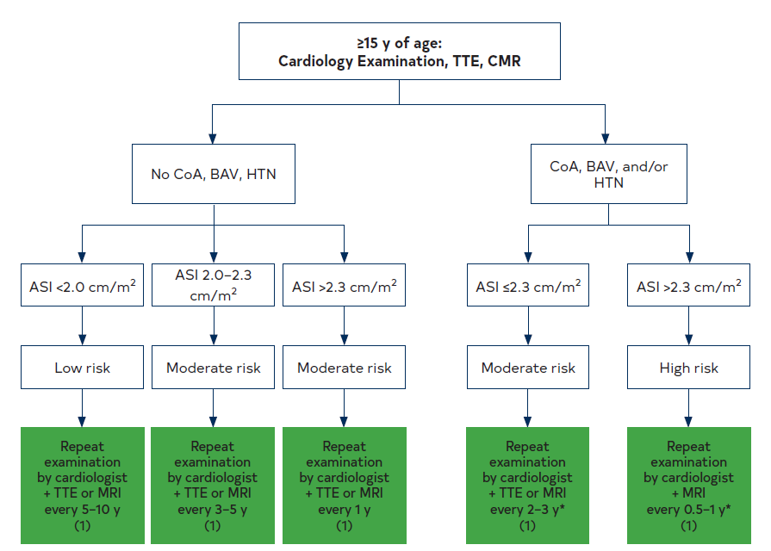
Figure 18. Suggested Aortic Monitoring Protocol for Girls and Women With Turner Syndrome Who Are ≥15 Years of Age.
*Surveillance frequency may vary depending on disease severity (ie, aortic valve dysfunction, severity of coarctation obstruction, hypertension, and left ventricular hypertrophy).
ASI indicates aortic size index; BAV, bicuspid aortic valve; CoA, coarctation of the aorta; HTN, hypertension; MRI, magnetic resonance imaging; and TTE, transthoracic echocardiography

Slide 75
Table 13. Surgical Thresholds for Prophylactic Aortic Root and Ascending Aortic Replacement in Nonsyndromic Heritable Thoracic Aortic Disease Based on the Genetic Variant and Additional Risk Factors for Aortic Dissection
COR* | LOE* | Genetic Variant | Risk Factors | Aortic Diameter (cm)
2a | C-LD | ACTA2 | No | ≥4.5
2b | C-EO | ACTA2 | Yes† | ≥4.2
2b | C-LD | PRKG1 | No | ≥4.2
2b | C-EO | PRKG1 | Yes† | ≥4.0†
*Patient has risk factors for aortic dissection (family history of type A aortic dissection with minimal aortic enlargement, aortic growth rate ≥0.3 cm/y) or significant valve disease requiring surgery. †Earlier surgery may be considered in patients with a family history of type A aortic dissection in the setting of no or minimal aortic dilation, aortic growth rate ≥0.3 cm/y, or at the patient’s request.
COR indicates class of recommendation; and LOE, level of evidence.

Slide 76
BAV Aortopathy
Recommendations for BAV Aortopathy Referenced studies that support the recommendations are summarized in the Online Data Supplement.
COR | LOE | Recommendations
1 | B-NR | In patients with a BAV, TTE is indicated to evaluate valve morphology and function, to evaluate the diameter of the aortic root and ascending aorta, and to evaluate for aortic coarctation and other associated cardiovascular defects.
1 | C-LD | In patients with a BAV, CT or MRI of the thoracic aorta is indicated when the diameter and morphology of the aortic root, ascending aorta, or both cannot be assessed accurately or completely by TTE.

Slide 77
BAV Aortopathy (con’t.)
1 | C-LD | In patients with a BAV and either HTAD or phenotypic features concerning for Loeys-Dietz syndrome, a medical genetics evaluation is recommended.
1 | C-LD | In patients with a BAV and a dilated aortic root or ascending aorta, screening of all first-degree relatives by TTE is recommended to evaluate for the presence of a BAV, dilation of the aortic root and ascending aorta, or both; if the diameter and morphology of the aortic root, ascending aorta, or both cannot be assessed accurately or completely by TTE, a cardiac-gated CT or MRI of the thoracic aorta is indicated.
2a | B-NR | In patients with a BAV, screening of all first-degree relatives by TTE is reasonable to evaluate for the presence of a BAV, dilation of the aortic root and ascending aorta, or both.

Slide 78
Routine Follow-Up of BAV Disease Aortopathy
Recommendations for Routine Follow-Up of BAV Disease Aortopathy Referenced studies that support the recommendations are summarized in the Online Data Supplement.
COR | LOE | Recommendations
1 | B-NR | In patients with a BAV who have undergone previous aortic valve repair or replacement and have a diameter of the aortic root, ascending aortic, or both of ≥4.0 cm, lifelong surveillance imaging of the aortic root and ascending aorta by TTE, CT, or MRI is recommended at an interval dependent on aortic diameter and rate of growth.
1 | C-LD | In patients with a BAV and a diameter of the aortic root, ascending aorta, or both of ≥4.0 cm, lifelong surveillance imaging of the aortic root and ascending aorta by TTE, CT, or MRI is recommended at an interval dependent on aortic diameter and rate of growth.

Slide 79
BAV Aortopathy Interventions: Replacement of the Aorta in Patients With BAV
Recommendations for BAV Aortopathy Interventions: Replacement of the Aorta in Patients With BAV Referenced studies that support the recommendations are summarized in the Online Data Supplement.
COR | LOE | Recommendations
1 | B-NR | In patients with a BAV and a diameter of the aortic root, ascending aorta, or both of ≥5.5 cm, surgery to replace the aortic root, ascending aorta, or both is recommended.
2a | B-NR | In patients with a BAV and a cross-sectional aortic root or ascending aortic area (cm²) to height (m) ratio of ≥10 cm²/m, surgery to replace the aortic root, ascending aorta, or both is reasonable, when performed by experienced surgeons in a Multidisciplinary Aortic Team.

Slide 80
BAV Aortopathy Interventions: Replacement of the Aorta in Patients With BAV (con’t.)
2a | B-NR | In patients with a BAV, a diameter of the aortic root or ascending aorta of 5.0 cm to 5.4 cm, and an additional risk factor for aortic dissection (Table 14), surgery to replace the aortic root, ascending aorta, or both is reasonable, when performed by experienced surgeons in a Multidisciplinary Aortic Team.
2a | B-NR | In patients with a BAV who are undergoing surgical aortic valve repair or replacement, and who have a diameter of the aortic root or ascending aorta of ≥4.5 cm, concomitant replacement of the aortic root, ascending aorta, or both is reasonable, when performed by experienced surgeons in a Multidisciplinary Aortic Team.
2b | B-NR | In patients with a BAV, a diameter of the aortic root or ascending aorta of 5.0 cm to 5.4 cm, no other risk factors for AoD (Table 14), and at low surgical risk, surgery to replace the aortic root, ascending aorta, or both may be reasonable, when performed by experienced surgeons in a Multidisciplinary Aortic Team.

Slide 81
AAA: Cause, Risk Factors, and Screening
Recommendations for AAA: Cause, Risk Factors, and Screening Referenced studies that support the recommendations are summarized in the Online Data Supplement.
COR | LOE | Recommendations
1 | B-R | In men who are ≥65 years of age who have ever smoked, ultrasound screening for detection of AAA is recommended.
1 | C-LD | In men or women who are ≥65 years of age and who are first-degree relatives of patients with AAA, ultrasound screening for detection of AAA is recommended.
2a | C-EO | In women who are ≥65 years of age who have ever smoked, ultrasound screening for detection of AAA is reasonable.

Slide 82
AAA: Cause, Risk Factors, and Screening (con’t.)
2b | C-LD | In men or women <65 years of age and who have multiple risk factors (see Table 15) or a first-degree relative with AAA, ultrasound screening for AAA may be considered.
3: No Benefit | B-NR | In asymptomatic men or women >75 years who have had a negative initial ultrasound screen, repeat screening for detection of AAA is not recommended.

Slide 83
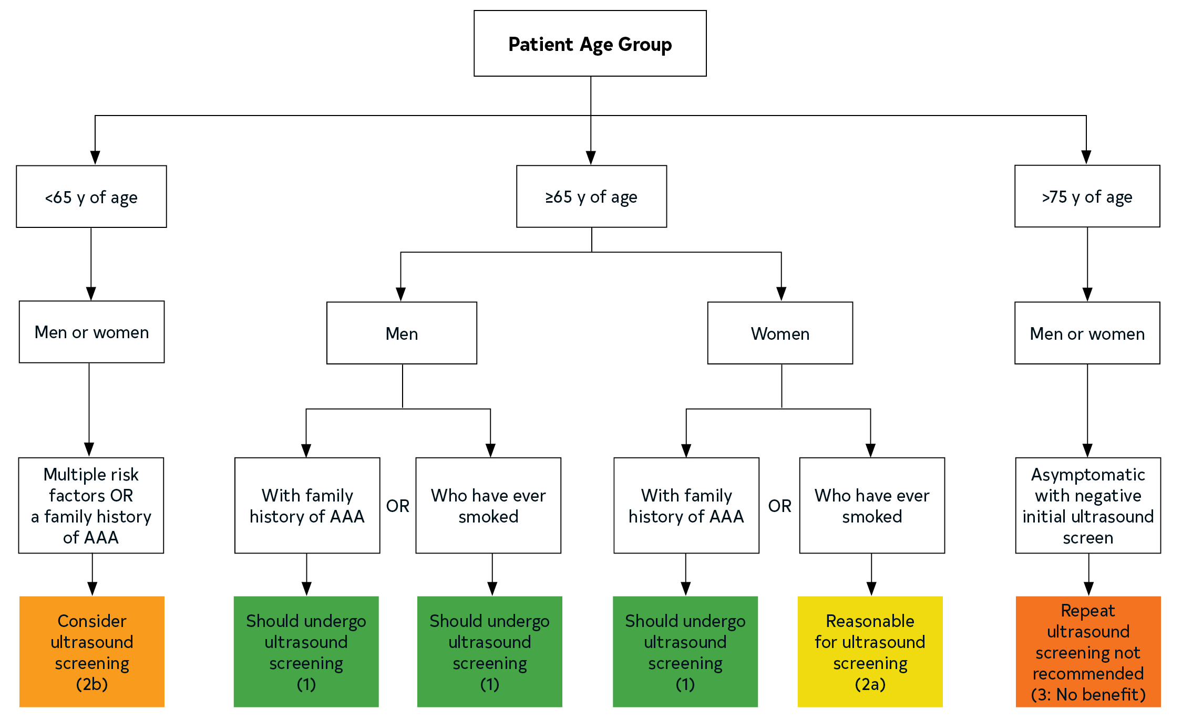
Figure 19. Algorithm for Identifying Patients to Screen for Abdominal Aortic Aneurysm.
AAA indicates abdominal aortic aneurysm.
Colors correspond to Table 1

Slide 84
Table 14. Risk Factors for Aortic Dissection
Family history of aortic dissection
Aortic growth rate ≥0.3 cm/y
Aortic coarctation
“Root phenotype” aortopathy

Slide 85
Table 15. Risk Factors for Abdominal Aortic Aneurysm
Strong Risk Factors | Additional Risk Factors
Smoking history | Hypertension
Older age | Hyperlipidemia
Male sex | White race
Family history of abdominal aortic aneurysm | Inherited vascular connective tissue disorder
 | Atherosclerotic cardiovascular disease

Slide 86
BP Management in Sporadic TAA
Recommendations for BP Management in TAA Referenced studies that support the recommendations are summarized in the Online Data Supplement.
COR | LOE | Recommendations
1 | B-NR | In patients with TAA and an average systolic BP (SBP) of ≥130 mm Hg or an average diastolic BP (DBP) of ≥80 mm Hg, the use of antihypertensive medications is recommended to reduce risk of cardiovascular events.
2a | C-LD | In patients with TAA, regardless of cause and in the absence of contraindications, use of beta blockers to achieve target BP goals is reasonable.
2a | C-EO | In patients with TAA, regardless of etiology and in the absence of contraindications, ARB therapy is a reasonable adjunct to beta-blocker therapy to achieve target BP goals.

Slide 87
Treatment of TAA With Statins
Recommendations for Treatment of TAA With Statins
COR | LOE | Recommendations
2a | C-LD | In patients with TAA and imaging or clinical evidence of atherosclerosis, statin therapy at moderate or high intensity is reasonable.
2b | C-LD | In patients with TAA who have no evidence of atherosclerosis, the use of statin therapy may be considered.

Slide 88
Smoking Cessation in TAA
Recommendation for Smoking Cessation in TAA
COR | LOE | Recommendation
1 | C-LD | In patients with TAA who smoke cigarettes, smoking cessation efforts are recommended.

Slide 89
Antiplatelet Therapy in TAA
Recommendation for Antiplatelet Therapy in TAA
COR | LOE | Recommendation
2a | C-EO | In patients with atherosclerotic TAA and concomitant aortic atheroma or PAU, the use of low-dose aspirin is reasonable, unless contraindicated.

Slide 90
BP Management in AAA
Recommendation for BP Management in AAA Referenced studies that support the recommendations are summarized in the Online Data Supplement.
COR | LOE | Recommendation
1 | B-NR | In patients with AAA and an average SBP of ≥130 mm Hg, or an average DBP of ≥80 mm Hg, the use of antihypertensive medication is recommended to reduce risk of cardiovascular events.

Slide 91
Treatment of AAA With Statins
Recommendations for Treatment of AAA With Statins Referenced studies that support the recommendations are summarized in the Online Data Supplement. | Recommendations for Treatment of AAA With Statins Referenced studies that support the recommendations are summarized in the Online Data Supplement.
COR | LOE | Recommendations
1 | B-NR | In patients with AAA and evidence of aortic atherosclerosis, statin therapy at moderate or high intensity is recommended.
2b | C-LD | In patients with AAA but no evidence of atherosclerosis, statin therapy may be considered.

Slide 92
Smoking Cessation in AAA
Recommendation for Smoking Cessation in AAA
COR | LOE | Recommendation
1 | C-LD | In patients with AAA who smoke cigarettes, smoking cessation efforts are recommended.

Slide 93
Antithrombotic Therapy in AAA
Recommendation for Antithrombotic Therapy in AAA
COR | LOE | Recommendation
2b | C-LD | In patients with AAA with concomitant atheroma and/or PAU, the use of low-dose aspirin may be considered, unless contraindicated.

Slide 94
Surveillance of Thoracic Aortic Dilation and Aneurysm
Recommendations for Surveillance of Thoracic Aortic Dilation and Aneurysm
COR | LOE | Recommendations
1 | C-LD | In patients with a dilated thoracic aorta, a TTE is recommended at the time of diagnosis to assess aortic valve anatomy, aortic valve function, and thoracic aortic diameters.
2a | C-LD | In patients with a dilated thoracic aorta, a CT or MRI at the time of diagnosis is reasonable to assess thoracic aortic anatomy and diameters.
2a | C-LD | In patients with a dilated thoracic aorta, follow-up imaging (with TTE, CT, or MRI, as appropriate based on individual anatomy) in 6 to 12 months is reasonable to determine the rate of aortic enlargement; if stable, surveillance imaging every 6 to 24 months (depending on aortic diameter) is reasonable.

Slide 95
Surveillance of Abdominal Aortic Dilation and Aneurysm
Recommendations for Surveillance of Abdominal Aortic Dilation and Aneurysm Referenced studies that support the recommendations are summarized in the Online Data Supplement.
COR | LOE | Recommendations
1 | B-NR | In patients with an AAA of 3.0 cm to 3.9 cm, surveillance ultrasound is recommended every 3 years to assess for interval change.
1 | B-NR | In men with an AAA of 4.0 cm to 4.9 cm and in women with an AAA of 4.0 cm to 4.4 cm, surveillance ultrasound is recommended annually to assess for interval change.

Slide 96
Surveillance of Abdominal Aortic Dilation and Aneurysm (con’t.)
1 | B-NR | In men with an AAA of ≥5.0 cm and women with an AAA of ≥4.5 cm, surveillance ultrasound is recommended every 6 months to assess for interval change.
1 | C-EO | In patients with an AAA that is inadequately defined with ultrasound, surveillance CT is recommended.
2a | C-LD | In such patients, when there is a contraindication to CT or to lower cumulative radiation risk, surveillance MRI is reasonable.
1 | C-EO | In patients with an AAA that meets criteria for repair, CT is recommended for preoperative planning.

Slide 97
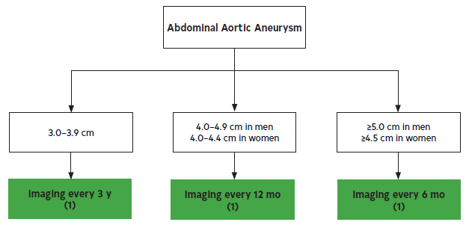
Figure 20. The Frequency of Surveillance Imaging of Abdominal Aortic Aneurysms Based on Current Aortic Diameter.

Slide 98
Surgery for Sporadic Aneurysms of the Aortic Root and Ascending Aorta
Recommendations for Surgery for Sporadic Aneurysms of the Aortic Root and Ascending Aorta Referenced studies that support recommendations are summarized in the Online Data Supplement.
COR | LOE | Recommendations
1 | C-LD | In patients with aneurysms of the aortic root and ascending aorta who have symptoms attributable to the aneurysm, surgery is indicated.
1 | B-NR | In asymptomatic patients with aneurysms of the aortic root or ascending aorta who have a maximum diameter of ≥5.5 cm, surgery is indicated.
1 | C-LD | In patients with an aneurysm of the aortic root or ascending aorta of <5.5 cm, whose growth rate confirmed by tomographic imaging is ≥0.3 cm/y in 2 consecutive years, or ≥0.5 cm in 1 year, surgery is indicated.

Slide 99
Surgery for Sporadic Aneurysms of the Aortic Root and Ascending Aorta (con’t.)
2a | B-NR | In asymptomatic patients with aneurysms of the aortic root or ascending aorta who have a maximum diameter of ≥5.0 cm, surgery is reasonable when performed by experienced surgeons in a Multidisciplinary Aortic Team.
2a | B-NR | In patients undergoing repair or replacement of a tricuspid aortic valve who have a concomitant aneurysm of the ascending aorta with a maximum diameter of ≥ 4.5 cm, ascending aortic replacement is reasonable when performed by experienced surgeons in a Multidisciplinary Aortic Team.
2a | B-NR | In patients undergoing repair or replacement of a tricuspid aortic valve who have a concomitant aneurysm of the ascending aorta with a maximum diameter of ≥5.0 cm, ascending aortic replacement is reasonable.
2b | C-LD | In patients undergoing cardiac surgery for indications other than aortic valve repair or replacement who have a concomitant aneurysm of ascending aorta with a maximum diameter of ≥5.0 cm, ascending aortic replacement may be reasonable.

Slide 100
Surgery for Sporadic Aneurysms of the Aortic Root and Ascending Aorta (con’t.)
2a | C-LD | In patients with a height >1 standard deviation above or below the mean who have an asymptomatic aneurysm of the aortic root or ascending aorta and a maximal cross-sectional aortic area/height ratio of ≥10 cm²/m, surgery is reasonable when performed by experienced surgeons in a Multidisciplinary Aortic Team.
2b | C-LD | In asymptomatic patients with aneurysms of the aortic root or ascending aorta who have either an ASI of ≥3.08 cm/m² or AHI of ≥3.21 cm/m, surgery may be reasonable when performed by experienced surgeons in a Multidisciplinary Aortic Team.

Slide 101
Surgical Approach for Patients With Sporadic Aneurysms of the Aortic Root and Ascending Aorta Meeting Criteria for Surgery
Recommendations for Surgical Approach for Patients With Sporadic Aneurysms of the Aortic Root and Ascending Aorta Meeting Criteria for Surgery Referenced studies that support recommendations are summarized in the Online Data Supplement.
COR | LOE | Recommendations
1 | B-NR | In patients with an aneurysm isolated to the ascending aorta who meet criteria for surgery, aneurysm resection and replacement with an interposition graft should be performed.
1 | B-NR | In patients undergoing aortic valve repair or replacement with a concomitant ascending aortic aneurysm, a separate aortic valve intervention and ascending aortic graft is recommended.

Slide 102
Surgical Approach for Patients With Sporadic Aneurysms of the Aortic Root and Ascending Aorta Meeting Criteria for Surgery (con’t.)
1 | B-NR | In patients undergoing aortic root replacement with an aortic valve that is unsuitable for sparing or repair, a mechanical or biological valved conduit aortic root replacement is indicated.
2a | B-NR | In patients undergoing aortic root replacement, valve-sparing aortic root replacement is reasonable if the aortic valve is suitable for sparing or repair and when performed by experienced surgeons in a Multidisciplinary Aortic Team.

Slide 103
Aortic Arch Aneurysms
Recommendations for Aortic Arch Aneurysms Referenced studies that support the recommendations are summarized in the Online Data Supplement.
COR | LOE | Recommendations
1 | C-EO | In patients with an aortic arch aneurysm who have symptoms attributable to the aneurysm and are at low or intermediate operative risk, open surgical replacement is recommended.
2a | B-NR | In patients with an isolated aortic arch aneurysm who are asymptomatic and have a low operative risk, open surgical replacement at an arch diameter of ≥5.5 cm is reasonable.

Slide 104
Aortic Arch Aneurysms (con’t.)
2a | C-LD | In patients undergoing open surgical repair of an ascending aortic aneurysm, if the aneurysmal disease extends into the proximal aortic arch, it is reasonable to extend the repair with a hemiarch replacement.
2b | C-LD | In patients undergoing open surgical repair of an aortic arch aneurysm, if the aneurysmal disease extends into the proximal descending thoracic aorta, an elephant trunk procedure may be considered.
2b | C-EO | In patients with an aortic arch aneurysm who are asymptomatic but meet criteria for intervention, but have a high risk from open surgical repair, a hybrid or endovascular approach may be reasonable.

Slide 105
Size Thresholds for Repair of Descending TAA
Recommendations for Size Thresholds for Repair of Descending TAA Referenced studies that support the recommendations are summarized in the Online Data Supplement.
COR | LOE | Recommendations
1 | B-NR | In patients with intact descending TAA, repair is recommended when the diameter is ≥5.5 cm.
2b | B-NR | In patients with intact descending TAA and risk factors for rupture (Table 17), repair may be considered at a diameter of <5.5 cm.
2b | B-NR | In patients at increased risk for perioperative morbidity and mortality (Table 18), it may be reasonable to increase the size threshold for surgery accordingly.

Slide 106
Table 16. Adverse Aortic Events at 1 Year, Based on Baseline Aortic Diameter, Among Patients With Descending TAA
Aortic Diameter (cm) | Definite Aortic Event* (%) | Probable Aortic Event† (%)
5.0 | 5.5 | 8.0
5.5 | 7.2 | 11.2
6.0 | 9.3 | 15.6
7.0 | 15.4 | 28.1
†Probable aortic event includes definite aortic events as well as sudden unexplained death.

Slide 107
Table 17. Risk Factors for Aortic Rupture Among Patients With Descending TAA
High-Risk Features for Rupture
Aneurysm growth of ≥0.5 cm/y
Symptomatic aneurysm
Marfan, Loeys-Dietz, or vascular Ehlers-Danlos syndrome, or HTAD
Saccular aneurysm
Female sex
Infectious aneurysm
HTAD indicates heritable thoracic aortic disease; and TAA, thoracic aortic aneurysm.

Slide 108
Table 18. Patient Characteristics Associated With Increased Perioperative Morbidity and Mortality After Open and Endovascular Repair of Descending TAA
Open Surgical Repair | Endovascular Repair
Advanced age 65-74 y (OR, 1.8; 95% CI, 1.4-2.4; P<0.001) ≥75 y (OR, 2.6; 95% CI, 2.0-3.5; P<0.001) | Functional dependence
Preoperative renal insufficiency (stage 3 or greater CKD) or hemodialysis | Thoracoabdominal aortic aneurysm extent
COPD and FEV1 ≤50% predicted | Pulmonary disease
Previous stroke | Need for iliac access
 | Zone 1/2 landing for thoracic stent graft
CKD indicates chronic kidney disease; COPD, chronic obstructive pulmonary disease; FEV1, forced expiratory volume in 1 second; and TAA, thoracic aortic aneurysm.

Slide 109
Endovascular Versus Open Repair of Descending TAA
Recommendations for Endovascular Versus Open Repair of Descending TAA Referenced studies that support the recommendations are summarized in the Online Data Supplement.
COR | LOE | Recommendations
1 | B-NR | In patients without Marfan syndrome, Loeys-Dietz syndrome, or vascular Ehlers-Danlos syndrome, who have a descending TAA that meets criteria for intervention and anatomy suitable for endovascular repair, TEVAR is recommended over open surgery.
1 | B-NR | In patients with a descending TAA that meets criteria for repair with TEVAR, who have smaller or diseased access vessels, considerations for alternative vascular access are recommended.
2a | B-NR | In patients with a descending TAA that meets criteria for intervention, who have anatomy unsuitable for endovascular repair, and who are without significant comorbidities and have a life expectancy of at least 10 years, open surgical repair is reasonable.

Slide 110
Left Subclavian Artery Management
Recommendations for Left Subclavian Artery Management Referenced studies that support the recommendations are summarized in the Online Data Supplement. | Recommendations for Left Subclavian Artery Management Referenced studies that support the recommendations are summarized in the Online Data Supplement.
COR | LOE | Recommendations
1 | B-NR | In patients with descending TAA who undergo TEVAR with planned left subclavian artery coverage, revascularization of the left subclavian artery before TEVAR is recommended to prevent spinal cord injury (SCI) and potentially to reduce stroke risk and prevent other ischemic complications.
2b | C-LD | In patients with descending TAA who have undergone TEVAR with left subclavian coverage and develop SCI that is unresponsive to an increase in BP or a cerebrospinal fluid drain, left subclavian artery revascularization may be considered.

Slide 111
Celiac Artery Management
Recommendation for Intentional Celiac Artery Coverage During TEVAR References that support the recommendation are included in the Online Data Supplement.
COR | LOE | Recommendation
2a | B-NR | In patients with descending TAA undergoing TEVAR in whom celiac artery coverage is being considered, it is reasonable to first confirm adequate collateralization.

Slide 112
Ruptured Descending TAA
Recommendations for Ruptured Descending TAA Referenced studies that support the recommendations are summarized in the Online Data Supplement.
COR | LOE | Recommendations
1 | B-NR | In patients with ruptured descending TAA who are anatomic candidates for endovascular repair, TEVAR is recommended over open repair because of decreased perioperative death and morbidity.
2b | B-NR | In patients with ruptured descending TAA undergoing TEVAR, intentional coverage of the left subclavian artery, celiac artery, or both may be considered to increase the landing zone for endovascular repair.

Slide 113
Access Issues for TEVAR in Descending TAA
Recommendations for Access Issues for TEVAR in Descending TAA Referenced studies that support the recommendations are summarized in the Online Data Supplement.
COR | LOE | Recommendations
1 | B-NR | In patients with descending TAA undergoing TEVAR, review of preoperative CTA of the iliofemoral vessels should be performed to evaluate access.
1 | B-NR | In patients with descending TAA undergoing TEVAR, if iliac access is marginal or inadequate to prevent access-related complications, the use of alternative conduits is recommended.
2a | B-NR | In patients with descending TAA undergoing TEVAR who have suitable anatomy, total percutaneous femoral access is a reasonable alternative to open surgical cutdown to avoid access-related complications.

Slide 114
Size Thresholds for Open Surgical Repair of TAAA
Recommendations for Size Thresholds for Open Surgical Repair of TAAA Referenced studies that support the recommendations are summarized in the Online Data Supplement.
COR | LOE | Recommendations
1 | B-NR | In patients with intact degenerative TAAA, repair is recommended when the diameter is ≥6.0 cm.
2a | B-NR | In patients with intact degenerative TAAA, repair is reasonable when the diameter is ≥5.5 cm and the repair is performed by experienced surgeons in a Multidisciplinary Aortic Team.
2a | B-NR | In patients with intact degenerative TAAA who have features associated with an increased risk of rupture (Table 19), repair is reasonable when the diameter is <5.5 cm.

Slide 115
Table 19. Features Associated With an Increased Risk of TAAA Rupture
Rapid growth (confirmed increase in diameter of ≥0.5 cm/y)
Symptomatic aneurysm
Significant change in aneurysm appearance
Saccular aneurysm or presence of penetrating atherosclerotic ulcers
TAAA indicates thoracoabdominal aortic aneurysm.

Slide 116
Open Versus Endovascular Repair of TAAA
Recommendations for Open Versus Endovascular Repair of TAAA Referenced studies that support the recommendations are summarized in the Online Data Supplement.
COR | LOE
Ruptured TAAA
1 | B-NR | In patients with ruptured TAAA requiring intervention, open repair is recommended.
2b | C-LD | In patients with ruptured TAAA requiring intervention, provided that the patient is hemodynamically stable, endovascular repair may be reasonable in centers with endovascular expertise and access to appropriate endovascular stent grafts.

Slide 117
Open Versus Endovascular Repair of TAAA (con’t.)
Intact TAAA
1 | C-LD | In patients with Marfan syndrome, Loeys-Dietz syndrome, or vascular Ehlers-Danlos syndrome and intact TAAA requiring intervention, open repair is recommended over endovascular repair.
2b | B-NR | In patients with intact degenerative TAAA and suitable anatomy, endovascular repair with fenestrated stent grafts, branched stent grafts, or both may be considered in centers with endovascular expertise and access to appropriate endovascular stent grafts.

Slide 118
TAAA Spinal Cord Protection
Recommendations for TAAA Spinal Cord Protection Referenced studies that support the recommendations are summarized in the Online Data Supplement.
COR | LOE | Recommendations
1 | A | In patients undergoing open TAAA repair who are at high risk for SCI, cerebrospinal fluid drainage is recommended to reduce the incidence of temporary SCI, permanent SCI, or both.
1 | B-NR | In patients who experience delayed spinal cord dysfunction after either open or endovascular TAAA repair, timely measures to optimize spinal cord perfusion and decrease intrathecal pressure are recommended (Table 20).

Slide 119
Table 20. Measures to Optimize Spinal Cord and End-Organ Perfusion
Cardioversion for tachyarrhythmias
Insertion of cerebrospinal fluid drain
Increase mean arterial pressure to >100 mm Hg
Transfuse to a hemoglobin >10 g/dL
Volume resuscitation

Slide 120
TAAA Renal and Visceral Organ Protection
Recommendations for TAAA Renal and Visceral Organ Protection Referenced studies that support the recommendations are summarized in the Online Data Supplement.
COR | LOE | Recommendations
1 | A | In patients undergoing open repair of TAAA involving the renal arteries, cold blood or crystalloid renal perfusion is recommended to provide effective protection against renal injury.
1 | B-NR | In patients undergoing open or endovascular TAAA repair who have end-organ ischemia or significant stenoses from atherosclerotic visceral or renal artery disease, additional revascularization procedures are recommended.

Slide 121
Access During Endovascular Repair of AAA
Recommendation for Access During Endovascular Repair of AAA Referenced studies that support the recommendation are summarized in the Online Data Supplement.
COR | LOE | Recommendation
1 | B-R | In patients undergoing endovascular repair of AAA who have suitable common femoral artery anatomy, ultrasound-guided percutaneous access and closure is recommended over open cutdown to reduce operative time, blood loss, length of stay, time to wound healing, and pain.

Slide 122
Repair of Ruptured AAA
Recommendations Repair of Ruptured AAA Referenced studies that support the recommendations are summarized in the Online Data Supplement.
COR | LOE | Recommendations
1 | B-R | In patients presenting with ruptured AAA who are hemodynamically stable, CT imaging is recommended to evaluate whether the AAA is amenable to endovascular repair.
1 | B-R | In patients presenting with ruptured AAA who have suitable anatomy, endovascular repair is recommended over open repair to reduce the risk of morbidity and mortality.
2a | B-NR | In patients undergoing endovascular repair for ruptured AAA, local anesthesia is preferred to general anesthesia to reduce risk of perioperative mortality.
2a | C-LD | In patients with ruptured AAA, permissive hypotension can be beneficial to decrease the rate of bleeding.

Slide 123
Threshold for AAA Repair
Recommendations for the Threshold for AAA Repair Referenced studies that support the recommendations are summarized in the Online Data Supplement.
COR | LOE | Recommendations
1 | A | In patients with unruptured AAA, repair is recommended in those with a maximal aneurysm diameter of ≥5.5 cm in men or ≥5.0 cm in women.
1 | B-NR | In patients with unruptured AAA who have symptoms that are attributable to the aneurysm, repair is recommended to reduce the risk of rupture.
2b | C-LD | In patients with unruptured saccular AAA, intervention to reduce the risk of rupture may be reasonable.
2b | C-LD | In patients with unruptured AAA and aneurysm growth of ≥0.5 cm in 6 months, repair to reduce the risk of rupture may be reasonable.

Slide 124
Open Versus Endovascular Repair of AAA
Recommendations for Open Versus Endovascular Repair of AAA Referenced studies that support the recommendations are summarized in the Online Data Supplement.
COR | LOE | Recommendations
1 | A | In patients with nonruptured AAA with low to moderate operative risk and who have anatomy suitable for either open or EVAR, a shared decision-making process weighing the risks and benefits of each approach is recommended.
1 | B-NR | In patients undergoing elective endovascular repair for nonruptured AAA, adherence to manufacturer’s instructions for use is recommended.

Slide 125
Open Versus Endovascular Repair of AAA (con’t.)
2a | B-NR | In patients with nonruptured AAA and a high perioperative risk, EVAR is reasonable to reduce the risk of 30-day morbidity, mortality, or both.
2a | B-NR | For patients with nonruptured AAA, a moderate to high perioperative risk, and anatomy suitable for an FDA-approved fenestrated endovascular device, endovascular repair is reasonable over open repair to reduce the risk of perioperative complications.

Slide 126
Treatment of Concomitant Common Iliac Aneurysms
Recommendations for the Treatment of Concomitant Common Iliac Aneurysms Referenced studies that support the recommendations are summarized in the Online Data Supplement.
COR | LOE | Recommendations
1 | C-LD | For patients with asymptomatic small AAA and concomitant common iliac artery aneurysm(s) ≥3.5 cm, elective repair of both abdominal and iliac aneurysms is recommended.
1 | B-NR | When treating common iliac artery aneurysms or ectasia as part of AAA repair, preservation of at least 1 hypogastric artery is recommended, if anatomically feasible, to decrease the risk of pelvic ischemia.

Slide 127
Surveillance After TAA Repair
Recommendations for Surveillance After TAA Repair Referenced studies that support the recommendations are summarized in the Online Data Supplement.
COR | LOE | Recommendations
1 | B-NR | In patients treated with TEVAR, surveillance imaging with CT is recommended after 1 month and 12 months and, if stable, annually thereafter.

Slide 128
Surveillance After TAA Repair (con’t.)
2a | B-NR | In patients treated with TEVAR, longitudinal surveillance with MRI is a reasonable alternative to CT for reduction of long-term radiation exposure or avoidance of an iodinated contrast allergy.
2a | B-NR | In patients treated with open repair of the thoracic aorta without residual aortopathy, surveillance imaging with a CT or MRI within 1 year postoperatively and then every 5 years thereafter is reasonable.
2a | C-EO | In patients treated with open repair of the thoracic aorta who have residual aortopathy or abnormal findings on surveillance imaging, annual surveillance imaging is reasonable.

Slide 129
Surveillance After AAA Repair
Recommendations for Surveillance After AAA Repair Referenced studies that support the recommendations are summarized in the Online Data Supplement.
COR | LOE | Recommendations
1 | B-NR | In patients with AAA treated with EVAR, baseline surveillance imaging with CT is recommended at 1 month postoperatively; if there is no evidence of endoleak or sac enlargement, continued surveillance with duplex ultrasound at 12 months and then annually thereafter is recommended.
2a | C-LD | In patients with AAA treated with EVAR who are undergoing annual surveillance imaging duplex ultrasound, additional cross-sectional imaging with CT or MRI of the abdomen and pelvis every 5 years postoperatively is reasonable.

Slide 130
Surveillance After AAA Repair (con’t.)
2a | C-LD | In patients with AAA treated with EVAR and abnormal findings (Table 21) on any surveillance duplex ultrasound, additional cross-sectional imaging with CT or MRI is reasonable.
2a | C-LD | In patients with AAA treated with complex EVAR, a modified surveillance imaging plan that combines cross-sectional imaging and duplex ultrasound of target vessels is reasonable.
2a | C-LD | In patients with AAA who have undergone open repair, surveillance imaging with CT or MRI of the abdominopelvic aorta within 1 year postoperatively and then every 5 years thereafter is reasonable.

Slide 131
Table 21. Abnormal Findings on Duplex Imaging After EVAR That Should Prompt Additional Imaging
Aneurysm sac enlargement
Any endoleak
Stent graft fracture
Stent graft migration
Stent graft separation
EVAR indicates endovascular abdominal aortic aneurysm repair.

Slide 132
Acute Aortic Syndromes

Slide 133
Table 22. Signs and Symptoms of AAS
Clinical Signs and Symptoms | Cause
Asymmetric blood pressure (>20 mm Hg) between limbs | Compromise of branch artery flow
Bowel ischemia or gastrointestinal bleed | Malperfusion of the celiac or superior mesenteric artery
Dysphagia | Compression of the esophagus
Dyspnea | Compression of trachea or bronchus, congestive heart failure from aortic regurgitation, or cardiac tamponade
Hemoptysis | Vascular rupture into lung parenchyma
Hoarseness | Compression recurrent laryngeal nerve
Horner’s syndrome | Compression of sympathetic chain
Myocardial ischemia or myocardial infarction | Coronary artery involvement by dissection or compression by aneurysm
AAS indicates acute aortic syndrome.

Slide 134
Table 22. Signs and Symptoms of AAS
New murmur of aortic regurgitation | Incomplete aortic valve closure secondary to leaflet tethering by the dilated aorta or cusp prolapse because of dissection into the aortic root
Oliguria or hematuria (gross) | Malperfusion of 1 or both renal arteries
Paraplegia | Spinal malperfusion attributable intercostal artery involvement
Lower extremity ischemia | Malperfusion of iliac artery
Shock | Cardiac tamponade, hemothorax, frank aortic rupture, acute severe aortic regurgitation, severe myocardial ischemia
Shortness of breath | Pericardial effusion, congestive heart failure from acute severe aortic regurgitation, or hemothorax
Stroke symptoms | Carotid or vertebral artery involved
Superior vena cava syndrome | Compression of the superior vena cava
Syncope | Carotid artery involvement or cardiac tamponade
AAS indicates acute aortic syndrome.

Slide 135
AAS: Diagnostic Evaluation (Imaging, Laboratory Testing)
Recommendations for AAS: Diagnostic Evaluation (Imaging, Laboratory Testing)
COR | LOE | Recommendations
1 | C-LD | In patients with a suspected AAS, CT is recommended for initial diagnostic imaging, given its wide availability, accuracy, and speed, as well as the extent of anatomic detail it provides.
2a | C-LD | In patients with a suspected AAS, TEE and MRI are reasonable alternatives for initial diagnostic imaging.

Slide 136
Table 23. Plain Chest X-Ray Findings Suggestive of Aortic Dissection
Signs of Aortic Dissection on Chest X-Ray
Mediastinal widening
Disruption of the normally distinct contour of the aortic knob
Calcium sign, which appears as a separation of the intimal calcification from the aortic wall of >5 mm
Double density appearance within the aorta
Tracheal deviation to the right
Deviation of the nasogastric tube to the right

Slide 137
Table 24. Aortic Dissection Detection Risk Score (ADD-RS) Items
High-Risk Conditions | High-Risk Pain Features | High-Risk Examination Features
Marfan syndrome or other connective tissue disease | Chest, back, or abdominal pain described as: | Pulse deficit or systolic blood pressure differential
Family history of aortic disease | Abrupt onset | Focal neurologic deficit (with pain)
Known aortic valve disease | Severe in intensity | Murmur of aortic regurgitation (new, with pain)
Recent aortic manipulation | Ripping or tearing in quality | Hypotension or shock state
Known thoracic aortic aneurysm

Slide 138
Table 25. Aorta Simplified Score (AORTAs)10 Pretest Probability Assessment Score
Clinical Item | Points
Hypotension/shock | 2
Aneurysm | 1
Pulse deficit | 1
Neurologic deficit | 1
Severe pain | 1
Sudden-onset pain | 1

Slide 139
Acute Medical Management of AAS
Recommendations for Acute Medical Management of AAS Referenced studies that support the recommendations are summarized in the Online Data Supplement.
COR | LOE | Recommendations
1 | B-NR | In patients presenting to the hospital with AAS, prompt treatment with anti-impulse therapy with invasive monitoring of BP with an arterial line in an ICU setting is recommended as initial treatment to decrease aortic wall stress.
1 | C-LD | Patients with AAS should be treated to an SBP <120 mm Hg or to lowest BP that maintains adequate end-organ perfusion, as well as to a target heart rate of 60 to 80 bpm.

Slide 140
Acute Medical Management of AAS (con’t.)
1 | B-NR | In patients with AAS, initial management should include intravenous beta blockers, except in patients with contraindications.
2a | B-NR | In those with contraindications or intolerance to beta blockers, initial management with an intravenous non-dihydropyridine calcium channel blocker is reasonable for heart rate control.
1 | C-LD | In patients with AAS, initial management should include intravenous vasodilators if the BP is not well controlled after initiation of intravenous beta-blocker therapy.
1 | C-EO | Patients with AAS should be treated with pain control, as needed, to help with hemodynamic management.

Slide 141
Subsequent Medical Management of AAS
Recommendation for Subsequent Medical Management of AAS Referenced studies that support the recommendation are summarized in the Online Data Supplement.
COR | LOE | Recommendation
1 | B-NR | In patients with AAS, it is recommended to treat with long-term beta blockers (unless contraindicated) to control heart rate and BP to reduce late aortic-related adverse events. Additional antihypertensive agents (particularly ARBs and ACEIs) should be added, as necessary, to adequately control BP.

Slide 142
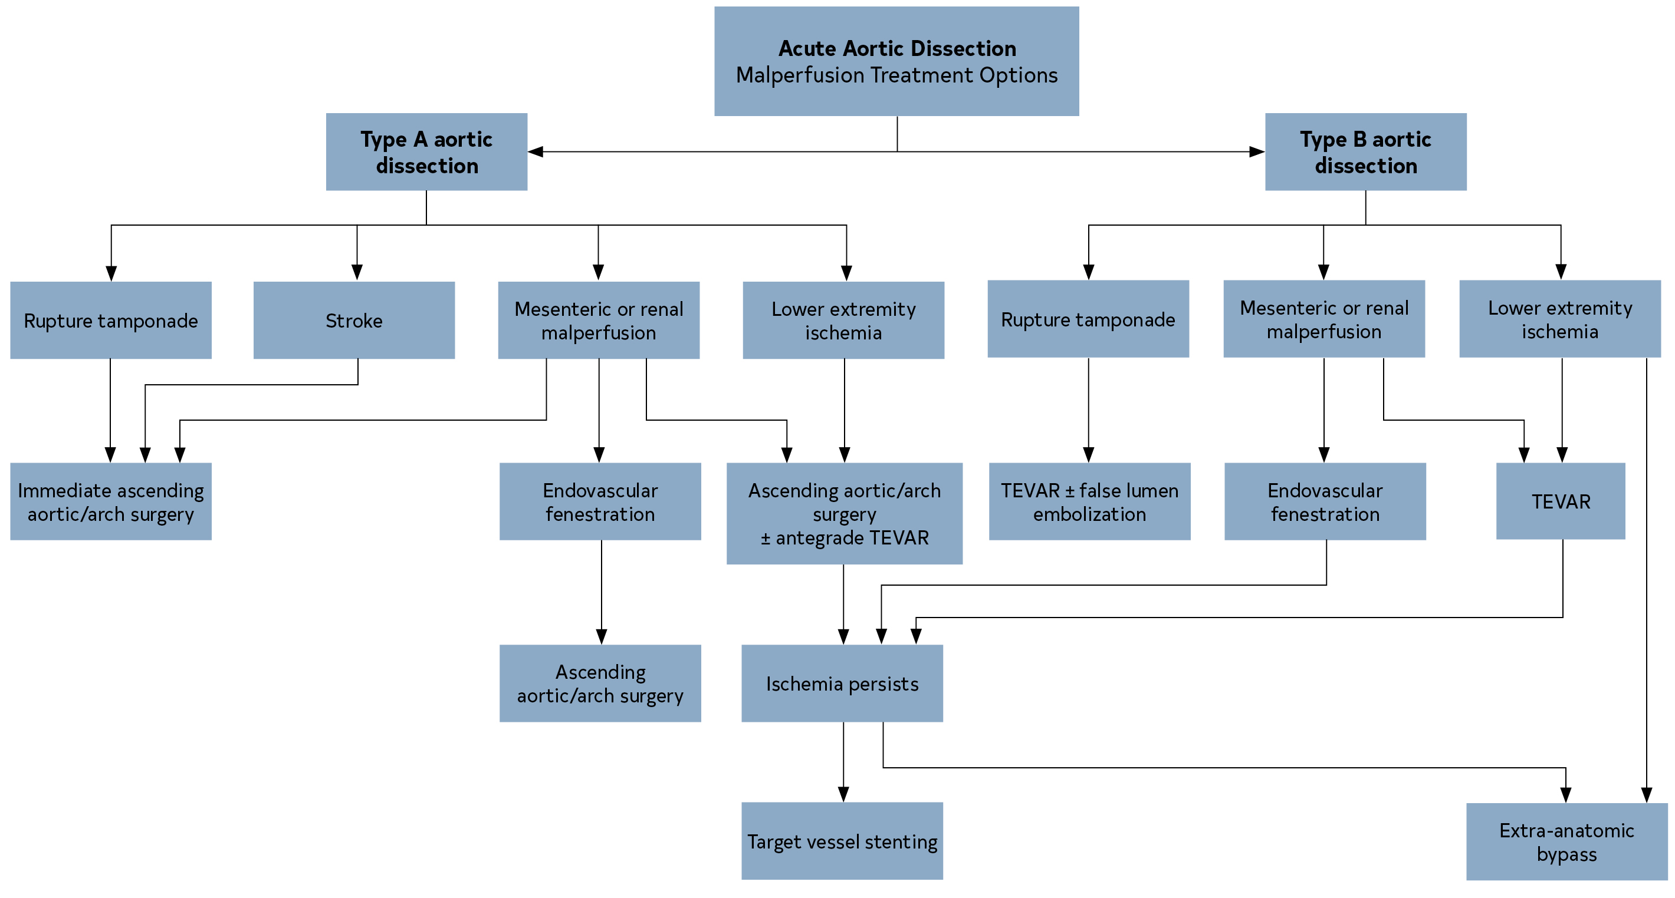
Figure 21. Acute Aortic Dissection: Malperfusion Treatment Options.
AoD indicates aortic dissection; and TEVAR, thoracic endovascular aortic repair.

Slide 143
Initial Surgical Considerations in Acute Type A Aortic Dissection
Recommendations for Initial Surgical Considerations in Acute Type A Aortic Dissection Referenced studies that support the recommendations are summarized in the Online Data Supplement.
COR | LOE | Recommendations
1 | B-NR | In patients presenting with suspected or confirmed acute type A aortic dissection, emergency surgical consultation and evaluation and immediate surgical intervention is recommended because of the high risk of associated life-threatening complications.

Slide 144
Initial Surgical Considerations in Acute Type A Aortic Dissection (con’t.)
2a | B-NR | In patients presenting with acute type A aortic dissection, who are stable enough for transfer, transfer from a low- to a high-volume aortic center is reasonable to improve survival.
2a | B-NR | In patients presenting with nonhemorrhagic stroke complicating acute type A aortic dissection, surgical intervention is reasonable over medical therapy to reduce mortality and improve neurologic outcomes.

Slide 145
Management of Malperfusion
Recommendations for Management of Malperfusion Referenced studies that support the recommendations are summarized in the Online Data Supplement.
COR | LOE | Recommendations
1 | B-NR | In patients with acute type A aortic dissection presenting with renal, mesenteric, or lower extremity malperfusion, it is recommended to proceed to immediate operative repair of the ascending aorta.
2a | C-LD | In patients with acute type A aortic dissection presenting with clinically significant mesenteric (celiac, SMA) malperfusion, either immediate operative repair of the ascending aorta or immediate mesenteric revascularization via endovascular or open surgical intervention by those with this expertise before ascending aortic repair is reasonable.

Slide 146
Table 26. Clinical Evidence of Malperfusion (“Malperfusion Syndrome”)
End Organ | Clinical Findings
Cardiac | Electrocardiographic changes of ischemia or infarction, troponin elevation, myocardial dysfunction
Cerebral | Stroke and neurologic deficits, coma and altered mental status
Spinal | Paraplegia
Mesenteric | Abdominal pain, bowel ischemia, lactic acidosis, elevation of liver function test results
Renal | Acute kidney injury, oliguria
Extremity | Loss of pulses in ≥1 extremity, sensory or motor dysfunction

Slide 147
Surgical Repair Strategies in Acute Type A Aortic Dissection
Recommendations for Surgical Repair Strategies in Acute Type A Aortic Dissection Referenced studies that support the recommendations are summarized in the Online Data Supplement.
COR | LOE | Recommendations
Aortic Repair Strategies |  | Aortic Repair Strategies
1 | B-NR | In patients with acute type A aortic dissection and a partially dissected aortic root but no significant aortic valve leaflet pathology, aortic valve resuspension is recommended over valve replacement.

Slide 148
Surgical Repair Strategies in Acute Type A Aortic Dissection (con’t.)
1 | B-NR | In patients with acute type A aortic dissection who have extensive destruction of the aortic root, a root aneurysm, or a known genetic aortic disorder, aortic root replacement is recommended with a mechanical or biological valved conduit.
2b | C-LD | In selected patients who are stable, valve-sparing root repair may be reasonable, when performed by experienced surgeons in a Multidisciplinary Aortic Team.
1 | B-NR | In patients with acute type A aortic dissection undergoing aortic repair, an open distal anastomosis is recommended to improve survival and increase false-lumen thrombosis rates.

Slide 149
Surgical Repair Strategies in Acute Type A Aortic Dissection (con’t.)
1 | B-NR | In patients with acute type A aortic dissection without an intimal tear in the arch or a significant arch aneurysm, hemiarch repair is recommended over more extensive arch replacement.
2b | C-LD | In patients with acute type A aortic dissection and a dissection flap extending through the arch into the descending thoracic aorta, an extended aortic repair with antegrade stenting of the proximal descending thoracic aorta may be considered to treat malperfusion and reduce late distal aortic complications.

Slide 150
Surgical Repair Strategies in Acute Type A Aortic Dissection (con’t.)
Perfusion and Cannulation Strategies
2a | B-NR | In patients with acute type A aortic dissection undergoing surgical repair, axillary cannulation, when feasible, is reasonable over femoral cannulation to reduce the risk of stroke or retrograde malperfusion.
2a | B-NR | In patients with acute type A aortic dissection undergoing surgical repair who require circulatory arrest, cerebral perfusion is reasonable to improve neurologic outcomes.
2a | B-NR | In patients with acute type A aortic dissection undergoing surgical repair, direct aortic or innominate artery cannulation with imaging guidance is reasonable as an alternative to femoral or axillary cannulation.

Slide 151
Management of Acute Type B Aortic Dissection
Recommendations for the Management of Acute Type B Aortic Dissection Referenced studies that support the recommendations are summarized in the Online Data Supplement.
COR | LOE | Recommendations
1 | B-NR | In all patients with uncomplicated acute type B aortic dissection, medical therapy is recommended as the initial management strategy.

Slide 152
Management of Acute Type B Aortic Dissection (con’t.)
1 | C-LD | In patients with acute type B aortic dissection and rupture or other complications (Table 27), intervention is recommended. In patients with rupture, in the presence of suitable anatomy, endovascular stent grafting, rather than open surgical repair, is recommended. In patients with other complications, in the presence of suitable anatomy, the use of endovascular approaches, rather than open surgical repair, is reasonable.
1 | C-EO
2a | C-LD
2b | B-R | In patients with uncomplicated acute type B aortic dissection who have high-risk anatomic features (Table 28), endovascular management may be considered.

Slide 153
Table 27. Consensus Features of Complicated Acute Type B Aortic Dissection
Feature | Comment
Aortic rupture | This can be either free or contained (including hemothorax, increasing periaortic hematoma, or both; or mediastinal hematoma) and should be addressed promptly.
Branch artery occlusion and malperfusion | Complete or partial occlusion of a major branch, with or without clinical evidence of ischemia; this includes visceral, renal, and peripheral arterial branches.
Extension of dissection³ | Extension of the dissection flap either distally or proximally (ie, retrograde type A dissection)
Aortic enlargement | Progressive enlargement of the true, false, or both lumens while in the acute phase may require prompt intervention.
Intractable pain
Uncontrolled hypertension

Slide 154
Table 28. High-Risk Features in Uncomplicated Acute Type B Aortic Dissection
High-Risk Imaging Findings
Maximal aortic diameter >40 mm
False-lumen diameter >20–22 mm
Entry tear >10 mm
Entry tear on lesser curvature
Increase in total aortic diameter of >5 mm between serial imaging studies
Bloody pleural effusion
Imaging-only evidence of malperfusion
High-Risk Clinical Findings
Refractory hypertension despite >3 different classes of antihypertensive medications at maximal recommended or tolerated doses
Refractory pain persisting >12 h despite maximal recommended or tolerated doses
Need for readmission

Slide 155
Management of IMH
Recommendations for Management of IMH Referenced studies that support the recommendations are summarized in the Online Data Supplement.
COR | LOE | Recommendations
1 | B-NR | In patients with complicated (Table 29) acute type A or type B aortic IMH, urgent repair is recommended.
1 | B-NR | In patients with uncomplicated acute type A IMH, prompt open surgical repair is recommended.
2b | C-LD | In selected patients with uncomplicated acute type A IMH who are at increased operative risk and do not have high-risk imaging features (Table 30), an initial or expectant approach of medical management may be considered.
1 | B-NR | In patients with uncomplicated acute type B IMH, medical therapy as the initial management strategy is recommended.

Slide 156
Management of IMH (con’t.)
2a | C-LD | In patients with type B IMH who require repair of the distal aortic arch or descending thoracic aorta (zones 2-5) and have favorable anatomy, endovascular repair is reasonable when performed by surgeons with endovascular expertise.
2a | C-LD | In patients with type B IMH who require repair of the distal aortic arch or descending thoracic aorta (zones 2-5) and have unfavorable anatomy for endovascular repair, open surgical repair is reasonable.
2b | C-LD | In patients with uncomplicated type B IMH and high-risk imaging features (Table 30), intervention may be reasonable.

Slide 157
Table 29. Features of Complicated IMH
Feature
Malperfusion
Periaortic hematoma
Pericardial effusion with cardiac tamponade
Persistent, refractory, or recurrent pain
Rupture
IMH indicates intramural hematoma.

Slide 158
Table 30. High-Risk Imaging Features of IMH
For Type A IMH | For Type B IMH
Maximum aortic diameter >45–50 mm | Maximum aortic diameter >47–50 mm
Hematoma thickness ≥10 mm | Hematoma thickness ≥13 mm
Focal intimal disruption with ulcer-like projection involving ascending aorta or arch | Focal intimal disruption with ulcer-like projection involving the descending thoracic aorta if it develops in acute phase
Pericardial effusion on admission | Increasing or recurrent pleural effusion
IMH indicates intramural hematoma.

Slide 159
Table 30. High-Risk Imaging Features of IMH (con’t.)
For Both Type A and Type B IMH
Progression to aortic dissection
Increasing aortic diameter
Increasing hematoma thickness
IMH indicates intramural hematoma.

Slide 160
PAU With IMH, Rupture, or Both
Recommendations for PAU With IMH, Rupture, or Both Referenced studies that support the recommendations are summarized in the Online Data Supplement.
COR | LOE | Recommendations
1 | B-NR | In patients with PAU of the aorta with rupture, urgent repair is recommended.
1 | B-NR | In patients with PAU of the ascending aorta with associated IMH, urgent repair is recommended.
2a | C-LD | In patients with PAU of the aortic arch or descending thoracic aorta with associated IMH, urgent repair is reasonable.
2b | C-LD | In patients with PAU of the abdominal aorta with associated IMH, urgent repair may be considered.

Slide 161
Isolated PAU
Recommendations for Isolated PAU Referenced studies that support the recommendations are summarized in the Online Data Supplement.
COR | LOE | Recommendations
1 | B-NR | In patients with isolated PAU who are symptomatic and have persistent pain that is clinically correlated with the radiologic findings, repair is recommended.
2b | C-LD | In patients with isolated PAU who are asymptomatic but have high-risk imaging features (Table 31), elective repair may be considered.

Slide 162
Table 31. High-Risk Imaging Features of PAUs
Feature
Maximum PAU diameter ≥13–20 mm
Maximum PAU depth ≥10 mm
Significant growth of PAU diameter or depth
PAU associated with a saccular aneurysm
PAU with an increasing pleural effusion
PAU indicates penetrating atherosclerotic ulcer.

Slide 163
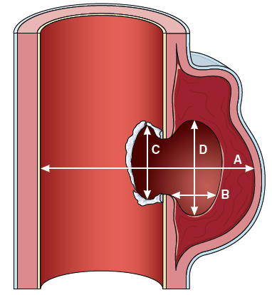
Figure 22. Dimensions of Penetrating Atherosclerotic Ulcers.
A, Maximal aortic diameter at ulcer site diameter (from ulcer across to opposite aortic wall). B, Depth of intramural blood pool. C, Length of intimal defect at ulcer site. D, Width of intramural blood pool.

Slide 164
PAU Open Surgical Repair Versus Endovascular Repair
Recommendations for PAU Open Surgical Repair Versus Endovascular Repair
COR | LOE | Recommendations
1 | C-LD | In patients who require repair of a PAU in the ascending aorta or proximal aortic arch (zones 0-1), open surgical repair is recommended.
2a | C-LD | In patients who require repair of a PAU in the distal aortic arch (zones 2-3), descending thoracic aorta, or abdominal aorta, either open surgical repair or endovascular repair is reasonable, based on anatomy and medical comorbidities.

Slide 165
Initial Management of BTTAI in the Emergency Department
Recommendations for Initial Management of BTTAI in the Emergency Department
COR | LOE | Recommendations
1 | C-EO | In patients with BTTAI, management and treatment at a trauma center with the facilities and expertise to treat aortic pathology is recommended.
1 | C-LD | In patients with BTTAI, anti-impulse therapy to reduce the risk of injury extension and rupture should be implemented, except in patients with hypotension or hypovolemic shock.

Slide 166
Approach to the Initial Management of BTTAI
Recommendations for Approach to the Initial Management of BTTAI
1 | C-LD | In patients with grade 1 BTTAI (Figure 23), nonoperative management and follow-up imaging are recommended.
1 | C-LD | In patients with grade 3 to 4 BTTAI (Figure 23) and nonprohibitive comorbidities or injuries, aortic intervention is recommended.
2a | C-LD | In patients with grade 2 BTTAI (Figure 23) and with high-risk imaging features (Table 32), aortic intervention is reasonable.
2b | C-LD | In patients with grade 2 BTTAI (Figure 23) and without high-risk imaging features (Table 32), nonoperative management and follow-up surveillance imaging may be reasonable.

Slide 167
Figure 23. Classification System for BTTAIs.
BTTAI indicates blunt traumatic thoracic aortic injury.

Slide 168
Table 32. High-Risk Imaging Features of BTTAI
Posterior mediastinal hematoma >10 mm
Lesion to normal aortic diameter ratio >1.4
Mediastinal hematoma causing mass effect
Pseudocoarctation of the aorta
Large left hemothorax
Ascending aortic, aortic arch, or great vessel involvement
Aortic arch hematoma
BTTAI indicates blunt traumatic thoracic aortic injury.

Slide 169
Endovascular Versus Open Surgical Repair
Recommendation for Endovascular Versus Open Surgical Repair Referenced studies that support the recommendation are summarized in the Online Data Supplement.
1 | B-NR | In patients with BTTAI who meet indications for repair and with appropriate anatomy, TEVAR is recommended over open repair

Slide 170
Initial Management of Blunt Traumatic Abdominal Aortic Injury (BAAI)
Recommendations for Initial Management of BAAI Referenced studies that support the recommendations are summarized in the Online Data Supplement.
COR | LOE | Recommendations
1 | C-LD | In patients with grade 1 to 2 BAAI (Table 33) without malperfusion, anti-impulse therapy, if clinically tolerated, and repeat imaging within 24 to 48 hours of the initial scan is recommended to reduce risk of injury progression.
1 | C-LD | In patients with grade 4 BAAI (Table 33), repair should be performed to address life-threatening aortic injury.

Slide 171
Initial Management of Blunt Traumatic Abdominal Aortic Injury (BAAI) (con’t.)
2a | C-LD | In patients with grade 2 BAAI (Table 33) and associated malperfusion, it is reasonable to consider repair.
2a | C-LD | In patients with BAAI, treatment with either endovascular or open repair is reasonable and depends on degree of injury, aortic anatomy, and the patient’s overall clinical status.
2b | C-LD | In patients with grade 3 BAAI (Table 33), it may be reasonable to consider repair to reduce risk of progression to life-threatening injury.
3: Harm | B-NR | In patients with BAAI, the usefulness of routine application of resuscitative endovascular balloon occlusion of the aorta (REBOA) for hemorrhage control is unclear and, in some cases, may cause harm.

Slide 172
Table 33. Descriptions of Blunt Aortic Injury Grades
Injury Grade | Descriptions
1 | Minor intimal tear, intimal defect, or thrombus (≤10 mm)
2 | Large intimal flap, intimal defect, or thrombus (≥10 mm in length or width)
3 | Pseudoaneurysm
4 | Aortic rupture

Slide 173
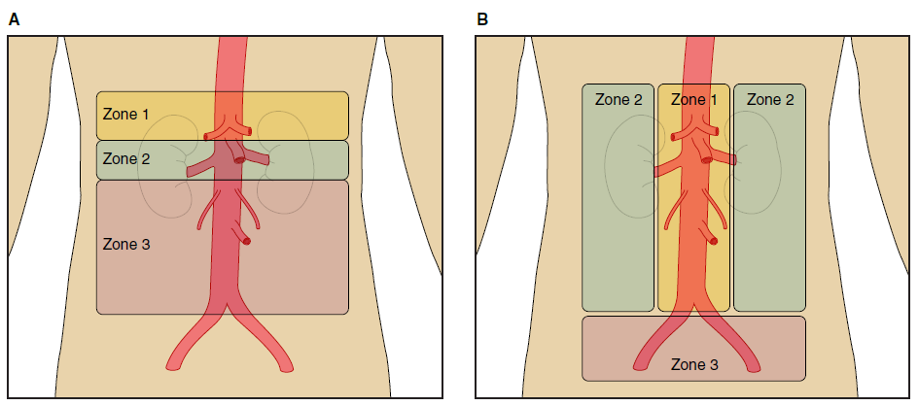
Figure 24. Abdominal Aortic Zones of Injury for Surgical Approaches and Abdominal Zones of Injury Based on Trauma Classification.

Slide 174
Long-Term Management and Surveillance After Blunt Traumatic Aortic Injury (BTAI)
Recommendations for Long-Term Management and Surveillance After BTAI
COR | LOE | Recommendations
2a | C-LD | In patients with BTAI who have undergone aortic repair, surveillance imaging at intervals appropriate for the repair approach and location (see Section 7.8, “Long-Term Management and Surveillance Imaging Following AAS”) is reasonable.
2b | C-LD | In patients with BTAI who have not undergone repair, surveillance imaging with a CT at 1 month, 6 months, and 12 months after the diagnosis and, if stable, at appropriate intervals thereafter (depending on the type and extent of the injury), may be reasonable.

Slide 175
Long-Term Surveillance Imaging After Aortic Dissection and IMH
Recommendations for Long-Term Surveillance Imaging After Aortic Dissection and IMH Referenced studies that support the recommendations are summarized in the Online Data Supplement.
COR | LOE | Recommendations
1 | B-NR | In patients who have had an acute aortic dissection and IMH treated with either open or endovascular aortic repair and have residual aortic disease, surveillance imaging with a CT (or MRI) is recommended after 1 month, 6 months, and 12 months and then, if stable, annually thereafter.
1 | B-NR | In patients who have had an acute aortic dissection and IMH that was managed with medical therapy alone, surveillance imaging with a CT (or MRI) is recommended after 1 month, 6 months, and 12 months and then, if stable, annually thereafter.

Slide 176
Long-Term Management After Acute Aortic Dissection and IMH
Recommendation for Long-Term Management After Acute Aortic Dissection and IMH Referenced studies that support the recommendation are summarized in the Online Data Supplement.
COR | LOE | Recommendation
1 | B-NR | In patients with a previous acute aortic dissection and IMH, whether initially treated medically or with intervention, who have chronic residual TAD and an aneurysm with a total aortic diameter of ≥5.5 cm, elective thoracic aortic repair is recommended.

Slide 177
Long-Term Management and Surveillance for PAUs
Recommendations for Long-Term Management and Surveillance for PAUs
COR | LOE | Recommendations
2a | C-LD | In patients with a PAU who have undergone aortic repair, surveillance imaging at intervals appropriate for the repair approach and location (see Section 6.5.6, “Surveillance After Aneurysm Repair”) is reasonable.
2a | C-LD | In patients with a PAU that is being managed medically, surveillance imaging with a CT is reasonable at 1 month after the diagnosis and, if stable, every 6 months for 2 years, and then at appropriate intervals thereafter (depending on patient age and PAU characteristics).

Slide 178
Pregnancy in Patients With Aortopathy

Slide 179
Counseling and Management of Aortic Disease in Pregnancy and Postpartum
Recommendations for Counseling and Management of Aortic Disease in Pregnancy and Postpartum
COR | LOE | Recommendations
Prepregnancy |  | Prepregnancy
1 | C-LD | In patients with genetic aortopathies attributable to syndromic (Marfan syndrome, Loeys-Dietz syndrome, vascular Ehlers-Danlos syndrome) and nsHTAD and who are contemplating pregnancy, genetic counseling before pregnancy to discuss the heritable nature of their condition is recommended.
1 | C-LD | In patients with syndromic and nsHTAD, Turner syndrome, BAV with aortic dilation, and other aortopathy conditions, aortic imaging (with TTE, MRI or CT, or both as appropriate) before pregnancy is recommended to determine aortic diameters.
1 | C-LD | In patients with syndromic and nsHTAD, Turner syndrome, BAV with aortic dilation, and other aortopathy conditions, who are contemplating pregnancy, counseling about the risks of aortic dissection related to pregnancy is recommended.

Slide 180
Counseling and Management of Aortic Disease in Pregnancy and Postpartum (con’t.)
During Pregnancy
2a | C-EO | In patients with aortic aneurysms, or at increased risk of aortic dissection, or both, it is recommended that pregnancy be managed by a multidisciplinary team including a maternal fetal medicine specialist and cardiologist, and, if logistically feasible, that delivery be planned in a hospital where the capability for emergency aortic repair is available.
1 | C-LD | In patients with aortopathies who are pregnant, guideline-directed treatment of hypertension is recommended.
1 | C-EO | In patients with syndromic and nsHTAD, beta-blocker therapy during pregnancy and postpartum is recommended, unless contraindicated.
1 | C-LD | In pregnant patients with an aortopathic condition or a dilated aortic root or ascending aorta, surveillance TTE to monitor aortic diameters and aortic valve function is recommended each trimester and again several weeks postpartum, although imaging may be more frequent depending on aortic diameter, aortic growth rate, and underlying condition.
1 | C-LD | In pregnant patients with aortic disease who require surveillance imaging of the aortic arch, descending, abdominal aorta, or all 3, MRI without gadolinium is recommended over CT to avoid radiation exposure to the fetus.

Slide 181
Delivery in Pregnant Patients With Aortopathy
Recommendations for Delivery in Pregnant Patients With Aortopathy
COR | LOE | Recommendations
1 | C-EO | In pregnant patients with a history of chronic aortic dissection, cesarean delivery is recommended.
1 | C-EO | In pregnant patients with an aortopathy and an aortic diameter of <4.0 cm, vaginal delivery (when otherwise appropriate) is recommended.

Slide 182
Delivery in Pregnant Patients With Aortopathy (con’t.)
2a | C-EO | In pregnant patients with a diameter of the aortic root, ascending aorta, or both, of ≥ 4.5 cm, cesarean delivery is reasonable.
2b | C-EO | In pregnant patients with a diameter of the aortic root, ascending aorta, or both, of 4.0 cm to 4.5 cm, vaginal delivery with regional anesthesia, expedited second stage, and assisted delivery may be reasonable.
2b | C-EO | In pregnant patients with syndromic and nsHTAD, and a diameter of the aortic root, ascending aorta, or both, of 4.0 cm to 4.5 cm, cesarean delivery may be considered.

Slide 183
Surgery Before Pregnancy in Women With Aortic Disease
Recommendations for Surgery Before Pregnancy in Women With Aortic Disease
COR | LOE | Recommendations
1 | C-LD | In patients with Marfan syndrome and an aortic root diameter of >4.5 cm, aortic surgery before pregnancy is recommended.
2b | C-LD | If the aortic root diameter is 4.0 cm to 4.5 cm, aortic surgery before pregnancy may be considered, especially if there are risk factors for aortic dissection (ie, rapid aortic growth of ≥0.3 cm/y or a family history of aortic dissection).
2a | C-EO | In patients with Loeys-Dietz syndrome attributable to pathogenic variants in TGFB2 or TGFB3 and an aortic diameter of ≥4.5 cm, surgery before pregnancy is reasonable.
2b | C-EO | If the Loeys-Dietz syndrome is attributable to pathogenic variants in TGFBR1, TGFBR2, or SMAD3, and the aortic diameter is ≥4.0 cm, surgery before pregnancy may be considered.

Slide 184
Surgery Before Pregnancy in Women With Aortic Disease (con’t.)
1 | C-EO | In patients with nsHTAD and an aortic diameter of ≥4.5 cm, surgery before pregnancy is recommended.
2b | C-EO | If the aortic diameter is 4.0 cm to 4.4 cm, surgery before pregnancy may be considered, depending on the molecular diagnosis, family history, and aortic growth rate.
1 | C-LD | In patients with Turner syndrome and ASI of ≥2.5 cm/m², surgery before pregnancy is recommended.
1 | C-EO | In patients with a BAV (in the absence of Turner syndrome or an HTAD) and an aortic diameter of ≥5.0 cm, surgery before pregnancy is recommended.
1 | C-EO | In patients with sporadic aortic root aneurysms, ascending aortic aneurysms, or both and a diameter of ≥5.0 cm, surgery before pregnancy is recommended.

Slide 185
Table 34. Prophylactic Aortic Surgery Before Pregnancy in Women With Aortopathic Conditions
Condition | Surgical Threshold Before Pregnancy* by Aortic Diameter (cm) or Aortic Size Index (cm/m²)
Marfan syndrome | >4.5 cm
Marfan syndrome with risk factors (rapid aortic growth of ≥0.3 cm/y; family history of aortic dissection) | 4.0–4.5 cm
Loeys-Dietz syndrome (attributable to pathogenic variants in TGFBR1, TGFBR2, or SMAD3) | ≥4.0 cm
COR colors correspond to Table 1

Slide 186
Table 34. Prophylactic Aortic Surgery Before Pregnancy in Women With Aortopathic Conditions (con’t.)
Loeys-Dietz syndrome (attributable to pathogenic variants in TGFB2 or TGFB3) | ≥4.5 cm
Nonsyndromic heritable thoracic aortic disease | ≥4.5 cm†
Turner syndrome | ≥2.5 cm/m²
Bicuspid aortic valve | ≥5.0 cm‡
COR colors correspond to Table 1
†Aortic dissection related to pregnancy has occurred at small aortic diameters in women with ACTA2 and MYLK pathogenic variants. Prophylactic aortic surgery before pregnancy at smaller aortic diameters may be reasonable in these conditions and other nonsyndromic heritable thoracic aortic disease and may be informed by the molecular diagnosis, family history, and aortic growth rate.
‡Prophylactic aortic surgery may be considered at smaller aortic diameters depending on body size, aortic growth rate, and family history.

Slide 187
Pregnancy in Patients With Aortopathy: Aortic Dissection and Aortic Surgery in Pregnancy
Recommendations for Pregnancy in Patients With Aortopathy: Aortic Dissection and Aortic Surgery in Pregnancy
COR | LOE | Recommendations
1 | C-LD | In patients experiencing an acute type A aortic dissection during the first or second trimester of pregnancy, urgent aortic surgery with fetal monitoring is recommended.
1 | C-LD | In patients experiencing an acute type A aortic dissection during the third trimester of pregnancy, urgent cesarean delivery immediately followed by aortic surgery is recommended.
1 | C-EO | In patients experiencing an acute type B aortic dissection during pregnancy, medical therapy is recommended, unless endovascular or surgical therapy is required to manage acute complications.
2b | C-EO | In patients with progressive aortic dilation during pregnancy, prophylactic aortic surgery may be considered, depending on individual circumstances.

Slide 188
Other Aortic Conditions

Slide 189
Inflammatory Aortitis: Diagnosis and Treatment of Takayasu Arteritis and Giant Cell Arteritis (GCA)
Recommendations for Inflammatory Aortitis: Diagnosis and Treatment of Takayasu Arteritis and GCA Referenced studies that support the recommendations are summarized in the Online Data Supplement.
COR | LOE | Recommendations
Diagnosis
1 | C-LD | In patients with large vessel vasculitis (LVV), prompt evaluation of the entire aorta and branch vessels with MRI or CT, with or without 18F-FDG positron emission tomography (FDG-PET), is recommended.

Slide 190
Inflammatory Aortitis: Diagnosis and Treatment of Takayasu Arteritis and Giant Cell Arteritis (GCA) (con’t.)
Treatment
1 | B-NR | In patients with active GCA or Takayasu arteritis, initial medical therapy should include high-dose glucocorticoids.
1 | B-R | In patients with GCA who have evidence of active aortitis, tocilizumab is recommended as adjunctive therapy to glucocorticoids, with methotrexate as an alternative.
1 | C-LD | In all patients with Takayasu arteritis, nonbiological disease-modifying anti-rheumatic drugs (DMARD) should be given in combination with glucocorticoids.

Slide 191
Inflammatory Aortitis: Diagnosis and Treatment of Takayasu Arteritis and Giant Cell Arteritis (GCA) (con’t.)
1 | C-LD | In patients with active GCA or Takayasu arteritis, treatment efficacy should be periodically assessed by monitoring inflammatory serum markers (C-reactive protein and erythrocyte sedimentation rate), imaging with CT, MRI, or FDG-PET, and clinical symptoms.
2a | C-LD | In patients with GCA or Takayasu arteritis who are in remission, elective endovascular or open surgical intervention is reasonable to treat aortic and branch vessel complications.
2a | C-EO | In patients with GCA or Takayasu arteritis and aortic involvement who are in remission, annual surveillance imaging with CT, MRI, or FDG-PET is reasonable.

Slide 192
Table 35. Diagnostic Criteria for Inflammatory Aortitis
Names | Criteria Used in Diagnosis/Source | When Is Diagnosis Established?
Takayasu arteritis | Age of onset <40 y | ≥3 criteria are present (sensitivity 90.5%; specificity 97.8%)
 | Intermittent claudication
 | Diminished brachial artery pulse
 | Subclavian artery or aortic bruit
 | Systolic BP variation of >10 mm Hg between arms
 | Aortographic evidence of aorta or aortic branch stenosis

Slide 193
Table 35. Diagnostic Criteria for Inflammatory Aortitis (con’t.)
Giant cell arteritis | Age >50 y | ≥3 criteria are present (sensitivity >90%; specificity >90%)
 | Recent-onset localized headache
 | Temporal artery tenderness or pulse attenuation
 | Elevated erythrocyte sedimentation rate >50 mm/h
 | Arterial biopsy shows necrotizing vasculitis

Slide 194
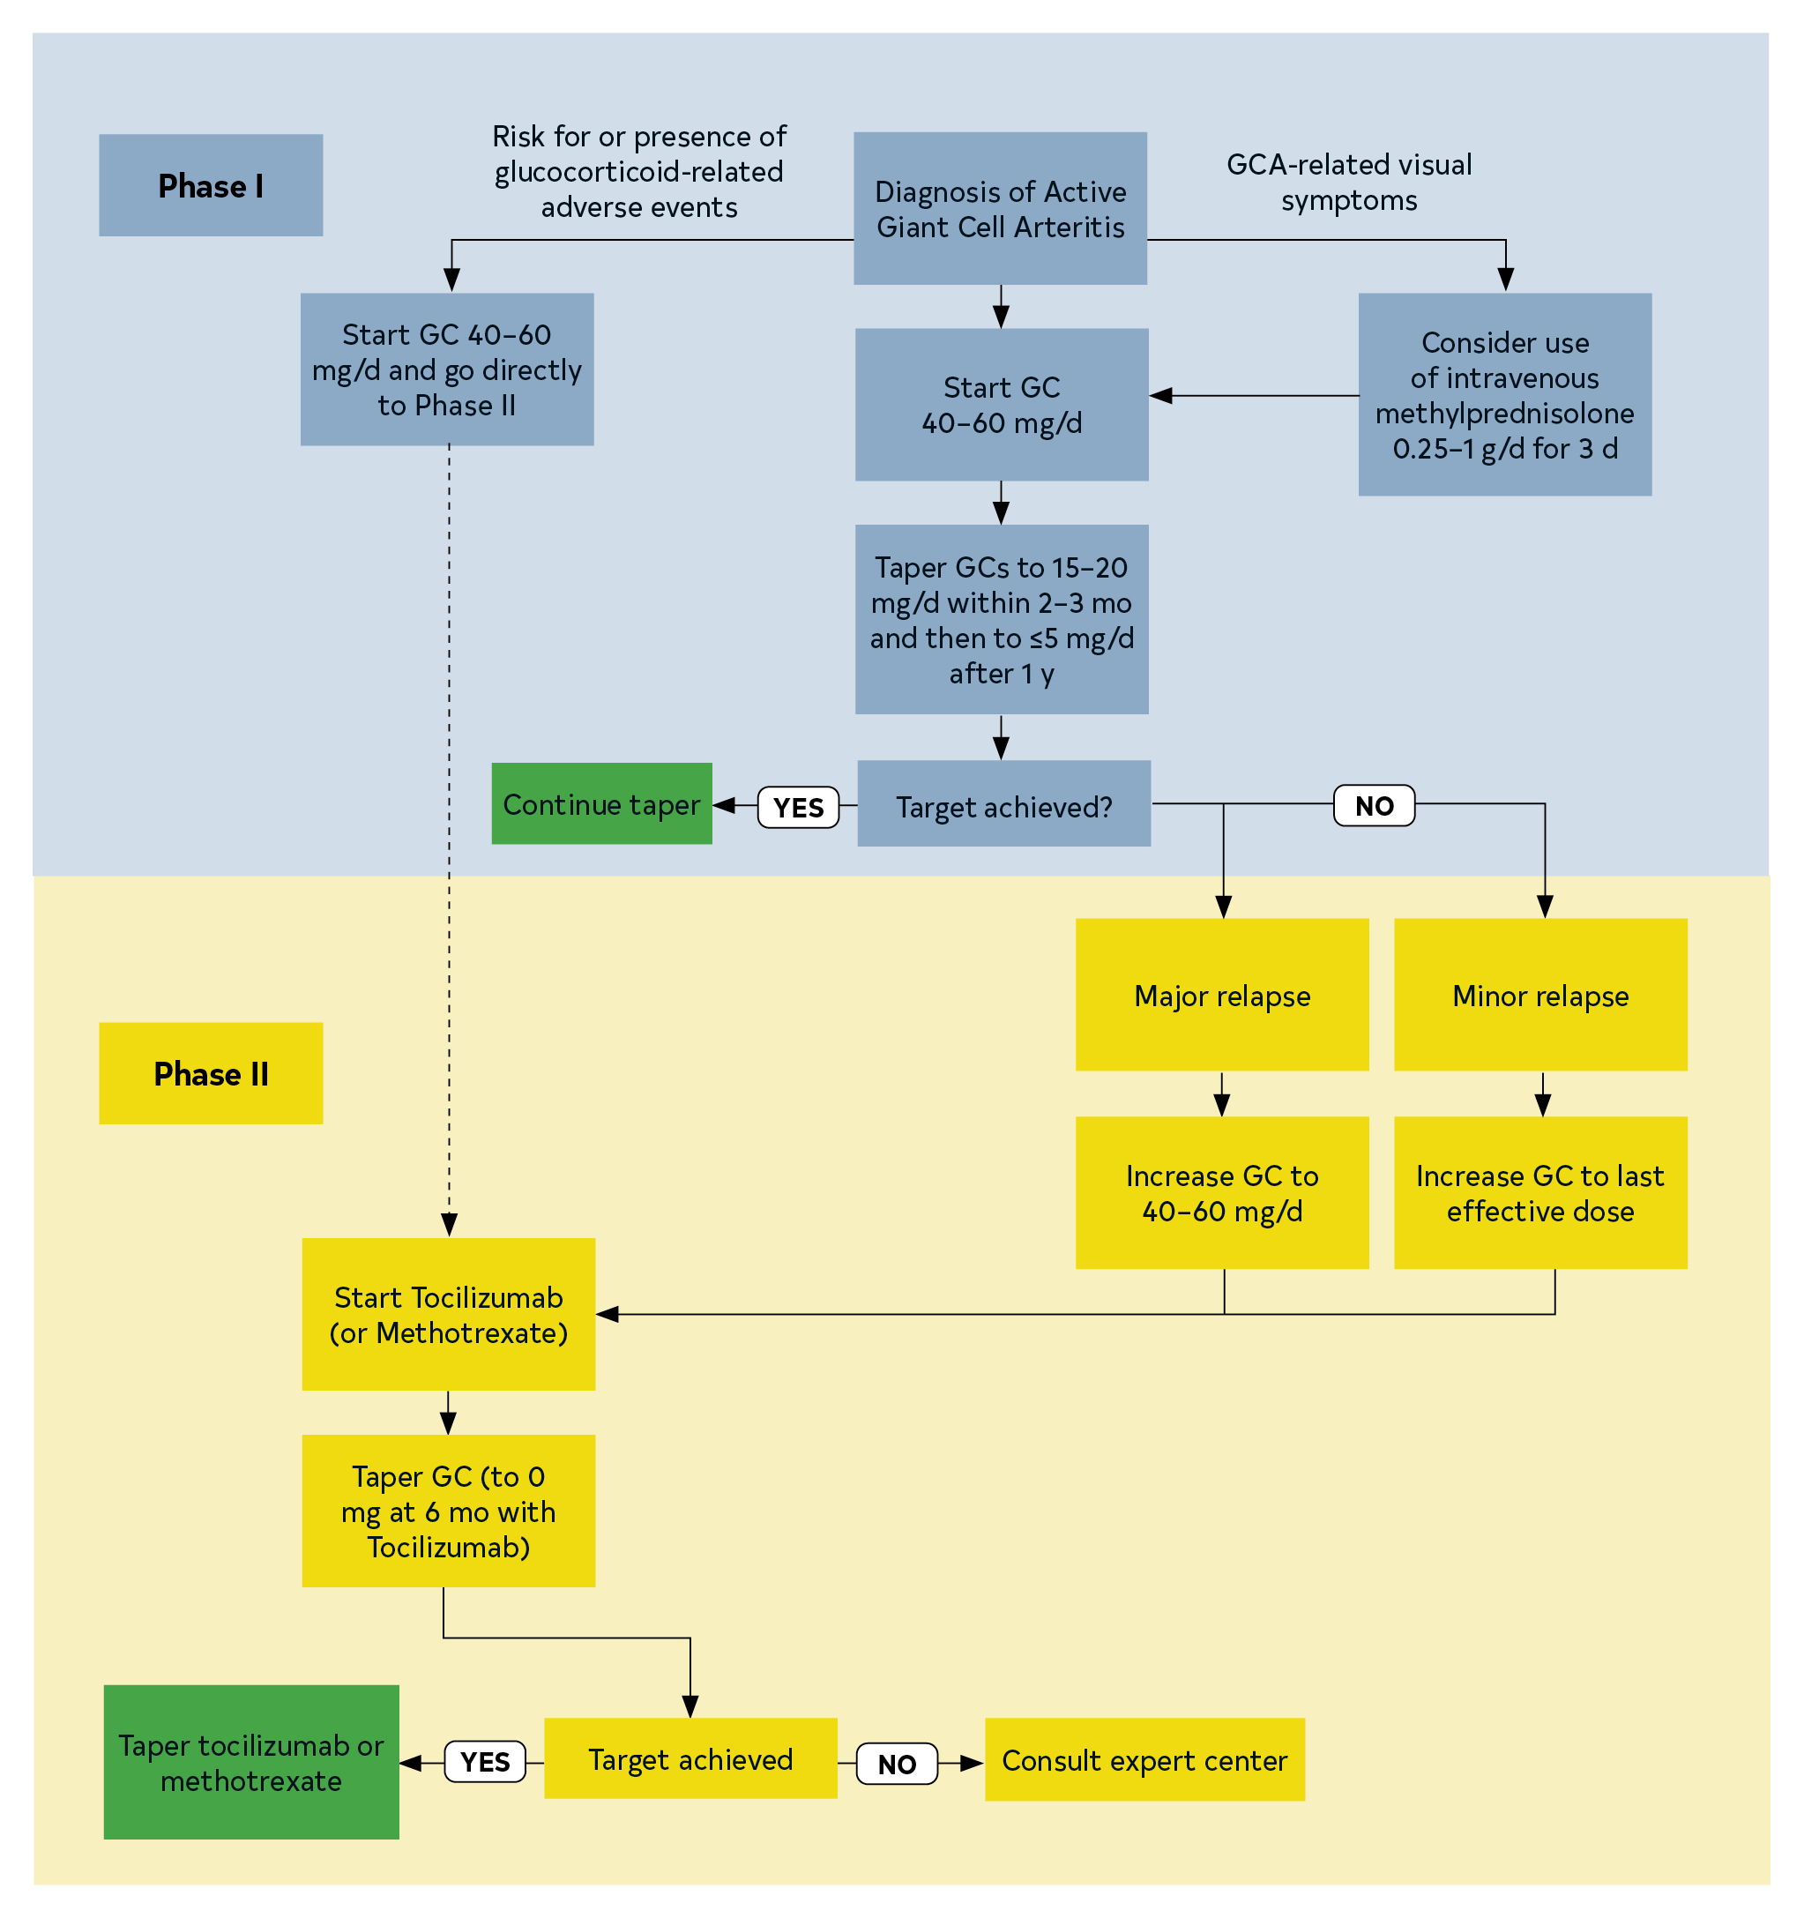
Figure 25. The 2018 European Alliance of Associations for Rheumatology (EULAR; formerly European League Against Rheumatism) Recommended Algorithms for the Pharmacological Treatment of Giant Cell Arteritis.
GC indicates glucocorticoids; GCA, giant cell arteritis; and TNF, tumor necrosis factor.

Slide 195
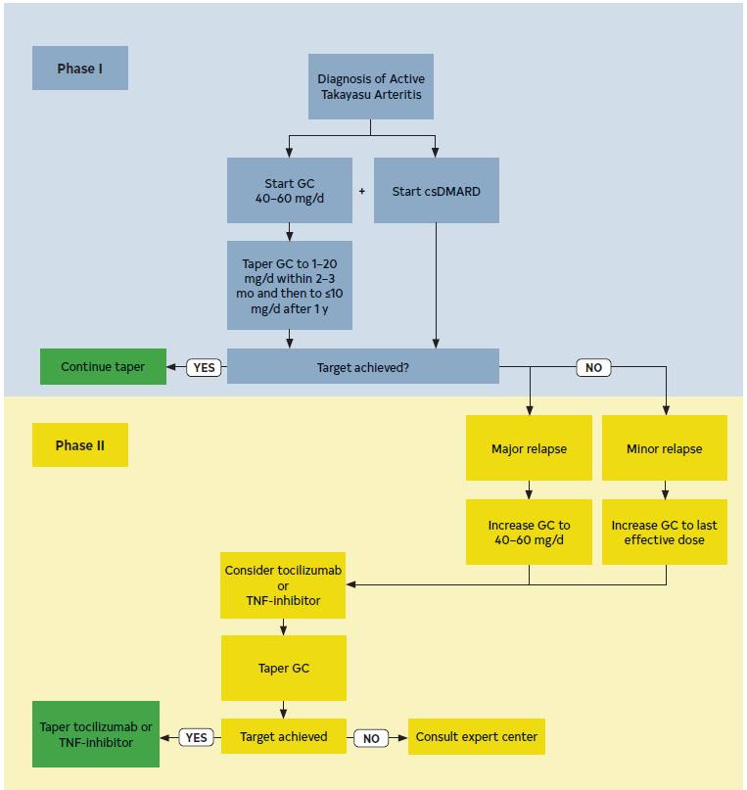
Figure 26. The 2018 European Alliance of Associations for Rheumatology (EULAR; formerly European League Against Rheumatism) recommended algorithms for the pharmacological treatment of Takayasu arteritis.
csDMARD indicates conventional synthetic disease modifying antirheumatic drug; GC, glucocorticoids; and TNF, tumor necrosis factor.

Slide 196
Diagnosis and Management of Infection of the Native Aorta
Recommendations for Diagnosis and Management of Infection of the Native Aorta
COR | LOE | Recommendations
1 | C-EO | In patients with infectious aortitis and associated aneurysms or dissection of the thoracic or abdominal aorta, open surgical repair is recommended.
2b | C-LD | In select patients, treatment with endovascular repair may be considered.

Slide 197
Diagnosis and Management of Infection of the Native Aorta (con’t.)
2a | C-EO | In patients with infectious aortitis complicated by rupture, either open or endovascular repair is reasonable, based on the patient’s status at presentation and institutional expertise.
2b | C-EO | In patients with infectious aortitis, intravenous antimicrobial therapy of at least 6 weeks’ duration may be considered, with lifelong suppressive therapy in select cases not amenable to interventional repair or who have recurrent infection.

Slide 198
Table 36. Management of Aortic Mycotic Aneurysm: Comparison of Resection and Extra-Anatomic Reconstruction, In Situ Reconstruction, or Endovascular Device Repair
Procedure | Potential Indications* | Advantages | Disadvantages
Extra-anatomic reconstruction | Infrarenal location with gross purulence, psoas or retroperitoneal abscess, vertebral osteomyelitis, inadequate response to antibiotic therapy, selected aortoenteric fistulae | Avoids placement of foreign body in infected area | Not technically feasible for thoracic, suprarenal, or visceral location or for emergency use Long operating time Long-term patency rates low Stump blowout Limb ischemia, amputation Reinfection rate higher than for in situ reconstruction Ischemic colitis
*Potential indication; must be individualized for each patient.

Slide 199
Table 36. Management of Aortic Mycotic Aneurysm: Comparison of Resection and Extra-Anatomic Reconstruction, In Situ Reconstruction, or Endovascular Device Repair (con’t.)
In situ reconstruction | Thoracic, suprarenal, infrarenal, or visceral location Selected aortoenteric fistulae | More versatile than extra- anatomic: fewer long-term complications, higher patency rates, lower recurrent infection rate, shorter operating time Polyester grafts† available for emergency surgery Selected aortoenteric fistulae | Theoretical risk of infection because of interposition of foreign material in infected site
†Polyester grafts, rifampin-soaked or silver-coated; less experience reported with cryopreserved arterial allografts or venous autografts.

Slide 200
Table 36. Management of Aortic Mycotic Aneurysm: Comparison of Resection and Extra-Anatomic Reconstruction, In Situ Reconstruction, or Endovascular Device Repair (con’t.)
Endovascular device repair | Bridge procedure‡: hemodynamic instability, uncontrolled bleeding, rupture or impending rupture, selected patients with aortocentric fistulae, patients who are not fit for open surgery | Emergency stabilization Low early morbidity, mortality Less invasive No cross-clamping of aorta: spinal cord injury, reperfusion injury | Persistent infections and device infections Higher long-term morbidity, mortality with device retention Requires device explanation, reconstruction
‡Bridge procedure, used to stabilize patients until device explanation and arterial reconstruction.

Slide 201
Diagnosis and Management of Prosthetic Aortic Graft Infection
Recommendations for Diagnosis and Management of Prosthetic Aortic Graft Infection Referenced studies that support the recommendations are summarized in the Online Data Supplement.
COR | LOE | Recommendations
Diagnosis
2a | B-NR | In patients with a prosthetic aortic graft, who have signs and symptoms or culture evidence of unexplained infection or have unexplained gastrointestinal bleeding, cross-sectional imaging is reasonable to evaluate for an underlying aortic graft infection.

Slide 202
Diagnosis and Management of Prosthetic Aortic Graft Infection (con’t.)
Treatment
2a | B-NR | In patients with an infected prosthetic aortic graft who are hemodynamically stable and have appropriate anatomy, it is reasonable to perform open surgery with either in situ reconstruction or extra-anatomic bypass.
2a | B-NR | In patients with an infected prosthetic aortic graft who are hemodynamically unstable, it is reasonable to perform open surgery with either explant or in situ reconstruction.
2a | C-LD | In patients with an infected prosthetic aortic graft, endovascular therapy is reasonable, either as bridge therapy in those with hemodynamic instability or as long-term therapy in those who are unsuitable candidates for open surgery.

Slide 203
Diagnosis and Management of Prosthetic Aortic Graft Infection (con’t.)
Late Management
1 | C-LD | In patients who have undergone treatment of an acute prosthetic aortic graft infection, targeted intravenous antimicrobial therapy of at least 6 weeks’ duration, with prolonged suppressive oral therapy in select cases, plus a consultation and follow-up with an infectious disease specialist, is recommended.
2b | C-LD | In patients with an infected prosthetic aortic graft and either an extensive perigraft abscess or an infection caused by methicillin-resistant S. aureus, Pseudomonas aeruginosa, or a multidrug-resistant microorganism, or who have undergone in situ reconstruction, lifelong suppressive oral antimicrobial therapy may be considered after the initial course of therapy.

Slide 204
Atherosclerotic Disease
Recommendations for Atherosclerotic Disease
COR | LOE | Recommendations
1 | C-LD | In patients with aortic atherosclerotic disease and concomitant coronary artery disease, PAD or both, it is recommended to prescribe antiplatelet therapy, anticoagulant therapy or both, guided by the clinical setting.
2a | C-LD | In patients with aortic atherosclerotic disease and risk factors for confirmed coronary artery disease, it is reasonable to prescribe a moderate- or high-intensity statin.
2b | C-LD | In patients with aortic atheromas of a thickness ≥4 mm, statin therapy may be reasonable.

Slide 205
Coarctation of the Aorta
Recommendations for CoA Referenced studies that support the recommendations are summarized in the Online Data Supplement.
COR | LOE | Recommendations
1 | B-NR | In patients with CoA, including those who have undergone surgical or endovascular intervention, an MRI or CT is recommended for initial, surveillance, and follow-up aortic imaging.
1 | C-EO | In patients with CoA, BPs should be measured in both arms and one of the lower extremities.

Slide 206
Coarctation of the Aorta (con’t.)
1 | B-NR | In patients with significant native or recurrent CoA (Table 37) and hypertension, endovascular stenting or open surgical repair of the coarctation is recommended.
1 | C-EO | In patients with CoA, guideline-directed medical therapy is recommended for the treatment of hypertension.
2b | B-NR | In adult patients with CoA, screening for intracranial aneurysms by MRI or CT may be reasonable.

Slide 207
Table 37. Criteria for Significant CoA
The presence of significant CoA is based on evidence of upper extremity hypertension (at rest, on ambulatory BP monitoring, or with pathologic blood pressure response to exercise) or left ventricular hypertrophy and evidence for 1 of these gradient measurements:
A noninvasive blood pressure difference of >20 mm Hg between the upper and lower extremities
A peak-to-peak gradient of >20 mm Hg across the coarct by catheterization; or a peak-to-peak gradient of >10 mm Hg across the coarct by catheterization in the setting of decreased left ventricular systolic function or significant collateral flow
A mean gradient of >20 mm Hg across the coarct by Doppler echocardiography; or a mean gradient of >10 mm Hg across the coarct by Doppler echocardiography in the setting of decreased left ventricular systolic function or significant collateral flow
CoA indicates coarctation of the aorta.

Slide 208
Aberrant Subclavian Artery, Kommerell’s Diverticulum
Recommendations for ASCA, Kommerell’s Diverticulum
COR | LOE | Recommendations
2a | C-LD | In patients discovered to have an ASCA in the absence of thoracic aortic imaging, dedicated imaging to assess for TAA is reasonable.
2b | C-LD | In patients with Kommerell’s diverticulum, depending on patient anatomy and comorbidities, repair may be reasonable when the diverticulum orifice is >3.0 cm, the combined diameter of the diverticulum and adjacent descending aorta is >5.0 cm, or both (Figure 27).

Slide 209
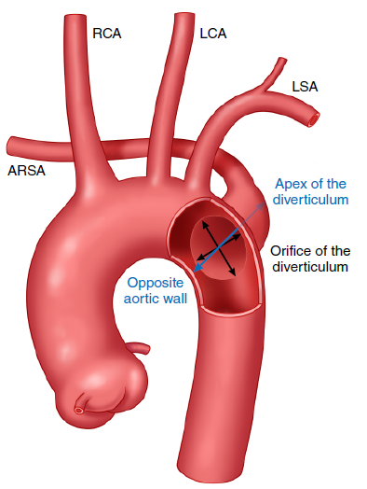
Figure 27. Measurements of Kommerell’s diverticulum.
ARSA indicates aberrant right subclavian artery; LCA, left common carotid artery; LSA, left subclavian artery; and RCA, right common carotid artery.

Slide 210
Aberrant Left Vertebral Artery Origin
Recommendation for Aberrant Left Vertebral Artery Origin
COR | LOE | Recommendation
2a | C-EO | In patients with an aberrant left vertebral artery origin arising directly from the thoracic aorta who require aortic repair involving reconstruction or coverage of the vertebral artery origin, revascularization of the vertebral artery is reasonable.

Slide 211
Bovine Arch (Common Innominate and Left Carotid Artery)
Recommendation for Bovine Arch (Common Innominate and Left Carotid Artery)
COR | LOE | Recommendation
2b | C-LD | In patients with bovine arch (common innominate and left carotid artery), imaging to assess for TAA may be reasonable.

Slide 212
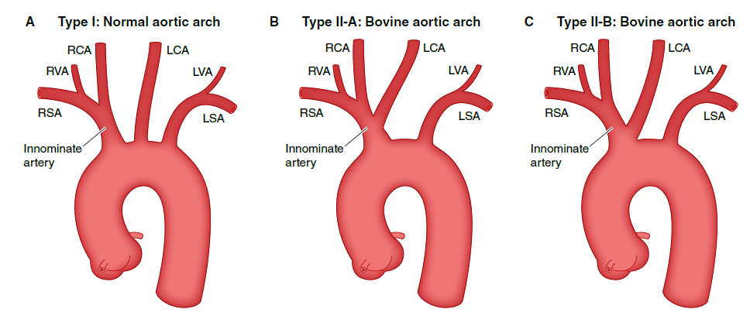
Figure 28. Normal and bovine aortic arch configurations.
LCA indicates left common carotid artery; LSA, left subclavian artery; LVA, left vertebral artery; RCA, right common carotid artery; RSA, right subclavian artery; and RVA, right vertebral artery.

Slide 213
Physical Activity and Quality of Life

Slide 214
Physical Activity and Quality of Life
Recommendations for Physical Activity and Quality of Life
COR | LOE | Recommendations
1 | C-EO | For patients with significant aortic disease, education and guidance should be provided about avoiding intense isometric exercises (eg, heavy weightlifting or activities requiring the Valsalva maneuver), burst exertion and activities, and collision sports.
1 | C-EO | For patients who have undergone surgery for aortic aneurysm or dissection, postoperative cardiac rehabilitation is recommended.

Slide 215
Physical Activity and Quality of Life (con’t.)
2a | C-LD | In patients with thoracic or abdominal aortic aneurysms whose BP is adequately controlled, it is reasonable to encourage 30 to 60 minutes of mild-to-moderate intensity aerobic activity at least 3 to 4 days per week.
2a | C-LD | For patients with clinically significant aortic disease, it is reasonable to screen for anxiety, depression, and posttraumatic stress disorder and, when indicated, provide resources for support; it is also reasonable to provide education and resources to minimize patients’ concerns, support optimal decision-making, and enhance quality of life.

Slide 216
Abbreviation | Meaning/Phrase
3D | 3-dimensional
AAA | abdominal aortic aneurysm
AAS | acute aortic syndrome
ACEI | angiotensin-converting enzyme inhibitor
AHI | aortic height index
AR | aortic regurgitation
ARB | angiotensin receptor blocker
ASCA | aberrant subclavian artery
ASCVD | atherosclerotic cardiovascular disease
ASI | aortic size index
AVR | aortic valve replacement
Abbreviations

Slide 217
BAAI | blunt traumatic abdominal aortic injury
BAV | bicuspid aortic valve
BP | blood pressure
BSA | body surface area
BTAI | blunt traumatic aortic injury
BTTAI | blunt traumatic thoracic aortic injury
CMR | cardiac magnetic resonance
CoA | coarctation of the aorta
CT | computed tomography
CTA | computed tomographic angiography
Abbreviations (con’t.)

Slide 218
DBP | diastolic blood pressure
DMARD | disease-modifying anti-rheumatic drug
ECG | electrocardiogram
EVAR | endovascular abdominal aortic aneurysm repair
FID | focal intimal disruption
FDA | US Food and Drug Administration
FDG-PET | fluorodeoxyglucose–positron emission tomography
FEVAR | fenestrated endovascular aortic repair
GCA | giant cell arteritis
HRQOL | health-related quality of life
HTAD | heritable thoracic aortic disease
Abbreviations (con’t.)

Slide 219
ICU | intensive care unit
IMH | intramural hematoma
IRAD | International Registry of Acute Aortic Dissection
LDL | low-density lipoprotein
LVV | large vessel vasculitis
MR | magnetic resonance
MRA | magnetic resonance angiography
MRI | magnetic resonance imaging
nsHTAD | nonsyndromic heritable thoracic aortic disease
PAD | peripheral artery disease
PAU | penetrating atherosclerotic ulcer
PET | positron emission tomography
Abbreviations (con’t.)

Slide 220
rAAA | ruptured abdominal aortic aneurysm
RCT | randomized controlled trial
REBOA | resuscitative endovascular balloon occlusion of the aorta
rEVAR | endovascular repair for rAAA
SMA | superior mesenteric artery
SBP | systolic blood pressure
SCI | spinal cord injury
TAA | thoracic aortic aneurysm
TAAA | thoracoabdominal aortic aneurysm
TAAD | thoracic aortic aneurysm and dissection
Abbreviations (con’t.)

Slide 221
Abbreviations (con’t.)
TAD | thoracic aortic disease
TAR | total arch replacement
TEE | transesophageal echocardiography
TEVAR | thoracic endovascular aortic repair
TTE | transthoracic echocardiography
VSRR | valve-sparing root replacement

