Slide 1
Baroreflex Activation Therapy for the Treatment of Heart Failure with a Reduced Ejection Fraction
William Abraham, MD¹, Michael Zile, MD², Fred Weaver, MD³, Christian Butter, MD⁴, Anique Ducharme, MD⁵, Marcel Halbach, MD⁶, Didier Klug, MD⁷, Eric Lovett, PhD⁸, Jochen Müller-Ehmsen, MD⁹, Jill Schafer, MS¹⁰, Michele Senni, MD¹¹, Vijay Swarup, MD¹², Rolf Wachter, MD¹³, William Little, MD¹⁴;
on behalf of the BAT for HFrEF Study Group
¹Division of Cardiovascular Medicine, The Ohio State University, Columbus, OH, USA; ²Medical University of South Carolina, Charleston, South Carolina; Ralph H. Johnson Department of Veterans Affairs Medical Center, Charleston, South Carolina, USA; ³Division of Vascular Surgery and Endovascular Therapy, Keck School of Medicine, University of Southern California, Los Angeles, California, USA; ⁴Department of Cardiology, Immanuel Heart Center Bernau - Medical School Brandenburg, Bernau, Germany; ⁵Montreal Heart Institute, University of Montréal, Montreal, Quebec, Canada; ⁶Department of Internal Medicine III, University Hospital of Cologne, Cologne, Germany; ⁷Department of Cardiology A, University Hospital, Lille, France; ⁸Department of Research, CVRx, Inc., Minneapolis, Minnesota, USA; ⁹Department of Medicine #, Asklepios Klinik Altona, Hamburg, Germany; ¹⁰Department of Statistics, NAMSA, Inc., Minneapolis, Minnesota, USA; ¹¹Cardiovascular Department, Ospedale Papa Giovanni XXIII, Bergamo, Italy; ¹²Department of Electrophysiology, Arizona Heart Hospital, Phoenix, Arizona, USA; ¹³Clinic for Cardiology and Pneumology, University Medicine Göttingen and German Cardiovascular Research Center (DZHK), Göttingen, Germany; ¹⁴Division of Cardiology, University of Mississippi Medical Center, Jackson, Mississippi, USA

Slide 2
Background
Increased sympathetic and decreased parasympathetic activity contribute to heart failure symptoms and disease progression
Baroreflex activation therapy (BAT) results in centrally mediated reduction of sympathetic outflow and increased parasympathetic activity
Preliminary observations suggest that BAT improves clinical status and outcomes in patients with heart failure and a reduced ejection fraction (HFrEF)¹
¹Gronda E, et al. Eur J Heart Fail 2014; 16:977-983.

Slide 3
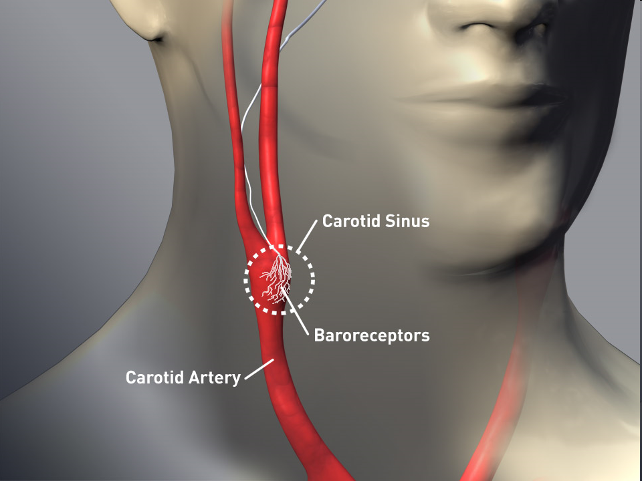

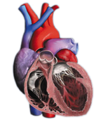
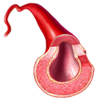
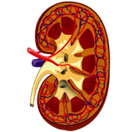
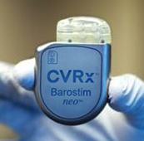
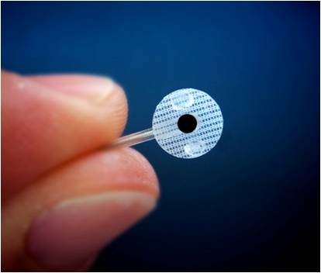
The Baroreflex as a Therapeutic Target
Carotid Baroreceptor Stimulation
Integrated Autonomic Nervous System Response
Inhibits Sympathetic Activity
Enhances Parasympathetic Activity
↓ HR
↓ Remodeling
↑ Vasodilation
↓ Elevated BP
↑ Diuresis
↓ Renin secretion
Notes:
3

Slide 4
BAT for HFrEF: Study Objective and Design
Objective: Evaluate the efficacy and safety of the CVRx neoTM Baroreflex Activation Therapy System in subjects with chronic heart failure and reduced ejection fraction
Design: Multi-national, prospective, randomized controlled trial
  Subjects randomized 1:1 to receive BAT plus optimal medical therapy or optimal medical therapy alone
  Enrollment in the US, Germany, Italy, France and Canada

Slide 5
BAT for HFrEF: Key Enrollment Criteria
NYHA Functional Class III
Left ventricular ejection fraction ≤ 35%
Six-minute hall walk distance 150 - 400 m
On stable optimal medical therapy for at least 4 weeks prior to baseline assessment
No restriction on QRS, concomitant devices*, or AF
* ≥ 6 months of CRT therapy in patients with CRT

Slide 6
BAT for HFrEF: Trial Oversight
Oversight | Details
Data Monitoring Committee (DMC) | Full review every 6 months
Heart Failure Steering Committee | Biweekly meetings
Independent Clinical Monitors | 100% source verification
Clinical Events Committee | Hospitalization adjudication
Independent Biostatistician | All statistical analyses
Adverse Event Committee | Adverse event adjudication

Slide 7
BAT for HFrEF: Subject Disposition
 |  |  |  |  | Randomized 146
 |  |  | BAT 76 |  |  |  |  | Med Mgmt 70
Activated 71 |  |  | Withdrawn 5 |  |  |  |  | “Activated” 69 |  |  | Death 1
To receive a randomization assignment, the intended date of BAT initiation was identified as the “activation date”
The activation date determined the schedule for all follow-up visits for both Med Mgmt and BAT group

Slide 8
BAT for HFrEF: Baseline Demographics
Variable | BAT (n=71) | Med Mgmt (n=69)
Race: Caucasian | 82% | 90%
Gender: Female | 13% | 16%
NYHA: Class III | 99% | 100%
Age (years) | 64 ± 11 | 66 ± 12
SBP (mmHg) | 115 ± 18 | 119 ± 17
DBP (mmHg) | 72 ± 11 | 73 ± 11
HR (bpm) | 73 ± 11 | 75 ± 12
LVEF (%) | 24 ± 7 | 25 ± 7
eGFR (mL/min) | 58 ± 21 | 59 ± 19
NT-pro BNP (pg/mL)* | 1422 [455, 4559] | 1172 [548, 2558]
6 Minute Hall Walk (m) | 297 ± 79 | 308 ± 85
MN Living with HF QOL† | 51 ± 21 | 43 ± 22
Number of Meds | 4.8 ± 1.6 | 4.4 ± 1.9
Coronary Artery Disease | 66% | 68%
History of Atrial Fibrillation | 45% | 44%
Chronic Kidney Disease | 34% | 25%
HF hospitalizations prior 6 Mo (days/pt/year) | 7.0 ± 21 | 2.4 ± 9
*Median [IQR]
†p≤0.05 between groups

Slide 9
BAT for HFrEF: Baseline Medications
Variable | BAT (n=71) | Med Mgmt (n=69)
Number of Meds | 4.8 | 4.4
ACE/ARB | 80% | 81%
Beta-Blocker | 87% | 85%
Calcium Channel Blocker | 6% | 9%
Digitalis | 21% | 10%
Diuretic† | 93% | 78%
Ivabradine | 4% | 2%
MRA | 59% | 50%
CRT | 34% | 30%
ICD | 89% | 86%
†p≤0.05 between groups

Slide 10
BAT for HFrEF: Primary Safety Endpoint
System- or Procedure-Related Major Adverse Neurological or Cardiovascular Events (MANCE) at 6 months
97% Event-Free Rate
  71 Subjects Implanted
        2 Pocket hematomas (1 and 7 days from implant)

Slide 11
Other System- or Procedure-Related Complications
  No death, stroke, or cranial nerve injury
  All but one* occurred within 7 days of implant and recovered with no residual effect:
        General Surgical
          2 Urinary retention / urinary tract infection
          1 Pneumothorax due to improper subcutaneous needle placement
          1 Cervical Neuralgia*
        Cardiovascular (All events began during or within 24 hours of implant)
          2 Non-sustained atrial arrhythmias
          1 Transient bradycardia
          1 Transient hypotension
          1 Transient worsening heart failure

Slide 12
BAT for HFrEF: Other Safety Observations
BAT does not cause hypotension in patients with advanced heart failure
  No reports of symptomatic hypotension
  SBP significantly increased in BAT group; DBP unchanged
BAT is compatible with co-existing cardiac rhythm management devices

Slide 13
BAT for HFrEF: Efficacy Endpoints
Change from baseline to 6 months in
  New York Heart Association Functional Class Rank
  Minnesota Living with Heart Failure Quality of Life Score
  Six-Minute Hall Walk (6-MHW) Distance
  Serum Biomarker (NT-proBNP)
  Left Ventricular Ejection Fraction
  Hospitalizations (Days) for Worsening Heart Failure*
*Baseline defined as 6 months prior to enrollment

Slide 14
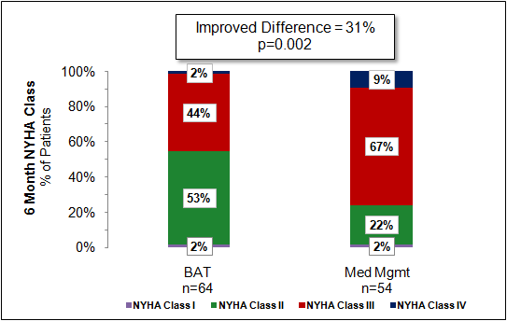
BAT Significantly Improves NYHA Class

Slide 15
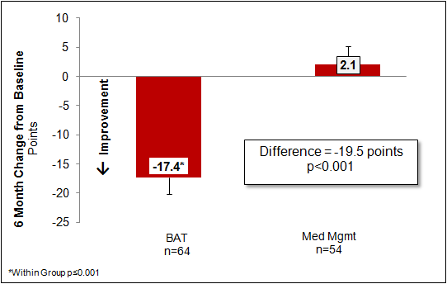
BAT Significantly Improves Quality of Life Score

Slide 16
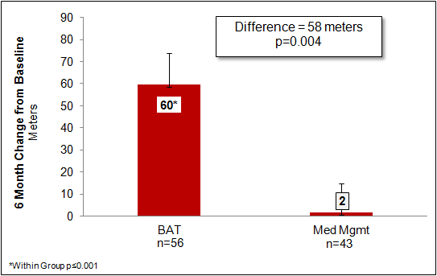
BAT Significantly Improves 6-MHW Distance

Slide 17
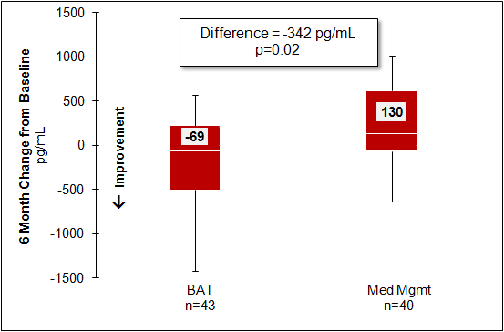
BAT Significantly Reduces NT-proBNP Levels
Non-parametric (median [IQR])

Slide 18
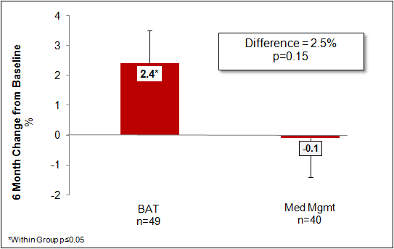
Effect of BAT on LV Ejection Fraction

Slide 19
Effect of BAT on Number of Hospitalization Days for Heart Failure
Global Randomized Clinical Trial – HF Hospitalization
Variable | BAT (n=57) | Med Mgmt (n=50) | Difference Mean ± SE
HF Hospitalization Days per Year
6 Months Pre-Enrollment | 6.95 ± 20.7 | 2.40 ± 8.6 | 4.55 ± 34
6 Months Post Enrollment | 0.67 ± 2.5 | 2.48 ± 7.4 | -1.82* ± 1
Change from Pre to Post | -6.28** ± 2.7 | 0.08 ± 1.7 | -6.36** ± 3
Negative Binomial 6M Post | 0.38 | 2.10 | 82% RR†*
*p≤0.10; **p≤0.05
†RR – Relative Reduction adjusted for 6 months Pre-Enrollment Heart Failure Hospitalizations (Negative Binomial Model)

Slide 20
Concordance of Results Support BAT Efficacy in HFrEF
 | Difference | p value | Favors
NYHA (% impoved) | 31 | < 0.01 | BAT
MLWHF QoL Score (points) | 20 | <0.001 | BAT
6-MHW Distance (m) | 58 | <0.01 | BAT
NT-proBNP (pg/ml)* | 342 | 0.02 | BAT
LVEF (absolute %) | 2.5 | 0.15 | BAT
Hospitalization Days for Worsening HF (days/pt/yr) | 6.4 | 0.05 | BAT
* Median

Slide 21
BAT for HFrEF: Summary
Baroreflex Activation Therapy is safe in HFrEF patients
    No system- or procedure-related deaths
    Few and short-lived complications; complication rate comparable to established HF device therapies
    No hypotension
BAT significantly improves NYHA Class, quality of life score, exercise capacity, NT-proBNP, and possibly the burden of heart failure hospitalizations
If these observations are confirmed in a larger study, BAT may offer a new addition for the treatment of advanced HFrEF patients

Slide 22
Baroreflex Activation Therapy for the Treatment of Heart Failure with a Reduced Ejection Fraction
Manuscript online today at JACC Heart Failure http://heartfailure.onlinejacc.org

