Slide 1
A Randomized Comparison of Everolimus-­ Eluting Absorb Bioresorbable Vascular Scaffolds vs. Everolimus-Eluting Metallic Stents: One-Year Angiographic and Clinical Outcomes from the ABSORB China Trial
Runlin Gao, MD, Yuejin Yang, MD, PhD, Yaling Han, MD, PhD, Yong Huo, MD, Jiyan Chen, MD, Bo Yu, MD, Xi Su, MD, Lang Li, MD, Hai-Chien Kuo, PhD, Shih-Wa Ying, MS, Wai-Fung Cheong, PhD, Yunlong Zhang, MD, Xiaolu Su, MS, Bo Xu, MBBS, Jeffery J. Popma, MD, and Gregg W. Stone, MD on behalf of ABSORB China Investigators

Slide 2
Disclosures
Runlin Gao has received a research grant
from Abbott Vascular

Slide 3
Background
Absorb BVS is designed to provide comparable radial strength and anti-restenotic efficacy to metallic DES in the first year after implantation, and superior long-term benefits after bioresorption of the scaffold
ABSORB China is the first BVS randomized trial with 1-year late loss as the primary endpoint, and was designed for regulatory approval of Absorb BVS in China
Notes:
2

Slide 4
ABSORB China
Prospective, randomized, active control, open-label, multicenter study in 480 subjects enrolled from 24 sites in China
Inclusion: Up to 2 de novo lesions in separate native coronary arteries
Lesion length ≤24 mm, RVD ≥2.5 mm - ≤3.75 mm, %DS ≥50% - <100%
Exclusion: AMI, EF <30%, eGFR <30 mL/min/1.73m²,
LMCA, ostial lesion, excessive vessel tortuosity, heavy calcification,
myocardial bridge, bifurcation with side branch ≥2 mm
1: 1 Randomization
Absorb BVS Treat with single study device Diameters: 2.5, 3.0. 3.5 mm
Lengths: 8, 12, 18, 28 mm
XIENCE V
Treat with single study device Diameters: 2.5, 3.0. 3.5 mm
Lengths: 8, 12, 18, 28 mm
Primary Endpoint: In-Segment Late Loss at 1 Year
in the Per-Treatment-Evaluable (PTE) Population*
* Treated with only the study device (Absorb BVS or XIENCE V), without major pre-specified protocol deviations
Notes:
3

Slide 5
Statistical Methods: Power and Non-Inferiority Testing for 1-Year In-Segment Late Loss
One-sided non-inferiority test
Non-inferiority margin = 0.150 mm
One-sided alpha = 0.025
Randomization ratio = 1:1
True mean is assumed to be the same for both arms
Assumed standard deviation = 0.47 mm for both arms
Power = 80%
Required sample size: 308 subjects
Assuming an angiographic follow-up rate of 70% → 440 pts required
If the non-inferiority p-value from the one-sided asymptotic test is <0.025,
Absorb BVS is regarded as non-inferior to XIENCE V for the primary endpoint
Notes:
4

Slide 6
Study Organization
Principal Investigator:
Runlin Gao, MD
Co-Principal Investigators:
Yuejin Yang, MD, PhD, Yaling Han, MD, PhD, Yong Huo, MD
Study Chairman:
Gregg. W. Stone, MD
Angiographic Core Laboratory:
Beth Israel Deaconess Medical Center, Inc.
Data Safety Monitoring Board:
CCRF (Beijing) Consulting Co. Ltd.
Clinical Events Committee:
CCRF (Beijing) Consulting Co. Ltd.
Data Management:
Abbott Vascular
Sponsor:
Abbott Vascular
Notes:
5

Slide 7

24 Investigational Sites
HARBIN
1st Affiliated Hospt of Harbin Medical University
2nd Affiliated Hospt of Harbin Medical University
BEIJING Fuwai Hospt
Beijing Anzhen Hospt
PLA 301 General Hospt
Chaoyang Hospt
Peking University 1st Hospt
Peking University People’s Hospt
Shenyang PLA General Hospt., Shenyang
Bethune International Peace Hospt of PLA, Shijiazhuang
TIANJIN
Tianjin Wujing Hospt
TEDA Internat’l Cardiovasc. Hospt
The First Affiliated Hospt of Lanzhou University, Lanzhou
JINAN
Shandong Univ. Qilu Hospt Shandong Provincial Hospt
Xijng Hospt of The Fourth Military Medical University, Xian
Wuhan Asia Hospt, Wuhan
SHANGHAI
Ruijin Hospt
Zhongshan Hospt
Nanjing No.1 Hospt, Nanjing
GUANGZHOU
Zhongshan People’s Hospt
Guangdong Provincial Hospt
Zhejiang Shaoyifu Hospt, Hangzhou
The 1st Affiliated Hospt of Guangxi Medical University, Nanning

Slide 8
Investigators and Sites (24)
Dr. Yuejin Yang, Fuwai Hospital, Beijing
Dr. Jiyan Chen, Guangdong Provincial Hospital, Guangzhou
Dr. Bo Yu, Ha Er Bin Medical University No.2, Ha'erbin
Dr. Xi Su, Wuhan Asia Hospital, Wuhan
Dr. Lang Li, The 1st Affiliated Hospital of Guangxi Medical University, Nanning
Dr. Lefeng Wang, Chaoyang Hospital, Beijing
Dr. Xiangqian Qi, TEDA International Cardiovascular Hospital, Tianjin
Dr. Jifu Li, Shangdong Qilu Hospital, Ji'nan
Dr. Yaling Han, Shenyang PLA General Hospital, Shenyang
Dr. Yundai Chen, People's Liberation Army General (301), Beijing
Dr. Haichang, Wang, Xijing Hospital of the Fourth Military Medical University, Xi'an
Dr. Lianqun, Cui, Shangdong Provincial Hospital, Ji'nan
Dr. Ye Tian, Ha Er Bin Medical University No.1 Hospital, Ha'erbin
Dr. Ruiyan Zhang, Shanghai Ruijin Hospital of Shanghai Jiao Tong University School of Medicine, Shanghai
Dr. Guosheng Fu, Zhejiang Shaoyifu Hospital, Hangzhou
Dr. Leisheng, Ru, Bethune International Peace Hospital of People's Liberation Army, Shijiazhuang
Dr. Weiming, Wang, Peking University People's Hospital, Beijing
Dr. Lei Ge, Shanghai Zhongshan Hospital, Shanghai
Dr. Tiemin Jiang, Tianjin Wujing Hospital, Tianjin
Dr. Shaoliang Chen, Nanjing No. 1 Hospital, Nanjing
Dr. Zheng Zhang, The 1st Affiliated Hosptial of Lanzhou University, Lanzhou
Dr. Yong Yuan, Zhongshan People's Hospital, Guangzhou
Dr. Changsheng Ma, Beijing Anzhen Hospital, Beijing
Dr. Jianping Li, Peking University 1st Hospital, Beijing
Notes:
7

Slide 9
Patient Flow and Follow-up (ITT)
Randomized
(N=480)
Absorb BVS
(N=241)
XIENCE V (N=239)
Withdrawal = 3
2 = Withdrawal
Absorb BVS
(N=238)
1-Year Clinical F/U (N=475; 99.0%)
XIENCE V (N=237)
Absorb BVS
(N=208)
1-Year Angio F/U (N=407; 84.8%)
XIENCE V (N=199)
ITT = 480 subjects (Absorb BVS: 241 and XIENCE V: 239)
PTE = 460 subjects (Absorb BVS: 228 and XIENCE V: 232)

Slide 10
Baseline Patient Demographics
 | Absorb BVS (N=241) | XIENCE V (N=239) | P-Value
Age (years) | 57.2 ± 11.4 | 57.6 ± 9.6 | 0.65
Male | 71.8% | 72.6% | 0.86
Body mass index (kg/m²) | 25.2 ± 3.4 | 25.3 ± 3.2 | 0.65
Current tobacco use | 32.8% | 35.4% | 0.54
Hypertension | 58.8% | 60.3% | 0.74
Dyslipidemia | 42.4% | 38.4% | 0.37
Diabetes | 25.2% | 23.2% | 0.61
Unstable angina | 64.7% | 64.1% | 0.90
Prior PCI/CABG | 9.7% | 8.0% | 0.53
Prior MI | 16.8% | 16.0% | 0.82
Notes:
9

Slide 11
Baseline QCA
 | Absorb BVS (L=251) | XIENCE V (L=252) | P-Value
Lesion location
- LAD | 55.4% | 52.4% | 0.50
- LCX/ramus | 19.5% | 24.2% | 0.20
- RCA | 25.1% | 23.4% | 0.66
Lesion length (mm) | 14.1 ± 0.32 | 13.9 ± 0.30 | 0.66
RVD (mm) | 2.81 ± 0.03 | 2.82 ± 0.03 | 0.83
MLD (mm) | 0.98 ± 0.03 | 1.00 ± 0.03 | 0.48
%DS | 65.3 ± 0.82 | 64.5 ± 0.82 | 0.48
Lesion length, RVD, MLD, and %DS are presented as least square mean ± standard error.
Notes:
10

Slide 12
Procedural Information
 | Absorb BVS (N=241) | XIENCE V (N=239) | P-Value
One target lesion treated | 94.5% | 93.7% | 0.69
Two Target lesions treated | 5.5% | 6.3% | 0.69
Non-target lesion treated | 8.4% | 6.8% | 0.50
Total no. of study devices | 1.1 ± 0.3 | 1.1 ± 0.3 | 0.64
Bailout procedure | 2.1% | 3.0% | 0.55
Procedure duration (min) | 45.2 ± 24.6 | 41.0 ± 22.6 | 0.05
Notes:
11

Slide 13
Procedural Information
 | Absorb BVS (L=251) (S=257) | XIENCE V (L=252) (S=259) | P-Value
Total study device length (mm) | 22.8 ± 6.7 | 22.3 ± 5.8 | 0.39
Mean study device diameter (mm) | 3.1 ± 0.4 | 3.1± 0.4 | 0.83
Pre-dilatation performed | 99.6% | 98.0% | 0.22
Post-dilatation performed | 63.0% | 54.4% | 0.05
Max. pre-dilatation balloon dia. (mm) | 2.8 ± 0.4 | 2.7 ± 0.4 | 0.07
Max. post-dilatation balloon dia. (mm) | 3.3 ± 0.4 | 3.2 ± 0.4 | 0.38
Max. pre-dilatation pressure (atm) | 12.4 ± 3.3 | 11.8 ± 3.3 | 0.04
Max. deployment pressure (atm) | 12.8 ± 2.4 | 12.8 ± 2.8 | 0.71
Max. post-dilatation pressure (atm) | 16.8 ± 3.8 | 16.9 ± 3.4 | 0.69
Notes:
12

Slide 14
Post-Procedural QCA
 | Absorb BVS (L=251) | XIENCE V (L=252) | P-Value
RVD (mm) | 2.84 ± 0.03 | 2.85 ± 0.04 | 0.72
In-segment MLD (mm) | 2.30 ± 0.03 | 2.29 ± 0.03 | 0.86
In-device MLD (mm) | 2.48 ± 0.02 | 2.59 ± 0.03 | 0.002
In-segment %DS | 19.0 ± 0.43 | 19.7 ± 0.52 | 0.32
In-device %DS | 12.2 ± 0.47 | 8.7 ± 0.46 | <0.0001
In-segment acute gain (mm) | 1.32 ± 0.03 | 1.28 ± 0.03 | 0.40
In-device acute gain (mm) | 1.51 ± 0.03 | 1.59 ± 0.03 | 0.04
QCA results are presented as least square mean ± standard error.
Notes:
13

Slide 15
Acute Success
 | Absorb BVS (N=241) (L=251) | XIENCE V (N=239) (L=252) | P-Value
Device Success | 98.0% | 99.6% | 0.22
Procedure Success | 97.0% | 98.3% | 0.37
Device Success (per lesion): Successful delivery and deployment of the assigned scaffold/stent at the intended target lesion and successful withdrawal of the delivery system with attainment of final in-scaffold/stent residual stenosis of less than 30% by QCA (or by visual estimation if QCA unavailable).
Procedure Success: (per patient): Device success using any device, without TLF during the hospital stay (maximum of 7 days)
Notes:
14

Slide 16
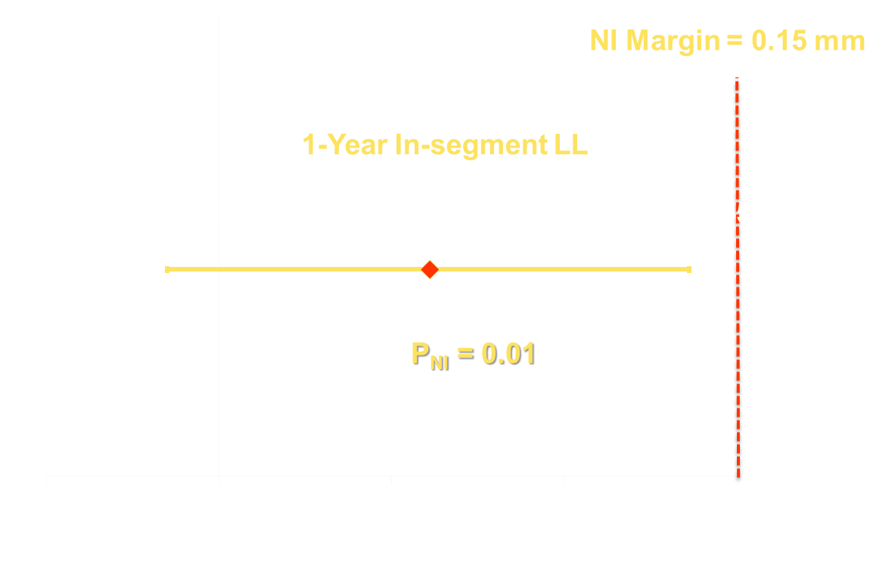
Primary Endpoint: In-Segment Late Loss at 1 Year (PTE)

Slide 17
In-Segment Late Loss
PTE Population
ITT Population
100%
100%
90%
90%
80%
80%
70%
Absorb BVS:
0.19 ± 0.03 (n=212)
XIENCE V:
0.13 ± 0.03 (n=208)
P_{NI} = 0.01
70%
Absorb BVS:
0.18 ± 0.03 (n=221)
XIENCE V:
0.13 ± 0.03 (n=213)
P_{NI} = 0.01
Cumulative Percent of Lesions
60%
60%
Cumulative Percent of Lesions
50%
50%
40%
40%
30%
30%
20%
20%
10%
10%
0%
0%
-1.5
-1
-0.5
0
0.5
1
1.5
2
2.5
3
3.5
-1.5
-1
-0.5
0
0.5
1
1.5
2
2.5
3
3.5
In-Segment Late Loss (mm)
In-Segment Late Loss (mm)
Summary results are adjusted using generalized estimating equations for cases in which 2 lesions were present in a single patient and presented as least square mean ± standard error.
Notes:
16

Slide 18
One-Year QCA Results
 | Absorb BVS (L=251) | XIENCE V (L=252) | P-Value
RVD (mm) | 2.80 ± 0.03 | 2.82 ± 0.03 | 0.64
In-segment MLD (mm) | 2.13 ± 0.03 | 2.17 ± 0.03 | 0.46
In-device MLD (mm) | 2.27 ± 0.03 | 2.50 ± 0.03 | <0.0001
In-segment %DS | 23.5 ± 0.84 | 23.0 ± 0.92 | 0.67
In-device %DS | 18.5 ± 0.92 | 11.3 ± 0.76 | <0.0001
In-segment LL (mm) | 0.18 ± 0.03 | 0.13 ± 0.03 | 0.15
In-device LL (mm) | 0.23 ± 0.03 | 0.10 ± 0.02 | 0.0001
In-segment restenosis (%) | 3.85 ± 1.34 | 2.75 ± 1.13 | 0.53
In-device restenosis (%) | 2.88 ± 1.16 | 0.75 ± 0.56 | 0.10
QCA results are presented as least square mean ± standard error.
Notes:
17

Slide 19
1-Year Target Lesion Failure
10
Absorb BVS
XIENCE V
9
8
HR [95% CI]=0.79 [0.31,2.00]
7
p=0.62 (Log rank test)
6
TLF (%)
5
4.2%
4
= -0.8%
3.4%
3
2
1
0
0
60
120
180
240
300
360
420
Time After Index Procedure (Days)
 | Number at risk
 | 0 | 60 | 120 | 180 | 240 | 300 | 365
Absorb BVS | 238 | 235 | 235 | 235 | 234 | 234 | 232
XIENCE V | 237 | 234 | 234 | 233 | 229 | 229 | 226
TLF = cardiac death, TV-MI, or ID-TLR
Notes:
18

Slide 20
One-Year Clinical Outcomes
 | Absorb BVS (N=241) | XIENCE V (N=239) | P-Value
PoCE | 8.0% (19/238) | 9.7% (23/237) | 0.51
TVF | 4.2% (10/238) | 5.9% (14/237) | 0.40
DoCE (TLF) | 3.4% (8/238) | 4.2% (10/237) | 0.62
All-cause death | 0.0% (0/238) | 2.1% (5/237) | 0.03
- Cardiac death | 0.0% (0/238) | 1.3% (3/237) | 0.12
All MI* | 2.1% (5/238) | 1.7% (4/237) | 1.0
- TV-MI* | 1.7% (4/238) | 0.8% (2/237) | 0.69
All revascularization | 6.7% (16/238) | 7.2% (17/237) | 0.85
- ID-TLR | 2.5% (6/238) | 2.1% (5/237) | 0.77
PoCE=patient-oriented composite endpoint (all-cause death, all MI, or any revascularization); DoCE=device-oriented composite endpoint; * CK-MB > 5x ULN for peri-procedural PCI MI
Notes:
19

Slide 21
One-Year Scaffold/Stent Thrombosis
 | Absorb BVS (N=241) | XIENCE V (N=239) | P-Value
All (0 - 365 days) | 0.4% (1/238) | 0.0% (0/232) | 1.0
Definite | 0.0% (0/238) | 0.0% (0/232) | 1.0
Probable | 0.4% (1/238) | 0.0% (0/232) | 1.0
Early (0 – 30 days) | 0.4% (1/238) | 0.0% (0/236) | 1.0
Late (31- 365 days) | 0.0% (0/238) | 0.0% (0/232) | 1.0
There was only one ST case reported in the Absorb BVS arm (subacute, probable)
Notes:
20

Slide 22
Limitations
Open-label study (potential for bias)
The primary endpoint was an objective measure of in-segment late loss analyzed by an independent angiographic core lab
Clinical events were adjudicated by an independent CEC
Highly selective patients and lesions enrolled, with only 1-year follow-up duration
Study population is typical of pivotal studies for approval
Long-term results will be presented as they become available
Notes:
21

Slide 23
Summary and Conclusions
ABSORB China met its primary endpoint of non-inferiority between Absorb BVS and XIENCE V for in-segment late loss at 1 year.
Absorb BVS achieved high rates of acute device and procedural success, similar to XIENCE V.
TLF and components (cardiac death, TV-MI, ID-TLR) were low and comparable between treatment arms through 1 year.
Device thrombosis rates were very low and not statistically different.
Notes:
22

Slide 24
Thank you
Notes:
23

