Slide 1
The Third DANish Study of Optimal Acute Treatment of Patients with ST-segment Elevation Myocardial Infarction: ischemic postconditioning during primary PCI
DANAMI3-iPOST
Thomas Engstrøm, MD, DMSci, PhD

Slide 2
Disclosures
The presenter has no disclosures with regard to the trial
DANAMI3-iPOST

Slide 3
Participating sites and investigators
Rigshospitalet University Hospital
Henning Kelbæk
Steffen Helqvist
Lars Køber
Dan Eik Høfsten
Lene Kløvgaard
Lene Holmvang
Erik Jørgensen
Kari Saunamäki
Frants Pedersen
Peter Clemmensen
Thomas Engstrøm
Niels Vejlstrup
Jacob Lønborg
Kiril Ahtarovski
Marek Treiman
Klaus Fuglsang Kofoed
Aalborg University Hospital
Hans-Henrik Tilsted
Jan Ravkilde
Svend Eggert Jensen
Anton Boel Villadsen
Jens Aarøe
Bent Raungaard
Christian Torp-Pedersen
Odense University Hospital
Lisette Okkels Jensen
Karsten T Veien
Data Safety and Monitoring Board (DSMB)
Gorm Bøje Jensen
Gunnar Gislasson
David Erlinge
Skejby University Hospital
Hans Erik Bøtker
Anne Kaltoft
Michael Maeng
Lars R Krusell
Christian J Terkelksen
Clinical Event Comité (CEC)
Kristian Thygesen
Anders Galløe
Jørgen Jeppesen
Funding
The Danish Agency for Science, Technology and Innovation
and Danish Council for Strategic research
ClinicalTrials.gov n_{o} NCT01960933
DANAMI3-iPOST

Slide 4
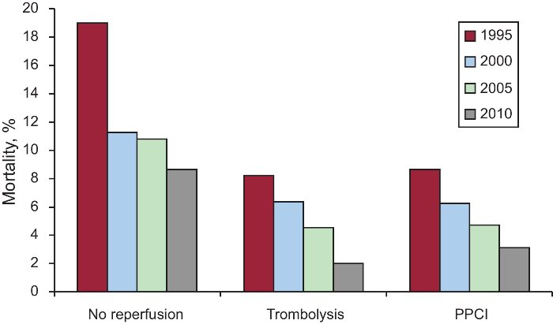
Mortality in STEMI
DANAMI3-iPOST
Jiménez-Candil et al., Rev Esp Cardiol 2013

Slide 5
Reperfusion injury
Cell death
Ischemia
Reperfusion
injury
Ischemic injury
Time
Ischemia
Reperfusion
DANAMI3-iPOST
Garcia-Dorado et al., Cardiovasc Res, 2006

Slide 6
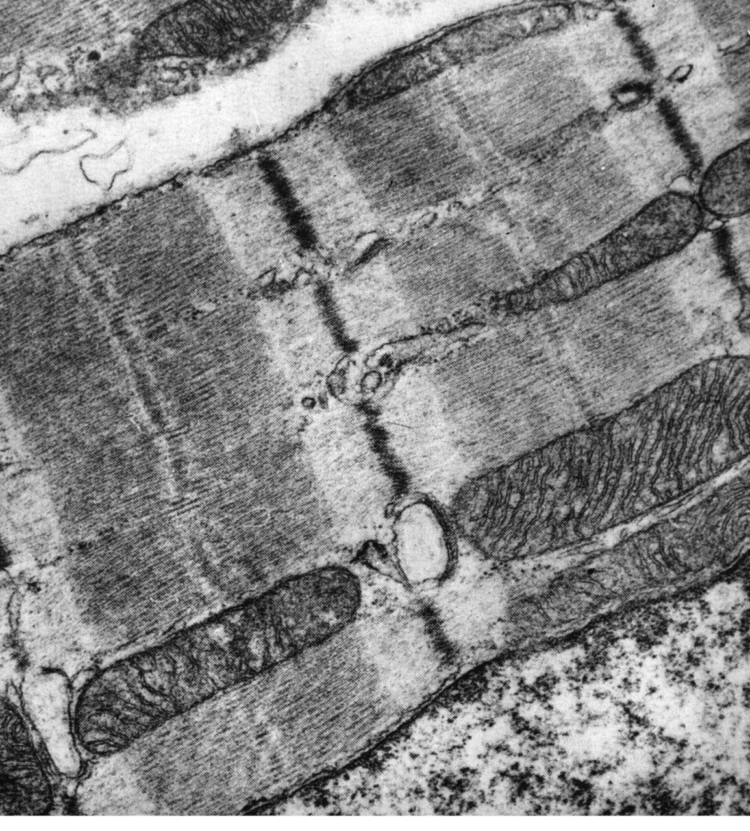
Normoxic heart
DANAMI3-iPOST

Slide 7
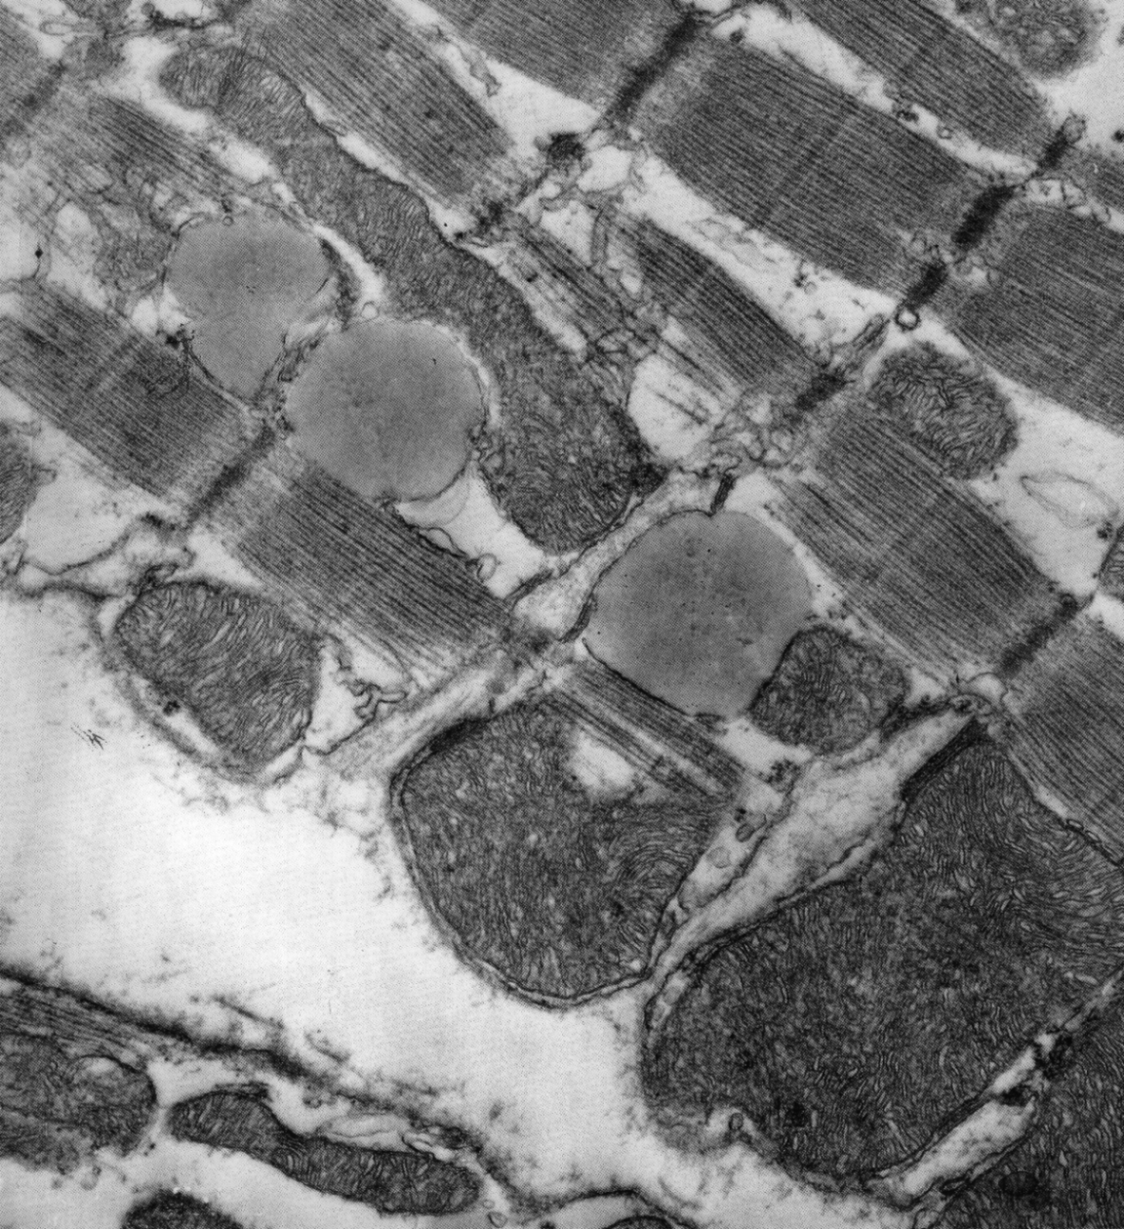
Ischemia 90 minutes
DANAMI3-iPOST

Slide 8
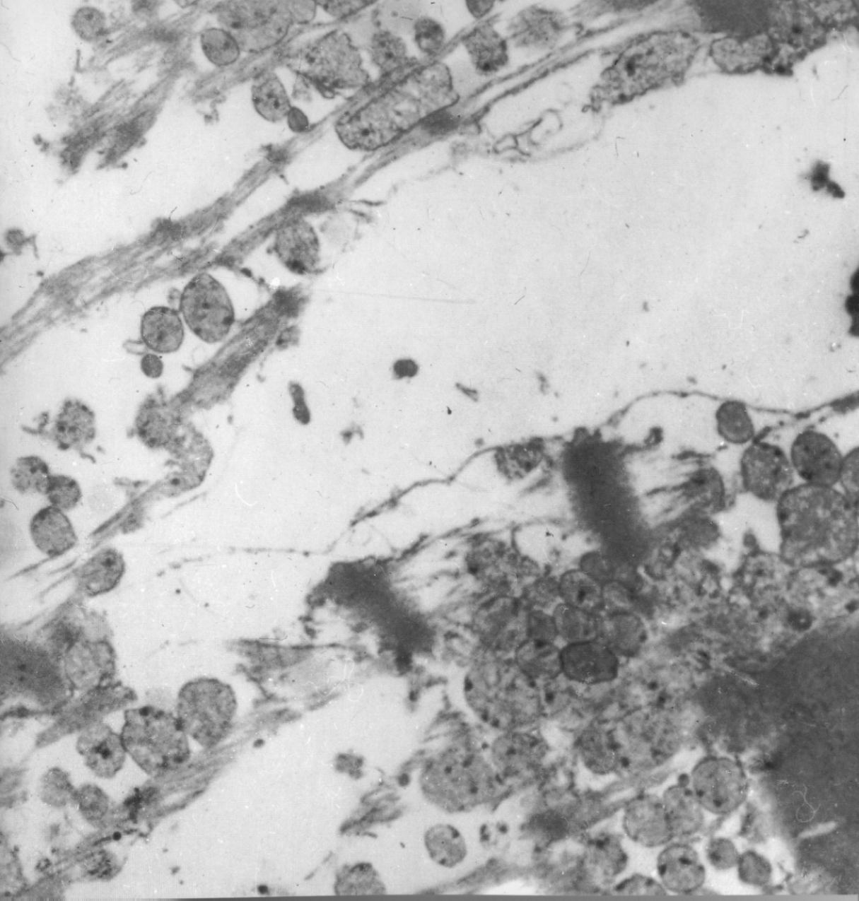
One minute reperfusion
DANAMI3-iPOST

Slide 9
Ischemic postconditioning
Occluded
Reperfusion
coronary artery
Reperfusion
injury
Conventional
treatment
Reperfusion
injury
Ischemic
postconditioning
30
30
30
30
30
30
30
30 sec
Balloon inflations – deflations
DANAMI3-iPOST

Slide 10
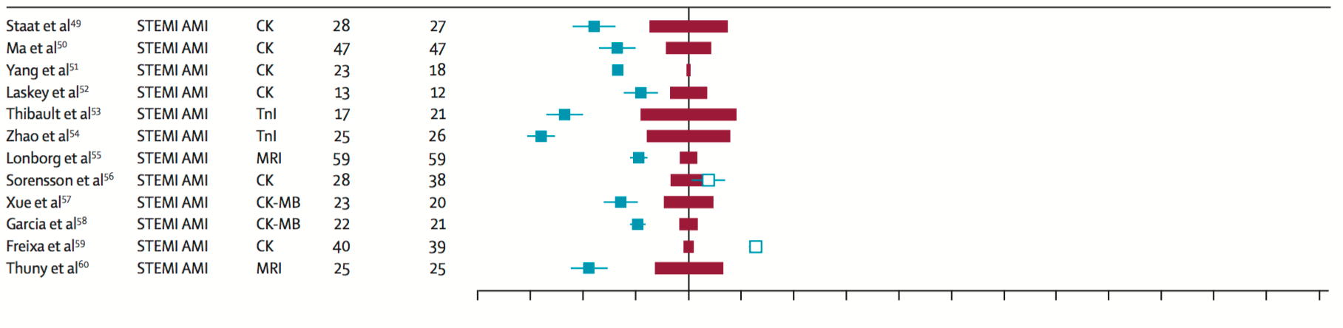
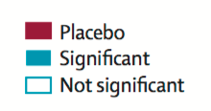
Ischemic postcondioning in STEMI – surrogate marker trials
DANAMI3-iPOST
Heusch G, Lancet 2013

Slide 11
Trial flow chart
1243 Randomized
617 Conventional primary PCI
617 Ischemic postconditioning
received the allocated intervention
3 CABG
received the allocated intervention
6 CABG
19 PCI failed or not feasible
617 analysed by intention to treat
3 lost to follow up after 12, 17 and 36 months
617 analysed by intention to treat
2 lost to follow up after 14 and 33 months
DANAMI3-iPOST
Notes:
11

Slide 12
Trial flow chart
1243 Randomized
617 Conventional primary PCI
617 Ischemic postconditioning
received the allocated intervention
3 CABG
received the allocated intervention
6 CABG
19 PCI failed or not feasible
617 analysed by intention to treat
3 lost to follow up after 12, 17 and 36 months
617 analysed by intention to treat
2 lost to follow up after 14 and 33 months
DANAMI3-iPOST
Notes:
12

Slide 13
Trial flow chart
1243 Randomized
617 Conventional primary PCI
617 Ischemic postconditioning
received the allocated intervention
3 CABG
received the allocated intervention
6 CABG
19 PCI failed or not feasible
617 analysed by intention to treat
3 lost to follow up after 12, 17 and 36 months
617 analysed by intention to treat
2 lost to follow up after 14 and 33 months
DANAMI3-iPOST
Notes:
13

Slide 14
Trial flow chart
1243 Randomized
617 Conventional primary PCI
617 Ischemic postconditioning
received the allocated intervention
3 CABG
received the allocated intervention
6 CABG
19 PCI failed or not feasible
617 analysed by intention to treat
3 lost to follow up after 12, 17 and 36 months
617 analysed by intention to treat
2 lost to follow up after 14 and 33 months
DANAMI3-iPOST
Notes:
14

Slide 15
Inclusion criteria
ST-segment elevation myocardial infarction
Symptom duration of no more than 12 hours
TIMI 0-1 in infarct related artery
DANAMI3-iPOST

Slide 16
Exclusion criteria
Unconsciousness or cardiogenic shock
Stent thrombosis
Indication for acute bypass surgery
DANAMI3-iPOST

Slide 17
Power calculation
One year all-cause mortality or hospitalization for heart failure was estimated to be 11% in the conventional PCI assignment group.
A relative reduction in the primary endpoint of 25% can be detected with a two-sided alpha level of 0∙05 and a power of 80% by enrolling 1100 patients if all patients were followed for at least 2 years.
DANAMI3-iPOST

Slide 18
Primary endpoint
Composite
All-cause mortality
Hospitalization for heart failure
Assessed when the last included patient had
been followed for 2 years
DANAMI3-iPOST

Slide 19
Baseline characteristics
 | Conventional (n = 617) | iPOST (n = 617)
Median age (range, years) | 62 (29-94) | 63 (35-92)
Men | 486 (79%) | 489 (79%)
Women | 131 (21%) | 128 (21%)
Diabetes | 50 (8%) | 55 (9%)
Hypertension | 209 (34%) | 241 (39%)
Current smoking | 306 (50%) | 294 (48%)
Previous smoking | 171 (28%) | 170 (28%)
Hyperlipidemia | 181 (28%) | 173 (28%)
Previous MI | 36 (6%) | 30 (5%)
Infarct location
Anterior | 249 (40%) | 262 (43%)
Inferior | 327 (53%) | 311 (50%)
Posterior | 39 (6%) | 42 (7%)
DANAMI3-iPOST

Slide 20
Procedural data
 | Conventional (n = 617) | iPOST (n = 617) | P
No. of arteries treated per patient (n) | 1 (0-3) | 1 (0-3) | >0.05
Number of implanted stents (n) | 1 (1-2) | 1 (1-2) | >0.05
Stent diameter (mm) | 3∙5 (3∙0-3∙75) | 3∙5 (3∙0-3∙75) | >0.05
Total stent length (mm) | 23 (17-33) | 23 (18-31) | >0.05
Stent type |  |  | >0.05
No stenting | 26 (4%) | 23 (4%) | >0.05
Bare-metal | 20 (3%) | 18 (3%) | >0.05
Drug-eluting | 571 (93%) | 576 (93%) | >0.05
Pre-treatment with heparin | 590 (96%) | 596 (97%) | >0.05
Use of Glycoprotein IIb/IIIa inhibitor | 67 (11%) | 89 (14%) | >0.05
Use of Bivalirudin | 501 (81%) | 505 (82%) | >0.05
Thrombus aspiration | 423 (69%) | 291 (47%) | <0.001
Time from symptom onset to PCI (hrs) | 2∙9 (2∙0-4∙7) | 2∙9 (2∙1-4∙6) | >0.05
DANAMI3-iPOST

Slide 21
Clinical characteristics
 | Conventional (n = 617) | iPOST (n = 617) | P
Killip Class II - IV at any time | 49 (8%) | 33 (5%) | >0.05
Multi vessel disease | 248 (40%) | 249 (40%) | >0.05
Culprit lesion |  |  | >0.05
LAD | 229 (37%) | 245 (40%) | >0.05
RCA | 266 (43%) | 260 (42%) | >0.05
CX | 59 (10%) | 52 (8%) | >0.05
Other (D, OM, PLA, PDA) | 62 (10%) | 58 (9%) | >0.05
Indeterminable | 1 (0∙2%) | 2 (0∙3%) | >0.05
TIMI3 post procedure | 582 (94%) | 588 (95%) | >0.05
DANAMI3-iPOST

Slide 22
Medical theraphy at discharge
 | Conventional (n = 617) | iPOST (n = 617) | P
Antiplatelet therapy
Aspirin − (%) | 601 (97%) | 605 (98%) | >0.05
Clopidogrel − (%) | 99 (16%) | 92 (15%) | >0.05
Prasugrel − (%) | 264 (43%) | 269 (44%) | >0.05
Ticagrelor − (%) | 245 (40%) | 249 (40%) | >0.05
Statin − (%) | 602 (98%) | 597 (97%) | >0.05
Betablocker − (%) | 544 (88%) | 549 (89%) | >0.05
ACE inhibitor or angiotensin-II-receptor blocker − (%) | 286 (46%) | 323 (52%) | >0.05
Calcium channel blocker − (%) | 46 (8%) | 55 (9%) | >0.05
DANAMI3-iPOST

Slide 23
Primary endpoint – median follow up 37.5 months
DANAMI3-iPOST

Slide 24
All cause mortality – median follow up 37.5 months
DANAMI3-iPOST

Slide 25
Heart failure – median follow up 37.5 months
DANAMI3-iPOST

Slide 26
DANAMI3-iPOST outcomes
Outcome | Conventional (n = 617) | iPOST (n = 617) | Hazard ratio [95% CI] | p
Primary composite endpoint | 69 (11∙2) | 65 (10∙5) | 0·93 [0∙66 – 1∙30] | 0∙66
All-cause mortality | 50 (8∙1) | 38 (6∙2) | 0∙75 [0∙49 – 1∙14] | 0∙18
Heart failure hospitalization | 30 (4∙9) | 30 (4∙9) | 0∙99 [0∙60 – 1∙64] | 0∙96
Cardiovascular mortality | 30 (4∙9) | 26 (4∙2) | 0∙86 [0∙51 – 1∙45] | 0∙56
Recurrent myocardial infarction | 29 (4∙7) | 33 (5∙4) | 1∙13 [0∙68 – 1∙86] | 0∙64
TVR by PCI | 14 (2∙3) | 19 (3∙1) | 1∙35 [0∙67 – 2∙68] | 0∙40
TVR by CABG | 2 (0∙3) | 6 (1∙0) | 2∙97 [0∙60 – 14∙72] | 0∙28
DANAMI3-iPOST

Slide 27
DANAMI3-iPOST outcomes
 | Conventional (n = 299) | iPOST (n = 275) | P
LVEF all patients (%) | 50.8 | 52.7 | <0.05
LVEF anterior infarcts (%) | 45.9 | 49.5 | 0.04
Number of patients with LVEF >45% | 215 (72%) | 220 (80%) | 0.015
DANAMI3-iPOST

Slide 28
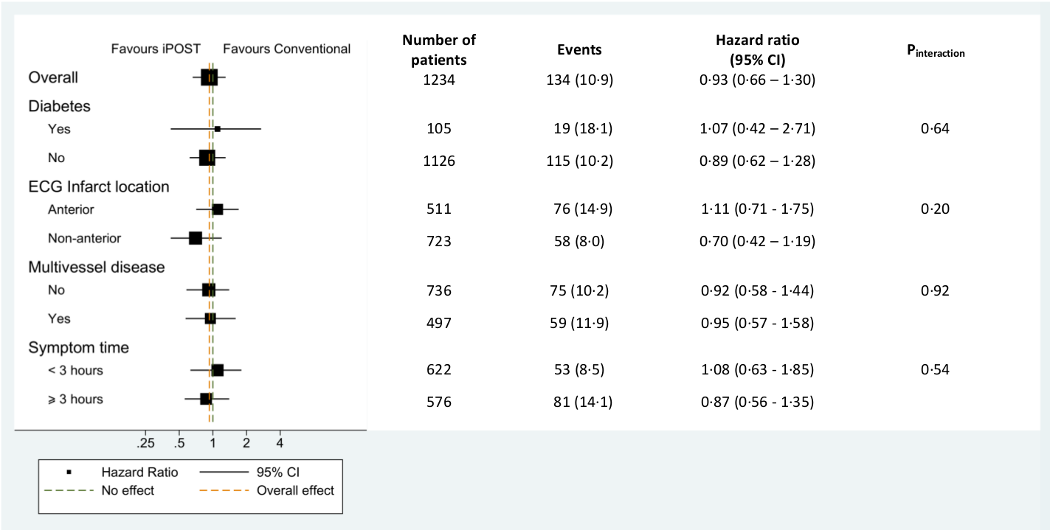
Subgroup analysis
DANAMI3-iPOST

Slide 29
Conclusions
Ischemic postconditioning during primary angioplasty in STEMI patients failed to reduce
the rate of the primary composite endpoint of all-cause mortality and hospitalization
for heart failure.
Ischemic postconditioning reduced the secondary endpoint of all cause mortality by 25% but
this reduction did not reach statistical significance.
Ischemic postconditioning significantly increased the number of patients with left ventricular
ejection fraction above 45% after 18 months.
DANAMI3-iPOST

