Slide 1
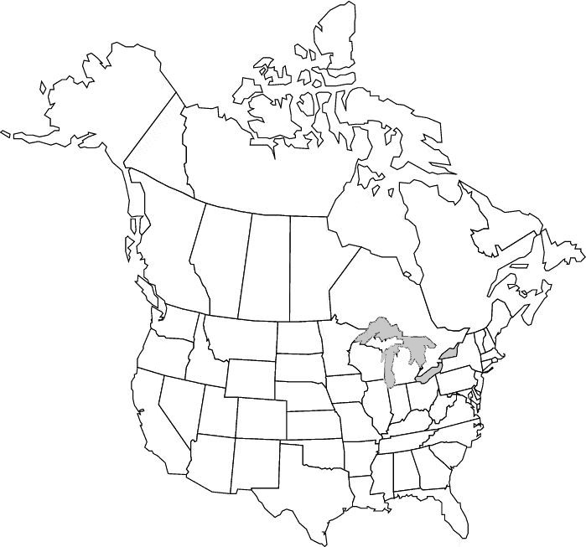
Antiarrhythmic Drugs for Shock-Refractory
Out-of-Hospital Cardiac Arrest:
The Amiodarone, Lidocaine or Placebo Study (ALPS)
Resuscitation Outcomes Consortium Investigators
Vancouver BC-Ottawa
Seattle-King Co
UW CTC, Seattle
Milwaukee
Toronto
Portland
Pittsburgh
San Diego
Alabama
Dallas

Slide 2
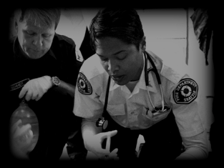
Trial Protocol
Adult nontraumatic
out-of-hospital cardiac arrest
Persistent or recurrent VF/VT after ≥ 1 shock(s)
Vascular Access
Vasopressor
RANDOMIZE
(open study kit)
Amiodarone
Lidocaine
Neither
Saline Placebo
Standard ALS care
Hospital Admission - Monitored Care
SURVIVAL TO HOSPITAL DISCHARGE
Notes:
Although patients were eligible for randomization regardless of the initial rhythm causing their cardiac arrest, the trial’s main focus was on those whose initial cardiac rhythm was VF/VT that persisted or recurred after shock, that is was shock-refractory.

