Slide 1





TCT 2016, Washington convention center
Main arena I, Sunday Oct. 30, 12:30-12:40 pm
Plenary Session VI First Report Investigations 1
ABSORB II: Three-year Clinical Outcomes from a Prospective, Randomized Trial of an Everolimus-Eluting Bioresorbable Vascular Scaffold vs. an Everolimus-Eluting Metallic Stent in Patients with Coronary Artery Disease
Patrick W. Serruys MD. PhD.¹
Bernard Chevalier MD.²
Yoshinobu Onuma MD. PhD.³
on behalf of ABSORB II investigators
1. NHLI, Imperial College London, London, United Kingdom,
2. Institut Jacques Cartier, Massy, France
3. Cardialysis, Rotterdam, the Netherlands / Erasmus university

Slide 2
Disclosure Statement of Financial Interest
Within the past 12 months, I or my spouse/partner have had a financial interest/arrangement or affiliation with the organization(s) listed below.
Affiliation/Financial Relationship
Company
Grant/Research Support
Consulting Fees/Honoraria
Abbott
AstraZeneca
Biotronik
Boston scientific
Cardialysis
GLG Research
Medtronic
Sinomedical Sciences Technology
Société Europa Digital Publishing,
Stentys France
Svelte Medical Systems
Volcano
Qualimed
St. Jude Medical

Slide 3
Background
Absorb BRS was CE-mark approved in December 2010 based on the data of the first in man trial (ABSORB Cohort B trial).
“At the time of the study design in July 2011, clinical evidence has been attained without use of a comparator (Xience).” *
The absorb II study has been powered to demonstrate two mechanistic co primary end points
Superiority of the bioresorbable scaffold Absorb on the metallic stent Xience in vasomotion post intracoronary nitrate
Non inferiority in late loss post intracoronary nitrate
*Serruys et al. Lancet October 30, 2016—16:30 (GMT)

Slide 4
Design and Methods
ABSORB II trial, prospective, randomized, single blind
501 patients randomized 2:1 to either Absorb or Xience
Trial protocol allowed up to 2 de novo coronary lesions
Device sizing based on online QCA Dmax
Pre-dilatation with undersized balloon by 0.5 mm
Post-dilatation: 61% in Absorb vs. 59% in Xience
Clinical follow-up at 30 and 180 days and 1, 2, and 3 years
Repeat invasive imaging (QCA and QIVUS) at 3 years
QCA pre and post nitrate to assess vasomotion
Seattle angina questionnaires pre-implantation, at 30 and 180 days and 1, 2, and 3 years
Exercise testing with ECG: ST-T depression of ≥0.1 mV or chest pain, indicative of ischemia
Study Sponsor- Abbott Vascular

Slide 5
Co-primary endpoints
Vasomotion assessed at 3-year follow-up by change in mean lumen diameter assessed by QCA pre and post intracoronary nitrate and assumed to be 0.07 mm for Absorb and 0.0 mm for Xience Prime.
Superiority test using a 2-sided t-test.
Angiographic late luminal loss at 3-year follow-up (minimum lumen diameter [MLD] at 3 years post-nitrate minus MLD post-procedure post-nitrate)
Non-inferiority test using a one-sided asymptotic test, against a non-inferiority margin of 0·14 mm.
Multiple matched angiographic views for assessment of vasomotion and late loss.

Slide 6
Secondary endpoints
Major Secondary imaging endpoint
In-stent/scaffold mean lumen area change from post- procedure to 3 years by IVUS
Secondary endpoints (ARC definitions)
Clinical endpoints
Device oriented composite endpoint
(cardiac death, target vessel MI*, ischemia driven TLR)
Patient oriented composite endpoint
(all cause death, any MI, any revascularization)
Quality of Life related endpoints
Seattle angina questionnaire
Angiographic and IVUS endpoints
* MI definition – WHO or WHO extended definition

Slide 7
Definitions of clinical endpoints
Cardiac death (ARC*)
Myocardial infarction
1) Per Protocol Definition (the WHO Definition)
Q wave MI
Development of new, pathological Q wave on the ECG
Non-Q wave MI
Elevation of CK levels to ≥ two times the ULN with elevated CK-MB in the absence of new pathological Q waves
2) WHO extended#
Clinically indicated TLR (ARC*)
Scaffold/stent thrombosis (ARC*: definite or probable)
*Cutlip et al. Circulation 2007 # Vranckx et al EuroIntervention 2010

Slide 8

Co-primary endpoint: in-device vasomotion in ABSORB II
Cumulative frequency distribution curves of vasomotion at 3 years
Change in mean lumen diameter
Result will be discussed in details
in the following session:
Room 207, level 2 Monday Oct. 31, 2:45-2:53 pm
“BVS at the Cusp of Complete Bioresorption: MLD and Vasomotion at 3-years in Absorb and Xience from the ABSORB II”
Absorb | n=258 | 0.047±0.109 mm
XIENCE | n=130 | 0.056±0.117 mm
Cumulative frequency
P_{superiority} = 0.49
Vasomotion (mm)

Slide 9


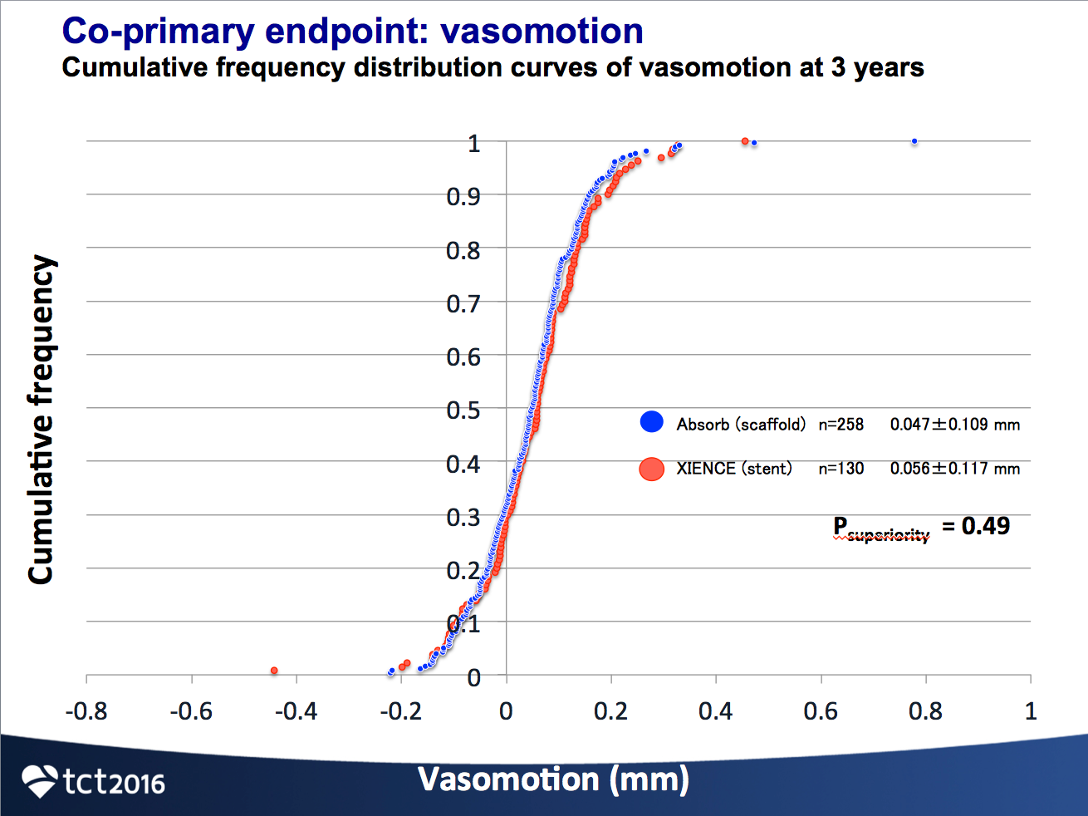
In-device vasomotion in ABSORB Japan trial
Cumulative frequency distribution curves of vasomotion at 2 years
Although analyzed by another core lab (USA) , similar findings on vasomotion were made in ABSORB Japan.
Absorb | n=75 | 0.06±0.14 mm
XIENCE | n=35 | 0.07±0.17 mm
Cumulative frequency
P_{superiority} = 0.89
Vasomotion (mm)
Onuma et al. EuroIntervention 2016

Slide 10
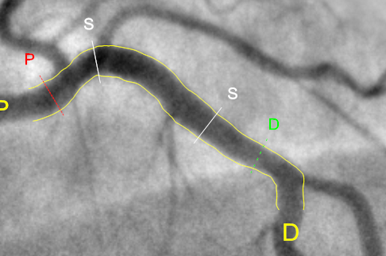
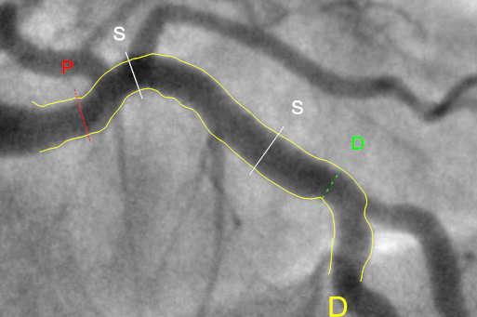
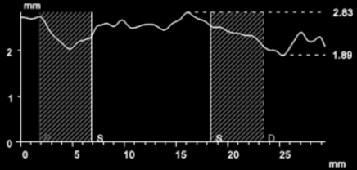
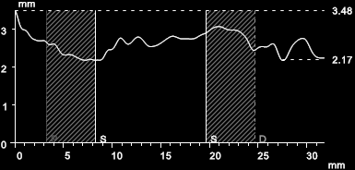
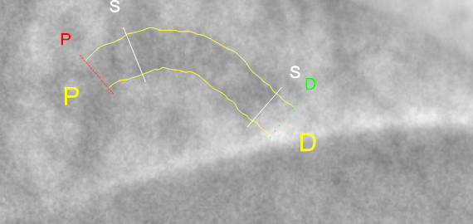
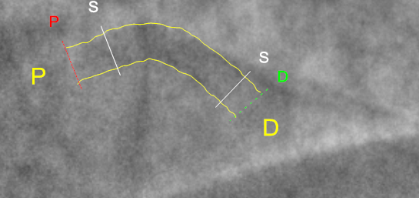
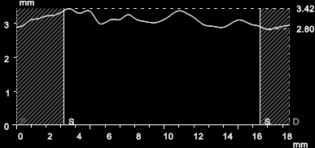
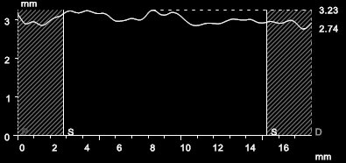
Case example of Vasomotion in Xience
Before nitrate
After nitrate
in-stent mean lumen diameter
2.53 mm
in-stent mean lumen diameter
2.63 mm
+0.10 mm
mean stent diameter
3.12 mm
mean stent diameter
3.07 mm

Slide 11
Co-primary endpoint: angiographic late luminal loss
Cumulative frequency distribution curves of late luminal loss at 3 years
Acute ScT (n=1)
Subacute ScT (n=1)
Late ScT (n=1)
NI Margin
Very Late ScT (n=6)
Cumulative frequency
XIENCE | n=151 | 0.250±0.250 mm
0.12
Absorb | n=298 | 0.371±0.449 mm
95%CI (0.06 – 0.19)
P _{non-inferiority} = 0.78
P _{non-inferiority} = 0.78
0
0.14
Late luminal loss (in-stent/scaffold) (mm)

Slide 12
Scaffold or stent thrombosis
2 : 1 randomization
 | Absorb 335 patients | Xience 166 patients | p value
Definite | 2·5% (8) | 0·0% (0) | 0·06
Acute (0–1 day) | 0·3% (1) | 0·0% (0) | 1·0
Sub-acute (2–30 days) | 0·3% (1) | 0·0% (0) | 1·0
Late (31–365 days) | 0·0% (0) | 0·0% (0) | 1·0
Very late (>365 days) | 1·8% (6) | 0·0% (0) | 0·19
Definite or probable | 2·8% (9/320) | 0·0% (0/159) | 0·03
Acute (0–1 day) | 0·3% (1) | 0·0% (0) | 1·0
Sub-acute (2–30 days) | 0·3% (1) | 0·0% (0) | 1·0
Late (31–365 days) | 0·3% (1) | 0·0% (0) | 1·0
Very late (>365 days) | 1·8% (6) | 0·0% (0) | 0·19

Slide 13
Dual antiplatelet therapy
 | Absorb 335 patients | Xience 166 patients | p value
Patients on DAPT at day 1095 | 30.5% | 29.5% | 0·81
Overall duration (day) of DAPT | 566 days | 561 days | 0·88
DAPT use in scaffold thrombosis cases
 | Time (day)
AST | 0
SAST | 2
LST | 335
VLST | 447
VLST | 602
VLST | 967
VLST | 981
VLST | 1022
VLST | 1082
DAPT use
Scaffold thrombosis
Absorb | no VLST | VLST
DAPT 3y without interruption | 63 | 0
DAPT with interruption | 266 | 6
Probable
Thrombolysis
unknown
p = 0.599
Fisher’s exact test
Time to event (days)
The patients with late or very late scaffold thrombosis were not on DAPT.

Slide 14
Secondary angiographic results
 | Absorb 298 lesions | Xience 151 lesions | p value
In-scaffold/stent assessment
Minimum lumen diameter
Pre-procedure diameter (mm) | 1·06 | 1·06 | 0·81
Acute gain (mm) | 1·16 | 1·45 | <0·0001
Post-procedure diameter (mm) | 2·22 | 2·50 | <0·0001
Late loss (mm) | 0·37 | 0·25 | 0·0003
Follow-up diameter (mm) | 1·86 | 2·25 | <0·0001
Net gain (mm) | 0·80 | 1·20 | <0·0001
=
<
<
>
<
<
Percent Diameter stenosis
Pre-procedure (%) | 59% | 59% | 0·83
Post-procedure (%) | 15·6% | 10·1% | <0·0001
Follow-up (%) | 25·8% | 15·7% | <0·0001
In-device binary restenosis (%) | 7·0% | 0·7% | 0·003
In-segment binary restenosis (%) | 8·4% | 3·3% | 0·042
=
>
>
>
>

Slide 15
Intravascular ultrasound results
 | Absorb 247 lesions | Xience 136 lesions | p value
Mean lumen area
Pre-procedure (mm²) | 4·81 | 5·02 | 0·1568
Post-procedure (mm²) | 6·05 | 6·81 | <0·0001
Follow-up (mm²) | 6·12 | 6·66 | 0·003
=
<
<
Major secondary endpoint
Mean Change in mean lumen area from postprocedure to 3 years (mm²) | + 0·07 | - 0·15 | 0·02
>
Minimal lumen area
Pre-procedure (mm²) | 2·01 | 2·11 | 0·2714
Acute gain (mm²) | 2·89 | 3·64 | <0·0001
Post-procedure (mm²) | 4·88 | 5·72 | <0·0001
Late loss (mm²) | 0.56 | 0.33 | 0.0401
Follow-up (mm²) | 4·32 | 5·38 | <0·0001
=
<
<
>
<

Slide 16
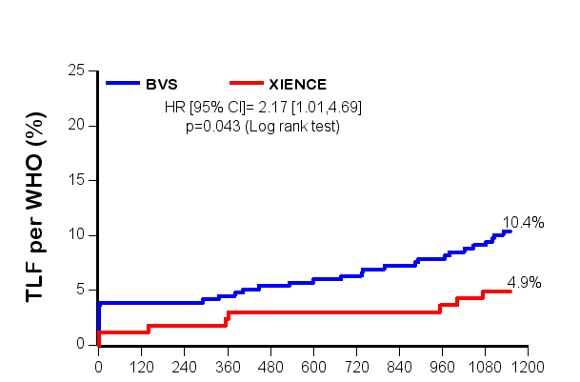
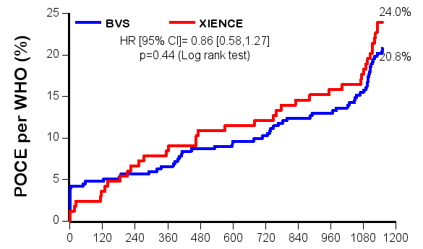
Kaplan Meier curves for Device- and Patient- oriented composite endpoints (DOCE and POCE)
Cardiac death
TV-MI
CI-TLR
All-cause death
Any-MI
Any revascularization
DOCE
POCE
24.0%
25
25
Absorb
Xience
Absorb
Xience
20
HR [95% CI]
2.17 [1.01, 4.69]
p=0.043
20
HR [95% CI]
0.86 [0.58, 1.27]
p=0.44
15
10.4%
15
Device oriented clinical endpoint (%)
Patient oriented clinical endpoint (%)
20.8%
10
10
4.9%
5
5
0
0
Time to event (days)
Time to event (days)
Three-year protocol mandated imaging triggered subsequent revascularizations, clinically indicated or not.

Slide 17
Clinical endpoints
2 : 1 randomization
Non-hierarchical | Absorb 325 patients | Xience 161 patients | Relative Risk | p value
Device-oriented composite endpoint [DOCE] | 10.5% | 5.0% | 2·11 [1·00, 4·44] | 0·04
Cardiac death | 0.9% | 1.9% | 0·50 [0·10, 2·43] | 0·40
Target vessel MI | 7.1% (23) | 1.2% (2) | 5.70 [1.36, 23.87] | 0.0061
Periprocedural MI (WHO) | 3.9%(13) | 1.2% (2) | 3.22 [0.74, 14.11] | 0.16
Spontaneous MI (WHO extended) | 3.1% (10) | 0% (0) | NC [NC] | 0.06
Clinically indicated TLR | 6.2%(20) | 1.9% (3) | 3.30 [1.00, 10.95] | 0.036
Patient-oriented composite endpoint [POCE] | 20.9% | 24.2% | 0·86 [0·61, 1·22] | 0·40
All-cause death | 2.5% | 3.7% | 0·66 [0·23, 1·87] | 0·57
Any MI | 8.3% | 3.1% | 2.68 [1.05, 6.82] | 0.03
Any revascularization | 15.1% | 20.5% | 0.74 [0.49, 1.10] | 0.13
Out of 20 CI-TLR, 8 had a definite scaffold thrombosis with STEMI.These 8 definite scaffold thromboses are also tabulated in the category spontaneous MI in the hierarchical presentation.
Out of 10 spontaneous MI, 9 were due to scaffold thrombosis (8 definite and 1 probable) and 1 definite thrombosis case died. This case is also tabulated in the category cardiac death in the hierarchical presentation.
The findings of higher non-clinically driven TVR/TLR rates for Xience could have been attributed to the unblinded nature of the intervention. Unblinded physicians may be prone to readily re-intervene in the control group in patients treated with Xience, whereas they might have been unconsciously reluctant to intervene in the experimental device arm (Absorb), although this assumption is purely speculative and has not been objectively documented.

Slide 18
Clinical endpoints
2 : 1 randomization
Hierarchical | Absorb 325 patients | Xience 161 patients | Relative Risk | p value
Device-oriented composite endpoint [DOCE] | 10.5% | 5.0% | 2·11 [1·00, 4·44] | 0·04
Cardiac death | 0.9% | 1.9% | 0·50 [0·10, 2·43] | 0·4
Target vessel MI | 6.5% (21) | 1.2% (2) | 5·20 [1·23, 21·91] | 0·01
Periprocedural MI (WHO) | 3.9%(13) | 1.2% (2) | 3.22 [0.74, 14.11] | 0.16
Spontaneous MI (WHO extended) | 2.5% (8) | 0% (0) | NC [NC] | 0.06
Clinically indicated TLR | 3.1% (10) | 1.9% (3) | 1·65 [0·46, 5·92] | 0·56
Patient-oriented composite endpoint [POCE] | 20.9% | 24.2% | 0·86 [0·61, 1·22] | 0·4
All-cause death | 2.5% | 3.7% | 0·66 [0·23, 1·87] | 0·57
Any MI | 7.7% | 3.1% | 2.48 [0.97, 6.35] | 0.048
Any revascularization | 10.8% | 17.4% | 0·62 [0·39, 0·98] | 0.04
The findings of higher non-clinically driven TVR/TLR rates for Xience could have been attributed to the unblinded nature of the intervention. Unblinded physicians may be prone to readily re-intervene in the control group in patients treated with Xience, whereas they might have been unconsciously reluctant to intervene in the experimental device arm (Absorb), although this assumption is purely speculative and has not been objectively documented.

Slide 19
Exercise test
 | Absorb 335 patients | Xience 166 patients | p value
Participated in exercise test | 71·3% | 72·3% | 0·83
Patient without prior repeat revascularization | 60·6% | 56·0% | 0·33
Maximum heart rate (bpm) | 131·0 | 136·2 | 0·054
Peak systolic blood pressure (mmHg) | 178·1 | 181·9 | 0·30
Exercise duration (min) | 8·57 | 9·23 | 0·11
≥ 0.1 mV ST depression or chest pain | 17·3% | 11·8% | 0·23
Antianginal medication
Beta blocker | 69·5% | 65·9% | 0·55
Calcium channel blocker | 23·6% | 24·2% | 0·92
Nitrate | 18·7% | 26·4% | 0·14

Slide 20
Seattle Angina Questionnaire
angina stability, frequency, physical limitation, disease perception, and treatment satisfaction (Compliance in answering SAQ: 93% for both arms at 3 years)
Absorb
Xience

Slide 21
Conclusions 1/2
The data presented in our report are the first randomized data published after a period of observation of 3 years.
The trial did not meet its mechanistic co-primary endpoints of superior vasomotor reactivity because Xience showed unexpected vasomotion which had been hypothesised to be zero.
The trial did not meet its co-primary endpoints of non-inferior late luminal loss with respect to Xience that was found to have lower late luminal loss than Absorb.
Serial intravascular ultrasound follow-up showed a significant difference between the stable mean lumen area of Absorb as opposed to a significant loss in mean lumen area for Xience.

Slide 22
Conclusions 2/2
A higher rate of device oriented composite endpoint due to target vessel myocardial infarction largely driven by peri-procedural myocardial infarction was observed in the Absorb arm.
The incidence of very late scaffold thrombosis is a signal that warrants further careful monitoring of the patient having a clinical follow-up of longer than 2 years.
The patient oriented composite endpoint, exercise testing and anginal status (compliance: 93%) were not statistically different between both devices at 3 years with treatment satisfaction of >90% in both arms.

Slide 23
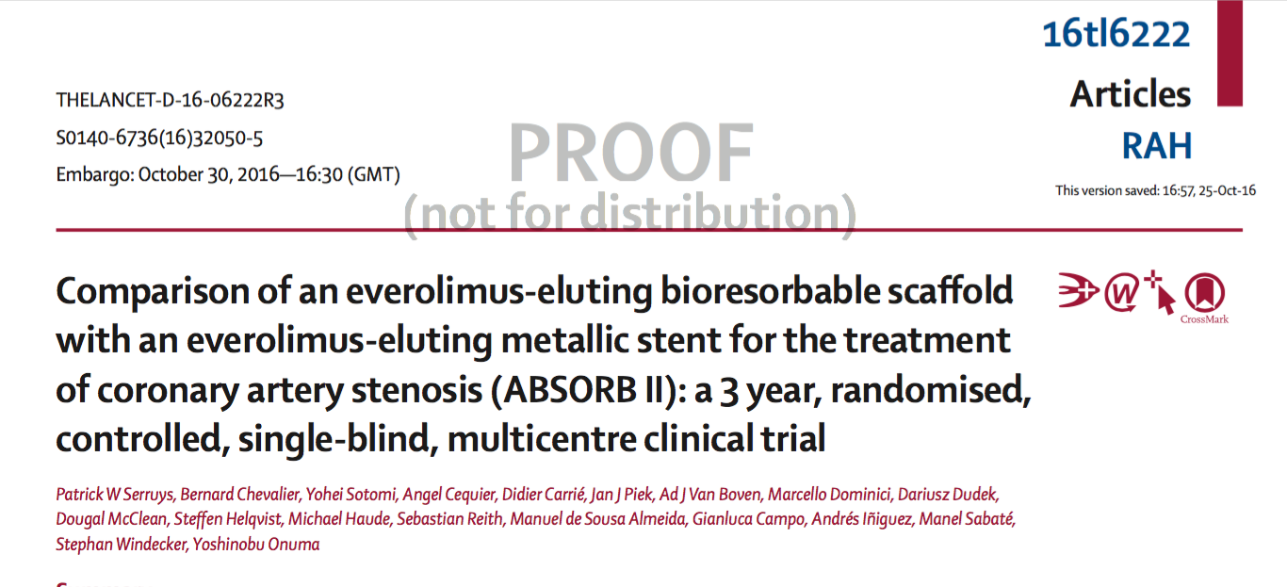
“Future studies should investigate the clinical impact of accurate intravascular imaging in sizing the device and in optimizing the scaffold implantation. The benefit and need for prolonged dual antiplatelet therapy after bioresorbable scaffold implantation could also become a topic for future clinical research.”

