Slide 1
Effects of a comprehensive community-based lifestyle intervention in patients with coronary artery disease: the trial
Randomized Evaluation of Secondary Prevention by Outpatient Nurse SpEcialists
Ron Peters, MD, PhD
on behalf of the study group
Department of Cardiology
Academic Medical Center
Amsterdam
the Netherlands

Slide 2
background (1)
among patients with coronary artery disease (CAD), lifestyle related risk factors (LRFs) are common
main 3 LRFs:
overweight
physical inactivity
smoking
improvement of LRFs reduces cardiovascular morbidity and mortality
however, modification of LRFs is very challenging

Slide 3
background (2)
nurse-led care improves
drug-treated cardiovascular risk factors (BP, LDL-C)
quality of life in CAD patients
(RESPONSE 1 trial*)
however, the impact on LRFs is minimal
hospital based approaches may be insufficient to change a patient’s daily routines
*Jorstad HT et al. Heart 2013;99: 1421-1430

Slide 4
hypothesis
LRFs in CAD patients will be improved by
nurse-coordinated referral to
a comprehensive set of up to three community-based interventions to achieve
weight loss,
improvement of physical activity, and
smoking cessation,
encouraging partner participation,
on top of usual care.

Slide 5
emphasizes a healthy diet
changing unhealthy behavior
regular physical activity
group motivation
weight
activity
smoking
internet-based program
improving physical activity
accelerometer
online coach, feedback
smoking cessation
telephone counselling
motivational interviewing
pharmacologic support

Slide 6
design
inclusion:
ACS and/or coronary revascularization < 8 weeks
at least one of the following LRF:
BMI>27 kg/m²
physical inactivity: <30 min; 5 times / week
smoking (on admission)
exclusion:
planned revascularization
insufficient motivation
programs not feasible
Hospital Anxiety and Depression Scale >14

Slide 7
usual care, guideline based
visits to the cardiologist
cardiac rehabilitation
nurse-led secondary prevention program
healthy lifestyles
drug treated risk factors
medication adherence

Slide 8
intervention
nurse-coordinated referral to up to 3 community-based programs
Weight Watchers™
Philips DirectLife™
Luchtsignaal™
the number and sequence of programs was determined by the patient’s risk profile and preference
partners were offered participation in the programs

Slide 9
primary outcome
the proportion of successful patients at 12 months
success defined at patient level as:
improvement of at least one LRF
without deterioration in the other two
objective outcome measurements:
weight (kg)
6 Minute Walking Distance (meters)
urinary cotinine (>200 microgram/L)

Slide 10
enrollment
RCT in 15 centers in the Netherlands
from April 2013 to July 2015
2031 CAD patients screened
824 informed consent and randomized
731 12 months follow-up
711 primary analysis

Slide 11
Baseline characteristics
 | Intervention (n=360) | Control (n=351)
age (yrs) | 58.2 ±9.0 | 59.2 ±9.4
female (%) | 21 | 21
caucasian | 94 | 92
married, cohabitating | 83 | 81
BMI, mean (SD), kg/m² | 29.8 ±4.3 | 29.3 ±4.3
overweight (BMI>27) (%) | 75 | 72
physically inactive | 63 | 62
smoking on admission * | 28 | 25
antiplatelet agents | 99 | 97
lipid lowering drugs | 97 | 97
β-Blockers (%) | 83 | 87
ACE inhibitor/ARB (%) | 76 | 72

Slide 12
primary outcome:
proportion of successful patients

Slide 13
secondary outcomes
 | Intervention | Control | Rel. Risk (95% CI) | P-value
improvement in 1 LRF (%) | 60 | 50 | 1.20 (1.05-1.37) | 0.008
weight reduction >5% (%) | 27 | 14 | 1.97 (1.44-2.70) | < 0.001
improvement on 6MWD (%) | 45 | 40 | 1.15 (0.97-1.36) | 0.13
negative urinary cotinine (%) | 76 | 74 | 1.03 (0.94-1.12) | 0.55
systolic BP<140 mmHg (%) | 72 | 67 | 1.08 (0.98-1.19) | 0.12
LDL-C <70 mg/dl (%) | 34 | 38 | 0.88 (0.72-1.07) | 0.23

Slide 14
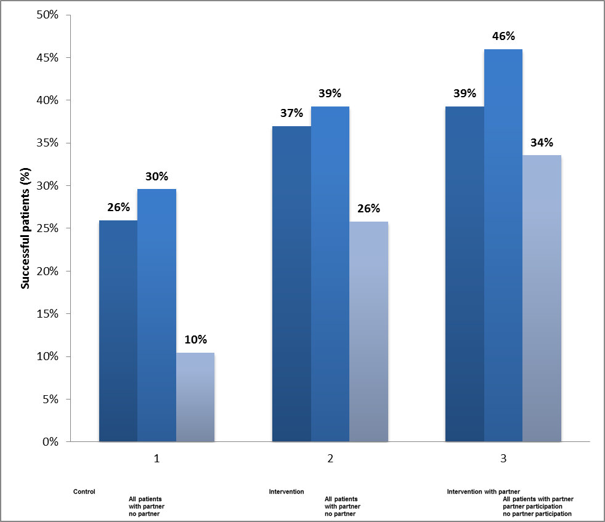
Partners
p=0.03
primary outcome
control
intervention
intervention
ⱳ partner
a b c
d e f
g h i
a. all controls (351)
b. controls with partner (284)
c. controls no partner (67)
d. all interventions (360)
e. interventions with partner (298)
f. interventions no partner (62)
g. all interventions with partner (298)
h. intervention with participating partner (137)
i. interventions with nonparticipating partner (161)

Slide 15
conclusions
nurse-coordinated referral of CAD patients and their partners to a comprehensive set of lifestyle programs improves LRFs significantly more than usual care alone
partner participation was associated with a higher rate of success
this strategy can be easily implemented into daily practice to improve secondary prevention of CAD

Slide 16
study group
steering committee
centers
Amphia MC, Breda
Atrium MC, Heerlen
Catharina MC, Eindhoven
Diakonessen MC, Utrecht
Flevo MC, Almere
Gelderse Vallei, Ede
Groene Hart MC, Gouda
Leeuwarden MC
Martini MC, Groningen
MS Twente, Enschede
OLVG MC, Amsterdam
Rijnstate MC, Arnhem
St Antonius MC, Nieuwegein
Tergooi MC, Hilversum
AMC, Amsterdam
Madelon Minneboo, MD
Sangeeta Lachman, MD
Marjolein Snaterse, MSc
Harald Jørstad, MD, PhD
Gerben ter Riet, MD PhD
Matthijs Boekholdt, MD, PhD
Wilma Scholte op Reimer, PhD
Ron Peters, MD, PhD, chair

Slide 17
Back-ups

Slide 18
deterioration in isolated LRFs
 | Intervention (n=360) | Control (n=351)
any weight gain | 164 (46%) | 180 (54%)
deterioration in 6MWD | 77 (21%) | 102 (29%)
urinary cotinine turned + | 21 (6%) | 14 (4%)

Slide 19
exclusion criteria
planned revascularization
life expectancy ≤ 2 years
CHF NYHA class III or IV
insufficient motivation
visits and/or lifestyle program not feasible
no internet access
Hospital Anxiety and Depression Scale >14

Slide 20
baseline characteristics
 | Intervention (n=360) | Control (n=351)
age (yrs) | 58.2 ±9.0 | 59.2 ±9.4
female (%) | 21 | 21
caucasian | 94 | 92
married, cohabitating | 83 | 81
STEMI | 42 | 39
Non-STEMI | 37 | 35
unstable angina | 7 | 9
stable angina revascularisation | 14 | 18
PCI | 76 | 80
CABG | 11 | 11

Slide 21
No disclosures

