Slide 1
Aldosterone Targeted NeuroHormonal CombinEd with Natriuresis TherApy – Heart Failure Trial ATHENA-HF Trial
Javed Butler, M.D., M.P.H, M.B.A.
On behalf of the
NHLBI Heart Failure Clinical Research Network

Slide 2
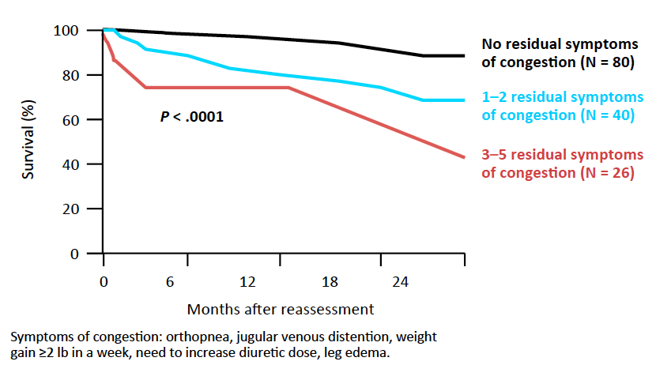
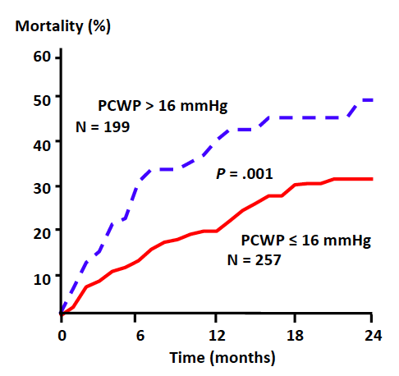
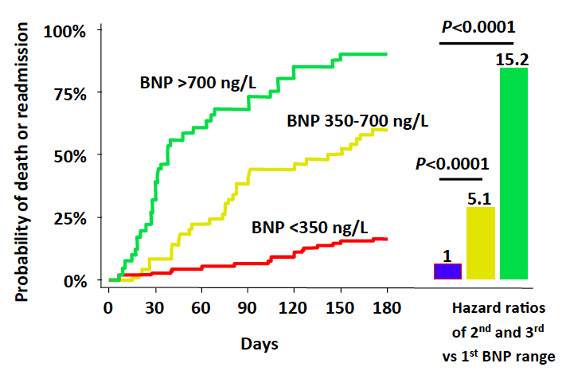
Persistent Congestion and Outcomes in Acute Heart Failure
Persistent clinical and sub-clinical congestion at discharge after AHF hospitalization is associated with worse outcomes.
Pulmonary Capillary
Wedge Pressure
Signs and symptoms
Natriuretic Peptide Levels
Lucas C, et al. Am Heart J. 2000;140:840-847.
Fonarow GC, et al. Circulation. 1994;90(pt. 2):1-488.
Logeart D, et al. J Am Coll Cardiol. 2004;43:635-641
Notes:
Physiology of HFpEF is unique with increased systolic and diastolic left ventricular and vascular stiffness, endothelial dysfunction and impaired systolic and diastolic reserve function, which contribute to exercise intolerance.

Slide 3
Acute Heart Failure
Aldosterone levels and high-dose MRA
Patients with AHF have elevated aldosterone levels that are associated with diuretic resistance and worse post-discharge outcomes Eur J Heart Fail. 2013;15(11):1228-35
High-dose mineralocorticoid receptor antagonists (MRA) therapy has been shown to overcome diuretic resistance in HF. Circ Heart Fail 2009; 2: pp. 370-376
In a single blind randomized trial of 100 patients, 50-100mg spironolactone use in AHF was associated with improved congestion and renal function.
Eur J Intern Med. 2014 Jan;25(1):67-72

Slide 4
Study Aim and Design
To test the hypothesis that high-dose spironolactone use in patients with AHF will lead to greater reductions in NT-proBNP levels from randomization to 96 hr.
Randomized, double blind, placebo-controlled, multicenter trial.
Patients not on MRA at baseline were randomized to spironolactone 100 mg or placebo
Those on low-dose spironolactone (12.5 or 25 mg) were randomized to 100 mg spironolactone or 25 mg spironolactone for 96h

Slide 5
Other Objectives
96 hours | Congestion score (dyspnea, orthopnea, fatigue, JVP, rales, edema) Dyspnea relief Net urine output Net weight change Loop diuretic dose requirement In-hospital worsening of HF
Day 30 | All-cause mortality All-cause readmissions Outpatient worsening HF (HF readmissions or ED visits or observational unit stays for HF or need for outpatients IV diuretics) MRA use Loop diuretic dose Index hospitalization length of stay
Day 60 | Vital status
Safety | Change in serum creatinine Hyperkalemia (>5.5mmol/L and >6.0mmol/L)

Slide 6
Key Inclusion Criteria
Age ≥21 yrs
At least 1 symptom and 1 sign of congestion
eGFR of ≥30 mL/min/1.73m²
Serum K⁺ ≤5.0 mmol/l
NT-proBNP ≥1000 pg/mL or BNP ≥250 pg/mL within 24h of randomization
Not on MRA or on low-dose spironolactone (12.5 mg or 25 mg daily) at baseline
Randomized within 24 hours of first IV diuretic dose

Slide 7
Key Exclusion Criteria
Eplerenone or >25 mg spironolactone at home
Systolic blood pressure <90 mmHg
Significant arrhythmias or ICD shock within 1 wk
ACS currently suspected or within the past 4 wk
Current or planned LVAD within 30 days
Post transplant or expected to receive one within 30d
Current inotrope use

Slide 8
Study Flow and Enrollment
12/2014 to 4/2016
360 patients enrolled from 22 sites.
182 patients randomized to high-dose spironolactone
178 to usual care
132 placebo
46 continued low dose spironolactone

Slide 9
Clinical Characteristics
 | Placebo | Spironolactone
Age (yr.) | 65 (54, 74) | 65 (57, 76)
Female (%) | 36 | 36
White/Black (%) | 56/43 | 55/41
Myocardial Infarction (%) | 30 | 28
Hypertension (%) | 81 | 87
Atrial fibrillation (%) | 48 | 50
Diabetes Mellitus (%) | 42 | 40
Chronic Kidney Disease (%) | 31 | 24
LVEF (%) | 30 (20, 45) | 35 (21, 50)
Proportion <45% (%) | 79 | 69

Slide 10
Baseline Treatment
 | Placebo (%) | Spironolactone (%)
ACEI or ARB | 63 | 58
Beta blockers | 74 | 74
MRA | 28 | 27
Loop diuretics | 95 | 97
Hydralazine | 26 | 24
Nitrates | 19 | 19
Implanted defibrillator | 42 | 35
Biventricular pacemaker | 37 | 42

Slide 11
Vitals and Laboratory Data
Baseline Characteristics | Placebo | Spironolactone
SBP - mmHg | 123 (108, 138) | 120 (106, 138)
Heart rate - bpm | 80 (70, 94) | 78 (70, 90)
Body mass index | 32 (27, 38) | 30 (25, 35)
Sodium - mEq/L | 140 (138, 142) | 140 (138, 142)
Potassium - mEq/L | 4 (3.6, 4.3) | 3.9 (3.6, 4.3)
Blood urea nitrogen - mg/dL | 22 (17, 31) | 23 (16, 33)
Creatinine - mg/dL | 1.3 (1.0, 1.5) | 1.2 (1.0, 1.5)
eGFR - ml/min/1.73 m² | 55 (46, 71) | 58 (45, 75)

Slide 12
Results - Primary Endpoint
 | Placebo | Spironolactone | P
Log NTproBNP
Baseline | 8.23 (7.58, 8.94) | 8.43 (7.90, 9.17)
96 h (or discharge) | 7.64 (6.93, 8.45) | 7.89 (7.19, 8.68)
Change | -0.49 (-0.98, -0.14) | -0.55 (-0.92, -0.18) | 0.57
N-terminal pro B-type natriuretic peptide, pg/ml
Baseline | 3753 (1968, 7633) | 4601 (2697, 9596)
96 h (or discharge) | 2080 (1025, 4675) | 2672 (1326, 5896)
Change | -1072 (-3182, -231) | -1796 (-3883, -571) | 0.76

Slide 13
Dyspnea and Congestion
 | Placebo | Spironolactone | P
Dyspnea - Likert Score | 2 (1, 3) | 2 (1, 3) | 0.30
Dyspnea – Visual Analog Scale
Baseline | 65 (40, 75) | 60 (45, 75)
96 h | 83 (70, 90) | 80 (65, 90)
96 h Change | 15 (5, 30) | 15 (2, 30) | 0.61
 | Placebo | Spironolactone | P
Clinical congestion score
Baseline | 11 (9, 12) | 10 (9, 12)
96 h | 4 (2, 6) | 4 (2, 7)
Change | -6 (-8, -4) | -6 (-8, -4) | 0.416

Slide 14
Urine Output and Weight Change
 | Placebo | Spironolactone | P
Net urine output, mL
24 h | 1183 (510, 1955) | 1100 (483, 2131) | 0.76
48 h | 2282 (1155, 4135) | 2484 (1203, 4411) | 0.44
72 h | 3810 (2011, 5565) | 4171 (2053, 6040) | 0.53
96 h | 5584 (2924, 8132) | 6086 (2780, 8420) | 0.57
Weight change, Ibs
Baseline | 207.1 (171.0, 250.4) | 195.0 (162.6, 237.0)
96 h or early discharge | 198.9 (167.6, 243.6) | 185.1 (158.5, 230.8)
Change | -6.1 (-11.2, -1.8) | -7.3 (-13.0, -2.0) | 0.33

Slide 15
Diuretic Use and Worsening Heart Failure
 | Placebo | Spironolactone | P
Furosemide equivalent diuretic dose, mg
Baseline | 160 (120, 320) | 160 (100, 320)
96 h | 80 (40, 240) | 80.0 (40, 200)
96 h change | -80 (-160, 0.0) | -80.0 (-160, 0) | 0.77
 | Placebo |  | Spironolactone | P
Worsening heart failure (%)
Inpatient |  | 18 | 19 | 0.76
Outpatient |  | 10 | 11 | 0.76

Slide 16
Hyperkalemia
 | Placebo | Spironolactone | P
Change in serum potassium – mEq/L. Median (25th, 75th
24 h | 0.00 (-0.40, 0.30) | 0.00 (-0.30, 0.30) | 0.50
48 h | 0.10 (-0.3, 0.40) | 0.10 (-0.10, 0.40) | 0.02
72 h | 0.20 (-0.40, 0.55) | 0.20 (-0.20, 0.60) | 0.08
96 h | 0.20 (-0.30, 0.60) | 0.30 (0.00, 0.70) | 0.08
One patient in the placebo group developed serum K levels between 5.5-5.9 mmol/L
No one developed K concentration > 6.0 mmol/L

Slide 17
Renal Function
 | Placebo | Spironolactone | P
Change in serum creatinine - mg/dL. Median (25th, 75th)
24 h | 0.05 (-0.05, 0.20) | 0.05 (-0.03, 0.17) | 0.76
48 h | 0.02 (-1.10, 0.20) | 0.10 (-0.03, 0.20) | 0.67
72 h | 0.08 (-0.08, 0.22) | 0.10 (-0.03, 0.28) | 0.85
96 h | 0.10 (-0.02, 0.33) | 0.10 (-0.05, 0.27) | 0.77
Change in eGFR- ml/min/1.73 m². Median (25th, 75th)
24 h | -1.95 (-8.46, 2.79) | -2.58 (-7.83, 1.53) | 0.87
48 h | -1.59 (-9.65, 3.71) | -4.12 (-8.87, 1.89) | 0.95
72 h | -3.70 (-12.06, 4.09) | -3.71 (-10.67, 0.87) | 0.82
96 h | -5.53 (-13.11, 0.79) | -4.35 (-11.06, 1.74) | 0.56

Slide 18
Post Discharge Outcomes
Median time to discharge: 4 (2, 7) days in both groups.
Two patients in each arm died in-hospital
7 patients in placebo and 5 in spironolactone arm died by day 30.
No significant difference in post-discharge mortality, HF hospitalization, or ED visit.
47% in placebo and 43% in spironolactone arm had SAE by day 30

Slide 19
Sub-group analysis
No differences in the primary endpoint between patients stratified by
Age (< or > 65 years)
Gender
Baseline use of low dose vs. no spironolactone
Change in log NTproBNP in the spironolactone and placebo groups respectively was
EF< 45% was -0.55 (-0.92, -0.19) and -0.54 (-0.99, -0.15),
EF >45% was -0.53 (-1.03, -0.14) and -0.42 (-0.64, -0.03) (interaction P=0.078)

Slide 20
Conclusion
In ATHENA-HF, 100mg/day spironolactone for 96 hr in AHF did not achieve its primary aim of reducing NTproBNP level more than usual care alone
None of the secondary endpoints differed between the 2 groups
Dyspnea relief, clinical congestion, net urine output, weight lose, or clinical events
High dose spironolactone was well tolerated
No significant difference in worsening renal function or hyperkalemia between the two groups
These data do not support the routine use of high dose spironolactone in AHF.
The role of high dose MRA targeted to patients resistant to loop diuretics needs to be further studied.

