Slide 1

Transcatheter Intracardiac Shunt Device Provides Sustained Clinical Benefit at One Year in Heart Failure with Preserved or Mildly Reduced Ejection Fraction:
The REDUCE LAP Heart Failure Trial
David M Kaye MD, PhD
on behalf of the REDUCE LAP HF Investigators

Slide 2
Disclosures
DK is an unpaid member of the Corvia Medical, Inc. Scientific Advisory Group

Slide 3
Introduction
Heart failure with preserved ejection fraction (HFPEF) has a complex pathophysiology and remains a therapeutic challenge.
Elevated left atrial pressure, especially during exercise, is a near-universal finding in patients with HFPEF.
Increased LV passive stiffness
Reduced active LV relaxation
Reduced LA compliance

Slide 4
Implications of Elevated LA Pressure in HFPEF
The magnitude of the exercise - mediated rise in PCWP in HFPEF is related to both symptoms and outcome.
SYMPTOMS
SURVIVAL
Dorfs EHJ 2014
REDUCE LAP-HF Unpublished data

Slide 5
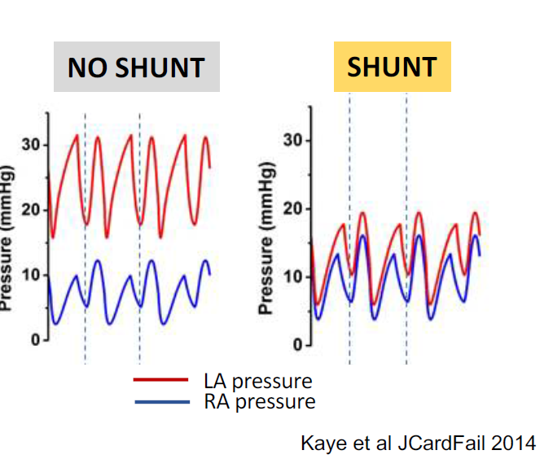
Left Atrial Decompression: IASD Rationale
Computer simulation demonstrated that an 8mm interatrial shunt device (IASD®) would provide acute LA decompression during exercise
LA pressure
RA pressure
Kaye et al JCardFail 2014

Slide 6
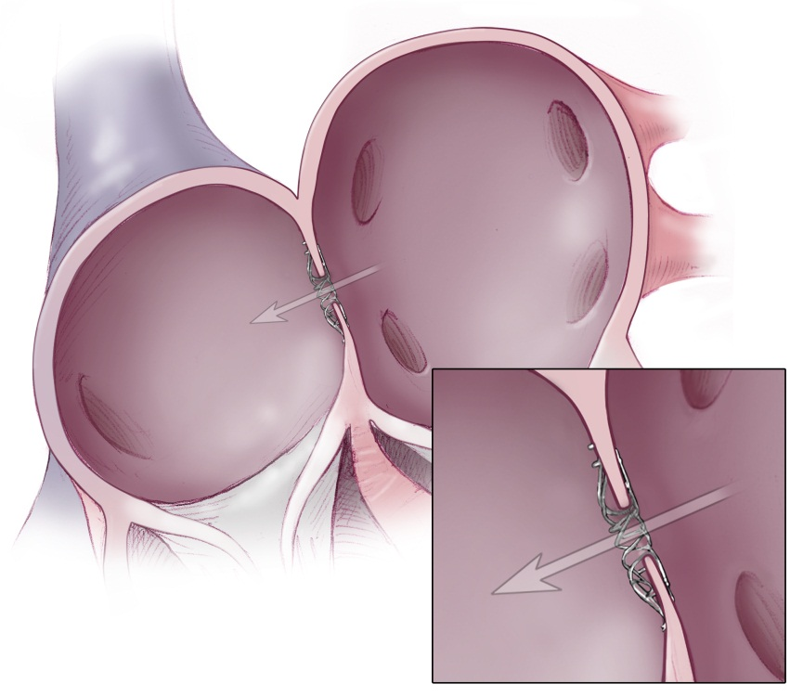
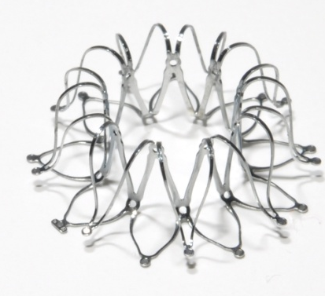
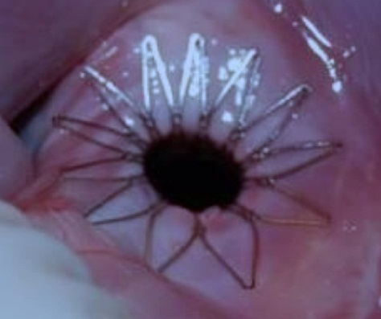
InterAtrial Shunt Device - Mode of Action
Elevated LV filling
pressures (Elevated LAP)
X
Pulmonary Venous
hypertension
Pulmonary Congestion & Dyspnea (rest/exercise)
Transcatheter interatrial shunt device
CAUTION ­­ Investigational device. Limited by Federal (or United States) law to investigational use

Slide 7
REDUCE LAP-HF Trial
Inclusion Criteria (n=64):
Open label
LVEF ≥ 40%,
NYHA class II-IV
Elevated PCWP
≥ 15 mmHg (rest) or
≥ 25 (supine bicycle exercise)
6 month outcomes
& reduced exercise PCWP
Hasenfuß G et al: Lancet 2016; 387: 1298–304
Notes:
Bar graphs showing New York Heart Association Class, Minnesota Living with Heart Failure score, six minute walk test distance and exercise time during right heart catheterisation at baseline and follow-up.

Slide 8
One year REDUCE LAP-HF OUTCOMES
Objective & Methods
To assess device safety (major adverse cardiac, cerebrovascular and systemic embolic events -MACCE), and device performance one year post implant.
  device performance: shunting (echocardiography)
To evaluate persistence of clinical benefit:
clinical efficacy: NYHA class, quality of life (MLWHFQ), 6MW distance
cardiac structure and function (echocardiography)
rest and exercise hemodynamics (optional sub-study, n=18)
  oximetry to assess Qp:Qs (n=13)
Study monitored by independent CEC and DSMB

Slide 9
Baseline Characteristics (n=64)
Age (Y) | 69±8
Gender (% Female/Male) | 66 / 34
LVEF (%) | 47 ± 7
NYHA Class (n, II/III/IV) | 18/46/0
Minnesota Living with HF Score | 49 ± 20
BMI kg/m² | 33 ± 6
Permanent AF (%) | 36
NT-Pro BNP (median, IQR pg./ml) | 377 (222-925)
Hypertension (%) | 81
Diabetes (%) | 33
Coronary artery disease (%) | 36
Diuretics at baseline (%) | 91
Resting CVP (mm Hg) | 9 ± 4
Resting PCWP (mm Hg) | 17 ± 5

Slide 10
Safety (MACCE) and Device Performance
MACCE event | Six months % | One year %
Death | 0 | 4.7 (3/64)
Stroke | 0 | 1.5 (1/64)* (pt died)
MI | 0 | 0
Systemic embolic event | 0 | 0
Implant removal | 0 | 0
Effectiveness | Six months % | One year %
L→ R Shunt flow (Echo) | 100 (49/49) | 100 (48/48)
R→ L Shunt flow (Echo) | 0 | 0
Qp:Qs | 1.27 ± 0.24 | 1.28 ± 0.25
Device patency confirmed in 54 subjects (by echo or oximetry)

Slide 11
Sustained Clinical Efficacy
Patients with data at all 3 time points.
Mean Δ at 1 year: 15 points
Mean Δ at 1 year: 33m
**p<0.01, ***p<0.001 vs baseline

Slide 12
Echocardiographic Results
No change in atrial volumes
*p<0.05, **p<0.01, ***p<0.001

Slide 13
Invasive Hemodynamic Results (rest)
 | Baseline | Six months | One year
RA pressure | 8 ± 3 | 11 ± 6 | 10 ± 4
PA _{mean} pressure | 25 ± 8 | 23 ± 7 | 26 ± 8
Wedge pressure | 19 ± 6 | 16 ± 8 | 17 ± 6
Cardiac output | 5.2 ± 1.3 | 6.3 ± 1.4** | 6.7 ± 1.8**
Patients with data at all 3 time points.
** p<0.01 vs baseline

Slide 14
Exercise Hemodynamic Results-1
* p<0.05, ** p<0.01 vs baseline

Slide 15
Exercise Hemodynamic Results-2
IASD therapy provides increased work capacity for a given LA pressure
* p<0.05, ** p<0.01 vs baseline

Slide 16
Summary and Conclusions
Implantation of an interatrial shunt device appears to be safe with an acceptable MACCE rate through one year of follow-up.
Interatrial shunt device patency was maintained through one year
The clinical and hemodynamic benefit observed 6 months after implant was sustained through one year, with no evidence of adverse sequelae
  Meaningful improvements in NHYA class, exercise capacity and QOL
  Clinically meaningful reduction in normalized PCWP
Randomised trials are required and ongoing to determine the value of this novel strategy for the management of HFPEF.

Slide 17
Back-up

Slide 18
Clinical Efficacy
Parameter* | Baseline | Six months | One year
NYHA class (60) | 2.7 ± 0.5 | 2.1 ± 0.7 ^{p < 0.001} | 2.0 ± 0.6 ^{p < 0.001}
MLWHF score (59) | 49.1 ± 20.1 | 35.1 ± 23 ^{p < 0.001} | 34 ± 33 ^{p <0.001}
6MWT (m) (55) | 331 ± 90 | 359 ± 100 ^{p < 0.01} | 364 ± 92 ^{p <0.01}
* Patients with data at all 3 time points.
RM-ANOVA with Bonferroni post hoc

