Slide 1
American College of Cardiology 2017
Scientific Sessions
“Prevalence of high-risk cardiovascular conditions for sport-related SCD, by an MRI-based study”
Angelini PE, Cheong BY, Lenge VV, Lopez JA, Uribe C, Masso AH, Ali SW, Davis B, Muthupillai R, Elayda MAE, Willerson JT.
Center for Coronary Artery Anomalies @ THI

Slide 2
Background
SCD in young athletes continues to be major concern.
In the USA, current screening policy is a “basic H&P”.
Exact incidence of SCD in population-based studies is not available.
A list of “high-risk cardiovascular conditions” (hr-CVC) is not yet well defined/investigated.
Obtaining an accurate estimate of hr-CVC prevalence is needed.
Screening MRI (s-MRI) could be a practical, cost-effective basis for finding hr-CVC and formulating an effective policy for SCD prevention.

Slide 3
Current Theory on SCD in athletes
Pre-existent defects, usually congenital, predispose to SCD during strenuous exertion.
By identifying those defects and establishing their severity (hr-CVC, or high-risk cardiovascular conditions), we can prevent SCD.
Basic condition to answer hr-CVC issues: prevalence of hr-CVC in a general population, versus in athletes’ SCD.
Additionally: we need to establish quantitative criteria for DCM- and HCM-hr-CVC (LV mass, LVEDV, LVEF and wall thickness).

Slide 4
Screen to Prevent Study (“S2P”, at THI)
Objectives: we used s-MRI to discover hr-CVC’s in a large, unselected population of school children.
Additionally, we established normal ranges of a normal population at the ages of 11-14y (to define DCM and HCM).
Testing screening tools: 1) questionnaire, 2) resting EKG and 3) s-MRI. Funding: Private Foundations.
Evaluate H&P and EKG value for screening.
Target hr-CVC’s: 1) EKG malignant anomalies; 2) Coronary artery anomalies (ACAOS-IM*); 3) Cardiomyopathies.
Years: 2010-2017, at Texas Heart Institute, Houston.
* Anomalous origin of coronary arteries, with intramural course

Slide 5
Screening Study Outline
CONSENTED PARTICIPANTS: N=5,642
COMPLETED STUDIES: 5,255 (93.1%)
INCOMPLETE STUDIES: 387 (6.9%)
Un-interpretable MRI for hr-CVC (artifacts): 8
Candidate declined Assent/Refused MRI: 213.
DEMOGRAPHICS
Discomfort/Claustrophobia: 78.
MRI Safety: 72
Other (weight, low HR, equipment failure: 24)
 | Asian | Black | Hispanic | White | Other¹ | Subtotal (n) | % | Average Age, y
Female (n) | 262 | 560 | 472 | 665 | 335 | 2294 | 44.3 | 13.1
Male (n) | 260 | 63 | 512 | 994 | 477 | 2881 | 55.7 | 13.0
Subtotal (n) | 522 | 1198 | 984 | 1659 | 8.12
% | 10.1 | 23.1 | 19.0 | 32.1 | 15.7
Harris County TX Census² % | 7.0 | 18.5 | 41.8 | 31.4 | 1.2
As self-reported, includes American Indian, Hawaiian/Pacific Islander, multiracial
Census Bureau Data for 2015: Harris County Profile at www.txcip.org The Texas Heart® Institute

Slide 6
Quantitative MRI analysis= 1,159 (mean and SD, using also short axis) Spectrum of LV mass (in g, SD+ no.): by age, gender, race
 | BLACK |  | HISPANIC |  | WHITE
GENDER AGE | Female (214) | Male (314) | Female (108) | Male (119) | Female (126) | Male (278)
11 (215) | 69.38±14.67 (43) | 71.57±22.11 (37) | 64.48±15.46 (15) | 70.46±22.78 (15) | 58.02±12.45 (36) | 65.32±18.8 (69)
12 (351) | 85.01±24.47 (63) | 81.16±23.16 (95) | 70.88±18.14 (33) | 78.17±17.07 (34) | 68.32±15.17 (39) | 71.34±17.72 (87)
13 (375) | 73.87±16.54 (70) | 100.01±26.55 (116) | 69.66±17.13 (40) | 92.99±18.1 (42) | 83.76±20.59 (38) | 90.83±26.28 (69)
14 (198) | 77.6±16.79 (38) | 105.46±26.26 (46) | 70.57±15.1 (20) | 97.42±20.35 (28) | 77.77±13.31 (13) | 98.25±22.88 (53)
The Texas Heart ®Institute

Slide 7
Left Ventricular End-diastolic Volume (mL)
ETHNICITY or RACE | BLACK |  | HISPANIC |  | WHITE
GENDER AGE | Female | Male | Female | Male | Female | Male
11 (215) | 109.79±22.7 (43) | 107.87±26.12 (37) | 100.03±20.78 (15) | 106.85±25.17 (15) | 96.4±25.78 (36) | 102.98±22.97 (69)
12 (351) | 123.86±26.56 (63) | 127±28.46 (95) | 110.29±18.12 (33) | 117.34±19.27 (34) | 111.77±19.64 (39) | 111.09±22.58 (69)
13 (375) | 114.56±21.73 (70) | 142.62±29.04 (116) | 108.64±18.92 (40) | 138.89±24.02 (42) | 131.08±27.5 (38) | 135.27± 29.11 (69)
14 (198) | 125.68±22.25 (38) | 147.14±31.69 (46) | 112.84±18.71 (20) | 147.21±25.31 (28) | 126.01±25.85 (13) | 142.23±26.91 (53)
The Texas Heart ®Institute

Slide 8
Frequency of Symptoms (% of 5,217) as Reported in Candidates’ Questionnaire, or signs measured (BP)
The Texas Heart ®Institute

Slide 9
EKG: frequent abnormalities (n= 5,255)
FINDINGS | No. | % of Total
Mobitz I, AV Block | 1 | 0.02
LVH (voltage) | 388 | 7.46
RVH (voltage) | 331 | 6.34
E-REPOL (automatic) | 766 | 14.73
ARVC (EP review) | 0 | 0.00
LBBB (> 120 ms) | 0 | 0.00
Note: none of these parameters correlated with hr-CVC (symptoms/MRI)
The Texas Heart ®Institute

Slide 10
Prevalence of Different Types of “hr-CVC”
Total Participants |  |  | n = 5,255 | 95% CI
hr-CVC, total (n) | 78 |  | 1.48% | 1.17-1.85
- ACAOS | 23 | 29.49% | 0.44% | 0.28-0.66
L-ACAOS | 6 | 7.69% | 0.11% | 0.04-0.25
L-ACAOS-IM | 2 | 2.56% | 0.04% | 0.00-0.14
L-ACAOS-NC | 2 | 2.56% | 0.04% | 0.00-0.14
L-ACAOS-HO | 2 | 2.56% | 0.04% | 0.00-0.14
R-ACAOS-IM | 17 | 21.79% | 0.32% | 0.19-0.52
- Cardiomyopathies | 15 | 19.23% | 0.29% | 0.16-0.47
DCM | 12 | 15.38% | 0.23% | 0.12-0.40
HCM | 3 | 3.85% | 0.06% | 0.01-0.17
- ECG | 40 | 51.28% | 0.76% | 0.54-1.04
Brugada | 1 | 1.28% | 0.02% | 0.00-0.11
WPW | 3 | 3.85% | 0.06% | 0.01-0.17
PQTc: >470 | 36 | 46.15% | 0.69% | 0.48-0.95
The Texas Heart ®Institute

Slide 11
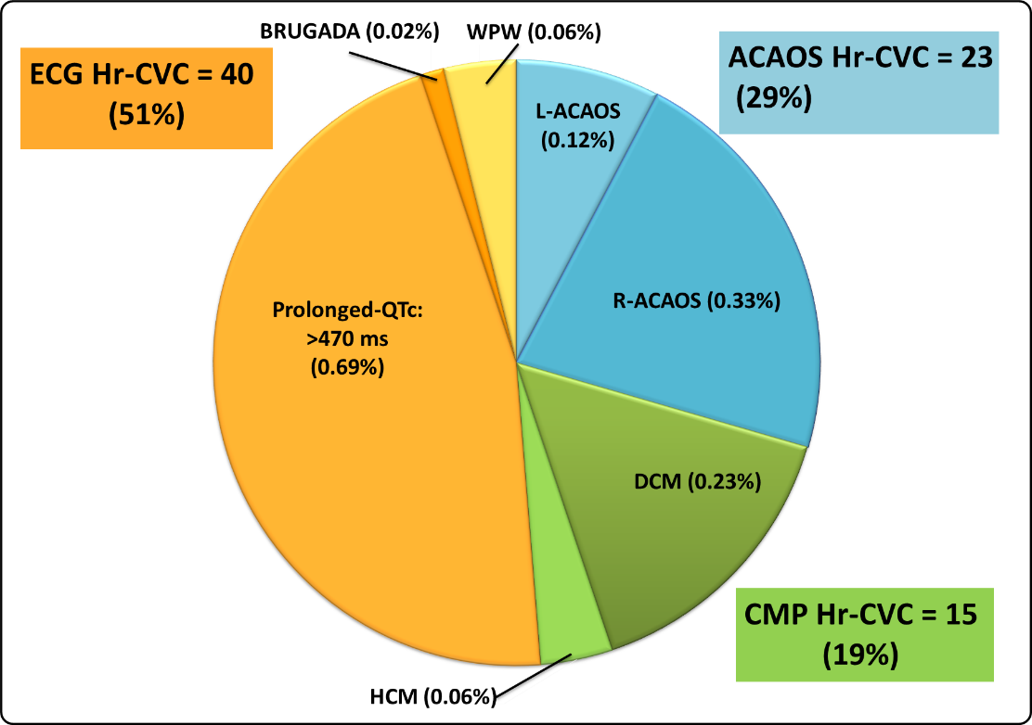
Prevalence of Most Frequent hr-CVC Subtypes (% of Total hr-CVC)
Note: If one assumes high-risk only QTc> 490 ms:
9 only were
hr= 11.6% !
The Texas Heart ®Institute

Slide 12
Myocardial Thickness in normal and NCLV
(total, normal cases)
NON-COMPACTION LEFT VENTRICLE= 982
(18.7% of 5,255; Confidence Index : 17.64-19.77)
Group | Thickness
Normal comparison group (n= 4,203) | 8.0± 1.0 mm
Non-compaction group (n= 988 adolescents) Compact at Non-compaction Control -Segments Compact | 2,6 ± 1.0 mm 7.0 ± 1.0 mm
The Texas Heart ®Institute

Slide 13
Quantitative Evaluation of LVEF, in 395 NCLV Cases
(39.9% of total= 982, under study)
EF % | n | %
EF >55% (“normal”) | 356 | 90.1
EF 50-55% (“abnormal”) | 29 | 7.3
EF 40-50% (“mild DCM”) | 10 | 2.5
EF <40% (DCM) | 0 | 0
The Texas Heart ®Institute

Slide 14
Conclusions
The S2P Screening protocol is able to reliably establish prevalence data of probable hr-CVC in the young. Specialist cardiologists are called to evaluate only 1.5% of candidates, whereas other 98.5% receive definitive re-assurance, in one session.
EKG defects seem to be most frequent class at screening, followed by ACAOS. At ages 11-14y, HCM is quite rare.
By themselves, at screening, both H&P and EKG are not useful for identifying structural hr-CVC (and their severity).
We now have a method to define “high risk” by using prevalence data: in general populations, versus in athletes victims of SCD.
Our innovative S-MRI-based method can be potentially proposed for screening young candidates (for sports or for recruits): it is safe, accurate, comfortable, and likely cost-effective in “high-risk populations”.
The Texas Heart ®Institute

