Slide 1


iFR vs FFR-guided Coronary Intervention – iFR-SWEDEHEART
Matthias Götberg, MD, PhD
Department of Cardiology, Lund University
Skane University Hospital
Lund, Sweden

Slide 2

Disclosures
Volcano/Philips: Unrestricted grant to fund iFR-SWEDEHEART
Consulting fees <5000 USD

Slide 3
Background
120
Wave-free period
Pressure (mm Hg)
Instantaneous Wave-Free Ratio (iFR) is a novel resting index for assessment of coronary lesion severity
Previous trials have demonstrated similar or improved diagnostic accuracy compared with Fractional Flow Reserve (FFR) but clinical outcome trials are lacking
Pa
70
Pd
1
0
Time (ms)

Slide 4
iFR-Swedeheart – Primary hypothesis
iFR is non-inferior to FFR at 1 year for the composite endpoint of:
− All-cause Death
− Non-fatal Myocardial Infarction
− Unplanned Revascularization

Slide 5
Primary Endpoint at 1 year
Pre-specified non-inferiority margin
= 3.2% for the upper 2-sided 95% confidence interval
iFR Non-inferior to FFR
95% CI
iFR inferior to FFR
95% CI
-2%
-1%
0
1%
2%
3%
4%
5%
Risk Difference in All-cause Death, MI and Unplanned Revascularization (%)

Slide 6
Power and statistical analysis
Expected event rate of 8% based on historical data *⁾
NI margin 3.2% (1.4)
With 85% power, 2000 patients required to test hypothesis
*⁾ SCAAR data on 12-month outcome in a mixed stable angina/ACS patient population

Slide 7
Study Design iFR-Swedeheart
Registry based Randomized Clinical Trial (RRCT) design established by TASTE-trial *⁾
National quality registries for data-input, online randomization and follow-up
Independent (blinded) Clinical Events Adjudication Committee for event adjudication (Uppsala Clinical Research Centre)
Independent (blinded) assessment of angiographic outcome
*) N Engl J Med. 2013, 369:1587
Notes:
Allows for a high inclusion rate with superior cost effectiveness

Slide 8
Major inclusion criteria
Patients with suspected stable angina pectoris or unstable angina pectoris/NSTEMI with a clinical indication for physiology-guided assessment of coronary lesions (30-80% stenosis grade)

Slide 9
Major exclusion criteria
Known terminal disease with a life expectancy <1 year
Unstable hemodynamics (Killip class III-IV)
Inability to tolerate adenosine
Previous CABG with patent graft to the interrogated vessel
Heavily calcified or tortuous vessel where inability to cross the lesion with a pressure wire was expected
Previous randomization in iFR-SWEDEHEART trial

Slide 10
Study Design
Patients with a clinical indication for physiology guided lesion assessment
1:1 Randomization
iFR-guided PCI
FFR-guided PCI
iFR >0.89
Defer PCI
iFR ≤0.89
Perform PCI
FFR >0.80
Defer PCI
FFR ≤0.80
Perform PCI
1-year Follow-up

Slide 11
Major Secondary Endpoints
Assessment of discomfort during the procedure (none/mild/moderate/severe
Target lesion revascularization (TLR)
Restenosis
Stent thrombosis
Rates of revascularization

Slide 12
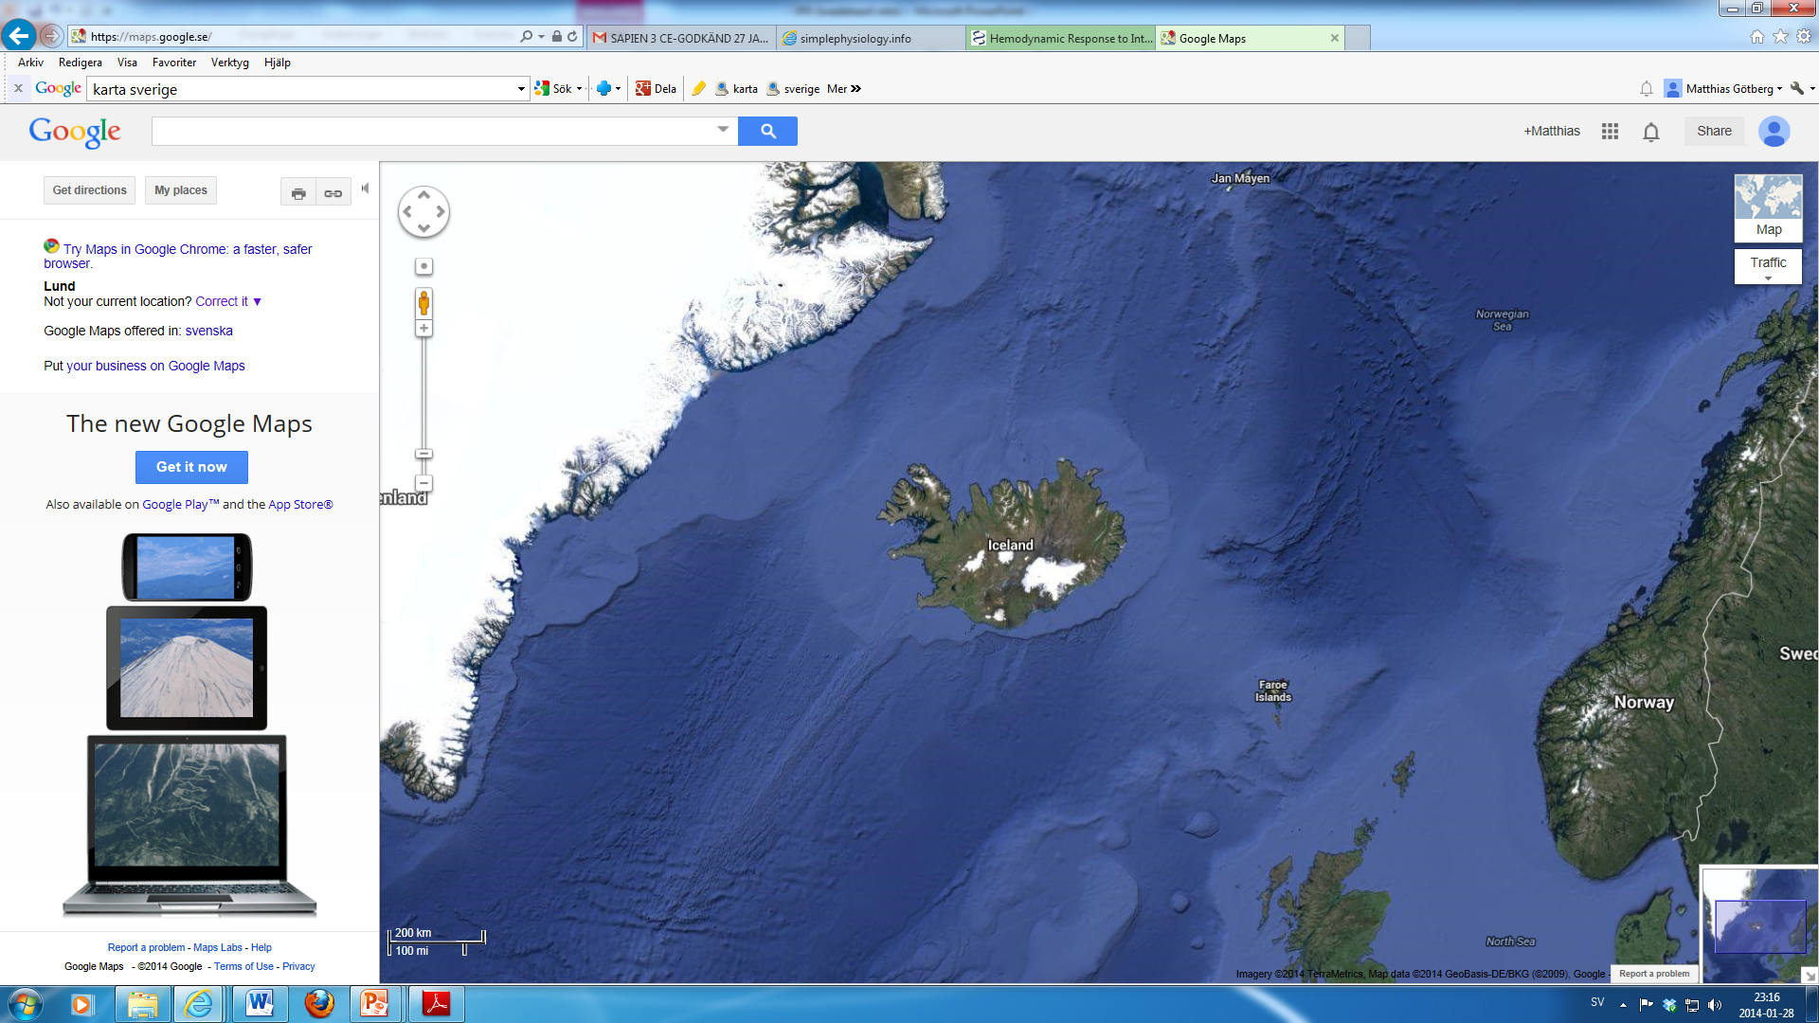
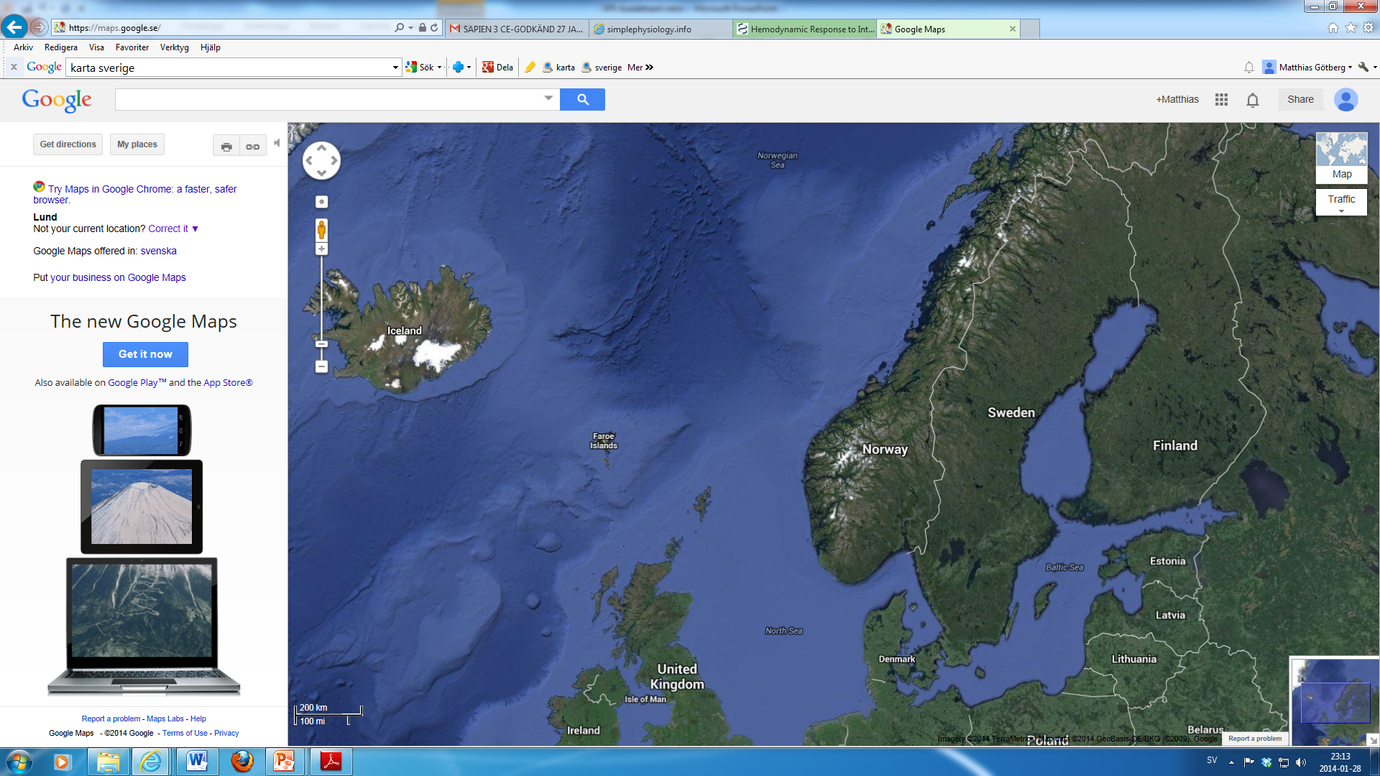
Participating sites
Lund/Malmö
Helsingborg
Kalmar
Göteborg
Linköping
Örebro
St Göran
Uppsala
Västerås
Karlstad
Sundsvall
Aarhus (Denmark)
Reykjavik (Iceland)
Steering committee
Matthias Götberg (PI)
Evald H. Christiansen
David Erlinge
Elmir Omerovic
Stefan K. James
Ole Fröbert (chairman)

Slide 13
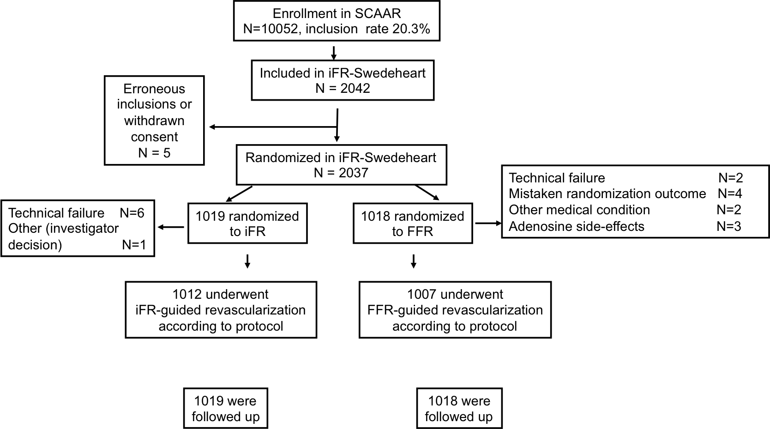
Enrollment
No patients were lost to follow-up

Slide 14
Baseline clinical characteristics
 | iFR | FFR
 | (N=1019) | (N = 1018)
Age - yr. (mean (± SD)) | 67.6 (9.6) | 67.4 (9.2)
Male sex - no. (%) | 756 (74.2) | 766 (75.3)
Indication for angiography - no. (%)
Stable angina | 632 (62.0) | 632 (62.0)
Unstable angina | 211 (20.7) | 208 (20.4)
NSTEMI | 176 (17.3) | 178 (17.5)
Diabetes mellitus - no. (%) | 232 (22.8) | 213 (20.9)
Hypertension - no. (%) | 730 (71.6) | 710 (69.7)
Hyperlipidemia - no. (%) | 733 (71.9) | 704 (69.1)
Current smoker | 159 (15.6) | 167 16.3)
Previous myocardial infarction - no. (%) | 337 (33.1) | 335 (32.9)
Previous PCI - no. (%) | 429 (42.1) | 425 (41.7)
Previous coronary artery by-pass grafting - no. (%) | 49 (4.8) | 43 (4.2)

Slide 15
Procedural characteristics (i)
 | iFR | FFR
 | (N=1012) | (N = 1007) | P Value
Radial artery approach - no. (%) | 841 (83.1) | 811 (80.5) | 0.13
Contrast use, ml (median (IQR)) | 110 (75) | 115 (81) | 0.10
Procedure time, min (IQR) | 50.8 (37) | 53.1 (35) | 0.09
Fluoroscopy time, min (median (IQR)) | 10.5 (10.7) | 10.2 (9.5) | 0.57
Total no. of lesions evaluated | 1568 | 1436
Mean no. of lesions evaluated (SD) | 1.55 (0.86) | 1.43 (0.70) | 0.002
Functionally significant lesions - no. (%) | 457 (29.2) | 528 (36.8) | <0.0001
Mean no. of functionally significant lesions per patient (SD) | 0.45 (0.71) | 0.52 (0.68) | 0.05
Mean iFR value (SD) | 0.91 (0.10) |  | -
Mean FFR value (SD) |  | 0.82 (0.10) | -
Notes:
More lesions evaluated with iFR. Higher number of significant lesions with FFR
Mean iFR/FFR-values indicate predominantly intermediate lesions

Slide 16
Procedural characteristics (ii)
 | iFR | FFR
 | (N=1012) | (N = 1007) | P Value
Treated vessel - no. (%) |  |  | 0.68
Left Main | 14 (1.5) | 16 (1.6)
LAD | 434 (47.4) | 469 (47.9)
LCx | 176 (19.3) | 179 (18.3)
RCA | 164 (17.9) | 196 (20.0)
Missing data | 127 (13.9) | 120 (12.2)
Mean no. of stents per patient undergoing PCI mean (SD) | 1.58 (1.08) | 1.73 (1.19) | 0.048
Drug eluting stent - no. (%) | 696 (98.6) | 770 (99.0) | 0.50
PCI as primary revascularization strategy - no. (%) | 443 (43.8) | 456 (45.3) | 0.50
CABG as primary revacularization strategy - no. (%) | 93 (9.2) | 113 (11.2) | 0.13
Total revascularization rates - no (%) | 536 (53.0) | 569 (56.5) | 0.11
Notes:
More lesions evaluated with iFR. Higher number of significant lesions with FFR
Mean iFR/FFR-values indicate predominantly intermediate lesions

Slide 17
Primary Endpoint at 1 year
(Death, MI, Unplanned revascularization)
iFR (n=1012)
FFR (n=1007)
HR (95% CI) =
1.12 (95% CI: 0.79, 1.58)
P=0.53
6.7%
6.1%

Slide 18
Primary Endpoint at 1 year
Non-inferiority Analysis
Pre-specified non-inferiority margin
= 3.2% for the upper 2-sided 95% confidence interval
Non-inferiority
achieved
0.7% 95% CI -1.5% to 2.8%
-2%
-1%
0
1%
2%
3%
4%
5%
Risk Difference in All-cause Death, MI and Unplanned Revascularization (%)

Slide 19
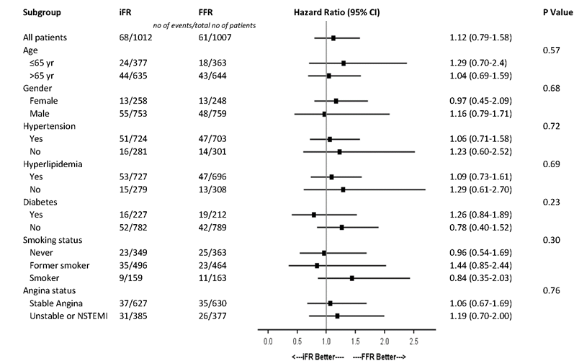
Primary Endpoint at 12 months
All-cause Death, MI, Unplanned Revascularization

Slide 20
Secondary Endpoints
 | iFR | FFR
 | (N=1012) | (N=1007) | Hazard Ratio (95% CI) | P Value
All cause death - no. (%) | 15 (1.5) | 12 (1.2) | 1.25 (0.58-2.66) | 0.57
Myocardial infarction - no. (%) | 22 (2.2) | 17 (1.7) | 1.29 (0.68-2.44) | 0.42
Unplanned revascularization - no. (%) | 47 (4.6) | 46 (4.6) | 1.04 (0.69-1.57) | 0.84
Target lesion revascularization (TLR) - no. (%) | 29 (2.9) | 27 (2.7) | 1.21 (0.70-2.07) | 0.49
Restenosis - no. (%) | 19 (1.9) | 18 (1.8) | 1.05 (0.55-2.01) | 0.87
Stent thrombosis - no. (%) | 1 (0.1) | 2 (0.2)

Slide 21
Unplanned Revascularization at 1 year medically treated patients
iFR (n=473)
FFR (n=435)
HR (95% CI) =
1.00 (95% CI: 0.44, 2.3)
P=0.98
2.5%
2.5%
Notes:
Due to lower rates of Revascularization in the iFR-group. No difference in unplanned revasc rates

Slide 22
Chest Discomfort from the procedure
3.0% vs 68.3% (P <0.0001)
I.v. adenosine 69%
I.c. adenosine 31%
iFR
FFR

Slide 23
Summary
In patients with a clinical indication for physiology-guided assessment of coronary lesions,
iFR was non-inferior to FFR regarding death, MI and unplanned revascularization at 1 year, while
iFR was superior to FFR regarding procedural discomfort

Slide 24
Conclusions
iFR-SWEDEHEART demonstrates that iFR is a safe and feasible alternative to FFR
iFR could be considered the preferred method for coronary physiology due to improved patient experience

Slide 25
Acknowledgements
Uppsala Clinical Research Centre (UCR)
Manage the Swedeheart registry
Clinical Research Organization (CRO)
Clinical Event Adjudication Committee
Chair: Christoph Warenhorst
Project Manager: Eva Jacobsson
Statisticians: Patrik Öhagen
Maria Bertilsson
Independent angiographic assessment: Prof. Thomas Engström, Rigshospitalet, Copenhagen, Denmark

Slide 26

Backup-Slide

Slide 27
Comparison of non-inferiority margins

Slide 28
Primary Endpoint at 12 months
(Death, MI, Unplanned revascularization)
iFR (n=1012)
FFR (n=1007)
HR (95% CI) =
1.12 (95% CI: 0.79, 1.58)
P=0.53
6.7%
6.1%

Slide 29
Enrollment per site
Institution | Investigator | N randomized
Aarhus University Hospital | Evald H. Christiansen | 308
Linköping University Hospital | Dimitrios Venetsanos | 228
Örebro University Hospital | Ole Fröbert | 225
Skane University Hospital (Lund) | Matthias Götberg | 195
Helsingborg County Hospital | Lennart Sandhall | 189
Karlstad County Hospital | Mikael Danielewicz | 179
Reykjavik University Hospital | Ingibjörg Gudmundsdottir | 131
Skane University Hospital (Malmö) | Matthias Götberg | 128
Kalmar County Hospital | Jörg Carlsson | 114
Sundsvall County Hospital | Jens Jensen | 76
Göteborg University Hospital | Elmir Omerovic | 73
St Göran County Hospital | Pontus Lindroos | 69
Västerås County Hospital | Amra Kåregren | 47
Halmstad County Hospital | Ann-Charlotte Karlsson | 43
Uppsala University Hospital | Stefan K. James | 32

