Slide 1
Real-World Comparative Effectiveness of Transcatheter Versus Surgical Aortic Valve Replacement in the United States: An Analysis From Two United States Registries Linked to Medicare Data
J. Matthew Brennan, MD, MPH
Duke University School of Medicine
Notes:
10 min presentation

Slide 2
Background
Randomized trials have demonstrated the safety and effectiveness of transcatheter aortic valve replacement (TAVR) in intermediate- and high-risk patients with aortic stenosis.
The German Aortic Valve Registry (GARY) raised concerns regarding mortality to 1 year (TAVR patients had a higher mortality rate than surgical aortic valve replacement [SAVR] patients).
Lingering questions:
Generalizability of TAVR to the real world?
Subgroups (especially intermediate-risk patients and those excluded from trials)?
Notes:
Background

Slide 3
Study Objectives
In a real-world cohort, we sought to evaluate:
The safety and effectiveness of TAVR versus SAVR.
Subgroup interactions, including by global risk (Society of Thoracic Surgeons [STS] Predicted Risk of Mortality [PROM] subgroups).
Notes:
Study Objectives

Slide 4


Data Sources and Design
Procedural registry data:
STS National Database
STS/American College of Cardiology (ACC) Transcatheter Valve Therapy (TVT) Registry
Follow-up: Medicare claims
Observational study (non-randomized)
Propensity-matched cohort
Notes:
Data Sources, Design
Procedural Registry Data:
Society of Thoracic Surgeons National Database
STS/American College of Cardiology Transcatheter Valve Therapies Registry
Follow-up:
Medicare claims
Observational Study (non-randomized)
Propensity Matched Cohort

Slide 5
Population Flow Diagram
STARTING POPULATION SAVR: 197,641 pts; 1041 sites from July 1, 2011 to December 31, 2013 TAVR: 25,579 pts; 392 sites from January 2, 2014 to September 30, 2015
EXCLUDE IF: Age <65 or >90 SAVR: 744 pts; TAVR: 3248 pts
STS: not isolated SAVR or CABG/SAVR SAVR: 140,851 pts
History of endocarditis SAVR: 873 pts; TAVR: 187 pts
Emergency / salvage status SAVR: 274 pts; TAVR: 47 pts
Aortic insufficiency without stenosis SAVR: 2374 pts; TAVR: 42 pts
STS: hostile chest SAVR: 4487 pts
TVT: inoperable and (hostile chest or porcelain aorta) TAVR: 1223 pts
Moderate or severe mitral stenosis SAVR: 507 pts; 721 pts
STS PROM ≤3% SAVR: 23,288 pts; TAVR: 2131 pts
Sites with <10 total records (TAVR or SAVR) SAVR: 1484 pts; TAVR: 20 pts
Characteristics | SAVR (n=4732) | TAVR (n=4732)
Age
Female
STS PROM
3-5%
5-8%
≥8%
ELIGIBLE POPULATION SAVR: 22,618 pts; 627 sites TAVR: 17,910 pts; 383 sites
Study Cohort (after PS matching) SAVR: 4732 pts; 627 sites TAVR: 4732 pts; 365 sites
Notes:
Population Flow Diagram
Baseline patient characteristics (brief)
In these 2 slides (this one & the next), I need to describe the cohort development & the included patients; also, need to address ‘balance’ of baseline risk across the 2 cohorts.
This is a lot of data– so, might want to combine this slide & the ones before & after in a different way– if you think another grouping would make more sense, let me know. (slides 4-6, here)

Slide 6
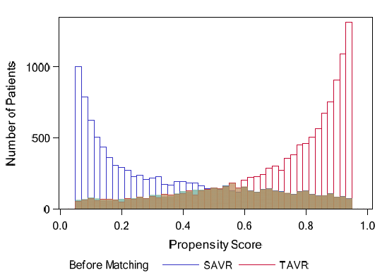
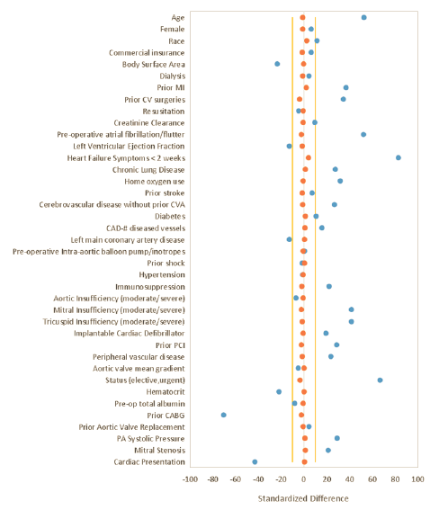
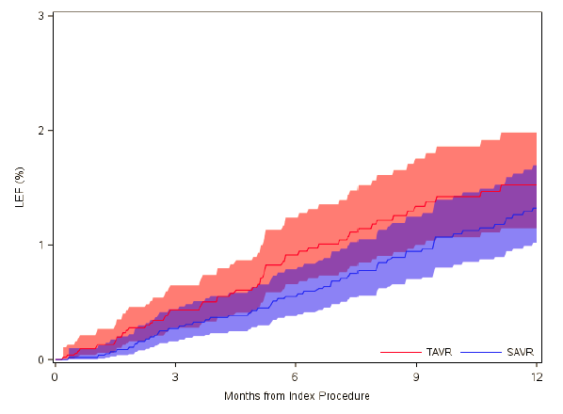
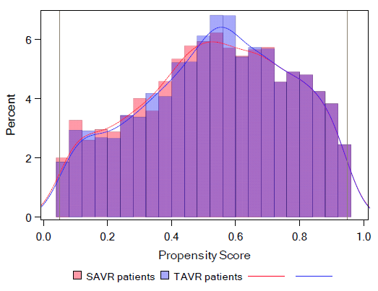
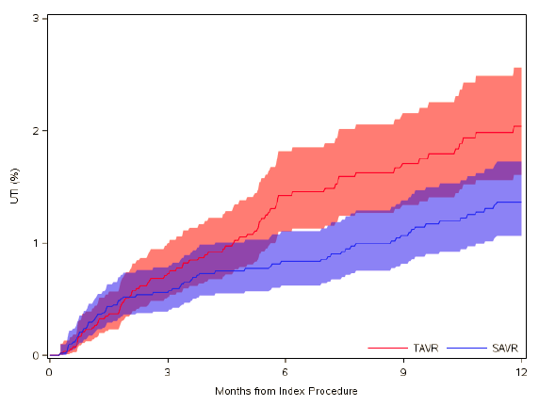
Propensity-Matched Cohort
Notes:
Propensity Matched Cohort – represented overlap (~55% ? Of overall treated cohort with AS in US)
Propensity distribution (L panel)
2 metrics of balance: St Diffs, Falsification Outcomes (R panel)

Slide 7
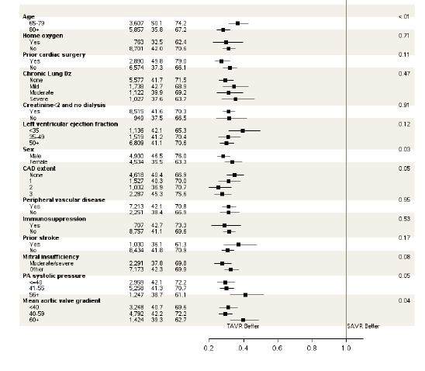
Inhospital Outcomes
#. of P-value for Subgroup Pts SAVR TAVR Interaction
Notes:
Inhospital Outcomes
Here, I need to describe inhospital outcomes.
Discharge to home is one of the outcomes that strongly favors TAVR – this is a subgroup analysis that shows that this is true across all of the subgroups evaluated.
Discharge to home is not necessarily an ‘inhospital outcome’– but, important to highlight somewhere.

Slide 8
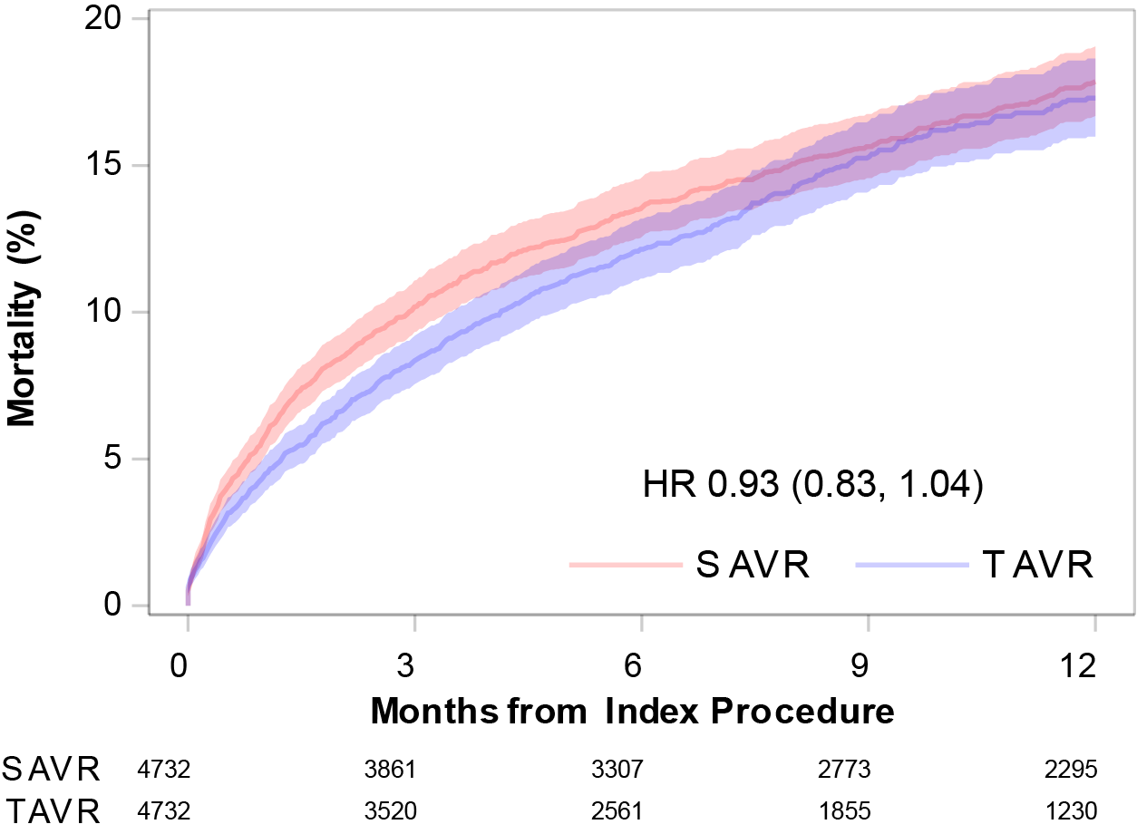
1-Year Outcomes: Mortality
Notes:
1-year outcomes:
Mortality

Slide 9
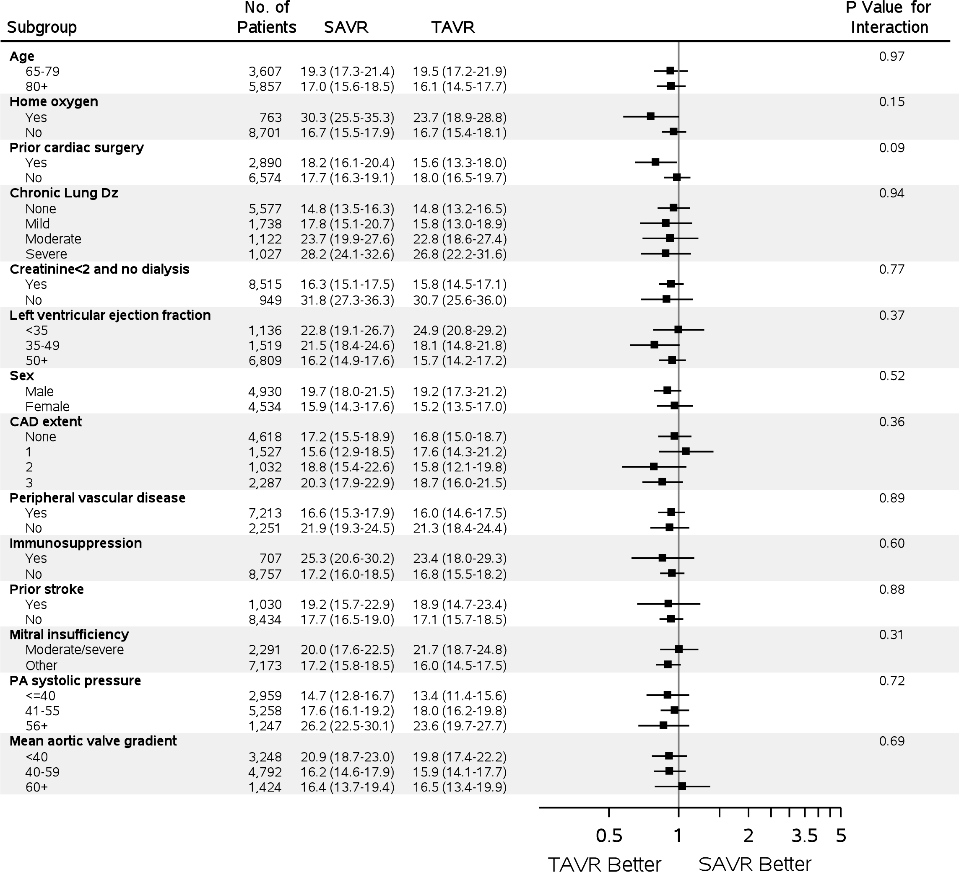
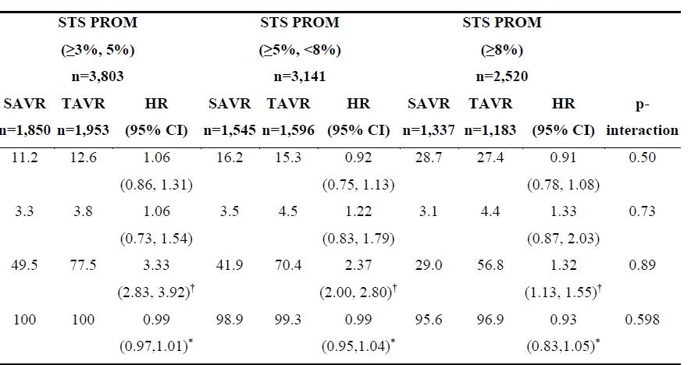
1-Year Outcomes: Mortality Subgroups
Notes:
1-year outcomes:
Mortality Subgroups
For the R-hand panel, forest plot that includes the 3 STS PROM subgroups & interaction term for Mortality

Slide 10
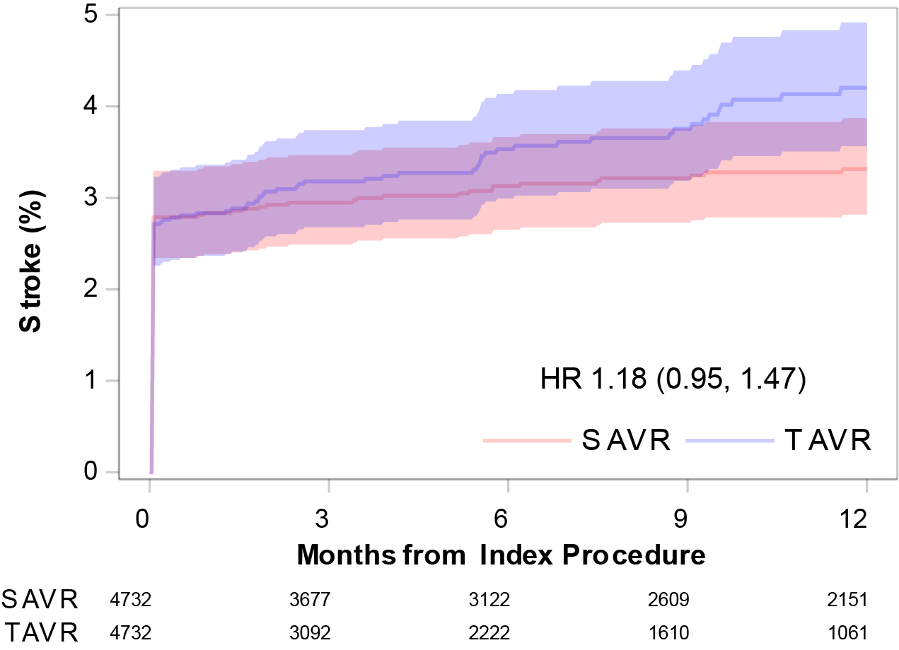
1-Year Outcomes: Stroke
Notes:
1-year outcomes:
Stroke

Slide 11
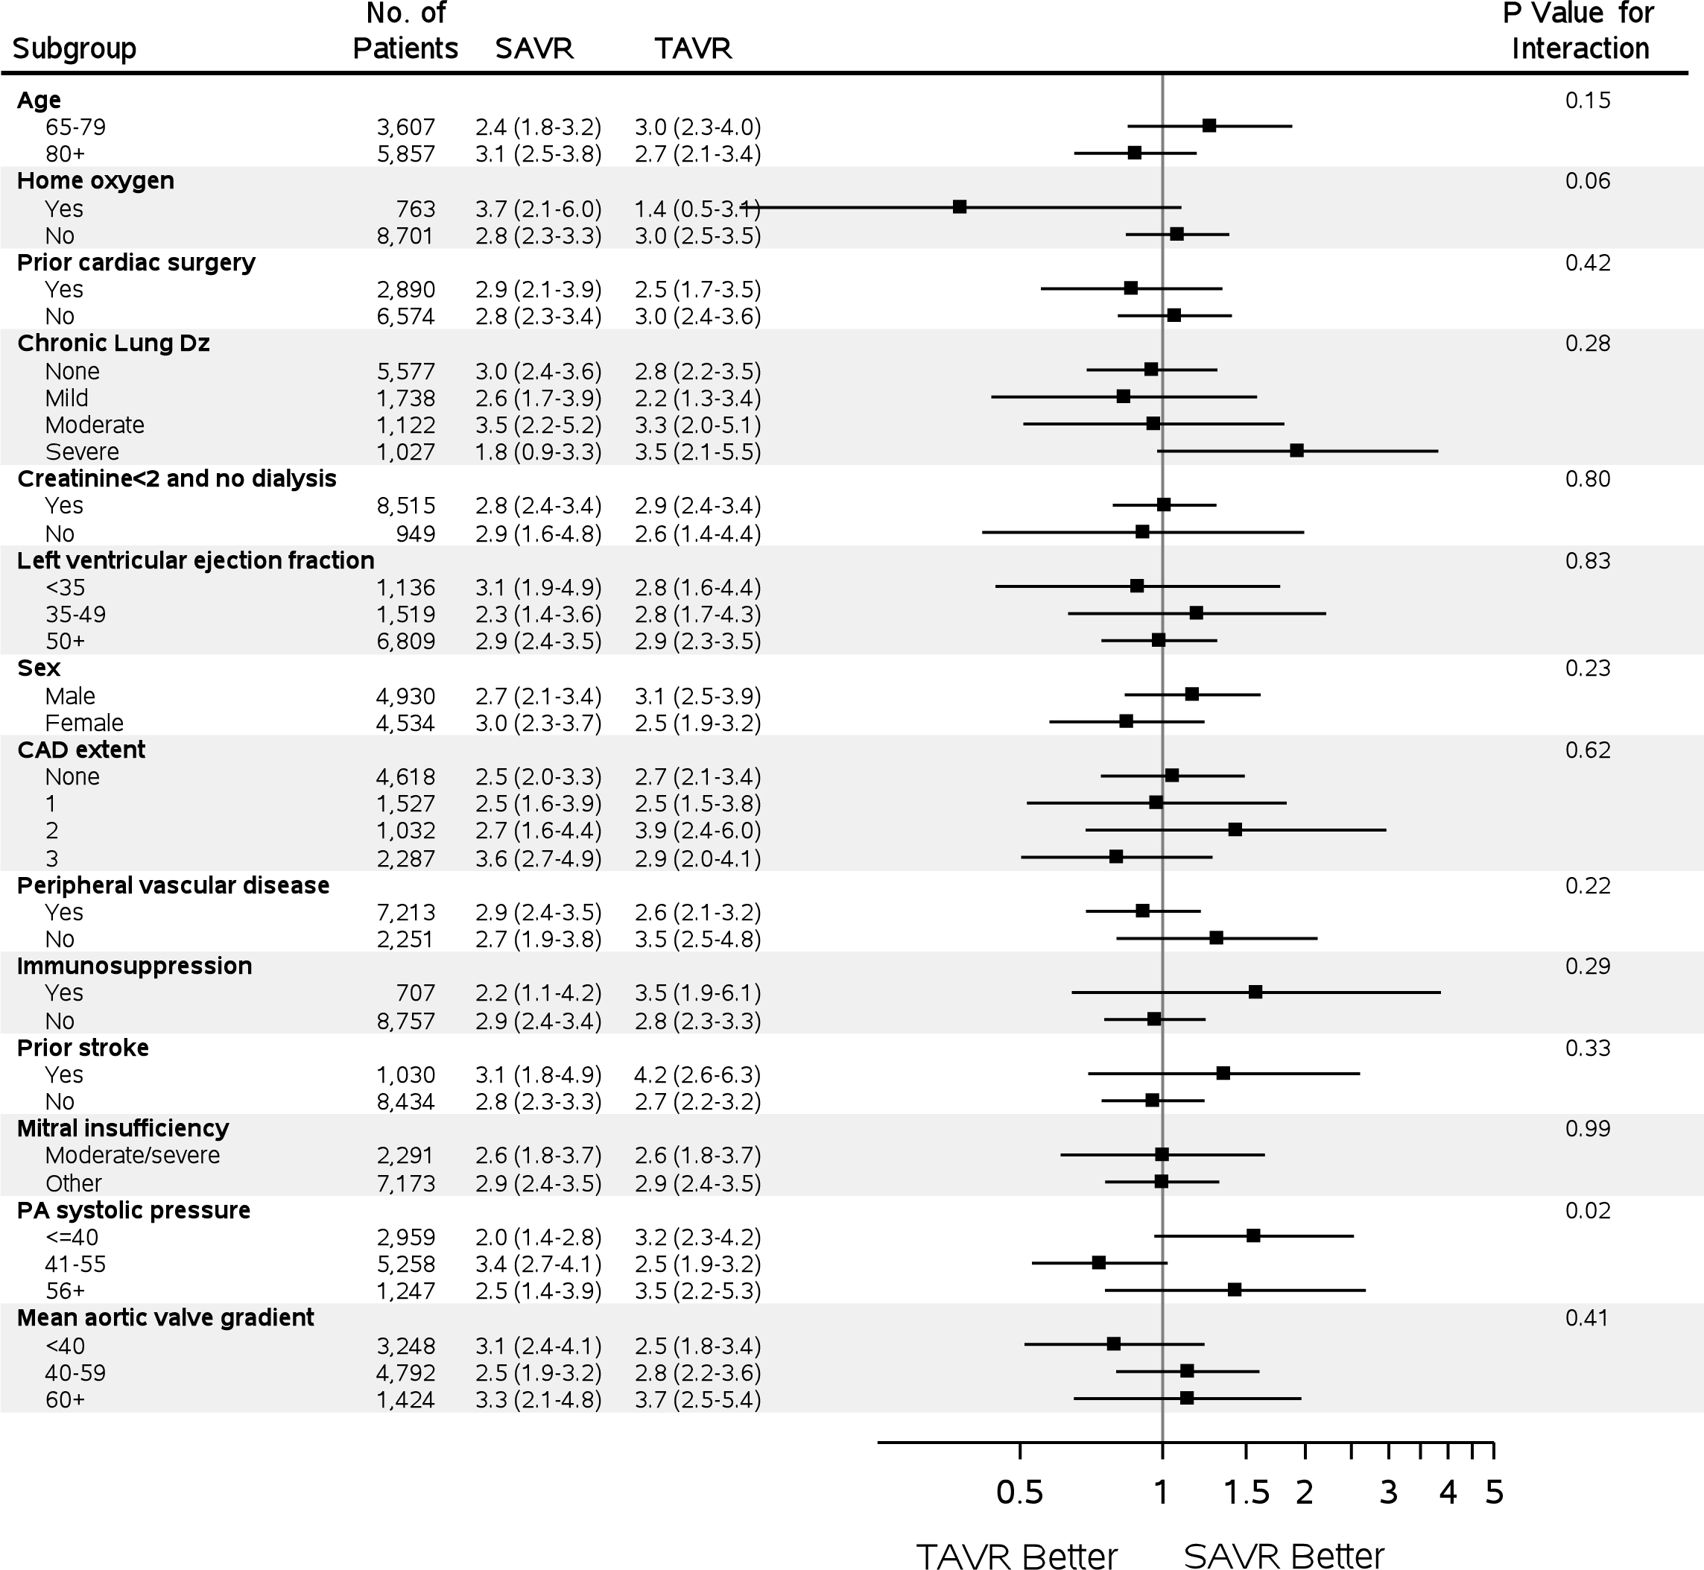
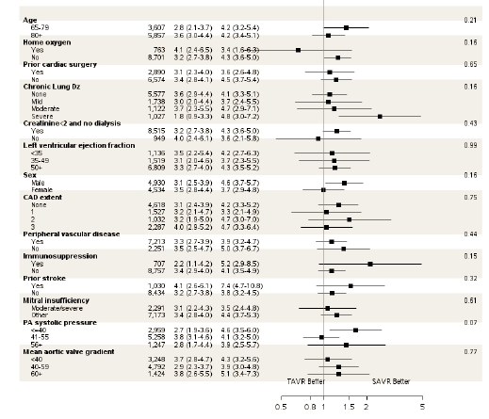
1-Year Outcomes: Stroke Subgroups
ONE-MONTH STROKE
ONE-YEAR STROKE
Notes:
1-year outcomes:
Stroke Subgroups
For Stroke, need to present forest plot results for both 1 month & 1 year separately– would be good to do this in 1 figure, though.
For the R-hand panel, forest plot that includes the 3 STS PROM subgroups & interaction term for Stroke

Slide 12
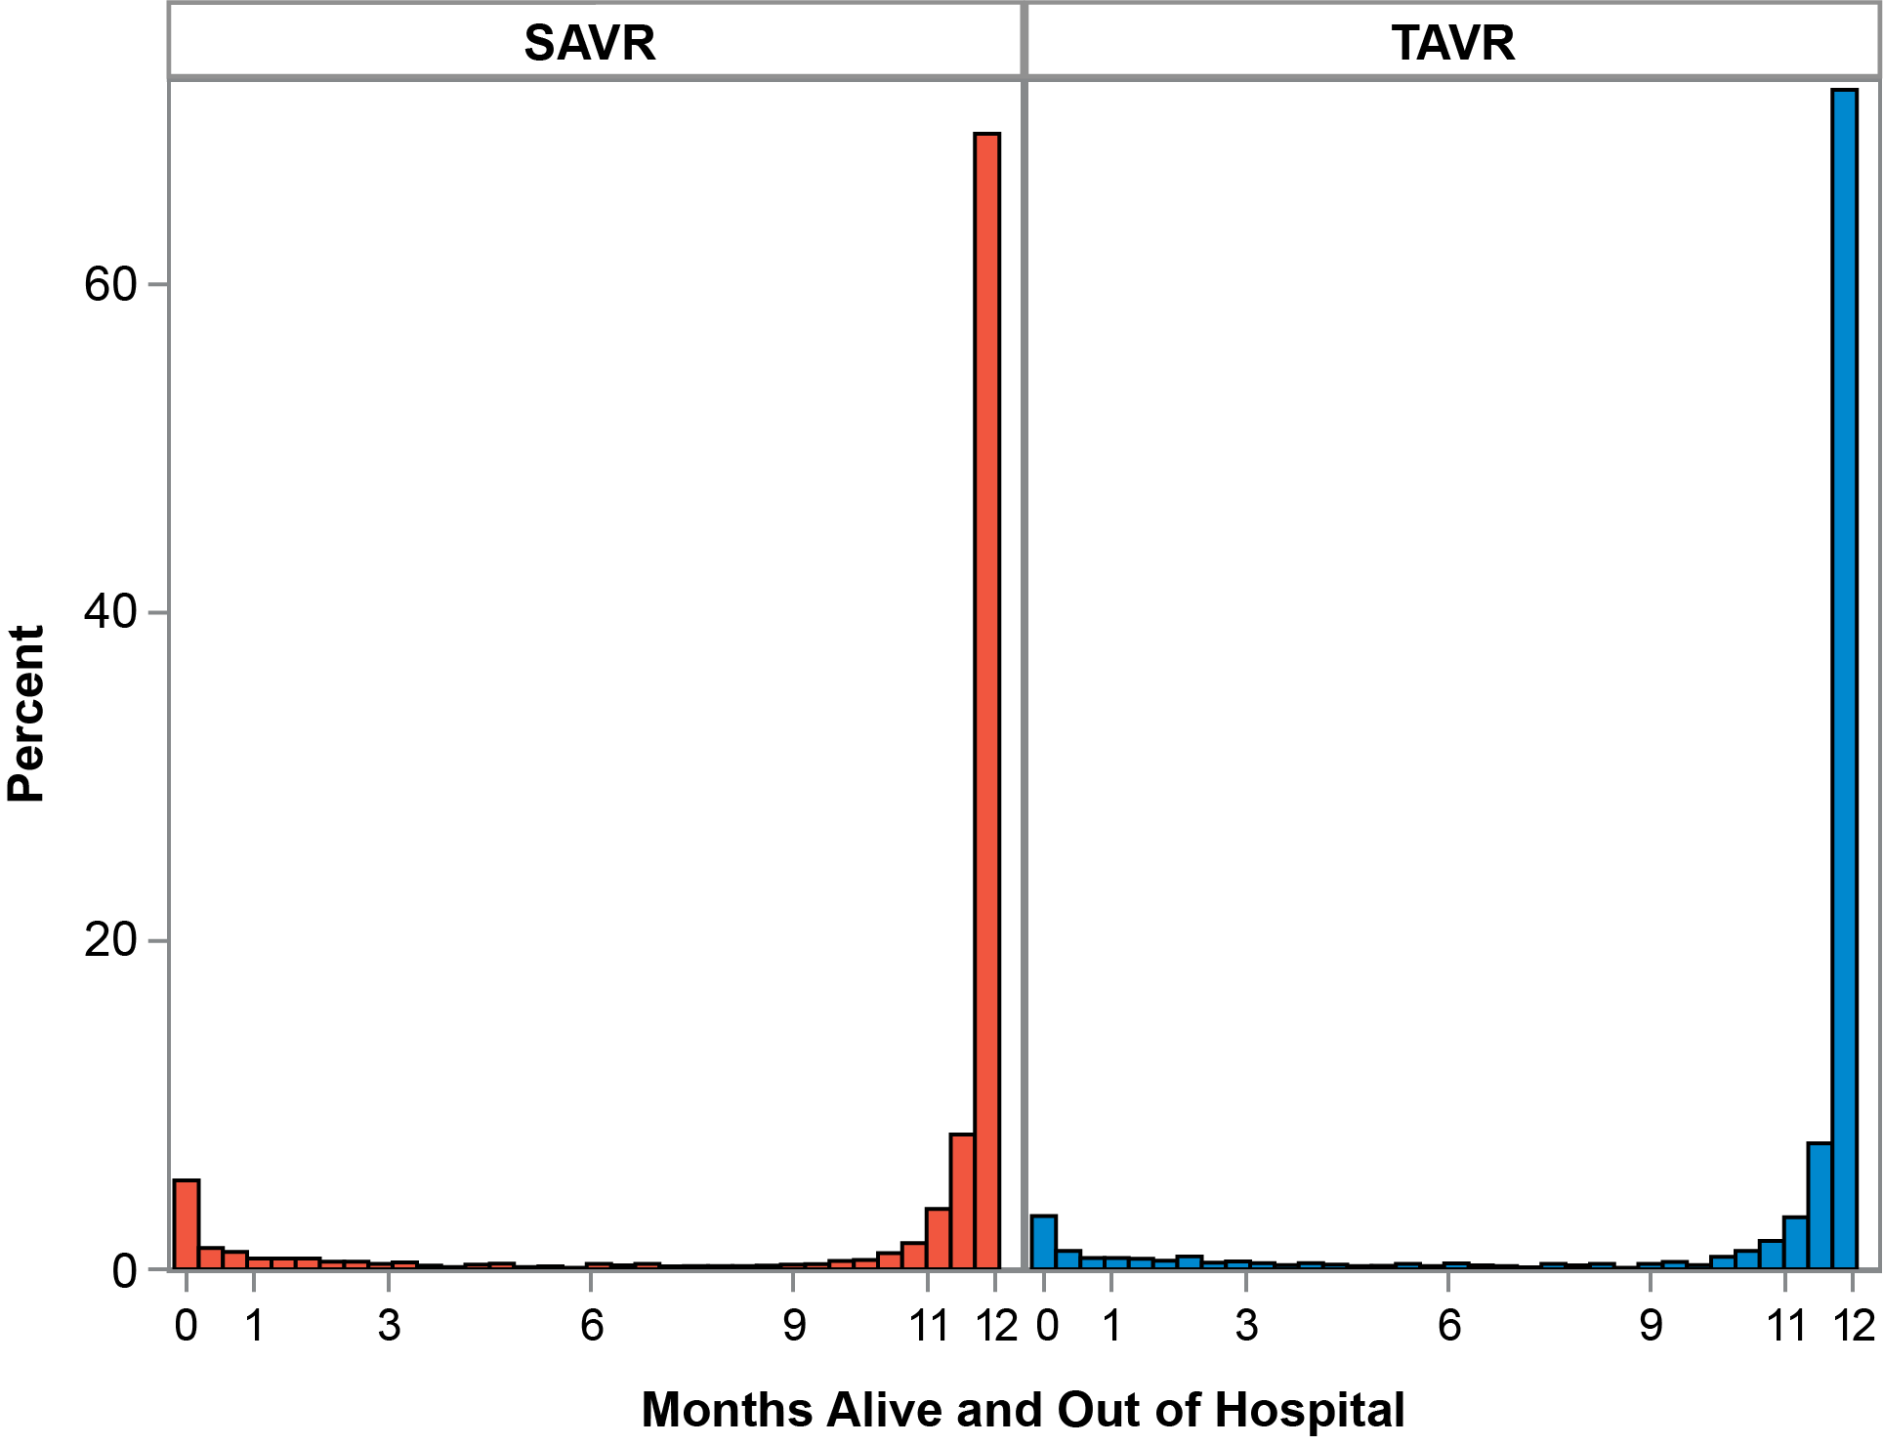
1-Year Outcomes: Days Alive and Out of the Hospital
Notes:
1-year outcomes:
Days alive and out of hospital

Slide 13
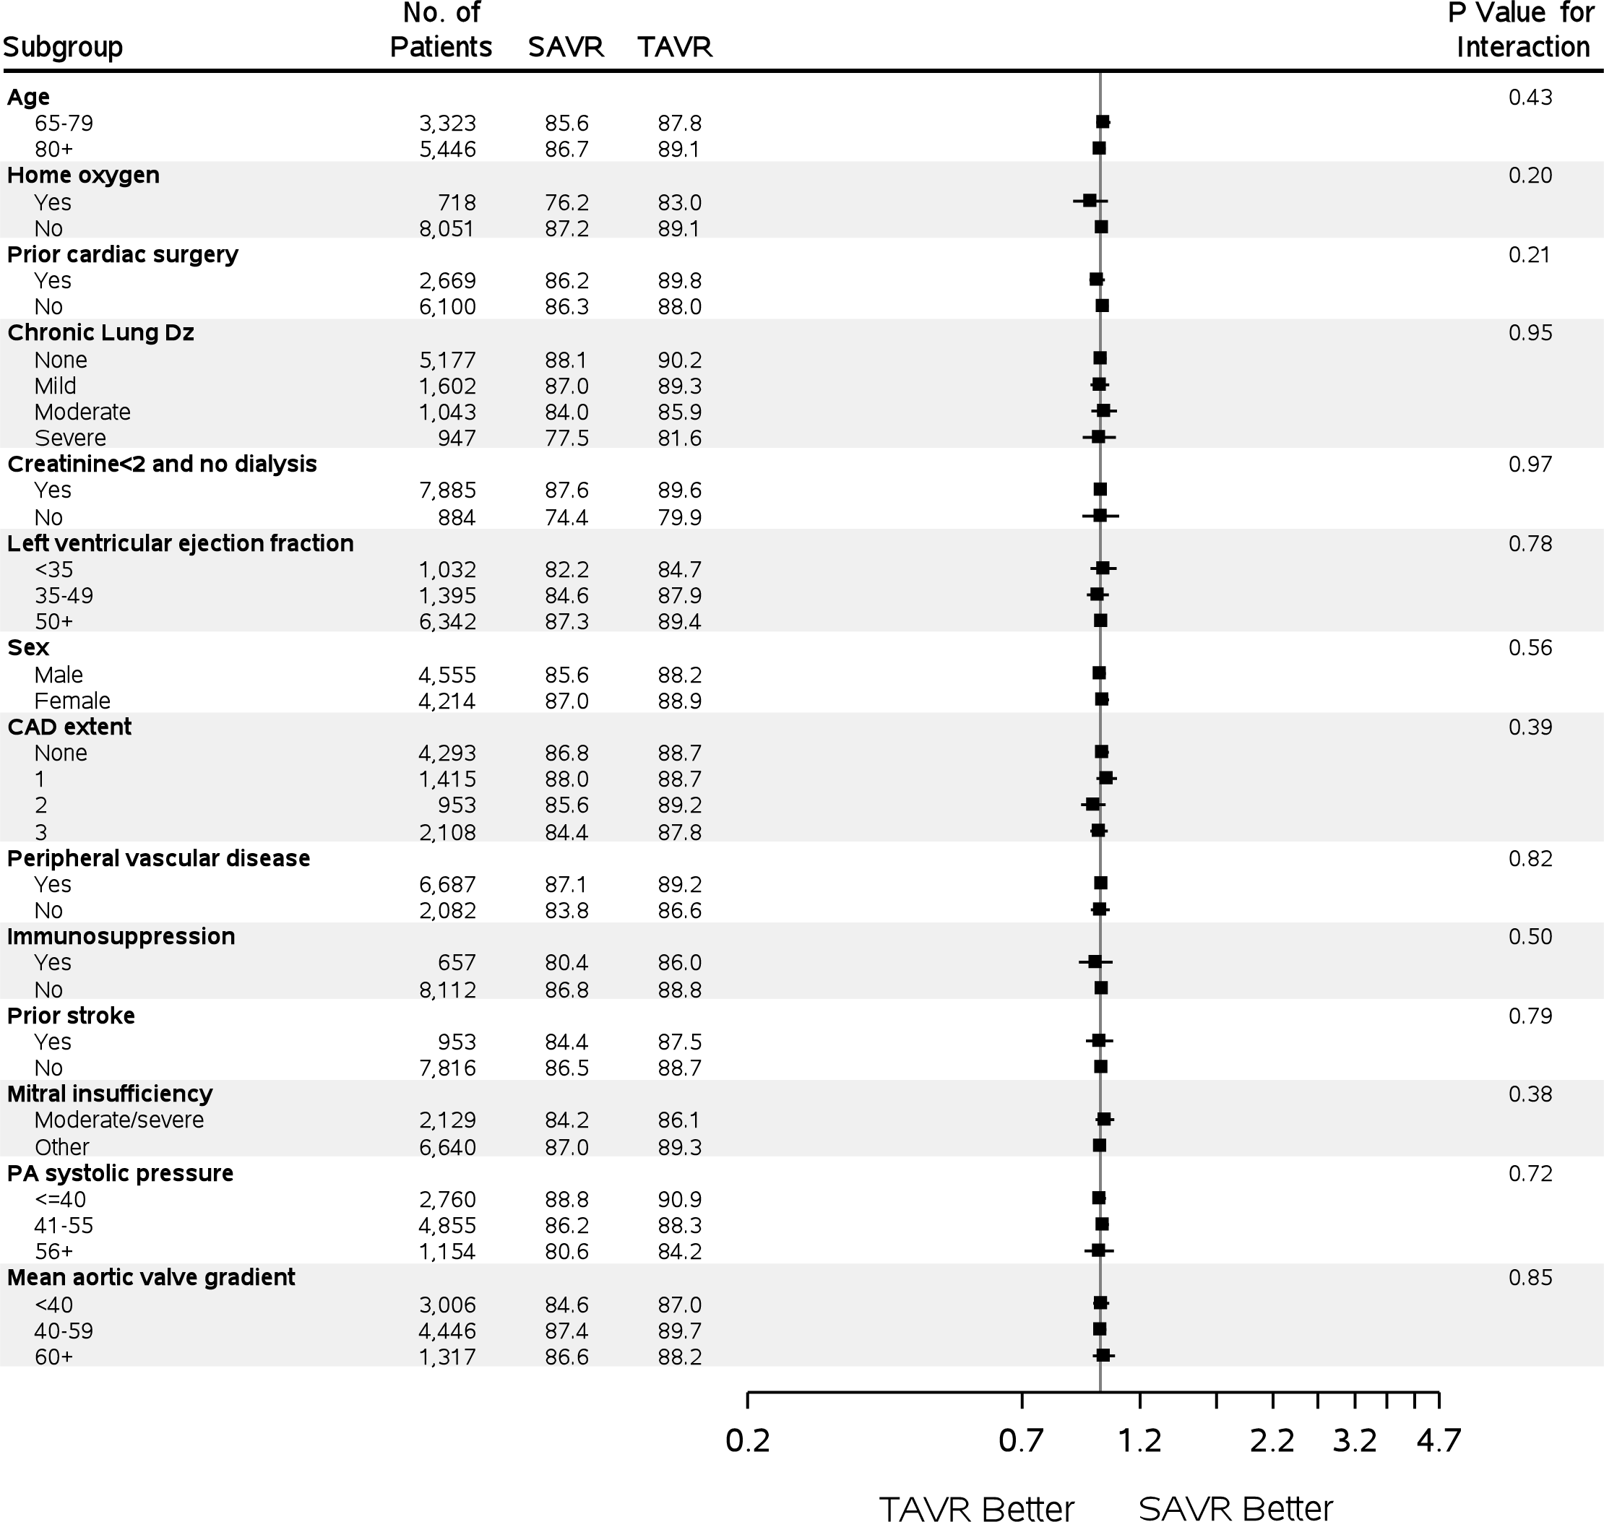
1-Year Outcomes: Days Alive and Out of the Hospital Subgroups
Notes:
1-year outcomes:
Days alive and out of hospital Subgroups
For the R-hand panel, forest plot that includes the 3 STS PROM subgroups & interaction term for DAOH

Slide 14
Summary
Among unselected real-world patients and hospitals, TAVR is a safe and effective alternative to SAVR for intermediate- and high-risk patients.
Discharge to home is more common among TAVR (versus SAVR) patients, which reflects a less demanding early recovery.
Notes:
Summary

Slide 15

Optimizing Outcomes Through Personalized Medicine
Personalized estimate of several clinical outcomes in the first year after valve replacement with either the TAVR or SAVR approach.
Developed by a team of patients who have experienced severe aortic valve disease, in collaboration with caregivers, clinicians, researchers, the STS, and the ACC.
www.valveadvice.org
Notes:
Team Acknowledgement
+ Sites
I’d like to put in a plug for the website & decision assistance tool on the last slide (here or on the next)

