Slide 1

Rivaroxaban or Aspirin for Extended Treatment of Venous Thromboembolism
Dr. Phil Wells
on behalf of the EINSTEIN CHOICE Steering Committee and Investigators
Weitz JI et al. N Engl J Med 2017 (In Press)
NCT02064439

Slide 2
Disclosures
Research support/P.I. | BMS/Pfizer
Employee | N/A
Consultant | N/A
Major stockholder | N/A
Speakers bureau | N/A
Honoraria * | Bayer Healthcare, BMS/Pfizer, Daiichi Sankyo
Scientific advisory board * | Bayer Healthcare
* last 3 years

Slide 3
Background
In patients without reversible risk factors, the risk of recurrent venous thromboembolism is up to 10% in the first year if anticoagulation therapy is stopped
Although extended anticoagulation therapy prevents recurrent venous thromboembolism, concerns about bleeding often lead to reluctance to continue treatment beyond 6 to 12 months
Lower dose anticoagulant therapy, or aspirin instead of an anticoagulant may reduce this bleeding risk
Head-to-head comparison is necessary to determine the relative efficacy and safety of these approaches

Slide 4

Study Design
Aim: Compare the efficacy and safety of once daily rivaroxaban (20 or 10 mg) with aspirin (100 mg) in VTE patients who completed 6 to 12 months of treatment and with equipoise regarding the need for extended anticoagulation
Randomized, double-blind, active-comparator, event-driven, superiority study
Patients with confirmed symptomatic DVT/PE who completed
6–12 months of anticoagulation
Rivaroxaban 20 mg od
1 month
observation
period
N=3396
Rivaroxaban 10 mg od
R
Aspirin 100 mg od
12-month treatment duration
  Weitz JI et al. Thromb Haemost 2015;114:645–50
Notes:
Abbreviations
DVT, deep vein thrombosis; od, once daily; PE, pulmonary embolism
References
Weitz et al., Thromb Haemost 2015; 114: 645–650

Slide 5
Outcomes
Efficacy outcomes:
  Primary: Symptomatic recurrent VTE (Non-fatal DVT or PE, fatal PE, or unexplained death where PE cannot be excluded)
  Symptomatic recurrent VTE or MI, ischemic stroke or systemic embolism
  Symptomatic recurrent VTE or venous thrombosis in other locations
  Symptomatic recurrent VTE or all-cause mortality
Safety outcomes
  Principal: Major bleeding (ISTH)
  Clinically relevant nonmajor bleeding (ISTH)
  Nonmajor bleeding associated with study drug interruption for >14 days
  Weitz JI et al. Thromb Haemost 2015;114:645–50
Notes:
Major bleeding (ISTH) is defined as clinically overt and:
• associated with a fall in hemoglobin of 2 g/dl (i.e. 1.25 mmol/l) or more, or
• leading to a transfusion of 2 or more units of packed red blood cells or whole blood. A red cell unit is defined as the quantity of red cells obtained from or corresponding to approximately 500 mL of whole blood, or
• in a critical site: intracranial, intraspinal, intraocular, pericardial, intra-articular, intramuscular with compartment syndrome, retroperitoneal, or
• contributing to death.
Clinically relevant non-major bleeding according to ISTH:
is defined as overt bleeding not meeting the criteria for major bleeding but associated with medical intervention, an unscheduled contact (visit or telephone call) with a physician, (temporary) cessation of study treatment, or associated with discomfort for the patient such as pain, or impairment of activities of daily life including
Non-major bleeding associated with study drug interruption for >14 days
Definition used in ASA studies (WARFASA/ ASPIRE)
non-major overt bleeding but associated with a study drug interruption of more than 14 days.
Abbreviations
ISTH, International Society on Thrombosis and Haemostatsis; MI, myocardial infarction; VTE, venous thromboembolism
References
Weitz JI et al, Thromb Haemost 2015;114:645–650

Slide 6
Sample Size Considerations and Analyses
Assumptions
  Rivaroxaban 20 mg vs aspirin HR=0.3 (RRR=70%)
  Rivaroxaban 10 mg vs aspirin HR=0.4 (RRR=60%)
With 80 primary efficacy outcomes
  90% power with a two-sided alpha of 0.05 to demonstrate that both doses of rivaroxaban are superior to aspirin
  Not powered to detect differences between 20 and 10 mg rivaroxaban regimens
  Analyses based on stratified Cox proportional hazard model
    Primary efficacy analysis was performed on all randomized patients who received at least one dose of study medication (intention-to-treat population)
Weitz JI et al. Thromb Haemost 2015;114:645–50
Notes:
Abbreviations
HR, hazard ratio; RRR, relative risk reduction
References
Weitz et al., Thromb Haemost 2015; 114: 645–650

Slide 7
Patient Flow
Randomized
N=3396
1121 randomized to rivaroxaban 20 mg
1136 randomized to rivaroxaban 10 mg
1139 randomized to
aspirin 100 mg
14 Did not take
study medication
9 Did not take
study medication
8 Did not take
study medication
1107
1127
1131
Included in ITT/ safety analyses
138 prematurely discontinued
study treatment*
8 died
14 withdrew consent
3 were lost to follow-up
143 prematurely discontinued
study treatment*
2 died
17 withdrew consent
3 were lost to follow-up
182 prematurely discontinued
study treatment*
7 died
16 withdrew consent
4 were lost to follow-up
1046
1063
1069
Included in
per-protocol analyses
*The other main reasons for premature discontinuation of study medication were adverse events, noncompliance with study drug, protocol violations, and efficacy or safety outcomes.
ITT (Intention to treat): all randomized patients who received at least one dose of study medication
Notes:
Intention-to-treat (ITT) population
Includes all randomized patients who received at least one dose of study medication. Patients who did not take study medication were excluded from the ITT, because
1. They violated an in/exclusion criterion and this criterion was measured objectively before randomization and/or
2. The decision of whether or not to begin treatment could not be influenced by knowledge of the assigned treatment
All safety analyses are performed on the ITT.
Per protocol (PP) population
This population excludes patients with insufficient compliance (<80%) to the study medication or with other major protocol deviation(s).

Slide 8
Clinical Characteristics*
Outcome |  | Rivaroxaban 20 mg (n=1107) | Rivaroxaban 10 mg (n=1127) | Aspirin 100 mg (n=1131)
Male, n (%) |  | 602 (54.4) | 620 (55.0) | 643 (56.9)
Age, (mean years±SD) |  | 57.9±14.7 | 58.8±14.7 | 58.8±14.7
Body mass index, n (%) | <30 kg/m² | 712 (64.3) | 751 (66.6) | 756 (66.8)
 | ≥30 kg/m² | 394 (35.6) | 376 (33.4) | 375 (33.2)
Creatinine clearance, n (%) | <30 ml/min | 1 (0.1) | 2 (0.2) | 1 (0.1)
 | 30–<50 ml/min | 40 (3.6) | 49 (4.3) | 63 (5.6)
 | 50–<80 ml/min | 279 (25.2) | 302 (26.8) | 277 (24.5)
 | ≥80 ml/min | 787 (71.1) | 774 (68.7) | 790 (69.8)
*Differences in baseline characteristics were not significant; SD, standard deviation
Notes:
Abbreviations
DVT, deep vein thrombosis; PE, pulmonary embolism; VTE, venous thromboembolism, SD, standard deviation; IQR, Interquartile range

Slide 9
Clinical Characteristics*
Outcome |  | Rivaroxaban 20 mg (n=1107) | Rivaroxaban 10 mg (n=1127) | Aspirin 100 mg (n=1131)
Index event, n (%) | DVT | 565 (51.0) | 565 (50.1) | 577 (51.0)
 | PE | 381 (34.4) | 381 (33.8) | 366 (32.4)
 | Both | 155 (14.0) | 179 (15.9) | 181 (16.0)
 | Asymptomatic or unconfirmed | 6 (0.5) | 2 (0.2) | 7 (0.6)
Classification of index VTE, n (%) | Unprovoked | 441 (39.8) | 480 (42.6) | 468 (41.4)
 | Provoked | 666 (60.2) | 647 (57.4) | 663 (58.6)
History of prior VTE, n (%) |  | 198 (17.9) | 197 (17.5) | 194 (17.2)
Known thrombophilia, n (%) |  | 79 (7.1) | 74 (6.6) | 70 (6.2)
Active cancer, n (%) |  | 25 (2.3) | 27 (2.4) | 37 (3.3)
Study drug duration (median days, IQR) |  | 349 (189-362) | 353 (190-362) | 350 (186-362)
*Differences in baseline characteristics were not significant; DVT, deep vein thrombosis; PE, pulmonary embolism; VTE, venous thromboembolism, IQR, Interquartile range
Notes:
Abbreviations
DVT, deep vein thrombosis; PE, pulmonary embolism; VTE, venous thromboembolism, SD, standard deviation; IQR, Interquartile range

Slide 10
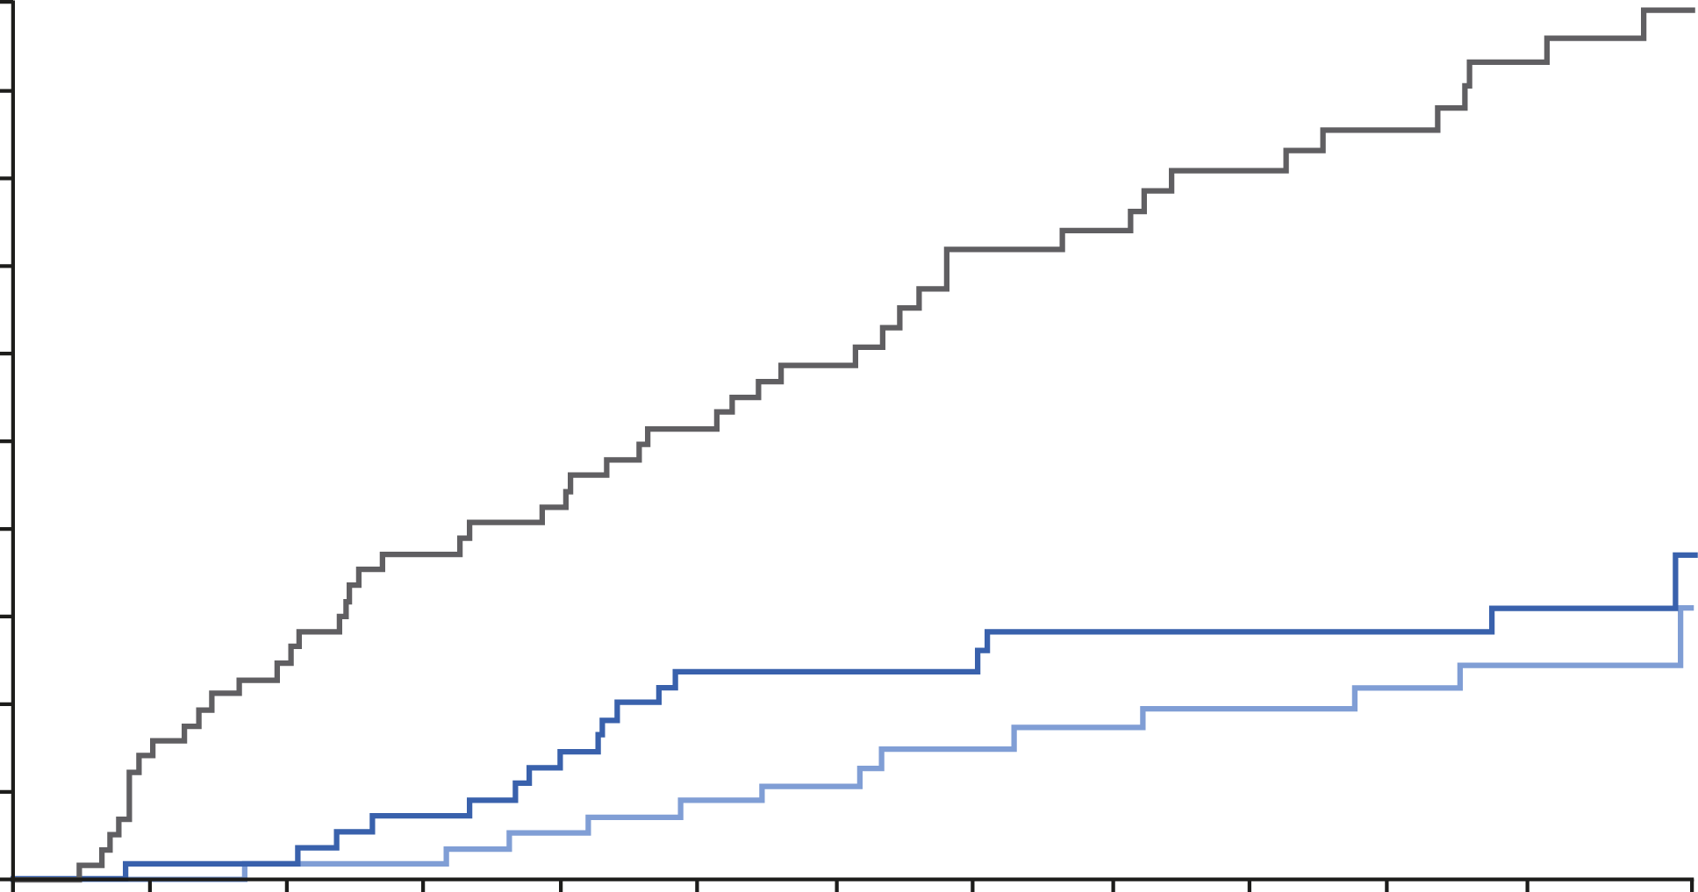
Recurrent VTE – Cumulative Incidence
5
Aspirin 4.4% (50/1131)
4
3
Cumulative incidence (%)
2
Rivaroxaban 20 mg 1.5% (17/1107)
1
Rivaroxaban 10 mg 1.2% (13/1127)
0
1
30
60
90
120
150
180
210
240
270
300
330
367
Days
Number of patients at risk
Rivaroxaban 20 mg | 1107 | 1102 | 1095 | 1090 | 1084 | 1079 | 997 | 876 | 872 | 860 | 794 | 718 | 0
Rivaroxaban 10 mg | 1126 | 1124 | 1119 | 1118 | 1111 | 1109 | 1029 | 890 | 886 | 867 | 812 | 723 | 0
Aspirin | 1131 | 1121 | 1111 | 1103 | 1094 | 1088 | 1010 | 859 | 857 | 839 | 776 | 707 | 0
  VTE, Venous thromboembolism; HR, hazard ratio
Notes:
Abbreviation
HR, hazard ratio

Slide 11
Efficacy Outcome Analyses
 | Rivaroxaban 20 mg (n=1107) | Rivaroxaban 10 mg (n=1127) | Aspirin 100 mg (n=1131) | Hazard Ratio (95% CI)
 |  |  |  | Rivaroxaban 20 mg vs aspirin* | Rivaroxaban 10 mg vs aspirin* | Rivaroxaban 20 mg vs 10 mg#
Recurrent VTE | 17 (1.5) | 13 (1.2) | 50 (4.4) | 0.34 (0.20–0.59) | 0.26 (0.14–0.47) | 1.34 (0.65–2.75)
DVT | 9 (0.8) | 7 (0.6) | 29 (2.6)
PE | 6 (0.5) | 5 (0.4) | 19 (1.7)
PE+DVT | 0 | 1 (0.1) | 0
Fatal VTE | 2 (0.2) | 0 | 2 (0.2)
Recurrent VTE, MI, ischemic stroke or SE | 19 (1.7) | 18 (1.6) | 56 (5.0) | 0.34 (0.20–0.57) | 0.32 (0.19–0.54) | 1.08 (0.57–2.06)
Recurrent VTE, all-cause mortality | 23 (2.1) | 15 (1.3) | 55 (4.9) | 0.42 (0.26–0.68) | 0.27 (0.15–0.47) | 1.57 (0.82–3.00)
Recurrent VTE, venous thrombosis in other locations | 20 (1.8) | 16 (1.4) | 57 (5.0) | 0.35 (0.21–0.58) | 0.28 (0.16–0.48) | 1.28 (0.66–2.46)
Recurrent VTE, MI, ischemic stroke, SE, venous thrombosis in other locations | 22 (2.0) | 21 (1.9) | 63 (5.6) | 0.35 (0.22–0.57) | 0.33 (0.20–0.54) | 1.07 (0.59–1.95)
  *all p- values<0.001; # all p- values not significant
  CI, confidence interval; MI, myocardial infarction; SE, systemic embolism; VTE venous thromboembolism
Notes:
Abbreviations
CI, confidence interval; HR, hazard ratio; MI, myocardial infarction; SE, systemic embolism

Slide 12
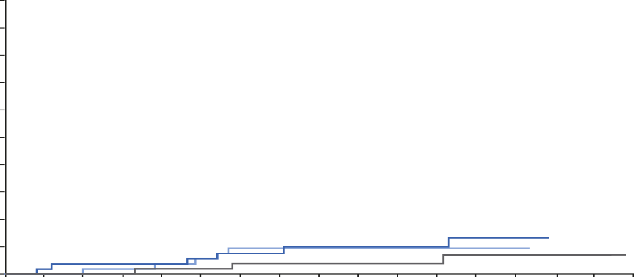
Major Bleeding – Cumulative Incidence
5
4
3
Cumulative incidence (%)
2
Rivaroxaban 20 mg 0.5% (6/1107)
Rivaroxaban 10 mg 0.4% (5/1127)
1
Aspirin 0.3% (3/1131)
0
1
30
60
90
120
150
180
210
240
270
300
330
360
390
420
450
480
Days
Number of patients at risk
Rivaroxaban 20 mg | 1107 | 1081 | 1063 | 1048 | 1036 | 1024 | 963 | 818 | 801 | 780 | 712 | 642 | 449 | 10 | 0 | 0 | 0
Rivaroxaban 10 mg | 1126 | 1103 | 1080 | 1070 | 1058 | 1046 | 988 | 823 | 812 | 790 | 733 | 653 | 469 | 8 | 0 | 0 | 0
Aspirin | 1131 | 1096 | 1075 | 1058 | 1040 | 1023 | 970 | 800 | 791 | 768 | 709 | 645 | 445 | 5 | 2 | 2 | 0
Treatment-emergent major bleeding: onset during study treatment up to 2 days after stop of study treatment
Notes:
Abbreviation
HR, hazard ratio

Slide 13
Bleeding Outcomes
 | Rivaroxaban 20 mg (n=1107) | Rivaroxaban 10 mg (n=1127) | Aspirin 100 mg (n=1131) | Hazard Ratio (95% CI)
 |  |  |  | Rivaroxaban 20 mg vs aspirin | Rivaroxaban 10 mg vs aspirin | Rivaroxaban 20 mg vs 10 mg
Major bleeding | 6 (0.5) | 5 (0.4) | 3 (0.3) | 2.01 (0.50–8.04) | 1.64 (0.39–6.84) | 1.23 (0.37–4.03)
Fatal, n (%) | 1 (<0.1) | 0 | 1 (0.1)
Non-fatal bleeding in a critical site, n (%) | 4 (0.4) | 2 (0.2) | 1 (0.1)
Other,* n (%) | 1 (0.1) | 3 (0.3) | 1 (0.1)
Major or clinically relevant nonmajor bleeding | 36 (3.3) | 27 (2.4) | 23 (2.0) | 1.59 (0.94–2.69) | 1.16 (0.67–2.03) | 1.37 (0.83–2.26)
Clinically relevant nonmajor bleeding | 30 (2.7) | 22 (2.0) | 20 (1.8) | 1.53 (0.87–2.69) | 1.09 (0.59–2.00) | 1.40 (0.81–2.43)
Nonmajor bleeding with study drug interruption ≥14 days | 17 (1.5) | 12 (1.1) | 12 (1.1) | 1.44 (0.69–3.02) | 0.99 (0.44–2.20) | 1.46 (0.70–3.06)
  All p- values not significant
  *Other: Non-fatal, non-critical bleeding, but fall in hemoglobin ≥2 g/dl and/or transfusions ≥2 units; CI, confidence interval;
Notes:
Abbreviations
CI, confidence interval; HR, hazard ratio; ISTH, International Society on Thrombosis and Haemostatsis

Slide 14
Recurrent VTE– According to Risk Profile and Duration of Anticoagulation Prior to Randomization
Outcome | Rivaroxaban 20 mg | Rivaroxaban 10 mg | Aspirin 100 mg
Recurrent VTE, all patients, n/N (%) | 17/1107 (1.5) | 13/1127 (1.2) | 50/1131 (4.4)
Risk profile index event, n/N (%)
Unprovoked | 8/441 (1.8) | 7/480 (1.5) | 26/468 (5.6)
Provoked | 9/666 (1.4) | 6/647 (0.9) | 24/663 (3.6)
History of prior VTE, n/N (%)
Yes | 3/198 (1.5) | 2/197 (1.0) | 17/194 (8.8)
No | 14/909 (1.5) | 11/930 (1.2) | 33/937 (3.5)
Duration of anticoagulation prior to randomization, n/N (%)
<9 months | 12/774 (1.6) | 7/782 (0.9) | 35/793 (4.4)
≥9 months | 5/333 (1.5) | 6/345 (1.7) | 15/338 (4.4)
  VTE Venous thomboembolism
Notes:
Abbreviation
VTE, venous thromboembolism

Slide 15
Summary and Conclusions
In patients with symptomatic VTE who completed 6 to 12 months of treatment and with equipoise regarding the need for extended anticoagulation
  Both rivaroxaban regimens (20 or 10 mg once daily) are superior to aspirin for the primary and other efficacy outcomes and are associated with similar rates of bleeding
  Compared with aspirin, numbers needed to treat with rivaroxaban 20 or 10 mg for one year to prevent one VTE without an increase in bleeding are 33 and 30, respectively
  Consistent results in subgroups of patients
Rivaroxaban 10 mg once daily provides an additional option for extended VTE treatment
  Patients requiring full-dose anticoagulant therapy were excluded and may need extended treatment with the 20 mg once daily rivaroxaban regimen
*Number needed to treat (NNT) compared with aspirin for primary efficacy outcome up to 1 year
Notes:
Abbreviations
PE, pulmonary embolism; VTE, venous thromboembolism

Slide 16
Acknowledgements
Steering Committee: Jeffrey Weitz (Co-Chair), Paolo Prandoni (Co-Chair), Rupert Bauersachs, Scott Berkowitz, Bonno van Bellen, Jan Beyer-Westendorf, Henri Bounameaux, Tim Brighton, Alexander Cohen, Bruce Davidson, Hervé Decousus, Lloyd Haskell, Gerlind Holberg, Ajay Kakkar, Anthonie WA Lensing, Martin Prins, Peter Verhamme, Phil Wells
Central Independent Adjudication Committee: Martin Prins (Chair), Harry Büller, Hugo ten Cate
Data Monitoring Committee: Samuel Goldhaber (Chair), Silvy Laporte, Alexander GG Turpie
Global Bayer study team: Jayme Augusto, Paula Batalha, Ian Darcy, Juliette Dehay, Cecilia Freitas, Martin Gebel, Ralf Goetzelmann, Melanie Hemmrich, Martin Homering, Andrea Horvat-Broecker, Axel Jansink, Ute Kohlhaas, Elizabeth McNally, Claudia Merten, Akos Ferenc Pap, Sarah SoYoung Park, Cornelia Peters-Wulf, Philippe Pires, Kathrin Schmidt, Antonella Serra, Rene Wentzeck
Elrohe Vascular Event Management, the Netherlands: Petro van Bergen, Sanne Koopmans, Frank Raedts
Covance study team (UK): Keren Avraham, Marcelo Baras, Sarit Ben Shahar, Suzie Boyse, Jacquelive Chen, Mildred Danao, Rocio Hurtado Hoyo, YanLing Hu, Sarah Jones, Danelle Jones-Covington, Thomas Leigh, Merin Mathew, Isabel Mendoza, Claude Price, Michelle Robles, Mark Sanderson, Santosh Shivakavi, Ursula Sayers Ward, Hayley Yue
Countries and Sites: Australia (10 sites), Austria (4 sites), Belgium (5 sites), Brazil (9 sites), Canada (12 sites), China (31 sites), Czech Republic (9 sites), Denmark (7 sites), France (24 sites), Germany (9 sites), Hungary (7 sites), Israel (10 sites), Italy (9 sites), Mexico (4 sites), Netherlands (10 sites), New Zealand (6 sites), Norway (2 sites), Philippines (1 site), Poland (5 sites), Russia (11 sites), South Africa (7 sites), South Korea (7 sites), Spain (5 sites), Sweden (2 sites), Switzerland (6 sites), Taiwan (3 sites), Thailand (2 sites), Turkey (2 sites), UK (4 sites), USA (17 sites), Vietnam (3 sites)

Slide 17
EINSTEIN CHOICE Investigators
A Bianchi, T Brighton, P Carroll, B Chong, S Chunilal, P Coughlin, J Curnow, D Jackson, H Tran, C Ward, M Brodmann, P Kyrle, P Marschang, V Petkov, P Hainaut, P Jordens, J Vandekerkhof, P Verhamme, J-C Wautrecht, J Annichino-Bizzacchi, B van Bellen, J Correa, A Cukier, A Freire, A Pereira, C Porto, R Sacilotto, A Vasconcelos Costa, A Della Siega, S Dolan, G Le Gal, P Gross, S Kahn, J Kassis, M Kovacs, Y Pesant, B Ritchie, S Schulman, S Shivakumar, S Solymoss, S Chang, R Chen, Z Chen, H Chen, X Dai, B Fang, W Fu, X Gao, J Huang, Y Lai, L Li, X Li, Y Li, J Liu, S Liu, W Ma, S Ni, Z Qin, G Shi, H Tian, S Wang, L Wang, W Xiao, K Ying, G Yu, Y Yuan, J Zhang, J Zhang, X Zhang, L Zhang, L Zhu, J Chlumský, J Chochola, M Dunaj, P Lang, P Matoška, I Podpera, R Spacek, O Stehlikova, J Brønnum-Schou, K Egstrup, G Gislason, J Jeppesen, O May, H Nielsen, H Wiggers, A Achkar, S Aquilanti, Y Benhamou, D Brisot, A Bura-Riviere, N Castella, A Elias, N Falvo, E Ferrari, P Lacroix, I Mahe, N Meneveau, E Messas, P Mismetti, K Montaclair, T Moumneh, F Parent, G Pernod, O Sanchez, J Schmidt, G Simoneau, D Stephan, B Amann, R Bauersachs,
J Beyer-Westendorf, E Blessing, M Czihal, C Espinola-Klein, G Kahrmann, M Licka, S Schellong, Z Boda, K Farkas, M Gurzo, A Katona, M Riba, G Sipos, K Tóth, A Braester, M Elias, A Gafter-Gvili, D Gavish, O Hussein, E Schiff, G Spectre, I Tzoran-Rozenthal, R Zimlichman, W Ageno, G Agnelli, C Bova, R Garbelotto, A Ghirarduzzi, D Imberti, R Pesavento, E Porreca, A Visonà, L Flota Cervera, D Rodriguez-Gonzalez, L Solis Morales, W Boersma, H ten Cate, A Grifioen-Keijzer, M Marwijk Kooy, K Meijer, S Middeldorp, J Swart-Heikens, M Ten Wolde, P Westerweel, I Braithwaite, P Harper, E Merriman, P Ockelford, G Royle, M Smith, W Ghanima, PM Sandset, M Abola, P Chęciński, P Grzelakowski, J Lewczuk, B Sobkowicz, W Tomkowski, I Abramov, P Chechulov, A Karpenko, I Katelnitskiy, A Kazakov, O Makarova, E Panchenko, E Sergeeva, Y Subbotin, I Suchkov, M Zeltser, D Adler, J Breedt, N Fourie, R Isaacs, B Jacobson, H Siebert, L van Zyl, J-H Choi, S-M Kang, K-H Kim, H-S Kim, D-I Kim, S-K Min, K H Park,
F García-Bragado Dalmau, J Gómez Cerezo, JCF Mirete, A Riera, J Del Toro, H Eriksson, I Torstensson, M Banyai, L Mazzolai, D Periard, M Righini, D Staub, C-E Chiang, K-M Chiu, P-Y Pai, P Angchaisuksiri, K Chansung, G Öngen, E Tuncay, R Alikhan, I Chetter, P Kesteven, T Nokes, Bauer K, A Comerota, D Elias, D Garcia, K Gibson, D Ginsberg, J Jenkins, E Kingsley, R Lambert, R Lyons, J Pullman, V Shah, SW Smith, R Stein, V Tapson, J Walsh, T-F Wang, D Do Loi, H Do Quang, N Pham

Slide 18
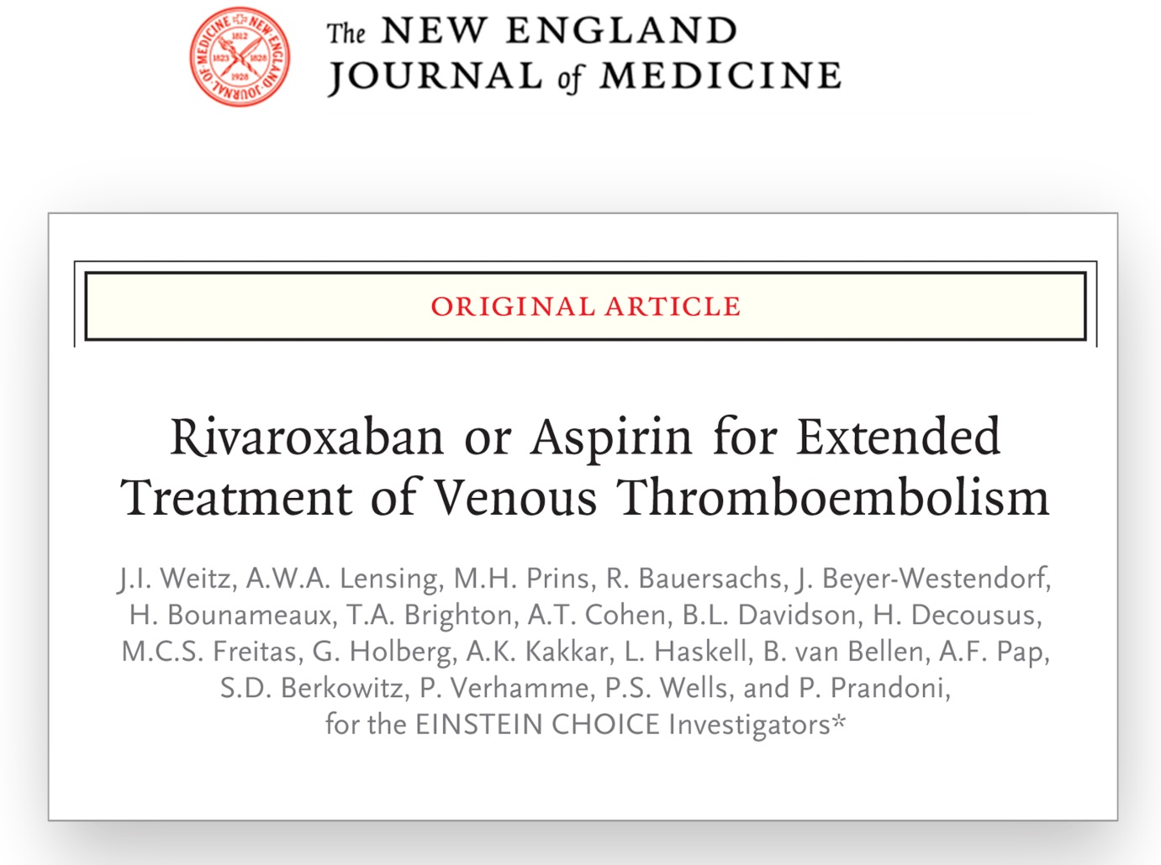
Simultaneous Publication – Published on 18 March 2017

