Slide 1
Silent cerebral microbleeds during TAVR: Insight from a prospective study
Eric Van Belle MD-PhD, Nicolas Debry MD et al.
Heart Institute
CHRU Lille, France

Slide 2
Disclosures : no disclosures
Eric Van Belle MD-PhD
Nicolas Debry MD
Heart and Lung Institute, Lille, France

Slide 3
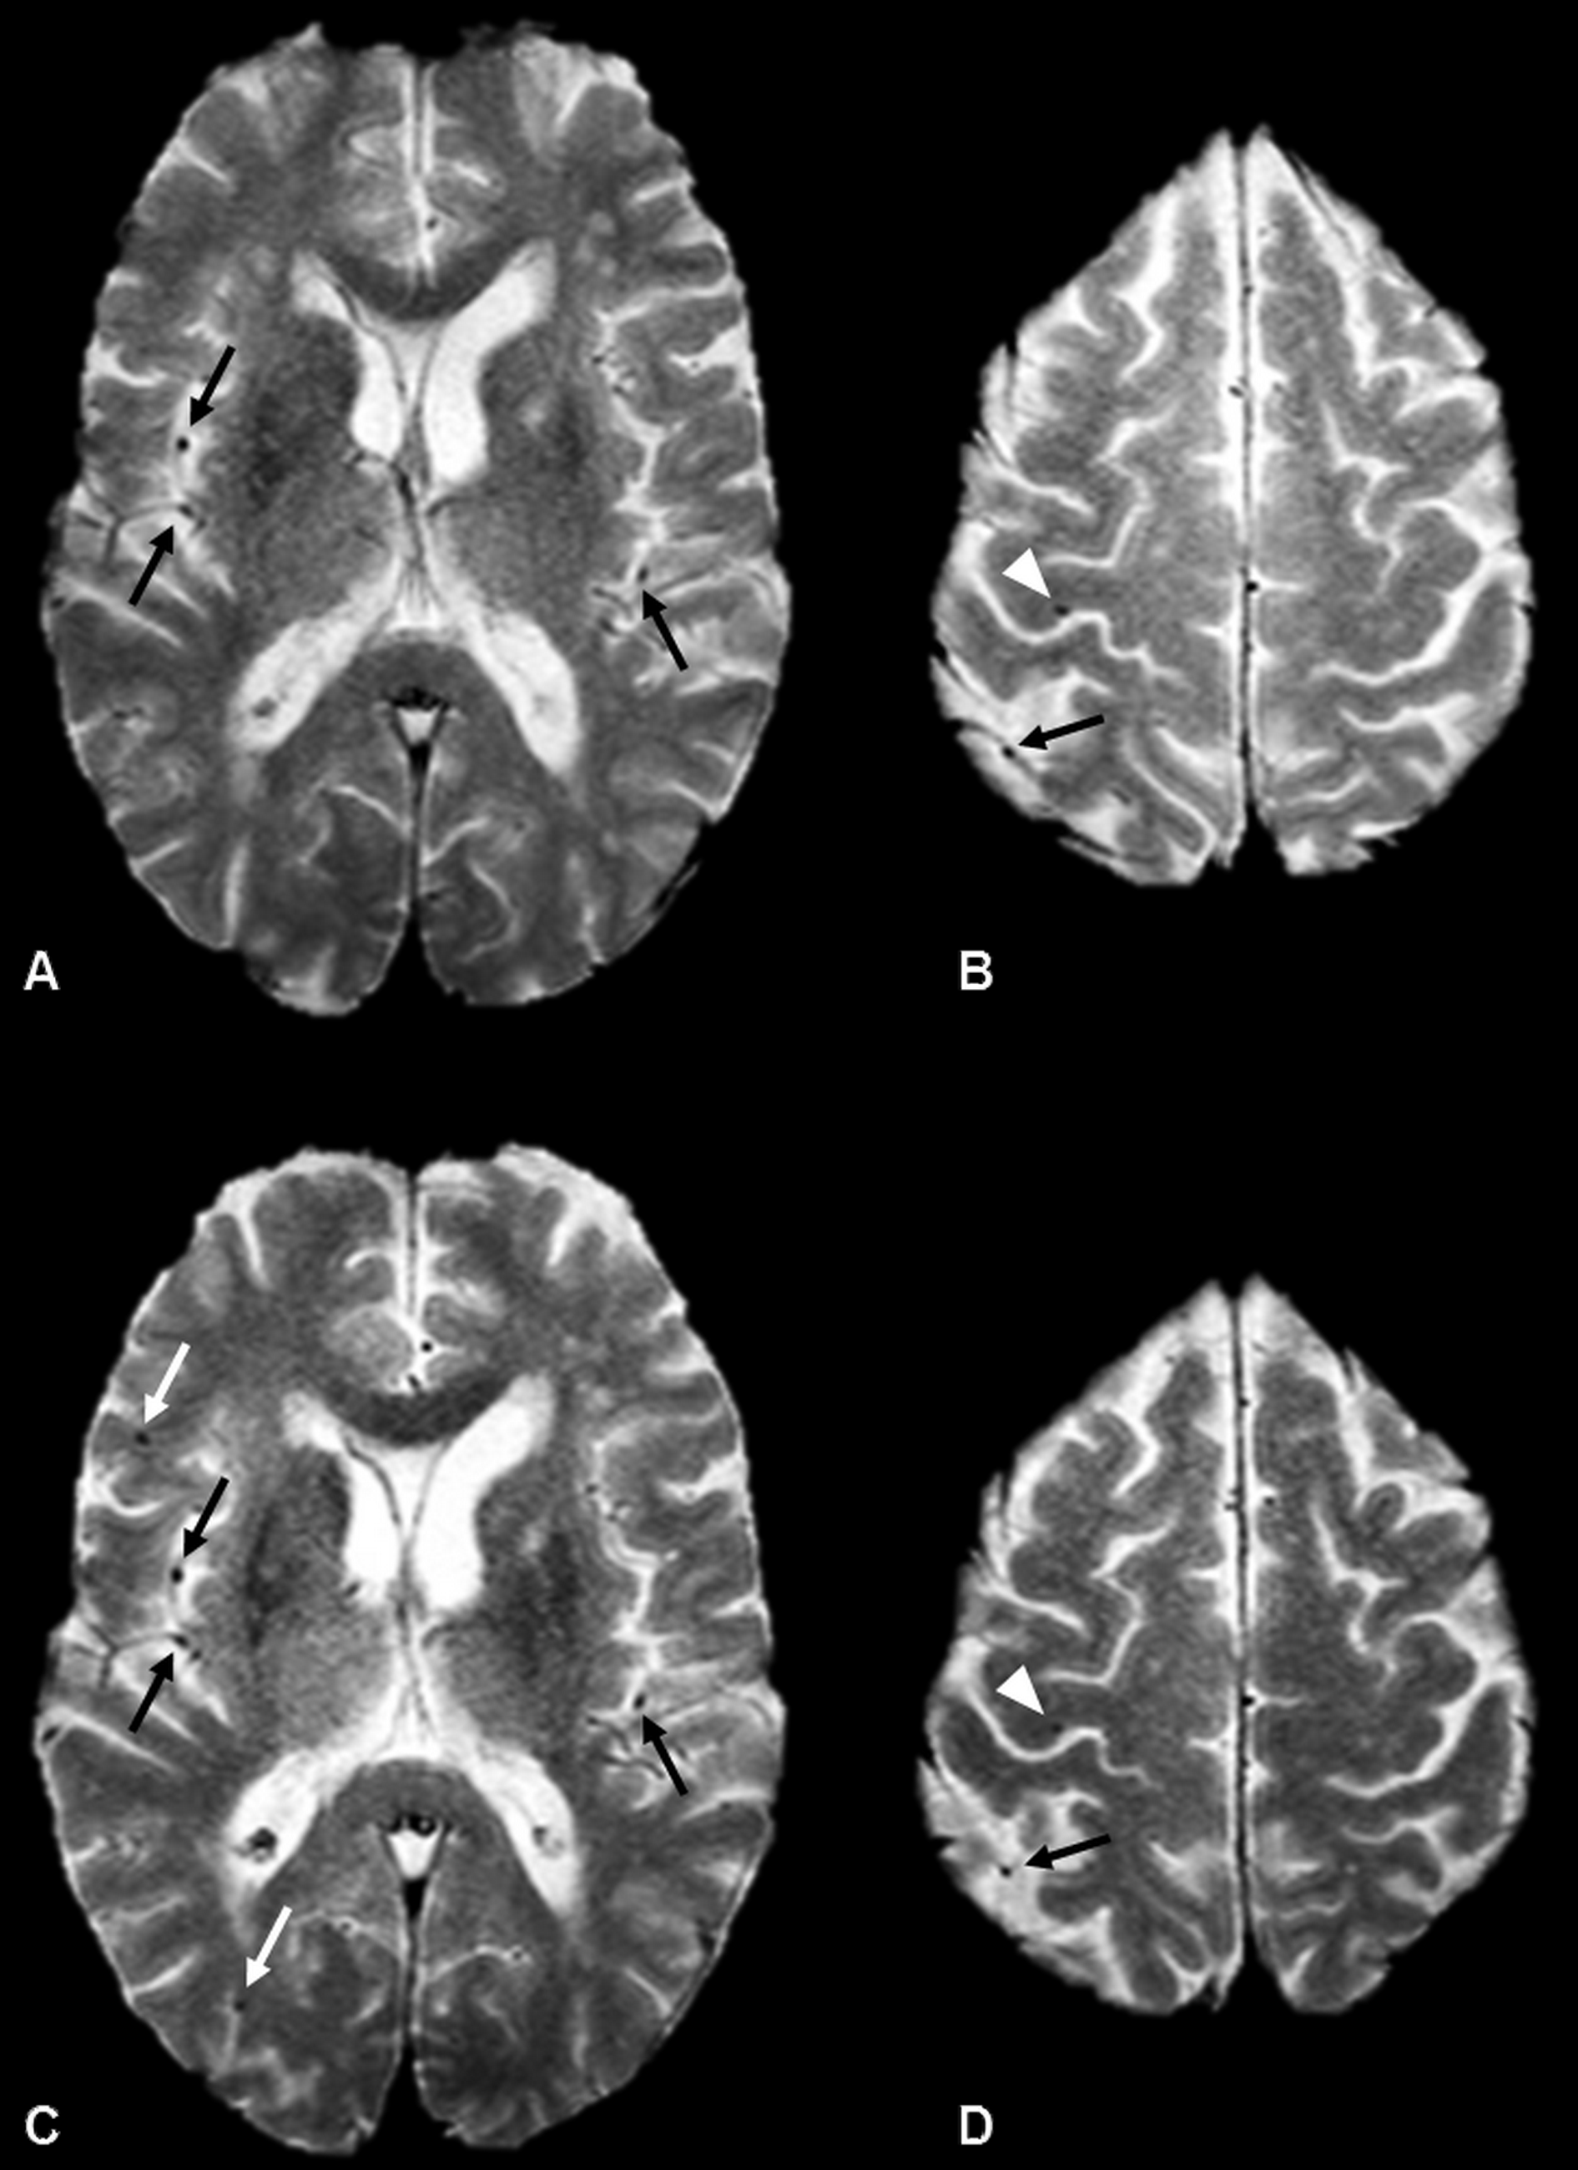
Cerebral microbleeds (CMB)
Extravasations of blood components through fragile cerebral microvascular walls
Markers of risk of stroke, dementia and cognitive impairment
Endovascular procedures ?
Greenberg SM, Vernooij MW, Cordonnier C, Viswanathan A, Al-Shahi Salman R, Warach S, et al. Cerebral microbleeds: a guide to detection and interpretation. Lancet Neurol. 2009 Feb;8(2):165–74.

Slide 4
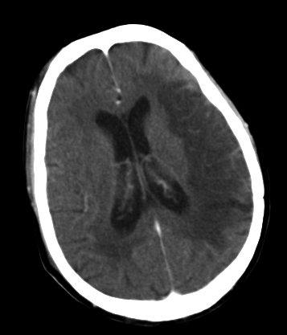
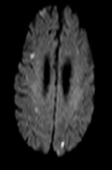
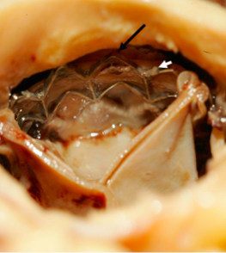
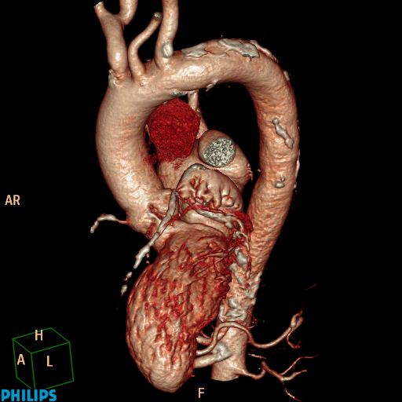
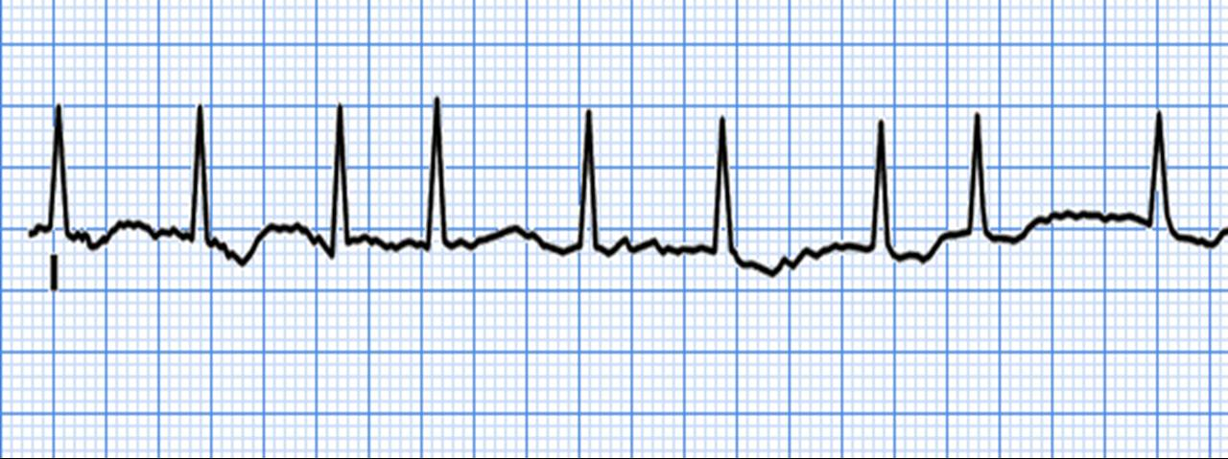
TAVR
Stroke
Silent cerebral emboli
3-5%
x 3,5-10 mortality
≈65%
Long-term cognitive performance preserved
Van Belle E, Hengstenberg C, Lefevre T, Kupatt C, Debry N, Husser O, et al. Cerebral Embolism During Transcatheter Aortic Valve Replacement: The BRAVO-3 MRI Study. J Am Coll Cardiol. 2016.

Slide 5
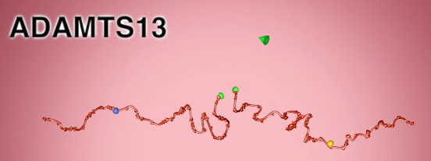
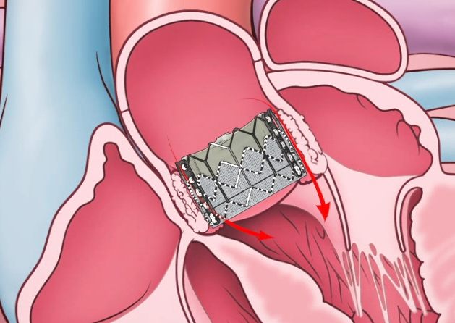
TAVR
Acute changes of haemostasis parameters
Correction of the acquired von Willebrand disease
-Van Belle E, Rauch A, Vincentelli A, Jeanpierre E, Legendre P, Juthier F, et al. Von Willebrand factor as a biological sensor of blood flow to monitor percutaneous aortic valve interventions. Circ Res. 2015
-Van Belle E, Rauch A, Vincent F, Robin E, Kibler M, Labreuche J, et al. Von Willebrand Factor Multimers during Transcatheter Aortic-Valve Replacement. N Engl J Med. 2016

Slide 6
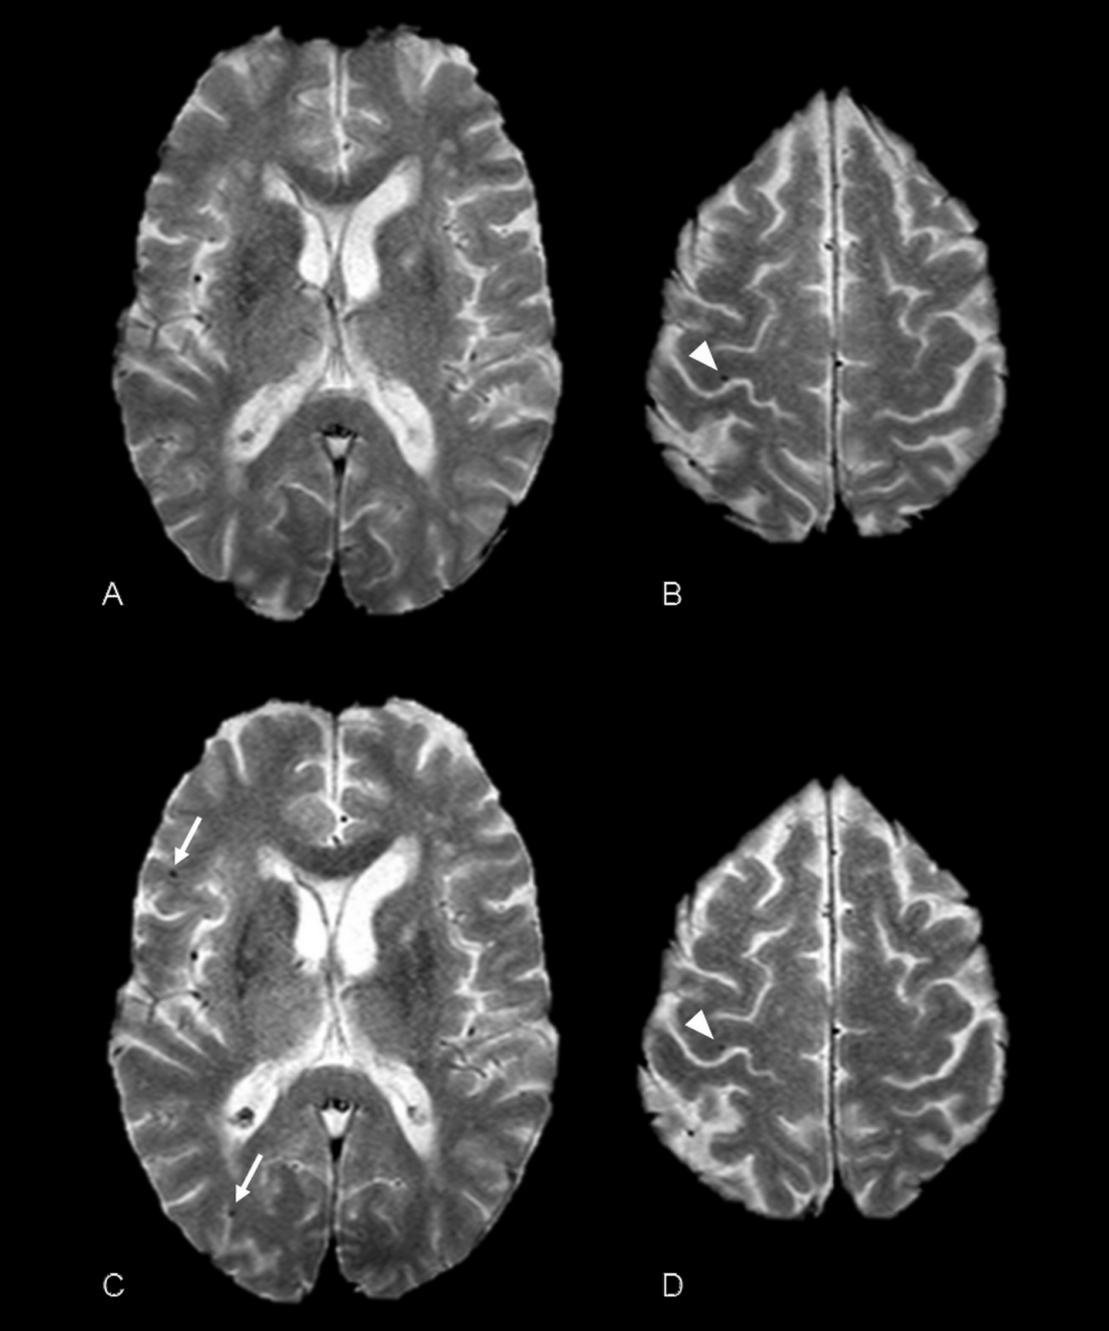
Cerebral microbleeds (CMB)
Incidence ?
Outcomes ? (VARC-2)
Neurological trajectory ?
Mortality ?

Slide 7
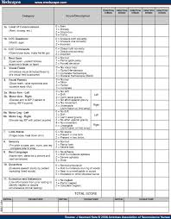
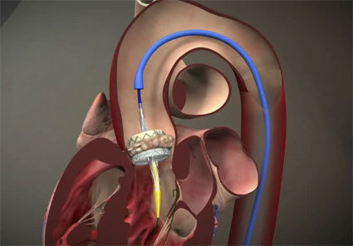
Methods
1
Patients referred for TAVR procedure
Pre-procedural cerebral MRI : cerebral microbleeds ?
3
TAVR procedure
4
Analysis of High Molecular Weight(HMW)-multimers of VWF
5
6
Intrahospital outcomes : VARC-2 criteria
2
7
Mid-term survival at 12 months
Neurological assessment (6 months): NIHSS score, modified Rankin score, EQ-5D scale, MMSE score, QVFS questionnaire
3
Neurological assessment (baseline): NIHSS score, modified Rankin score, EQ-5D scale, MMSE score
Analysis of High Molecular Weight(HMW)-multimers of VWF
Post-procedural cerebral MRI : new cerebral microbleeds ?

Slide 8
Methods
Primary endpoint : appearance and incidence of new cerebral microbleeds on the post-procedural cerebral MRI.
Secondary endpoints : presence of microbleed on the preprocedural MRI and cerebral emboli (CE) at preprocedural or post-procedural MRI.
Analyses :
Identification of predictive factors of primary and secondary endpoints.
Evaluation of their impact on early outcomes VARC-2
Impact on the neurological functions examined at 6 months
Impact on the global mortality at 1 year follow-up.

Slide 9
Methods
Neurological assessment (6 months post TAVR)
n = 84 had both MRI and were included in the analysis
Preprocedural cerebral MRI
Intrahospital outcomes : VARC-2 criteria
n= 73 (86%) were evaluated (n= 11 were dead before)
Patients referred for TAVR procedure
n= 90 patients consented and were enrolled in the study
Postprocedural cerebral MRI
n= 22 (26%) patients with at least one CMB; n= 5 (5%) patients with at least one infarct
n= 19 (23%) patients with at least one new CMB; n= 54 (64%) patients with at least one new infarct
Neurological assessment (preprocedural)
NIHSS score, modified Rankin score, EQ-5D scale, MMSE score
TAVR procedure
n= 5 (5% ) intrahospital clinical TIA/strokes
n= 75 (89%) had a neurological assessment (n= 9 were dead before)
Mid-term survival at 1 year

Slide 10
Results: baseline

Slide 11
Results: procedure and outcomes

Slide 12
Results: predictive factors of CMB
a prolonged procedure(RR=1.21 [1.01-1.170] for every increased 5 min of fluoroscopy time, p=0.04)
post-procedural acquired-VWD(RR 1.42 [1.08-1.89] for every lower “0.1 unit” of the HMW-multimer-ratio, p=0.004)
→were associated with the occurrence of new post-procedural microbleed(s).

Slide 13
Results: neurological exam

Slide 14
Conclusions
Occurrence of new microbleeds as measured 3 days after the procedure is high (≈20%)
Presence of microbleeds as detected after the procedure is impacting the 6-month neurological outcome
Procedural management and persistence of acquired-VWD are predictors of the occurrence of microbleeds.
Importance of preprocedural Cerebral MRI: 6% of patients had at least one cerebral emboli

