Slide 1

Five-Year Outcome of a Randomized Trial
Comparing Second Generation Drug-eluting Stents Using
Either Biodegradable Polymer or Durable Polymer
The NOBORI Biolimus-Eluting versus XIENCE/PROMUS Everolimus-eluting Stent Trial (NEXT)
Masahiro Natsuaki, MD
Saga University
Ken Kozuma, MD; Takeshi Morimoto, MD, MPH; Kazushige Kadota, MD;
Yoshihisa Nakagawa, MD, Takashi Akasaka, MD; Keiichi Igarashi Hanaoka, MD;
Kengo Tanabe, MD; Yoshihiro Morino, MD; and Takeshi Kimura, MD
On behalf of the NEXT Investigators

Slide 2
Potential conflicts of interest
Speaker's name: Masahiro Natsuaki
☑ I do not have any potential conflict of interest
Study sponsor: Terumo Japan

Slide 3


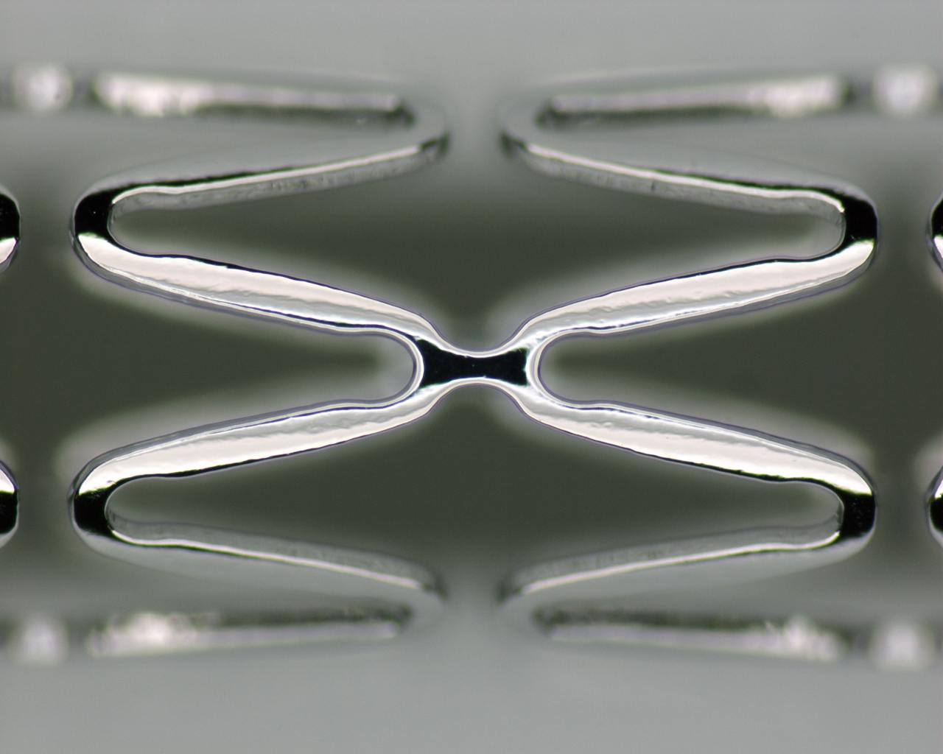
Nobori® Biodegradable Polymer Biolimus-eluting Stent Components
Biodegradable Polymer PLA (Poly-lactic Acid)
Abluminal coating
Controlled biodegradability
Precise drug release kinetics
Simultaneous release of drug and polymer degradation
Biolimus A9™
Anti-proliferative, anti- inflammatory properties
Highly lipophilic with optimal local tissue uptake
BMS Platform
Stainless steel alloy stent with 120 micron strut thickness
Wide cell opening with optimal side branch access
Innovative delivery system with hydrophilic M-coating

Slide 4
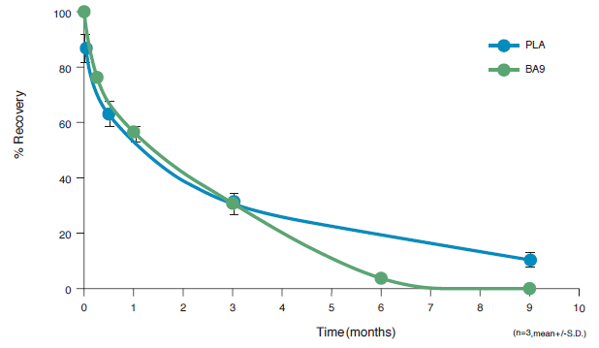
Nobori® Biolimus-eluting Stent
Biolimus A9 and PLA recovery over time on stents implanted in pig arteries
BA9（Biolimus A9） ：Released in 9 months
PLA（Biodegradable Polymer) : Degraded within 12 months

Slide 5
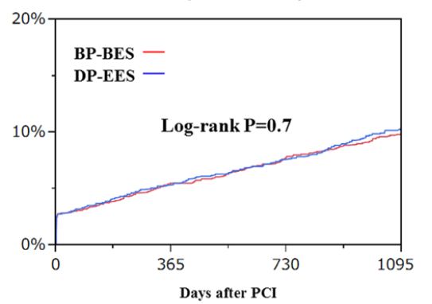
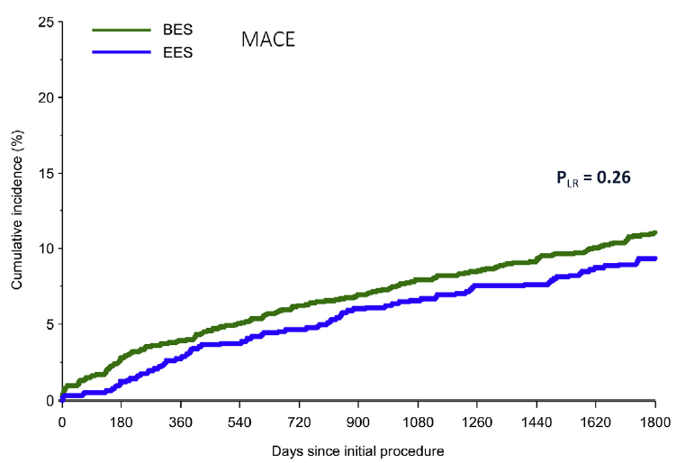
Background
The COMPARE II and NEXT trials showed no significant difference between biodegradable-polymer biolimus-eluting stent (BP-BES) and durable-polymer everolimus-eluting stent (DP-EES) in clinical outcomes at 5-year and 3-year, respectively.
COMPARE II
Cardiac death, Myocardial infarction
Target vessel revascularization
NEXT
Death or Myocardial infarction
Vlachojannis et al. J Am Coll Cardiol Intv. 2017;26:1215-21.
Natsuaki et al. Circ Cardiovasc Interv. 2015;Oct.8.

Slide 6
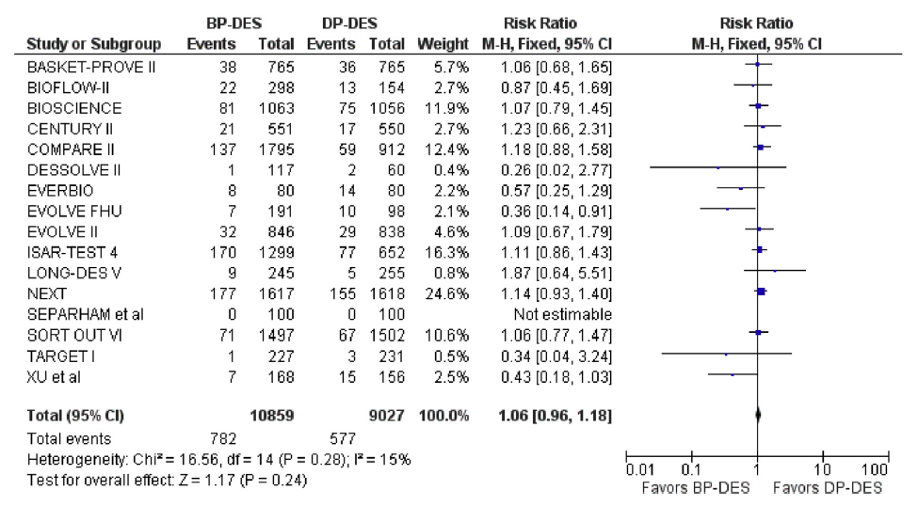
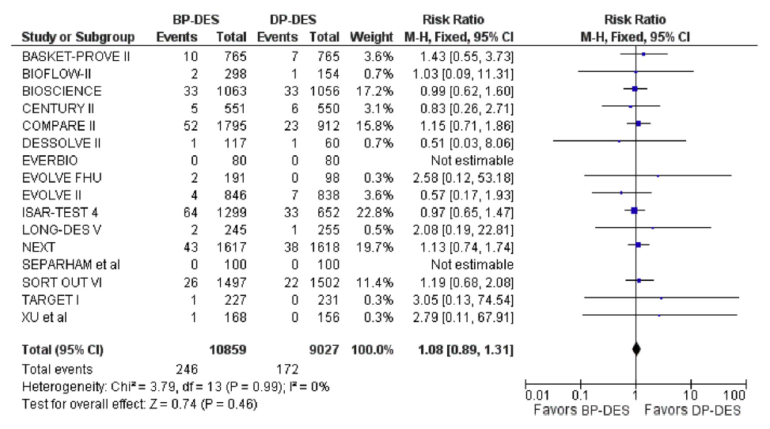
Background
Biodegradable polymer drug-eluting stent (BP-DES) also had similar safety and efficacy profiles compared to second-generation durable polymer drug-eluting stent (DP-DES) in the meta-analysis with mean follow-up duration of 26 months.
However, longer-term follow-up would be required to evaluate the safety and efficacy of BP-DES compared to DP-DES considering the occurrence of stent-related adverse events not attenuating over time. Therefore, we sought to evaluate the 5-year clinical outcomes of BP-DES as compared with second-generation DP-DES in the extended follow-up study from the NEXT trial.
Target Vessel Revascularization (TVR)
Risk Ratio 1.06 (0.96-1.18) P=0.24
Cardiac Death
Risk Ratio 1.08 (0.89-1.31) P=0.46
El-Hayek et al. J Am Coll Cardiol Intv. 2017;10:462-73.

Slide 7
NEXT Trial
Multicenter, randomized, non-inferiority trial comparing
biodegradable polymer biolimus-eluting stent (BP-BES) with durable polymer everolimus-eluting stent (DP-EES)
3200 patients scheduled for PCI using drug-eluting stent
No Exclusion Criteria (All-comer Design)
Randomization 1:1
Stratified by:
Center
Diabetes
Participation in the imaging sub-studies
Nobori
(Biolimus-eluting stent)
(1600 patients)
XIENCE V/ PROMUS
(Everolimus-eluting stent)
(1600 patients)
Scheduled Follow-up at 1, 2, 3 years
Extended follow-up at 5 and 10 years
<Primary Endpoint>
Safety: Death or Myocardial Infarction (MI) Efficacy: Target lesion revascularization (TLR)

Slide 8
Patient Flow Chart
Randomized
(N=3241)
Enrollment from 98 Japanese centers
between May and October, 2011
6 = Withdraw consent
ITT Population
(N=3235)
BP-BES (N=1617)
DP-EES (N=1618)
BES
(N=1617)
EES (N=1618)
3-Year Clinical Follow-up
(N=3158; 97.6%)
BP-BES (N=1576)
DP-EES (N=1582)
BES (N=263)
Follow-up <1035 days: N=41
)
Follow-up <1035 days: N=36
Extended Follow-up Study
(N=2568)
Enrollment from 78 Japanese centers
BP-BES (N=1283)
DP-EES (N=1285)
5-Year Clinical Follow-up
(N=2408; 93.8%)
BP-BES (N=1202)
DP-EES (N=1206)
Follow-up <1735 days: N=81
Follow-up <1735 days: N=79

Slide 9
Baseline Patient Characteristics
 | BP-BES | DP-EES | P
No. of patients | 1283 | 1285
Age (years) | 69.2 ± 9.8 | 69.5 ± 9.7 | 0.36
Male gender | 77 % | 76 % | 0.83
Body mass Index (kg/m²) | 24.1 ± 3.5 | 24.1 ± 3.4 | 0.9
Diabetes | 48 % | 46 % | 0.22
Insulin-treated | 11 % | 11 % | 0.84
Hypertension | 81 % | 81 % | 0.91
Current smoker | 18 % | 18 % | 0.78
Statin use | 77 % | 75 % | 0.47
Prior PCI | 50 % | 50 % | 0.97
Prior CABG | 5.0 % | 5.1 % | 0.94

Slide 10
Baseline Patient Characteristics
 | BP-BES | DP-EES | P
No. of patients | 1283 | 1285
Clinical diagnosis |  |  | 0.57
Acute myocardial infarction | 4.8 % | 4.3 %
Unstable angina | 12 % | 11 %
Stable coronary artery disease | 83 % | 85 %
Prior myocardial infarction | 29 % | 29 % | 0.88
Prior stroke | 10 % | 11 % | 0.16
Heart failure | 12 % | 11 % | 0.42
Hemodialysis | 7.2 % | 5.2 % | 0.04
Peripheral vascular disease | 10 % | 11 % | 0.21
Multivessel disease | 52 % | 54 % | 0.48
SYNTAX score | 10 (6-17) | 10 (6-16) | 0.22

Slide 11
Baseline Lesion Characteristics
 |  | BP-BES | DP-EES | P
No. of lesions |  | 1629 | 1600
Target vessel location
 | LMCA | 3.8 % | 3.9 % | 0.92
 | LAD | 51 % | 48 % | 0.11
 | LCx | 29 % | 31 % | 0.18
 | RCA | 38 % | 35 % | 0.18
 | Graft | 0.9 % | 1.0 % | 0.68
STEMI culprit lesions |  | 2.7 % | 2.5 % | 0.72
Chronic total occlusion |  | 8.2 % | 7.7 % | 0.57
In-stent restenosis |  | 11 % | 11 % | 0.54
Bifurcation lesions |  | 44 % | 45 % | 0.58
Reference vessel size <= 2.75 mm |  | 61 % | 62 % | 0.67
Lesion length > 18 mm |  | 43% | 41% | 0.22

Slide 12
Procedural Characteristics
 |  | BP-BES | DP-EES | P
No. of lesions treated per patient |  | 1.27 ± 0.57 | 1.25 ± 0.51 | 0.25
No. of stents
 | Per patient | 1.59 ± 0.86 | 1.58 ± 0.84 | 0.76
 | Per lesion | 1.25 ± 0.61 | 1.27 ± 0.64 | 0.46
Total stent length (mm)
 | Per patient | 33.0± 20.8 | 32.4 ± 20.9 | 0.76
 | Per lesion | 26.0 ± 16.0 | 26.1 ± 17.0 | 0.88
Stent diameter (mm) |  | 2.87 ± 0.68 | 2.86 ± 0.65 | 0.64
Direct stenting |  | 21 % | 20 % | 0.6
Maximum inflation pressure (atm) |  | 17.3 ± 4.6 | 17.0 ± 4.5 | 0.06
Bifurcation 2-stent |  | 1.4 % | 1.1 % | 0.45
IVUS use |  | 88% | 87% | 0.35
Multivessel treatment |  | 12% | 12% | 0.58
Staged procedures |  | 27% | 26% | 0.95

Slide 13
Clinical Outcomes at 5-year

Slide 14
Persistent Discontinuation of Dual Antiplatelet Therapy
100%
BP-BES
Cumulative Incidence (%)
80%
DP-EES
DP-EES 62.8%
60%
Log-rank P=0.74
BP-BES 61.5%
40%
20%
0%
0
1
2
3
4
5
Years after PCI
Interval | 0 day | 30 days | 1 year | 2 years | 3 years | 4 years | 5 years
BP-BES group
N of patients with discontinuation |  | 10 | 192 | 425 | 572 | 659 | 734
N of patients at risk | 1283 | 1270 | 1051 | 794 | 622 | 492 | 396
Cumulative Incidence |  | 0.8% | 15.3% | 34.3% | 46.7% | 54.5% | 61.5%
DP-EES group
N of patients with discontinuation |  | 11 | 179 | 417 | 578 | 685 | 758
N of patients at risk | 1285 | 1272 | 1073 | 813 | 630 | 490 | 398
Cumulative Incidence |  | 0.9% | 14.2% | 33.5% | 46.8% | 56.1% | 62.8%

Slide 15
Death or Myocardial Infarction
50%
BP-BES
Cumulative Incidence (%)
40%
DP-EES
30%
Log-rank P=0.37
20%
DP-EES 16.5%
BP-BES 15.1%
10%
0%
0
1
2
3
4
5
Years after PCI
Interval | 0 day | 30 days | 1 year | 2 years | 3 years | 4 years | 5 years
BP-BES group
N of patients with at least 1 event |  | 39 | 77 | 104 | 131 | 161 | 190
N of patients at risk | 1283 | 1243 | 1203 | 1170 | 1134 | 1058 | 1009
Cumulative Incidence |  | 3.0% | 6.0% | 8.1% | 10.0% | 12.7% | 15.1%
DP-EES group
N of patients with at least 1 event |  | 39 | 71 | 100 | 137 | 171 | 208
N of patients at risk | 1285 | 1246 | 1213 | 1179 | 1135 | 1054 | 991
Cumulative Incidence |  | 3.0% | 5.5% | 7.8% | 10.7% | 13.5% | 16.5%

Slide 16
Target-Lesion Revascularization
50%
BP-BES
Cumulative Incidence (%)
40%
DP-EES
30%
Log-rank P=0.79
20%
BP-BES 9.8%
10%
DP-EES 9.3%
0%
0
1
2
3
4
5
Years after PCI
Interval | 0 day | 30 days | 1 year | 2 years | 3 years | 4 years | 5 years
BP-BES group
N of patients with at least 1 event |  | 2 | 55 | 78 | 95 | 106 | 118
N of patients at risk | 1283 | 1279 | 1192 | 1138 | 1083 | 1004 | 947
Cumulative Incidence |  | 0.2% | 4.4% | 6.2% | 7.7% | 8.6% | 9.8%
DP-EES group
N of patients with at least 1 event |  | 2 | 63 | 84 | 97 | 102 | 114
N of patients at risk | 1285 | 1281 | 1191 | 1141 | 1089 | 1017 | 951
Cumulative Incidence |  | 0.2% | 5.0% | 6.7% | 7.8% | 8.2% | 9.3%

Slide 17
Proportion of Events Adjudicated by the Angiographic Core Laboratory
309
(96%)
223
(96%)
TVR
N=329
TLR
N=232
All the angiograms of patients with TVR were to be analyzed by the angiographic core laboratory
in an attempt to discriminate TLR from non-TLR TVR and to identify clinically-driven TLR.

Slide 18
Clinical Outcomes at 5-Year
Death
Cardiac
death
MI
Stent
thrombosis
Stroke
TVR
Bleeding
TIMI
Major/Minor
P=0.51
P=0.54
P=0.72
P=0.52
P=0.38
P=0.22
P=0.99
14.2%
12.6%
BP-BES
12.4%
11.7%
DP-EES
Cumulative Incidence
6.5%
6.4%
5.2%
5.7%
4.4%
4.8%
4.8%
3.9%
0.49%
0.34%

Slide 19
Pre-specified Subgroup Analysis for Death/MI
Subgroups N (BP-BES/ DP-EES)
HR 95% CI
P
Interaction P
Diabetic Status
Diabetes (619/589)
Non-diabetes (664/696)
DM insulin (143/140)
DM non-insulin (476/449)
Age >= 75 years (392/449)
Age < 75 years (891/836)
Yes (92/67)
No (1191/1218)
Yes (159/150)
No (1124/1135)
0.93 (0.71 – 1.22) 0.6 0.78
0.88 (0.66 – 1.17) 0.39
0.86 (0.52 – 1.41) 0.54 0.7
0.97 (0.7 – 1.33) 0.83
0.91 (0.68 – 1.21) 0.53 0.77
0.97 (0.74 – 1.27) 0.81
0.85 (0.54 – 1.36) 0.5 0.92
0.87 (0.7 – 1.09) 0.22
1.05 (0.64 – 1.74) 0.83 0.53
0.89 (0.71 – 1.1) 0.27
Insulin use
Elderly
Hemodialysis
Multi-vessel PCI
BP-BES Better
DP-EES Better

Slide 20
Pre-specified Subgroup Analysis for TLR
Subgroups N (BP-BES/ DP-EES)
HR 95% CI
P
Interaction P
Diabetic Status
Diabetes (619/589)
Non-diabetes (664/696)
DM insulin (143/140)
DM non-insulin (476/449)
Age >= 75 years (392/449)
Age < 75 years (891/836)
Yes (92/67)
No (1191/1218)
Yes (159/150)
No (1124/1135)
0.86 (0.61 – 1.22) 0.4 0.15
1.26 (0.86 – 1.85) 0.24
0.95 (0.52 – 1.73) 0.87 0.69
0.82 (0.53 – 1.27) 0.37
0.9 (0.54 – 1.51) 0.7 0.59
1.06 (0.79 – 1.44) 0.69
0.83 (0.44 – 1.6) 0.58 0.58
1.02 (0.77 – 1.35) 0.89
1.03 (0.54 – 1.97) 0.93 0.98
1.04 (0.78 – 1.37) 0.81
Insulin use
Elderly
Hemodialysis
Multi-vessel PCI
BP-BES Better
DP-EES Better

Slide 21
Clinical Outcomes
Between 1-year and 5-year
-Landmark Analysis-

Slide 22
Death or Myocardial Infarction
50%
BP-BES
Cumulative Incidence (%)
40%
DP-EES
30%
Log-rank
P=0.62
Log-rank P=0.13
20%
DP-EES 11.6%
10%
BP-BES 9.7%
0%
0
1
2
3
4
5
Years after PCI
Interval | 0 day | 1 year | 2 years | 3 years | 4 years | 5 years
BP-BES group
N of patients with at least 1 event |  | 77 | 27 | 54 | 84 | 113
N of patients at risk | 1283 | 1203 | 1170 | 1134 | 1058 | 1009
Cumulative Incidence |  | 6.0% | 2.3% | 4.5% | 7.1% | 9.7%
DP-EES group
N of patients with at least 1 event |  | 71 | 29 | 66 | 100 | 137
N of patients at risk | 1285 | 1213 | 1179 | 1135 | 1054 | 991
Cumulative Incidence |  | 5.5% | 2.4% | 5.5% | 8.4% | 11.6%

Slide 23
Target-Lesion Revascularization
50%
BP-BES
Cumulative Incidence (%)
40%
DP-EES
30%
Log-rank
P=0.45
Log-rank P=0.25
20%
10%
BP-BES 5.6%
DP-EES 4.5%
0%
0
1
2
3
4
5
Years after PCI
Interval | 0 day | 1 year | 2 years | 3 years | 4 years | 5 years
BP-BES group
N of patients with at least 1 event |  | 55 | 23 | 40 | 51 | 63
N of patients at risk | 1283 | 1192 | 1138 | 1083 | 1004 | 947
Cumulative Incidence |  | 4.4% | 2.0% | 3.5% | 4.5% | 5.6%
DP-EES group
N of patients with at least 1 event |  | 63 | 21 | 34 | 39 | 51
N of patients at risk | 1285 | 1191 | 1141 | 1089 | 1017 | 951
Cumulative Incidence |  | 5.0% | 1.8% | 2.9% | 3.4% | 4.5%

Slide 24
Clinical Outcomes between 1-year and 5-Year
Death
Cardiac
death
MI
Stent
thrombosis
Stroke
TVR
Bleeding
TIMI
Major/Minor
P=0.28
P=0.91
P=0.99
P=0.66
P=0.68
P=0.04
P=0.27
10.4%
BP-BES
9.1%
DP-EES
Cumulative Incidence
8.1%
5.9%
4.4%
3.6%
3.9%
3.6%
2.7%
2.8%
1.6%
1.6%
0.26%
0.17%

Slide 25
Incidence of Definite Stent Thrombosis
Acute
Subacute
Late
Very Late
BP-BES
0.16%
0.16%
0.17%
0.49%
Very Late
P=0.66
P=0.52
309
(96%)
223
(96%)
DP-EES
0.08%
0.26%
0.34%
Cumulative Incidence

Slide 26

Limitations
The number of study population was reduced from 3235 patients to 2568 patients
in the current extended follow-up study. The current study did not possess
adequate power to evaluate the low frequency events such as ST.
Despite the all-comers trial design, the actual study population mostly included
patients with stable coronary artery disease.

Slide 27
Conclusions
The Safety and efficacy outcomes of BP-BES were similar to those of DP-EES through 5-year
and beyond 1-year after stent implantation.
Advantages of biodegradable polymer DES over durable polymer DES were not apparent
even at 5-year follow-up after stent implantation.
Very long-term follow-up of the extended NEXT study scheduled at 10-year would provide
important information on the potential advantages of BP-DES over DP-DES.

Slide 28
Participating Centers
Caress Sappro Tokeidai Memorial Hospital
Oji General Hospital
Hokkaido Cardiovascular Hospital
Teine Keijinkai Hospital
Caress Sapporo Hokko Memorial Hospital
Aomori Prefectural Central Hospital
Iwate Prefectural Central Hospital
Iwate Medical University Hospital
Tohoku Medical and Pharmaceutical University Hospital
Sendai Open Hospital
Fukushima Medical University Hospital
Dokkyo Medical University Koshigaya Hospital
New Tokyo Hospital
Juntendo University Hospital
Sakakibara Heart Institute
NTT Medical Center Tokyo
The Cardiovascular Institute Hospital
Mitsui Memorial Hospital
Tokyo Medical University Hospital
Teikyo University Hospital
Tokyo Women's Medical University Hospital
Itabashi Chuo General Hospital
Yokohama Rosai Hospital
Tokai University Hospital
Yokohama City University Medical Center
Kitasato University Hospital
Kanazawa Cardiovascular Hospital
University of Fukui Hospital
Fukui Cardiovascular Center
Ogaki Municipal Hospital
Juntendo University Shizuoka Hospital
Shizuoka General Hospital
Okamura Memorial Hospital
Seirei Hamamatsu General Hospital
Hamamatsu Medical Center
Aichi Medical University Hospital
Toyota Memorial Hospital
Fujita Health University Hospital
Japanese Red Cross Nagoya Daini Hospital
Nagai Hospital
Mie University Hospital
Mie Heart Center
Japan Community Health Care Organization Yokkaichi Hazu Medical Center
Koto Memorial Hospital
Shiga University of Medical Science Hospital
Kyoto University Hospital
Mitsubishi Kyoto Hospital
National Hospital Organization Kyoto Medical Center
Osaka Saiseikai Noe Hospital
Osaka Red Cross Hospital
National Cerebral and Cardiovascular Center
Sumitomo Hospital
Bell Land General Hospital
Kobe City Medical Center General Hospital
Kobe University Hospital
Kansai Rosai Hospital
Hyogo Prefectural Amagasaki General Medical Center Tenri Hospital
Japanese Red Cross Society Wakayama Medical Center
Wakayama Medical University Hospital
Tottori University Hospital
Matsue Red Cross Hospital
The Sakakibara Heart Institute of Okayama
Kurashiki Central Hospital
Kawasaki Medical School Hospital
Hiroshima City Hiroshima Citizens Hospital
Iwakuni Clinical Center
Chikamori Hospital
Hospital of the University of Occupational and Environmental Health Japan
Fukuoka Wajiro Hospital
Kurume University Hospital
Kokura Memorial Hospital
Kouseikai Hospital
Saiseikai Kumamoto Hospital
National Hospital Organization Kumamoto Medical Center
Miyazaki Medical Association Hospital
Tenyokai Central Hospital
National Hospital Organization Kagoshima Medical Center

