Slide 1
Early strut coverage in patients receiving new-generation drug-eluting stents and its implications for dual antiplatelet therapy: a randomized clinical trial
Myeong-Ki Hong, MD. PhD
on behalf of the DETECT OCT trial investigators
Severance Cardiovascular Hospital and Cardiovascular Research Institute,
Yonsei University College of Medicine, Seoul, Korea

Slide 2
Conflict of Interest
I have nothing to disclose

Slide 3
Background
Adverse cardiac events after drug-eluting stent (DES) implantation have been associated with the delayed healing of stented artery
1. Joner M, et al. J Am Coll Cardiol 2006;48:193-202
2. Finn AV, et al. Circulation 2007;115:2435-41
3. Souteyrand G, Eur Heart J 2016;37:1208-16
The delayed healing of a stented artery requires an extended duration of dual antiplatelet therapy (DAPT)
The improvement of DES strut coverage may be translated into an early discontinuation of DAPT.

Slide 4
Study Design
Seven centers in Korea
Enrollment period: between January 2013 and April 2016
Eligible participants
at least 20 years old
typical angina and evidence of objective myocardial ischemia
significant coronary artery stenosis (>70% of DS by visual estimation)
anticipated 24-mm or shorter stent implantation

Slide 5
Study Flow
1,100 patients requiring DES implantation with two-by-two factorial design
EES (Xience) vs. BES (Nobori) were randomized
OCT vs. angiography guidance were randomized
Primary outcome: percentage of uncovered strut at 3 months by OCT
Uncovered strut ≤ 6.0%
Uncovered strut > 6.0%
Stop clopidogrel
(3-month DAPT)
Continue clopidogrel
(12-month DAPT)
Secondary outcome: cardiac death, MI, stent thrombosis, and major bleeding at 12 months

Slide 6
Hypotheses
Randomization with two-by-two factorial design
1. EES would show better strut coverage than BES at 3-month follow-up OCT
2. OCT-guided stent implantation would show better strut coverage than angiography-guided stent implantation at 3-month follow-up OCT.
We also examined clinical outcome with observational cohort manner…
3. Three-month DAPT based on a favorable degree of strut coverage would show similar long-term clinical outcomes as 12-month DAPT due to a poor degree of strut coverage

Slide 7
Procedures
DESs: EES (Xience®, Abbott Vascular) and DES (Nobori®, Terumo)
Criteria for optimal DES implantation
Angiography guidance: residual DS <20% by visual estimation and absence of angiographically detected dissection
OCT guidance: minimal stent cross-sectional area >4.0 mm² and minimal degree of stent strut malapposition
Discontinuation of clopidogrel at 3-month follow-up
If percentage of uncovered strut was <6%, clopidogrel was discontinued (Won H, et al. Int J Cardiovasc Imaging 2013;29:1255-63) (3-month DAPT and then aspirin alone)
Otherwise, clopidogrel was maintained for at least 12 months after DES implantation (12-month DAPT)

Slide 8
Outcomes
Primary outcome: the difference in early strut coverage 1) between EES and BES groups and 2) between OCT- and angiography-guided implantation group
Early strut coverage: measurement of the percentage of uncovered struts upon 3-month follow-up OCT
Secondary outcome: a composite of cardiac death, myocardial infarction, stent thrombosis, and major bleeding during the first 12 months after hospital discharge among patients who received 3-month or 12-month DAPT after DES implantation depending on the degree of strut coverage at 3-month follow-up

Slide 9
OCT analyses of strut coverage and apposition
analyzed at 1-mm intervals
struts were classified as uncovered, if neointimal thickness of the strut was zero
struts were classified as malapposed, if it did not abut the vessel wall and its detachment from the vessel wall was ≥100 μm for Xience® or ≥130 μm for Nobori®
struts were classified in 4 categories
covered embedded (A): covered by tissue and not otherwise interrupting the lumen
covered protruding (B): covered by tissue but extending into the lumen
uncovered apposed (C): not covered by tissue but abutting the vessel wall
uncovered malapposed (D): not covered by tissue and not abutting the vessel wall
Guagliumi G, et al. Circulation 2011;123:274-81

Slide 10
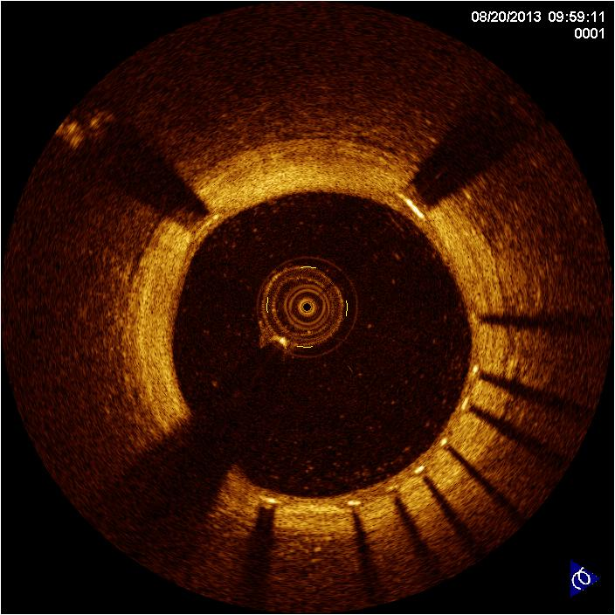
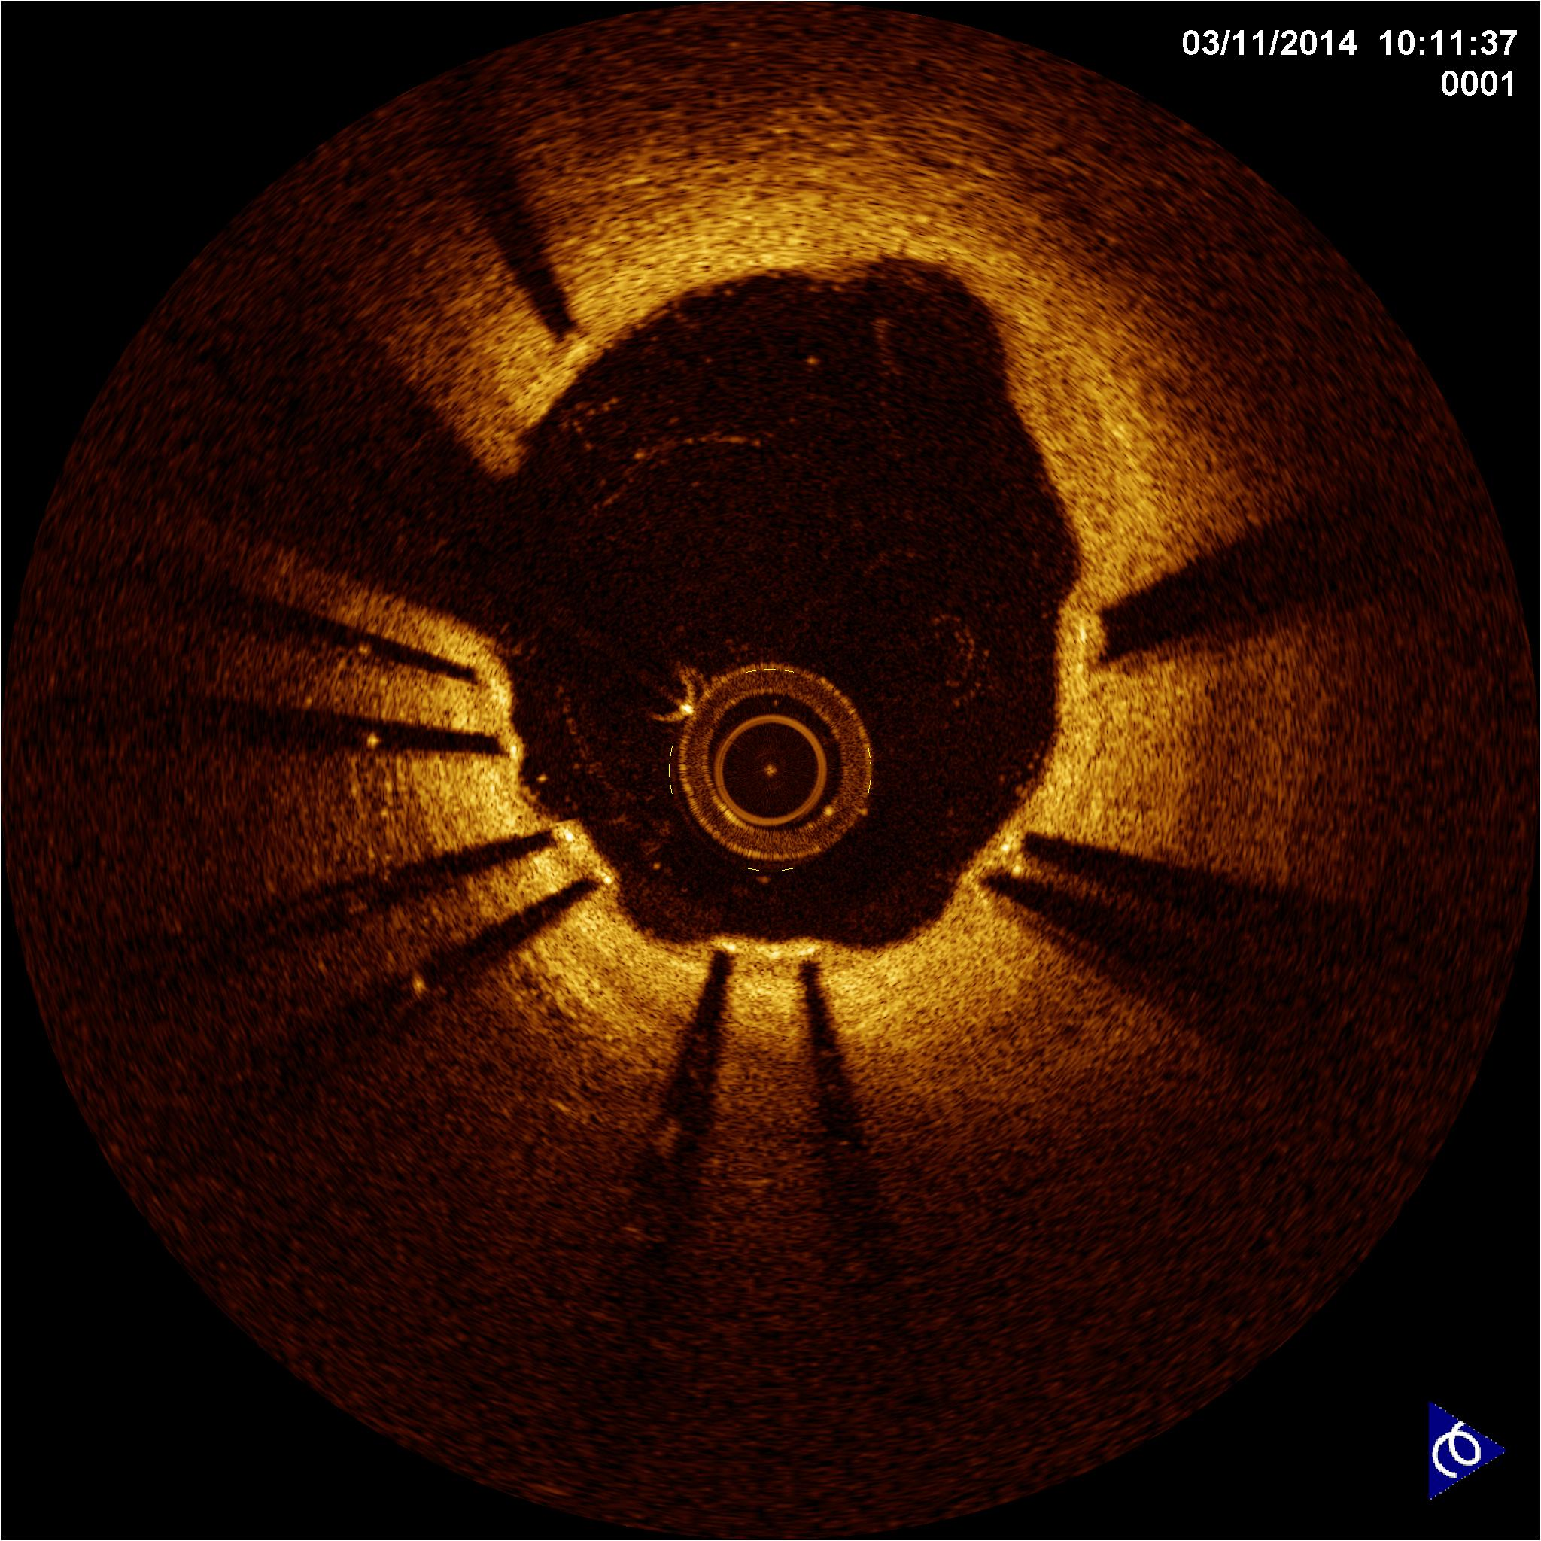
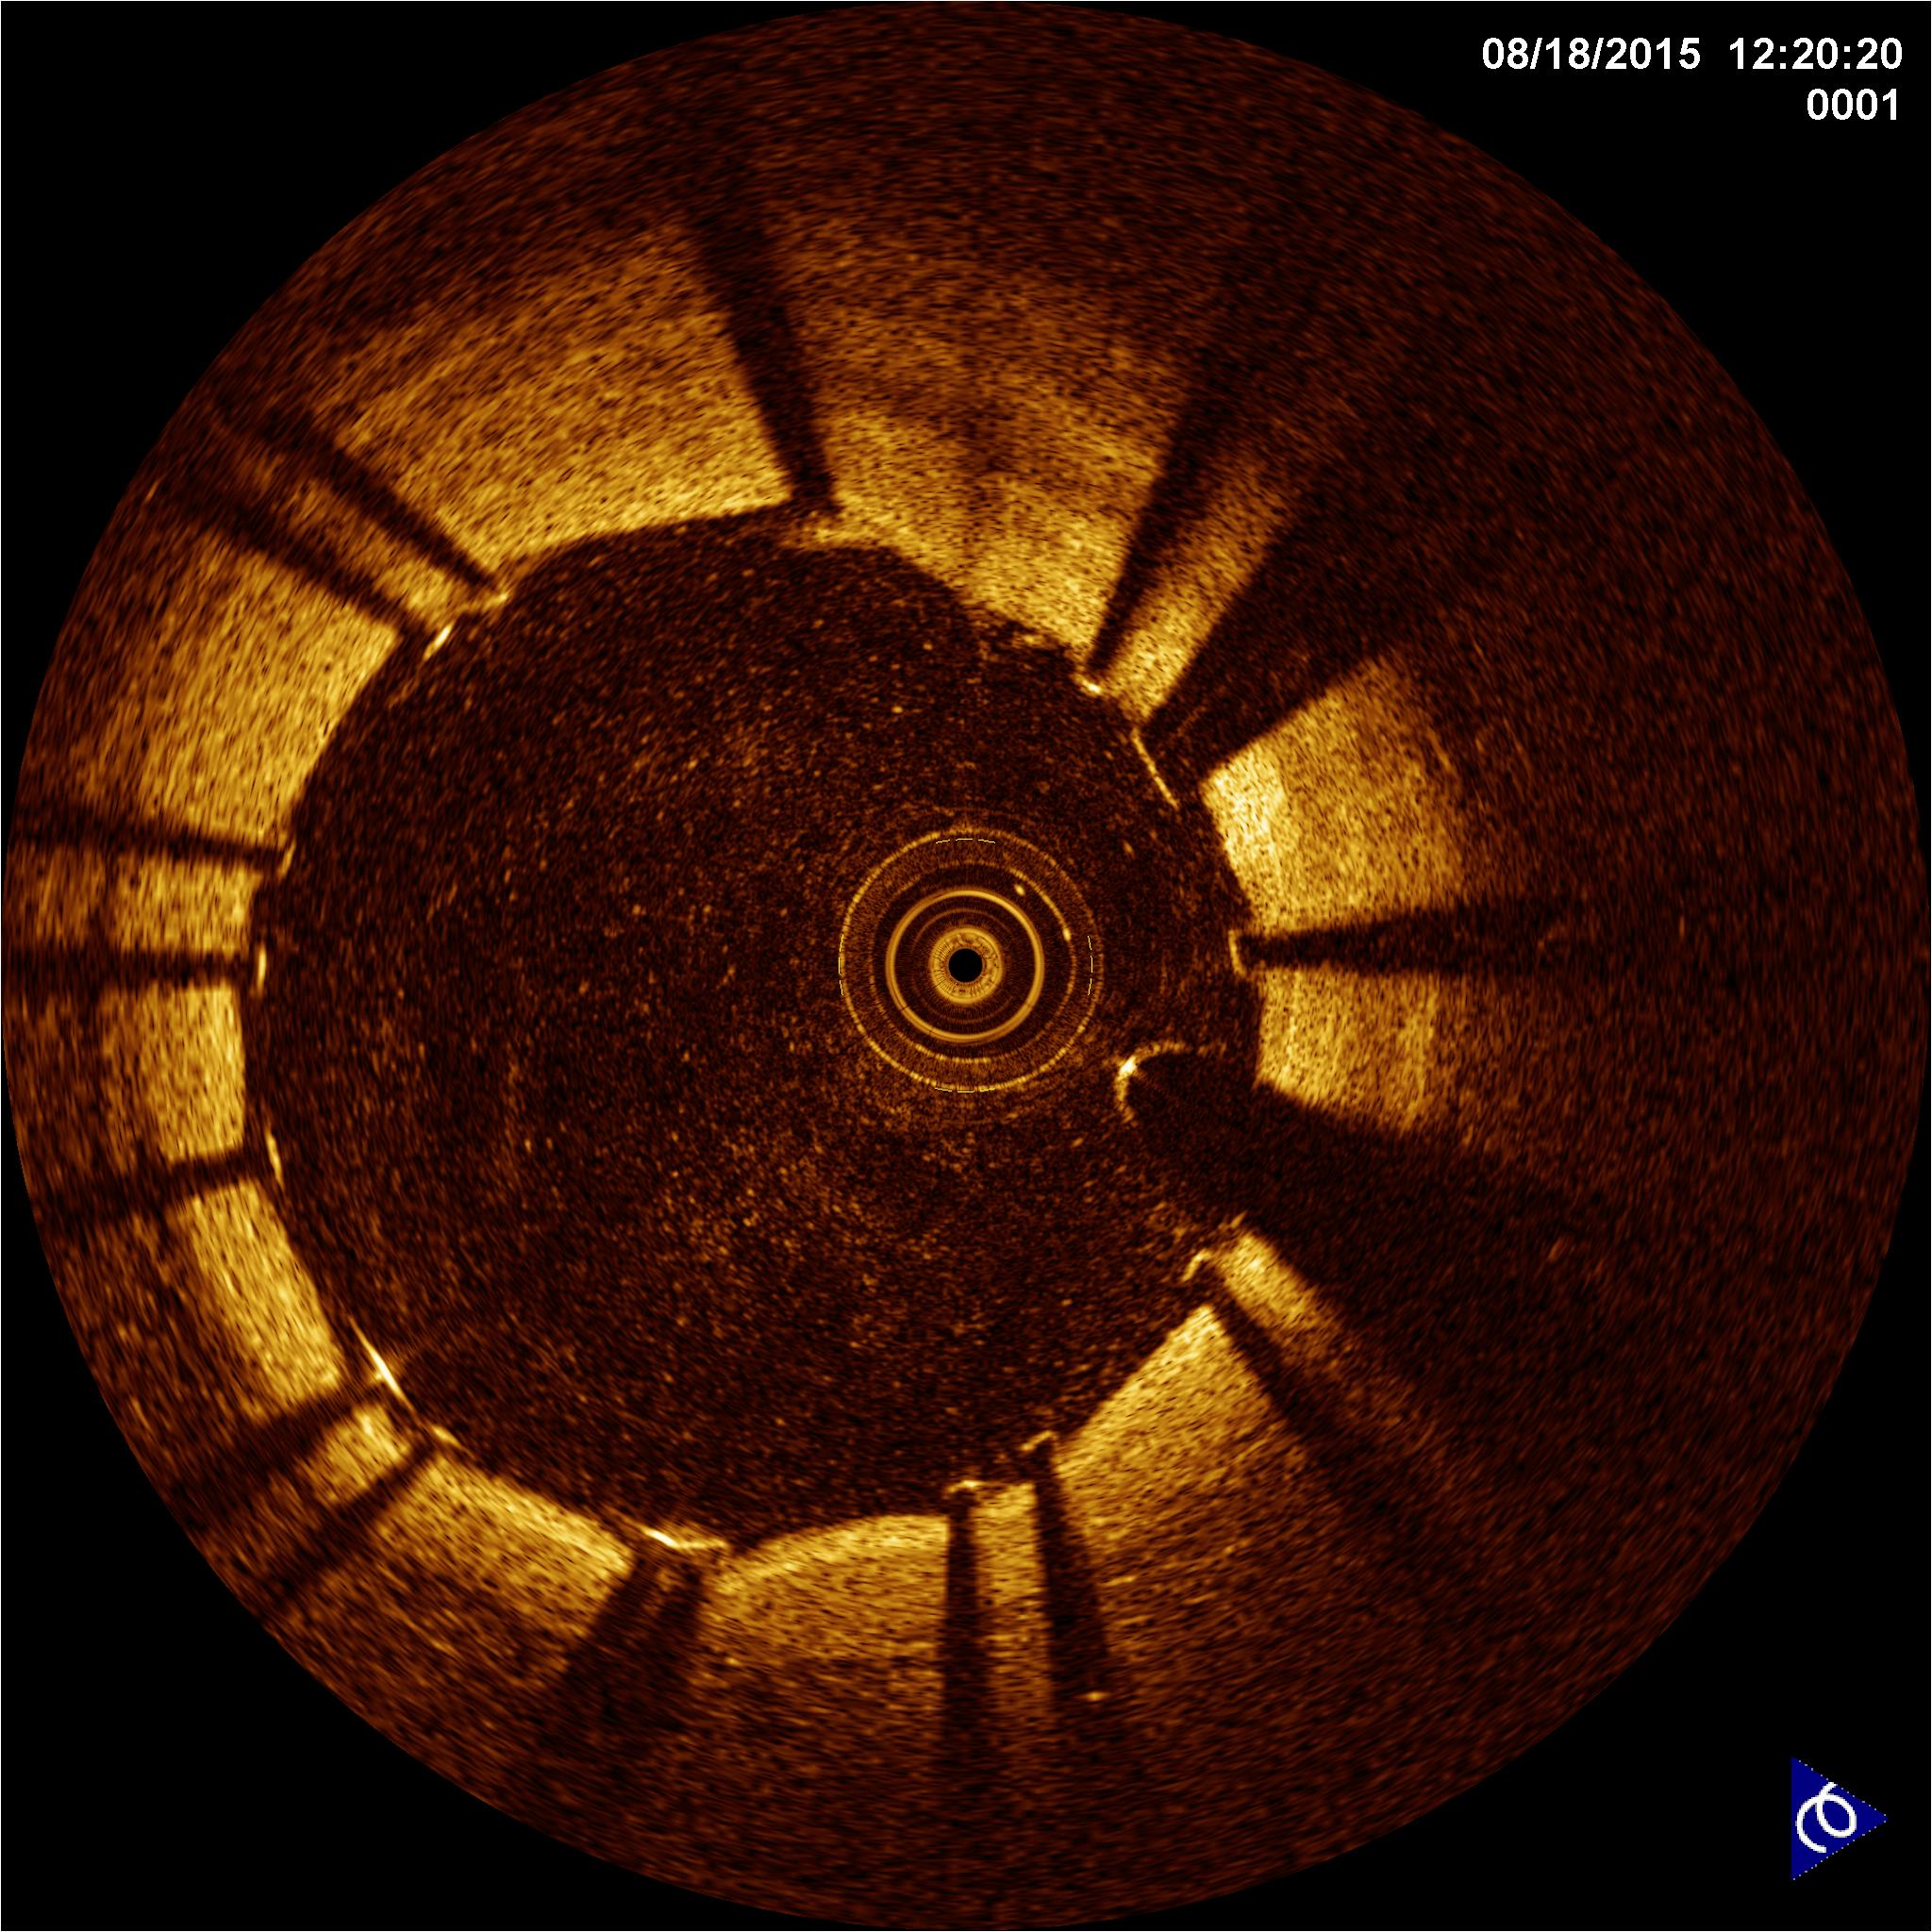
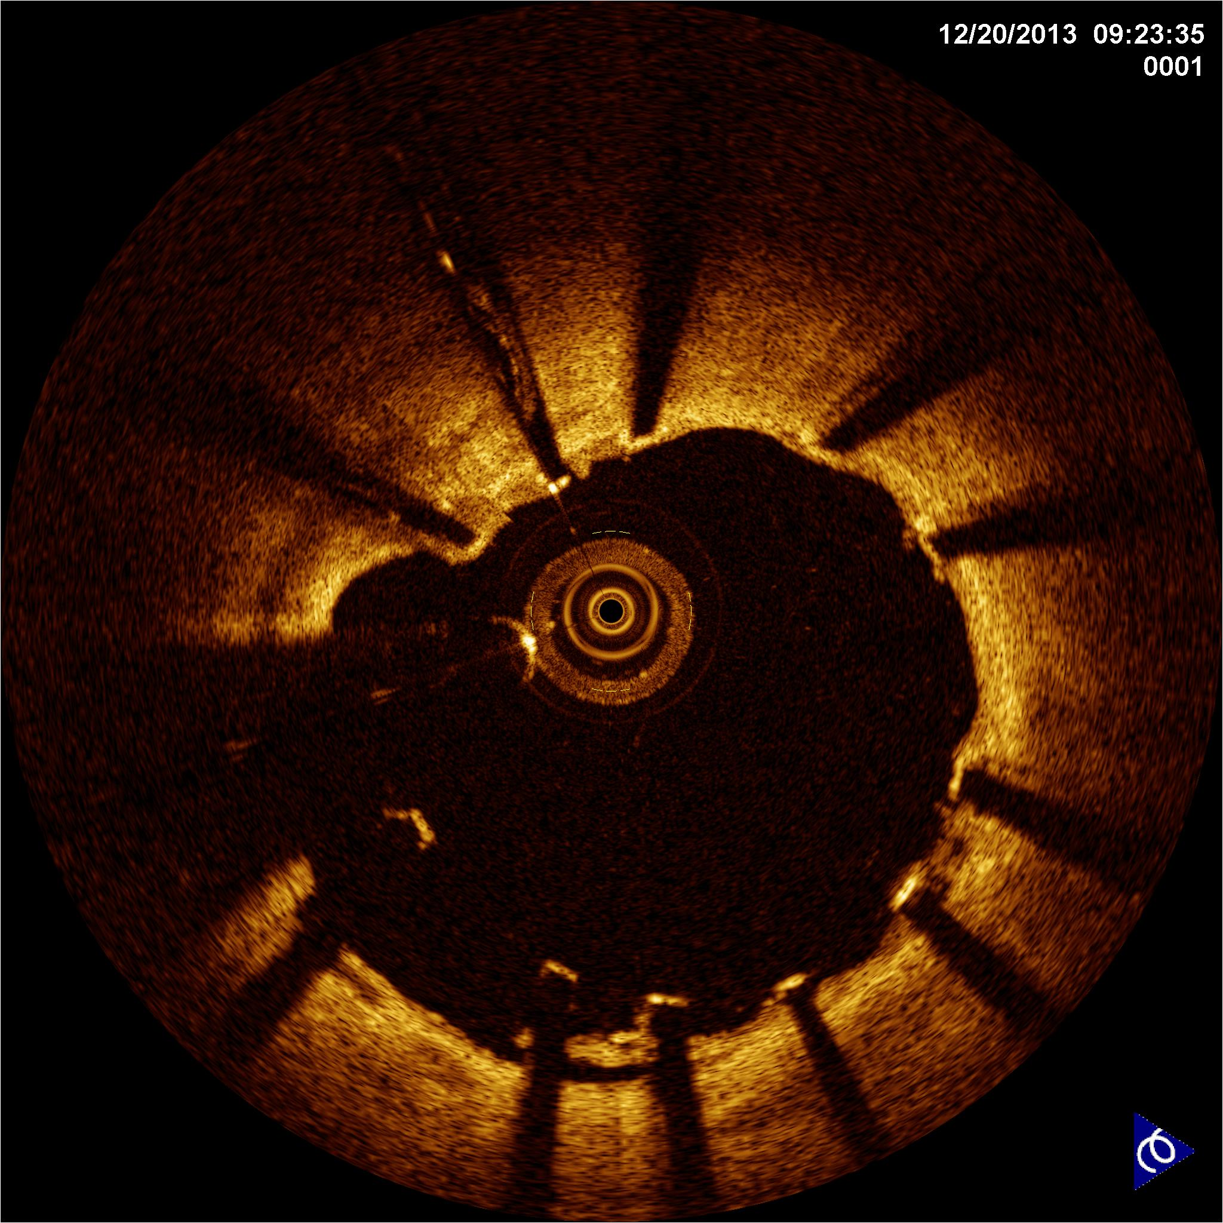
A
covered
B
covered
C
uncovered
D
uncovered

Slide 11
Sample size calculation
Superiority design
Two-sided α with Bonferroni correction of 2.5% and statistical power of 90%, drop out of 10%
Assuming the uncovered strut of EES and BES to be 3.7% and 14.4%, respectively (standard deviation, 10.1) → requiring a sample size of 33 patients for each group
Assuming the uncovered strut of OCT guidance to be reduced by 25%, compared with angiography guidance → requiring 495 patients for each group
Therefore, 550 patients for each group were needed in this study

Slide 12
Statistical Analysis
Intention-to-treat analysis
Primary outcome: Hierarchial multilevel regression model including patients and participating centers as random effects
Secondary outcome: Kaplan-Meier estimates with log-rank tests

Slide 13
Results
The trial was prematurely terminated for
low event rate in patients with 3-month DAPT
slow recruitment
halted production of Nobori® stents by the manufacturer
Therefore, 894 (81·3%) of 1,100 planned patients were randomly assigned

Slide 14
Participant Flow
8,756 assessed for eligibility
7,862 were excluded
4,722 did not meet study criteria
1,823 refused to participate
1,204 included in other study
73 withdrew consent
40 were withdrawn by investigators
894 were enrolled and randomized
with two-by-two factorial design
444 (EES) vs. 450 (BES) were randomized
445 (OCT guidance) vs. 449 (angiographic guidance) were randomized
222 were assigned to
EES and OCT guidance
222 were assigned to
EES and angiographic guidance
223 were assigned to
BES and OCT guidance
227 were assigned to
BES and angiographic guidance
4 did not undergo OCT guidance
29 did not undergo 3-month OCT
6 did not undergo OCT guidance
26 did not undergo 3-month OCT
1 underwent OCT guidance
1 withdrew consent after PCI
21 did not undergo 3-month OCT
1 received EES
30 did not undergo 3-month OCT

Slide 15
Baseline Characteristics
 | EES | BES | OCT guidance | Angiography guidance
No. of patients | 444 | 450 | 445 | 449
Age (years) | 63 (56–69) | 63 (56–69) | 63 (55–69) | 63 (56–69)
Men | 330 (74%) | 322 (72%) | 324 (73%) | 328 (73%)
Diabetes mellitus | 97 (22%) | 111 (25%) | 105 (24%) | 103 (23%)
Acute myocardial infarction | 51 (11%) | 54 (12%) | 55 (12%) | 50 (11%)
No. of diseased vessels
One | 289 (65%) | 278 (62%) | 280 (63%) | 287 (64%)
Two | 113 (25%) | 125 (28%) | 117 (26%) | 121 (27%)
Three | 42 (10%) | 47 (10%) | 48 (11%) | 41 (9%)

Slide 16
Procedural Characteristics
 | EES | BES | p | OCT guidance | Angiography guidance | p
Pre-intervention
Ref. vessel diameter (mm) | 3.04±0.49 | 3.01±0.48 | 0.3064 | 3.04±0.46 | 3.00±0.51 | 0.2388
Minimal lumen diameter (mm) | 0.89±0.45 | 0.85±0.40 | 0.1508 | 0.90±0.46 | 0.85±0.39 | 0.0759
Diameter stenosis (%) | 70.6±14.0 | 71.5±12.8 | 0.859 | 70.5±14.2 | 71.6±12.5 | 0.2496
Stent diameter (mm) | 3.23±0.42 | 3.13±0.36 | <0.0001 | 3.24±0.38 | 3.13±0.40 | <0.0001
Stent length (mm) | 18.0 (15.0–23.0) | 18.0 (14.0–18.0) | 0.6569 | 18.0 (15.0–18.0) | 18.0 (15.0–23.0) | 0.7033
Adjuvant post-dilation | 249 (55%) | 255 (55%) | 0.8008 | 271 (60%) | 233 (50%) | 0.0039
Post-intervention
Minimal lumen diameter (mm) | 2.82±0.44 | 2.78±0.43 | 0.1790 | 2.84±0.42 | 2.75±0.44 | 0.0020
Diameter stenosis (%) | 10.5±7.3 | 10.2±7.4 | 0.4805 | 9.9±7.1 | 10.9±7.6 | 0.0394

Slide 17
Primary Outcome: percentage of uncovered strut
EES vs. BES
Mean difference of 0.4%
95% confidence interval, -1.6–2.4
p=0.69
OCT vs. Angiography
Mean difference of 2.8%
95% confidence interval, 0.8–4.8
p=0.009
Median percentage of uncovered strut: 8.9% in EES and 8.2% in BES
7.5% in OCT guidance and 9.9% in angiography guidance

Slide 18
Participant Flow
106 did not undergo 3-month OCT
8 underwent repeated PCI of target vessel at 3-month follow-up
1 withdrew consent
Therefore, 779 (87.1%) of 894 were available for DAPT decision at 3-month follow-up
according to the percentage of uncovered strut
320 (40.7%) were eligible for 3-month DAPT
459 were eligible for 12-month DAPT
18 continued clopidogrel
4 restarted clopidogrel
320 were included in analysis
(3-month DAPT)
459 were included in analysis
(12-month DAPT)

Slide 19
Baseline and Procedural Characteristics
 | 3-month DAPT | 12-month DAPT | p
No. of patients | 320 | 459
Age (year) | 62 (55–69) | 63 (56–70) | 0.1050
Men | 219 (68%) | 347 (76%) | 0.0274
Hypertension | 164 (51%) | 263 (57%) | 0.0952
Diabetes mellitus | 68 (21%) | 104 (23%) | 0.6411
Clinical diagnosis |  |  | 0.3763
Stable angina | 177 (55%) | 256 (56%)
Unstable angina | 111 (35%) | 144 (31%)
Acute myocardial infarction | 32 (10%) | 59 (13%)
Used drug-eluting stent |  |  | 0.1181
EES | 151 (47%) | 248 (52·5%)
BES | 171 (53%) | 224 (47·5%)
Usage of OCT | 164 (51%) | 220 (47%) | 0.2315
Stent diameter (mm) | 3.14 ± 0.40 | 3.22 ± 0.39 | 0.0118
Stent length (mm) | 18.0 (15.0–18.0) | 18.0 (15.0–23.0) | 0.0413
Adjuvant post-dilation | 171 (53%) | 272 (58%) | 0.2078

Slide 20
Three-month OCT Findings
 | 3-month DAPT | 12-month DAPT | p
Stent volume index (mm³/mm) | 7.3 ± 2.5 | 7.8 ± 2.2 | 0.0116
Lumen volume index (mm³/mm) | 6.8 ± 2.3 | 7.4 ± 2.1 | 0.0002
Neointima volume index (mm³/mm) | 0.6 ± 0.4 | 0.3 ± 0.2 | <0.0001
No. of analyzed cross sections | 5,687 | 8,476
Cross sections with any uncovered strut (%) | 16.7 (8.0–28.0) | 66.7 (50.0–83.3) | <0.0001
Cross sections with uncovered strut >0.3 (%) | 0 (0–0) | 23.5 (10.7–41.7) | <0.0001
Cross sections with any malapposed strut (%) | 0 (0–5.3) | 12.5 (0–30.2) | <0.0001
Maximal malapposed distance (μm) | 250.0 (180.0–410.0) | 285.0 (190.0–460.0) | 0.1325
No. of analyzed struts | 57,771 | 88,786
Uncovered struts (%) | 2.5 (1.0–4.4) | 17.4 (10.3–27.3) | <0.0001
Malapposed struts (%) | 0 (0–0.6) | 1.8 (0–6.1) | <0.0001

Slide 21
Secondary Outcome
 | 3-month DAPT (n=320) | 12-month DAPT (n=459) | Difference (95% CI) | p
Cardiac death | 0 | 0 |  | -
MI | 1 (0.3%) | 0 | 0.3% (-0.3–0.9) | 0.4108
Definite or probable ST | 1 (0.3%) | 0 | 0.3% (-0.3–0.9) | 0.4108
Bleeding | 1 (0.3%) | 3 (0.7%) | -0.3% (-1.3–0.6) | 0.5138
Major | 0 | 1
Minor | 1 | 2
Target-vessel revascularization | 2 (0.6%) | 2 (0.4%) | 0.2% (-0.9–1.2) | 0.7175
A composite of cardiac death, MI, definite/probable ST, and major bleeding | 1 (0.3%) | 1 (0.2%) | 0.1% (-0.7–0.8) | 0.7967

Slide 22
Conclusions
Strut coverage at 3-month follow-up OCT evaluation was similar for EES and BES.
OCT-guided DES implantation resulted in better strut coverage than angiography-guided DES implantation at 3-month follow-up.
Three-month DAPT based on a favorable degree of strut coverage upon OCT evaluation was feasible in selected patients receiving new-generation DES.

Slide 23
Dreams will
come true

