Slide 1
A Naturally Randomized Trial Comparing the Effect of Genetic Variants that Mimic CETP Inhibitors and Statins on the Risk of Cardiovascular Disease.
Brian A. Ference MD, MPhil, MSc, John J. P. Kastelein MD, PhD, Henry N. Ginsberg MD, M. John Chapman PhD, DSc, Stephen J. Nicholls MBBS, PhD, Kausik K. Ray MD, MPhil, Chris J. Packard DSc, Ulrich Laufs MD, PhD, Robert D. Brook MD, Clare Oliver-Williams PhD, Adam S. Butterworth PhD, John Danesh FRCP, DPhil, George Davey Smith MD, DSc, Alberico L. Catapano PhD, and Marc S. Sabatine MD, MPH
From the Division of Cardiovascular Medicine, Wayne State University School of Medicine, Detroit and Institute for Advanced Studies, University of Bristol, Bristol, UK (B.A.F.); Department of Vascular Medicine, Academic Medical Center, University of Amsterdam, Amsterdam, The Netherlands (J.P.P.K.); Irving Institute for Clinical and Translational Research, Columbia University College of Physicians and Surgeons, New York (HNG); National Institute for Health and Medical Research (INSERM), Pitie-Salpetriere University Hospital, Paris, France (M.J.C.); South Australian Health and Medical Research Institute, University of Adelaide, Adelaide, Australia (S.J.N.); Imperial Centre for Cardiovascular Disease Prevention, Department of Primary Care and Public Health, School of Public Health, Imperial College London, London U.K. (K.K.R.); Institute of Cardiovascular and Medical Sciences, University of Glasgow, Glasgow, U.K. (C.J.P.); Department of Cardiology, University of Leipzig, Leipzig Germany (U.L.); Division of Cardiovascular Medicine, University of Michigan Medical School, Ann Arbor (R.D.B.); MRC/BHF Cardiovascular Epidemiology Unit, Department of Public Health and Primary Care, University of Cambridge, Cambridge, U.K. (C.O.W., A.S.B., J.D.); NIHR Blood and Transplant Research Unit in Donor Health and Genomics, University of Cambridge, Cambridge, UK. (A.S.B., J.D.); Wellcome Trust Sanger Institute, Hinxton, UK (J.D.), MRC Integrative Epidemiology Unit, University of Bristol, Bristol, U.K. (G.D.S.); Department of Pharmacological and Biomolecular Sciences, University of Milan and Multimedica IRCCS, Milano Italy (A.L.C.); and the Thrombolysis in Myocardial Infarction (TIMI) Study Group, Division of Cardiovascular Medicine, Brigham and Women’s Hospital, Harvard Medical School, Boston (M.S.S.)
Late Breaking Clinical Trial | Hotline Session | 28 August 2017

Slide 2
Financial Disclosures
Research Grants: Merck, Novartis, Esperion Therapeutics, Ionis Pharmaceuticals, dalCOR
Consulting Fees, Advisory Boards, Honoraria: Merck, Amgen, Pfizer, Regeneron, Sanofi, Ionis Pharmaceuticals, dalCOR, KrKa Phamaceuticals, Celera, Quest Diagnostics, American College of Cardiology, European Atherosclerosis Society
Late Breaking Clinical Trial | Hotline Session | 28 August 2017

Slide 3
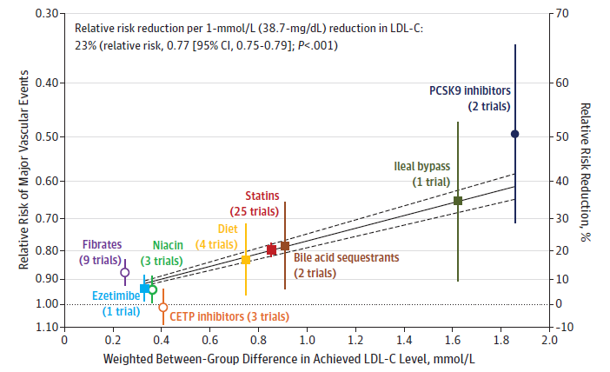
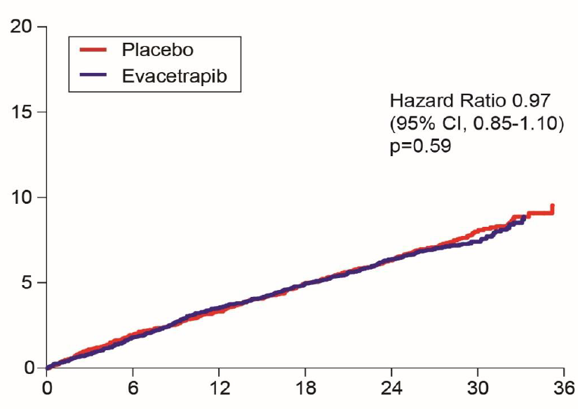
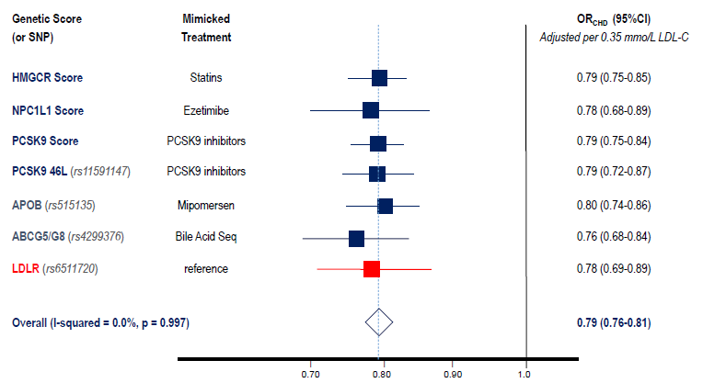
Background: Causal effect of LDL-C
Mendelian Randomization
Randomized Trials
ACCELERATE Trial
Ference BA, et al. EAS Consensus Statement on LDL Causality. Eur Heart J 2017; doi: 10.1093/eurheartj/ehx144
Silverman MG, et al. JAMA 2016;316:1289-1297.
Lincoff AM, et al. N Engl J Med. 2017; 376:1933-1942.

Slide 4
Objective
To evaluate the causal effect of lowering LDL-C (and other lipoprotein measures) on the risk of cardiovascular events due to inhibition of CETP, and compare it with the effect of lower LDL-C due to inhibition of HMG CoA-Reductase (statins), NPC1L1 (ezetimibe) and PCSK9 (PCSK9 inhibitors) to make inferences about whether the clinical benefit of lowering LDL-C depends on how LDL-C is lowered

Slide 5
Study Population
Primary outcome: major vascular events (MVE) defined as the first occurrence of non-fatal MI, stroke, coronary revascularization or coronary death
Primary study population: 102 837 participants from 14 prospective cohort or case-control studies (including 13 821 first MVE)
External Validation analyses: 189 539 participants from 48 studies (62 240 cases of CHD)
GWAS: 65 829 participants from 15 studies who had LDL-C and apoB measurements performed on the same nuclear magnetic resonance metabolomic platform
Total sample size: 358 205 participants from 77 studies (76 061 cardiovascular events)

Slide 6
Study Design
Genetic CETP score that mimics effect of CETP inhibitors (8 independently inherited CETP variants)
Naturally Randomized Trial
Randomized Controlled Trial
Eligible Population
Eligible Population
CETP variants associated with lower CETP activity
(Naturally Random Allocation of Alleles)
CETP inhibitor Therapy
(Random Allocation of Treatment)
Lower CETP activity Allele
(Treatment Arm)
Other Allele
(Usual Care Arm)
Treatment Arm
Usual Care Arm
Δ HDL-C, LDL-C, apoB
Δ HDL-C, LDL-C, apoB
Incident Major Cardiovascular Events
Incident Major Cardiovascular Events

Slide 7
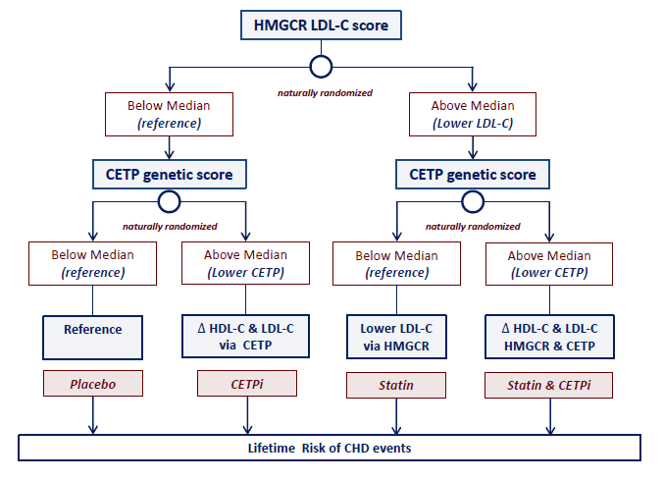
Study Design: combined effect of CETP and HMGCR inhibition
Genetic CETP score that mimics effect of CETP inhibitors (8 independently inherited CETP variants)
Genetic HMGCR score that mimics effect of statins (6 independently inherited HMGCR variants)

Slide 8
Baseline Characteristics
 | Characteristic | CETP score < median | CETP score ≥ median | p
 | Sample size | 49,435 | 53,402
Lipids
 | Low density lipoprotein cholesterol (mg/dl) | 130.8 (130.3-131.3) | 128.7 (128.2-129.2) | P < 0.001
 | Apolioprotein B (mg/dL) | 102.1 (101.5-102.7) | 100.7 (100.1-101.3) | P = 0.004
 | High density lipoprotein cholesterol (mg/dl) | 49.6 (49.4-49.8) | 54.4 (54.2-54.6) | P < 0.001
 | Triglycerides (mg/dl) | 119.7 (81-159) | 115.2 (77-156) | P < 0.001
 | Total cholesterol (mg/dL) | 205.7 (205.3-206.1) | 207.5 (207.1-207.9) | P < 0.001
 | Non-high density lipoprotein cholesterol (mg/dl) | 155.1 (154.7-155.5) | 151.9 (151.5-152.3) | P < 0.001
Non-Lipid characteristics
 | Age (years) | 59.8 (59.7-59.9) | 60.0 (59.9-60.1) | 0.13
 | Women (%) | 58.3 | 58.2 | 0.87
 | Systolic Blood pressure (mmHg) | 127.3 (127.1-127.5) | 127.5 (127.3-127.7) | 0.11
 | Diastolic Blood pressure (mmHg) | 75.0 (74.9-75.1) | 74.9 (74.8-75.0) | 0.16
 | Weight (kg) | 76.9 (76.7-77.1) | 76.8 (76.6-77.0) | 0.48
 | Body mass index (kg/m²) | 27.7 (27.6-27.8) | 27.6 (27.5-27.7) | 0.19
 | Prevalent diabetes at baseline (%) | 4.2 | 4.1 | 0.57
 | Ever Smoker (%) | 54.4 | 54.3 | 0.65

Slide 9
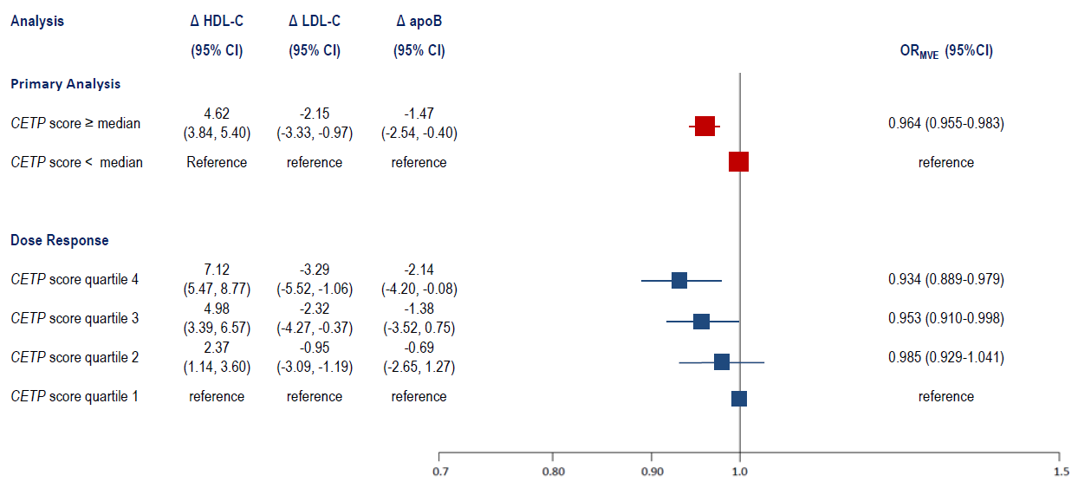
Main results and dose response

Slide 10
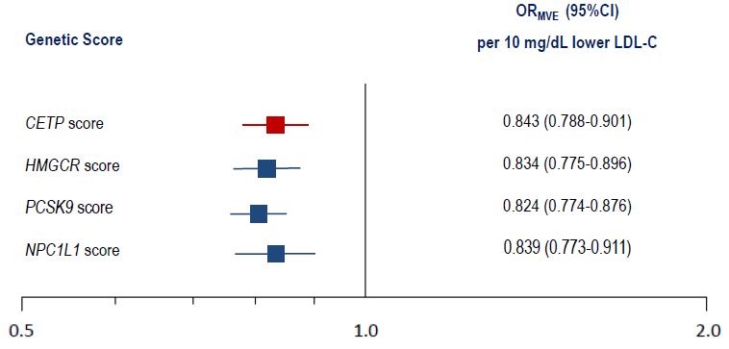
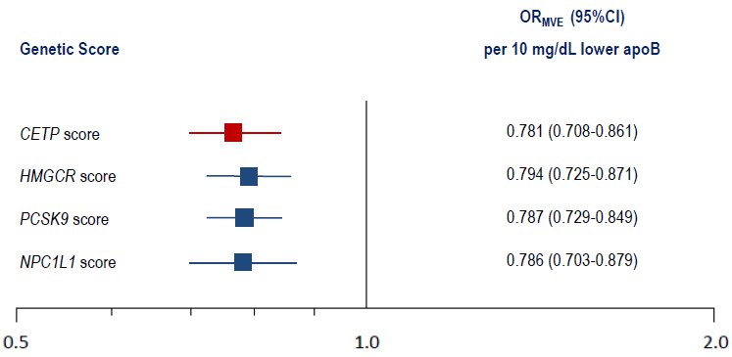
Comparative clinical effect
OR_{MVE} per unit change in LDL-C
OR_{MVE} per unit change in apoB

Slide 11
Combined effect of CETP and HMGCR inhibition
 | Both scores < median | CETP score ≥ median | HMGCR score ≥ median | Both scores ≥ median
OR for MVE (95% CI) | reference | 0.952 (0.910-0.995) | 0.929 (0.880-0.981) | 0.920 (0.869-0.976)
No. participants | 25 693 | 27 031 | 23 854 | 26 259
No. cases (%) | 3,622 (14.1) | 3,631 (13.4) | 3,145 (13.2) | 3,423 (13.0)
Biomarker, units
CETP activity, SMD | reference | -0.319 (-0.462, -0.176) | -0.008 (-0.026, 010) | -0.323, (-0.451, -0.196)
HDL-C, mg/dl | reference | 4.64 (3.44, 5.83) | 0.83 (0.11, 1.56) | 5.40 (4.16, 6.64)
LDL-C, mg/dL | reference | -2.16 (-3.69, -0.63) | -3.27 (-5.08, -1.46) | -5.29 (-7.29, -3.29)
apoB, mg/dL | reference | -1.93 (-3.27, -0.57) | -2.74 (-4.31, -1.07) | -3.33 (-5.19, -1.46)

Slide 12
Combined effect of CETP and HMGCR inhibition
 | Both scores < median | CETP score ≥ median | HMGCR score ≥ median | Both scores ≥ median
OR for MVE (95% CI) | reference | 0.952 (0.910-0.995) | 0.929 (0.880-0.981) | 0.920 (0.869-0.976)
No. participants | 25 693 | 27 031 | 23 854 | 26 259
No. cases (%) | 3,622 (14.1) | 3,631 (13.4) | 3,145 (13.2) | 3,423 (13.0)
Biomarker, units
CETP activity, SMD | reference | -0.319 (-0.462, -0.176) | -0.008 (-0.026, 010) | -0.323, (-0.451, -0.196)
HDL-C, mg/dl | reference | 4.64 (3.44, 5.83) | 0.83 (0.11, 1.56) | 5.40 (4.16, 6.64)
LDL-C, mg/dL | reference | -2.16 (-3.69, -0.63) | -3.27 (-5.08, -1.46) | -5.29 (-7.29, -3.29)
apoB, mg/dL | reference | -1.93 (-3.27, -0.57) | -2.74 (-4.31, -1.07) | -3.33 (-5.19, -1.46)

Slide 13
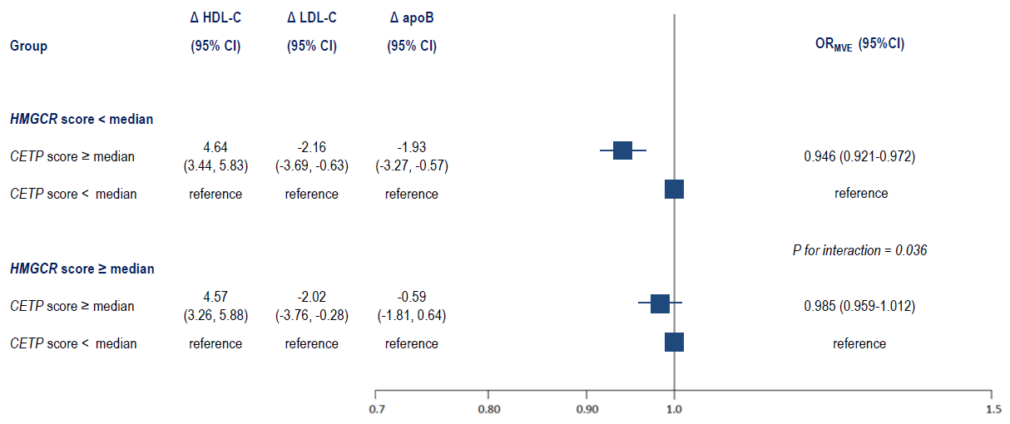
Combined effect of CETP and HMGCR inhibition

Slide 14
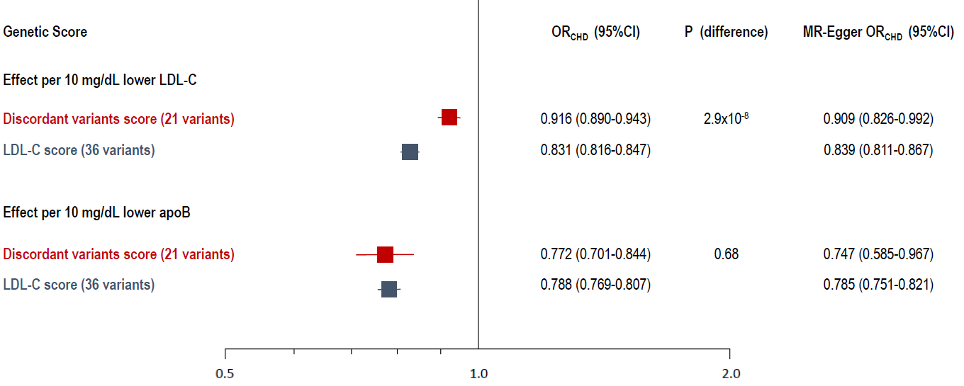
External validation
21 genetic variants with naturally occurring discordance between LDL-C and apoB similar in magnitude to what occurs when CETP & HMGCR inhibition are combined

Slide 15
Summary
CETP inhibition leads to concordant reductions in LDL-C and apoB and a lower risk of cardiovascular events that is proportional to the absolute change in LDL-C (or apoB)
Combined CETP and HMG-CoA reductase inhibition leads to discordant changes in LDL-C and apoB (due to an attenuated change in apoB) and a lower risk of cardiovascular events that is proportional to the absolute change in apoB, but less than expected per unit lower LDL-C
Genetic variants that lead to naturally occurring discordance between changes in LDL-C and apoB are also associated with a reduced risk of cardiovascular events that is proportional to absolute change in apoB, but less than expected per unit change in LDL-C

Slide 16
Conclusions
The causal effect of LDL on cardiovascular disease is determined by the circulating concentration of LDL particles (as estimated by apoB) rather than by the mass of cholesterol carried by those particles (as estimated by LDL-C)
Therefore, the clinical benefit of LDL-C lowering therapies may depend on the corresponding reduction in LDL particles as measured by apoB
Clinical benefit of LDL-C lowering therapies depends on how LDL-C is lowered
Therapies that reduce LDL-C by reducing LDL particles (e.g. statins, ezetimibe, PCSK9 inhibitors) should reduce the risk of cardiovascular events proportional to absolute change in LDL-C (or apoB)
Therapies that reduce LDL-C without necessarily proportionally reducing LDL particles (e.g. by altering the lipid content of LDL particles) should reduce the risk of cardiovascular events proportional to the absolute change in apoB, which may be less than the expected for the observed change in LDL-C

Slide 17
