Slide 1
Effect of Sildenafil on Clinical Outcomes in Patients with Corrected Valvular Heart Disease and Residual Pulmonary Hypertension.
The Sildenafil for Improving Outcomes after Valvular Correction (SIOVAC) Trial.
Javier Bermejo, on behalf of the SIOVAC investigators
There are no potential conflicts of interest to disclose

Slide 2
Objective
To determine whether chronic treatment with sildenafil improves clinical outcomes in patients with successfully corrected valvular heart disease.
Design
Academically-funded, multicenter, double-blind, placebo-controlled, parallel-group, randomized clinical trial. 18 tertiary public hospitals in Spain.
clinicaltrials.gov #: NCT00862043

Slide 3
The SIOVAC Design
Inclusion Criteria:
Full successful correction of primary VHD
1 month clinical stability
Exclusion Criteria:
Prosthesis or valvular dysfunction
SBP < 90 mmHg
Previous MI or stroke
Significant liver or renal insufficiency
Established contraindications to sildenafil
Notes:
Ask RY for source file

Slide 4
The SIOVAC Trial
Primary endpoint:
COMPOSITE CLINICAL SCORE
Worsened: death, hospital admission for heart failure (HF), worsening functional class, or significant worsening in global self-assessment.
Improved: improvement in functional class, or significant improvement in global self-assessment.
Unchanged
Key secondary endpoints:
time to a major clinical event (death or HF admission)
number of HF admissions
other functional (BNP, 6MWT) and imaging (ultrasound, MR)

Slide 5
The SIOVAC Trial
23
1
e
n
r
o
ll
e
d
31
P
H
n
o
t
c
o
n
fi
r
m
e
d
20
0
r
a
nd
om
i
z
e
d
10
4
a
ss
i
gn
e
d
t
o SILDENAFIL
9
6
ass
i
gn
e
d
t
o PLACEBO
104
t
r
e
a
t
e
d
w
i
t
h
96
t
r
e
a
t
e
d
w
i
t
h
s
il
d
e
n
a
fi
l
(
S
a
f
et
y
S
et
)
p
l
a
c
e
b
o
(
S
a
f
et
y
S
et
)
101
w
i
t
h
d
a
t
a
t
o
95
w
i
t
h
d
a
t
a
t
o
a
d
j
ud
i
c
a
t
e
o
u
t
c
om
e
a
d
j
ud
i
c
a
t
e
o
u
t
c
o
m
e
(
F
u
ll
A
n
al
y
s
i
s
S
et
)
(
F
u
ll
A
n
al
y
s
i
s
S
e
t
)
80
w
i
t
h
o
u
t
m
a
j
o
r
82
w
i
t
h
o
u
t
m
a
j
o
r
p
r
o
t
o
c
o
l
d
e
v
i
a
ti
o
ns
p
r
o
t
o
c
o
l
d
e
v
i
a
ti
o
ns
(
P
e
r
P
r
o
t
o
c
o
l
S
et
)
(
P
e
r
P
r
o
t
o
c
o
l
S
et
)
1
9
d
i
s
c
o
n
ti
nu
e
d
t
r
e
a
t
m
e
n
t
1
1
d
i
s
c
o
n
ti
nu
e
d
t
r
e
a
t
m
e
n
t
6
A
d
v
e
rs
e
e
v
e
n
ts
4
A
d
v
e
rs
e
e
v
e
n
ts
2
L
a
ck
o
f
e
ffi
c
a
c
y
3
W
i
t
hd
r
e
w
c
o
n
s
e
n
t
1
P
r
o
t
o
c
o
l
d
e
v
i
a
ti
o
n
2
L
o
s
t
f
o
r
f
o
ll
o
w
-
u
p
3
W
i
t
hd
r
e
w
c
o
n
s
e
n
t
2
D
i
e
d
2
L
o
s
t
f
o
r
f
o
ll
o
w
-
u
p
2
D
i
e
d
3
O
t
h
e
r
8
5
c
om
p
l
e
t
e
d
s
t
ud
y*
8
5
c
om
p
l
e
t
e
d
s
t
ud
y

Slide 6
The SIOVAC Trial
Baseline Characteristics
 | SILDENAFIL (N= 104) | PLACEBO (N= 96) | TOTAL (N= 200)
Age (years) | 70 (65, 77) | 73 (67, 77) | 72 (66, 77)
Women, n (%) | 76 (73) | 78 (81) | 154 (77)
Weight, Kg | 66 (59, 78) | 72 (62, 80) | 69 (60, 79)
Systolic blood pressure (mm Hg) | 131 (119, 144) | 140 (127, 154) | 136 (121, 150)
Cardiovascular Risk Factors, n (%)
Hypertension | 59 (57) | 69 (72) | 128 (64)
Diabetes | 31 (30) | 27 (28) | 58 (29)
Median (IQR)

Slide 7
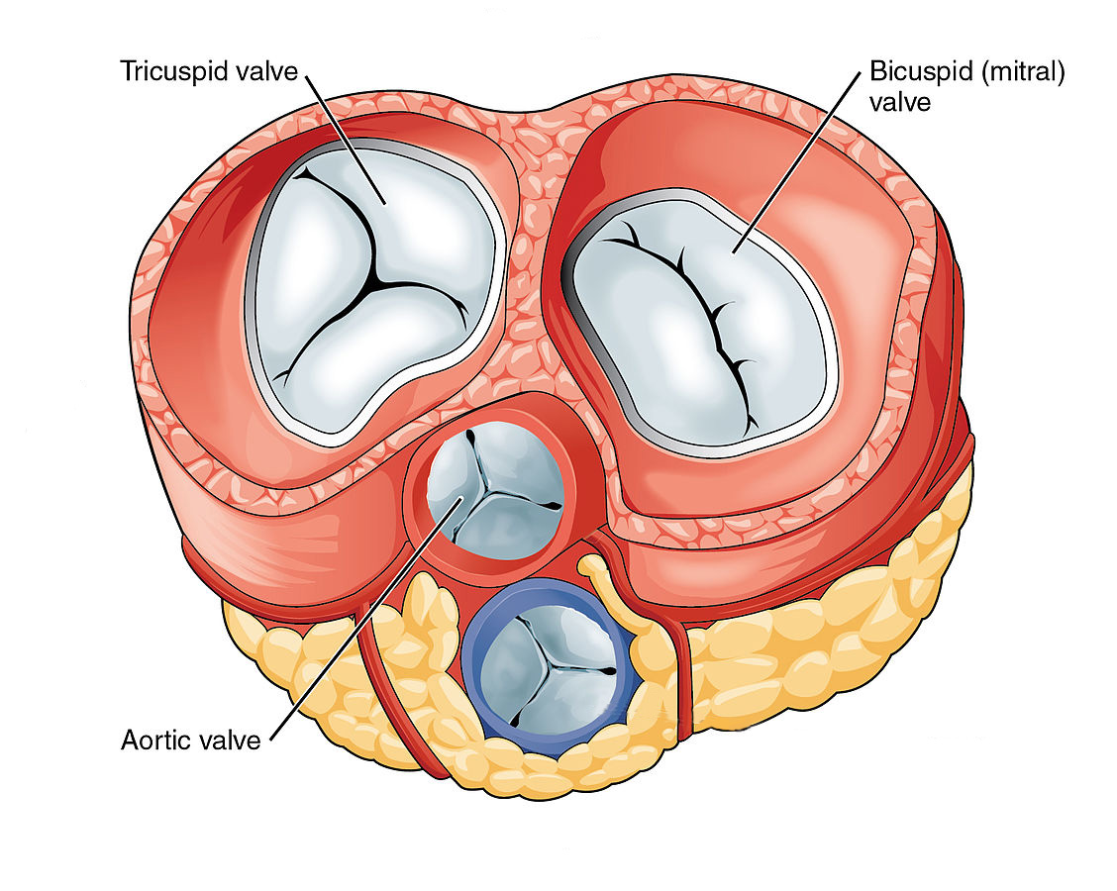
The SIOVAC Trial
Medical History
Mitral: N= 182 (91%)
Tricuspid: N= 78 (39%)
N= 96 | N= 86
N= 40 | N= 38
Repair:
n= 22 (11%)
Replacement:
n= 160 (80%)
Aortic: N= 91 (45%)
N= 51 | N= 40
Combined Surgery: N= 122 (61%)
Reinterventions: N= 63 (31%)
Sketch by: OpenStax College - Anatomy & Physiology, Connexions Web site. http://cnx.org/content/col11496/1.6/ Jun 19, 2013

Slide 8
The SIOVAC Trial
Baseline Functional Status
& Medications
 | SILDENAFIL (N= 104) | PLACEBO (N= 96) | TOTAL (N= 200)
WHO functional class, n (%)
I or II | 59 (59) | 52 (54) | 111 (56)
III | 42 (42) | 43 (45) | 85 (43)
Concomitant Medications
Diuretics, n (%) | 89 (86) | 84 (88) | 169 (87)
Aldosterone receptor antagonist, n (%) | 46 (44) | 38 (40) | 84 (42)
ACE inhibitors/ARB, n (%) | 67 (64) | 53 (55) | 120 (60)
Median (IQR)

Slide 9
The SIOVAC Trial
Key Catheterization Data
 | SILDENAFIL (N= 104) | PLACEBO (N= 96) | TOTAL (N= 200)
Mean Pulmonary Artery Pressure (mm Hg) | 40 (34, 46) | 37 (34, 44) | 38 (34, 44)
Mean Wedge Pulmonary Pressure (mm Hg) | 23 (19, 26) | 22 (19, 26) | 22 (19, 26)
Cardiac Index (L · s⁻¹ · m⁻²) | 2.8 (2.4, 3.2) | 2.8 (2.3, 3.4) | 2.8 (2.4, 3.3)
Transpulmonary Pressure Gradient (mm Hg) | 16.0 (13.0, 22.0) | 15.0 (12.0, 20.0) | 16.0 (12.0, 21.2)
Diastolic Transpulmonary Pressure Gradient (mm Hg) | 4.5 (2.0, 8.0) | 4.0 (1.5, 7.0) | 4.0 (2.0, 7.2)
Pulmonary Vascular Resistance (Wood Units) | 3.4 (2.4, 4.6) | 3.1 (2.2, 4.9) | 3.3 (2.3, 4.9)
Median (IQR)

Slide 10
Main results
The SIOVAC Trial

Slide 11
Primary Endpoint
The SIOVAC Trial

Slide 12
Key Secondary Endpoints
The SIOVAC Trial

Slide 13
The SIOVAC Trial
Key Secondary Endpoints

Slide 14
Imaging Secondary Endpoints
The SIOVAC Trial
MR
Ultrasound

Slide 15
Interaction Analysis

Slide 16
Conclusions
The SIOVAC Trial
Treatment with oral sildenafil 40 mg thrice a day in patients with residual PH after successful correction of VHD is associated to unfavorable clinical outcomes as compared to placebo.
Off-label indication of sildenafil in patients with LHD-PH due to valvular disease should be discouraged.

Slide 17
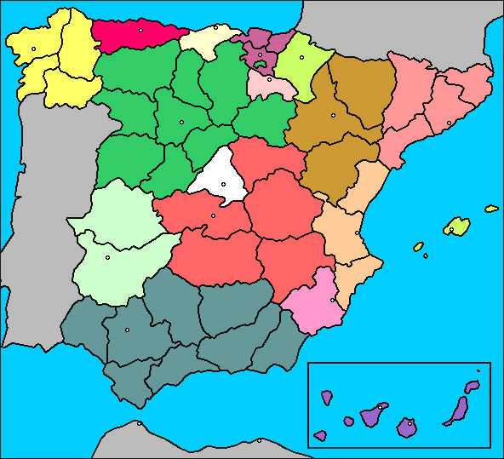
Steering Committee:
Javier Bermejo
Raquel Yotti
Francisco Fernández-Avilés
H. Galdakao
H. A Coruña
H. U. de León
H. Araba
H. Vall d’Hebron
H. Germán Triás i Pujol
H. U. de Valladolid
Adjudication and DSMB:
José A. García-Robles
Joaquín Alonso
Manuel Gómez-Bueno
H. Santa Creu i Sant Pau
H. U. de Salamanca
H. Puerta de Hierro
H. Gregorio Marañón
H. Infanta Leonor
Funded by the Spanish Government
Coordinated by the Spanish network Center for Cardiovascular Research (CIBERCV)
H. 12 de Octubre
H. Reina Sofía
H. San Cecilio
H. Alcorcón
H. Virgen de las Nieves
H. Virgen de la Victoria
The SIOVAC Trial

