Slide 1




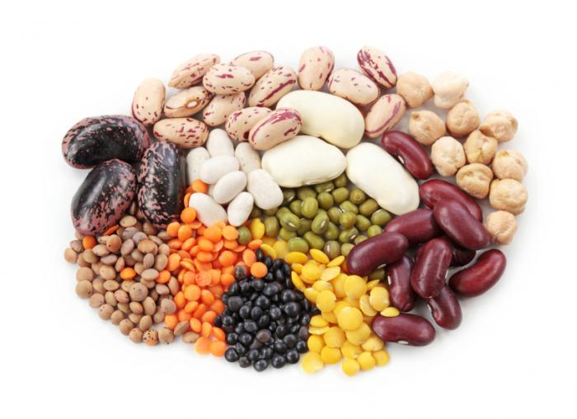
Fruit, vegetable and legume intake and CVD and deaths: the Prospective Urban Rural Epidemiology (PURE) study of 135,335 people in 18 countries
Andrew Mente, on behalf of the PURE investigators

Slide 2
Duality of Interests
None to declare with regards this presentation

Slide 3
Background
Dietary guidelines recommend at least 5 daily servings (≥400 g) of fruits, vegetables and legumes
Associated with lower risk of CVD and mortality, but could be influenced by health seeking behaviors
- Few data from South America, Middle East, Africa and
South Asia; Most data from N Amer, Europe, China, Japan
Recommendations do not differentiate between raw and cooked vegetable intake

Slide 4
Aims
To assess the association between fruit, vegetable and legume consumption and cardiovascular disease and mortality in 135,335 individuals in 18 countries

Slide 5
Study Methods
Design: Prospective cohort study
Population: Unbiased selection from general population in 667 urban/rural communities in 18 countries
N=135,335; aged 35-70 years, without CVD at baseline
Exposure: Country-specific, validated food frequency questionnaires
Covariates: Demographics, other lifestyle, health history, center
Outcomes: Major CVD (CV death and nonfatal MI, stroke, and heart failure) (n=4784), using standardized definitions;
total mortality (n=5796)
Follow-up: Median 7.4 years

Slide 6
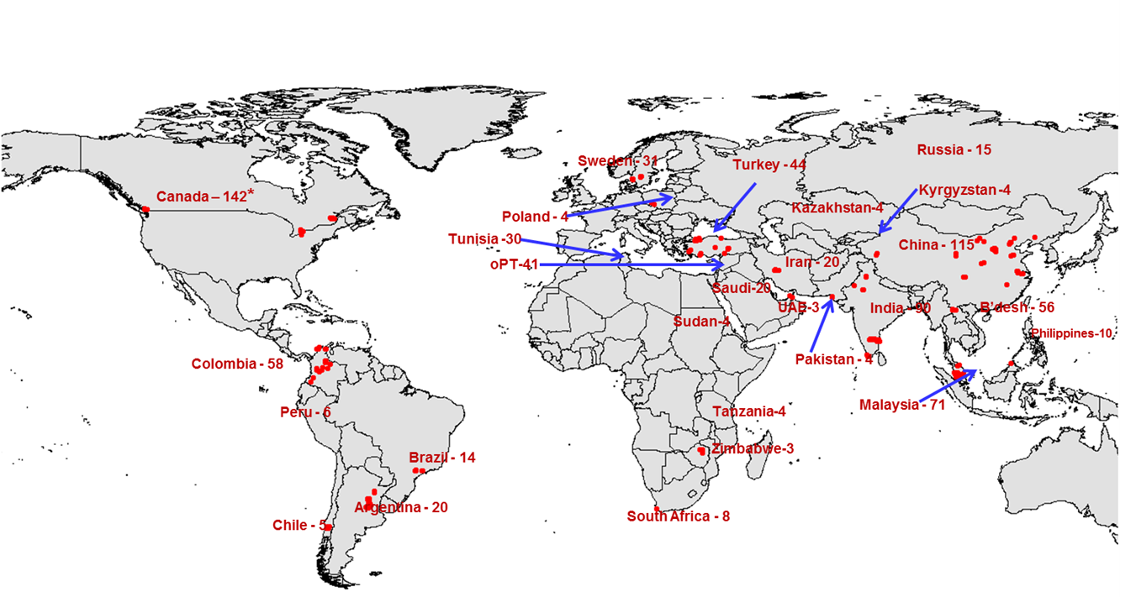
PURE: 135,335 from 667 communities in 18 Phase 1 countries from 5 continents
Target: 200,000 people
Notes:
PURE is unique because it is 1) large, 2) prospective, 3) covers 5 continents representing broad patterns of diet globally

Slide 7
Countries
Geographic region | Countries | N
South Asia | Bangladesh, India, Pakistan | 29,560
China | China | 42,152
Southeast Asia | Malaysia | 10,038
Africa | South Africa, Zimbabwe | 4,558
North America | Canada, Poland, Sweden, | 14,916
Middle East | Iran, Occupied Palestinian Territory, Turkey, United Arab Emirates | 11,485
South America | Argentina, Brazil, Chile, Colombia | 22,626
Overall |  | 135,335
Notes:
This slide shows the list of countries by geographic region, which include…

Slide 8
Phase-1 participants included in these analyses
N=157,543 participants from 18 countries
Did not complete
an FFQ (6.9%)
N=146,646 completed FFQ
Implausible values (1.9%)
Energy <500 or >5000 kcal/d
N=143,934
Missing follow-up (0.9%)
N=142,704
Baseline CVD (5.2%)
N=135,335

Slide 9
Statistical Methods
Studied time to events
Multivariable Cox frailty analysis with random intercepts to account for correlation of observation within centers
Adjusted for:
Age, sex, urban/rural location
Education, smoking, physical activity, diabetes
Energy intake, meats, bread & cereal
When reporting fruit, adjust for vegetables, and vice-versa

Slide 10
Mean fruit, vegetable and legume intake by region
Notes:
Overall average intake is 4 servings / day
>5 in 3 regions – A Amer/Eur, S Amer, and M East
Rest of the countries consume 3 servings per day
Legume intake is modest in each region except South Asia

Slide 11
Risk of mortality by total fruit, veg & legume intake
Servings/day | N | No. of deaths (%) | Age & sex adj. | Full adjusted
<1 /day | 9082 | 736 (8.1%) | 1.0 (ref) | 1.0 (ref)
1 to <2 /day | 19036 | 1371 (7.2%) | 0.92 (0.84-1.01) | 1.01 (0.91-1.12)
2 to <3 /day | 35128 | 1529 (4.4%) | 0.81 (0.74-0.89) | 0.91 (0.82-1.01)
3 to <4 /day | 24485 | 772 (3.2%) | 0.65 (0.58-0.74) | 0.78 (0.69-0.88)
4 to <5 /day | 14849 | 468 (3.2%) | 0.65 (0.58-0.74) | 0.83 (0.72-0.95)
5 to <6 /day | 9790 | 286 (2.9%) | 0.62 (0.53-0.71) | 0.78 (0.66-0.91)
6 to <8 /day | 6945 | 198 (2.9%) | 0.63 (0.54-0.75) | 0.84 (0.70-1.00)
7 to <8 /day | 4857 | 131 (2.7%) | 0.61 (0.50-0.74) | 0.83 (0.67-1.02)
>8 /day | 11163 | 305 (2.7%) | 0.58 (0.50-0.74) | 0.81 (0.68-0.96)
P for trend |  |  | <0.0001 | 0.0001
Notes:
There is a graded association with lower risk all the way to >8 serving/day
If fully adjusted, the maximum benefit is achieved by 3-4 servings and then risk appears to be constant
Therefore, 3-4 servings is associated with maximum benefit
After adjustment, the effect sizes are halved, - suggests that there may be residual confounding in estimating association between fruit, veg and legume intake versus mortality

Slide 12
Risk of mortality and major CVD by total fruit, vegetable and legume intake (servings/day)
Mortality
Major CVD
Intake
HR (95% CI)
Intake
HR (95% CI)
0.6
0.8
1
1.2
P-trend=0.0001
0.6
0.8
1
1.2
1.4
P-trend=0.13
Notes:
Figure shows risk of mortality and CVD by intake, after MV adjustment for confounders
Mortality figure – significant associations with mortality, with a minimal intake of 3-4 serv achieving a Signiant lowering risk of mortality.
CVd figure – no significant association seen with CVD, although there may be a trend. for lower risk

Slide 13
Risk of mortality and major CVD by fruit intake (servings)
Mortality
Major CVD
Intake
HR (95% CI)
Intake
HR (95% CI)
0.6
0.8
1
1.2
P-trend<0.0001
0.6
0.8
1
1.2
P-trend=0.11
Notes:
Consistent with lower mortality BUT
No significant association with CVD , perhaps a lower risk with >3 servings/day

Slide 14
Risk of mortality and major CVD by vegetable intake (servings/day)
Mortality
Major CVD
Intake
HR (95% CI)
Intake
HR (95% CI)
0.6
0.8
1
1.2
P-trend=0.12
0.8
1
1.2
1.4
P-trend=0.38
Notes:
a nonsignificant trend with lower mortality
No association with major CVD

Slide 15
Mean raw and cooked vegetable intake by region
Excluding China (N=42,152)
Notes:
Overall, average intake of fruit & veg is 2 servings per day.
N Amer/Eur consume more raw than cooked vegetables,
Conversely, other regions consume more cooked vegetables, particularly Africa, S Asia and SE Asia where is mostly cooked vegs.

Slide 16
Risk of mortality and major CVD by raw vegetable intake (servings)
Mortality
Major CVD
Intake
HR (95% CI)
Intake
HR (95% CI)
0.6
0.8
1
1.2
P-trend=0.0004
0.6
0.8
1
1.2
P-trend=0.27
Excluding China

Slide 17
Risk of mortality and major CVD by cooked vegetable intake (servings)
Mortality
Major CVD
Intake
HR (95% CI)
Intake
HR (95% CI)
0.6
0.8
1
1.2
P-trend=0.011
0.8
1
1.2
1.4
P-trend=0.085
Excluding China

Slide 18
Risk of mortality and major CVD by legume intake (servings)
Mortality
Major CVD
Intake
HR (95% CI)
Intake
HR (95% CI)
0.6
0.8
1
1.2
P-trend=0.0013
0.6
0.8
1
1.2
P-trend=0.19
Notes:
Sig association with legumes
Suggests legumes are associated with lower risk.

Slide 19
Conclusions
Fruit, vegetables and legumes associated with a moderately lower risk of mortality, but not CVD
Benefits appear to reach a maximum versus mortality at 3 to 4 daily servings (375 g)
Raw vegetables appear to be more protective than cooked vegetables
A balanced diet of >3-4 daily servings fruit, vegs. and legumes is associated with lower mortality
Notes:
Fruit, vegetables and legumes strongly associated with a moderately lower risk of mortality, but not CVD - consistent by region
-substantial attenuation of the risk estimates is found w/ adjustment for confounders – possibility of residual confounding exists (protection may be over estimated) – however, we did everything possible to minimize this.
Benefits appear to reach a maximum versus mortality at 3 to 4 daily servings (375 g)
Raw vegetables appear to be more protective than cooked vegetables
A balanced diet of >3-4 daily servings fruit, vegs. and legumes is associated with lower mortality

Slide 20
EXTRAS

Slide 21
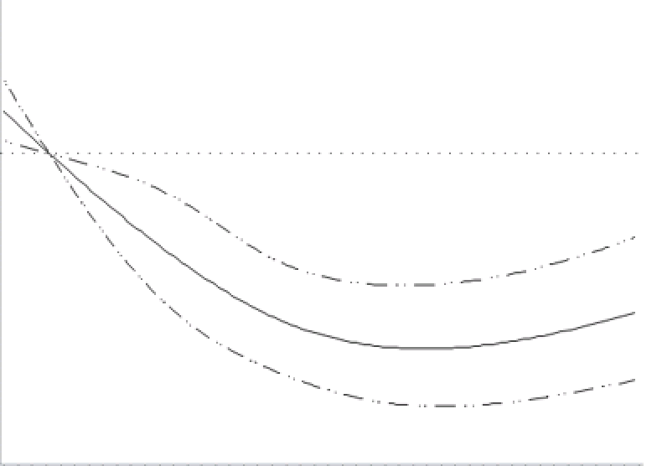
Total fruit, vegetable and legume intake vs. mortality
1.2
1.0
HR
0.8
0.6
0
1
2
3
4
5
6
7
8
9
Servings/day

Slide 22
Mean contribution of fruit type to total fruit intake

Slide 23
Mean contribution of vegetable type to total vegetable intake
Excluding China (N=42,152) because FFQ did not collect vegetable intake by type

Slide 24
Risk of MI and stroke by total fruit, vegetable and legume intake (servings/day)
Myocardial Infarction
Stroke
N=9,082
N=19,032
N=35,128
N=24,485
N=14,849
N=9,790
N=6,945
N=4,857
N=11,163
P-trend=0.20
P-trend=0.71

Slide 25
Risk of CV and non-CV mortality by total fruit, vegetable and legume intake (servings/day)
CV mortality
Non-CV mortality
N=9,082
N=19,032
N=35,128
N=24,485
N=14,849
N=9,790
N=6,945
N=4,857
N=11,163
P-trend=0.057
P-trend=0.0038

Slide 26
Risk of total mortality by tertiles of total fruit, vegetable and legume intake (servings/day), by region

Slide 27
PURE: 195,000 from 1000 communities in 26 countries from 5 continents

