Slide 1
The DARE trial (Drug-eluting bAlloon for in-stent Restenosis)
DARE TRIAL
A randomized comparison of paclitaxel-eluting balloon* versus everolimus-eluting stent for the treatment of any in-stent restenosis
José PS Henriques, MD
Jan Baan, MD
Academic Medical Center
Amsterdam, The Netherlands
*DEB Not approved in US
Jose PS Henriques

Slide 2
Disclosure Statement of Financial Interest
Within the past 12 months, I or my spouse/partner have had a financial interest/arrangement or affiliation with the organization(s) listed below.
Affiliation/Financial Relationship
Company
Grant/Research Support
Consulting Fees/Honoraria
Major Stock Shareholder/Equity
Royalty Income
Ownership/Founder
Intellectual Property Rights
Other Financial Benefit
B.Braun, Abbott Vascular
Company Names
Company Names
Company Names
Company Names
Company Names
Company Names

Slide 3
Background
DARE TRIAL
In-stent restenosis (ISR) still a major challenge
DES & BMS ISR is mostly treated by (repeat) DES
Drug-eluting balloon (DEB*) is an alternative treatment
DEB negates the need for additional stent implantation
No trials of DEB vs DES for any ISR (BMS and DES)
*DEB Not approved in US
Jose PS Henriques

Slide 4
DARE trial design
DARE TRIAL
Multicenter randomized non-inferiority trial
Patients with any ISR (DES or BMS)
1:1 randomization to SeQuent Please paclitaxel-eluting balloon* or Xience everolimus-eluting stent
Primary endpoint: 6-month in-segment MLD
*DEB Not approved in US
Jose PS Henriques

Slide 5
Inclusion criteria
DARE TRIAL
Any restenosis of stented vessels or surgical grafts
DES or BMS ISR
>50% in-stent and <5mm out of the stent
Reference diameter of ≥ 2.0 to 4.0 millimeters
Amendable to PCI treatment with either DEB or DES
Amendable to 1 year dual antiplatelet therapy.
Exclusion criteria
Restenosis in a biodegradable or non-CE marked stent
GFR <30mL/min, exception when on dialysis.
STEMI
Expected need PCI in the same vessel < 6 months.
Jose PS Henriques

Slide 6
Statistical Plan Power calculation assumptions
DARE TRIAL
6-month in-segment MLD mean 2.1mm
Standard deviation 0.6mm
Non-inferiority margin of 0.4mm
to reject the null hypothesis of inferiority with 80% power.
112 analyzable patients per group
Attrition rate of 20%
2x 135 patients (=270 total)
*DEB Not approved in US
Jose PS Henriques

Slide 7
DARE TRIAL
Trial organisation
Steering Committee
J.P.S. Henriques, AMC, Amsterdam
J. Baan, AMC, Amsterdam
R.J. van der Schaaf, O.L.V.G., Amsterdam
N. van Royen, VU Medisch Centrum, Amsterdam
P. den Heijer, Amphia Ziekenhuis, Breda
M.J. de Boer, UMC St. Radboud Ziekenhuis, Nijmegen
A.T.M. Gosselink, Isala Klinieken, Zwolle
A. Dirkali, Albert Schweitzer Ziekenhuis, Dordrecht
Clinical event committee
K. Th. Koch, AMC, Amsterdam, The Netherlands
T. Slagboom, OLVG, Amsterdam, The Netherlands
P.V. Oemrawsingh, HMC Westeinde, the Hague, The Netherlands
S. Brinkman, Tergooi Blaricum, the Netherlands
Data and Safety Monitoring Board
Felix Zijlstra,
Thorax Center, Erasmus University Medical Center, Rotterdam, The Netherlands
Menko-Jan de Boer, Radboud University Medical Center Nijmegen, Nijmegen, The Netherlands
Angiographic Corelab
Cordinamo. Wezep, The Netherlands
Data collection and analysis
Esther Scheunhage, Kirsten Boerlage-van Dijk, Ze-Yie Yong, Esther Wiegerinck, Gilbert Wijntjens, Bimmer Claessen, Jeroen Vendrik
Jose PS Henriques

Slide 8
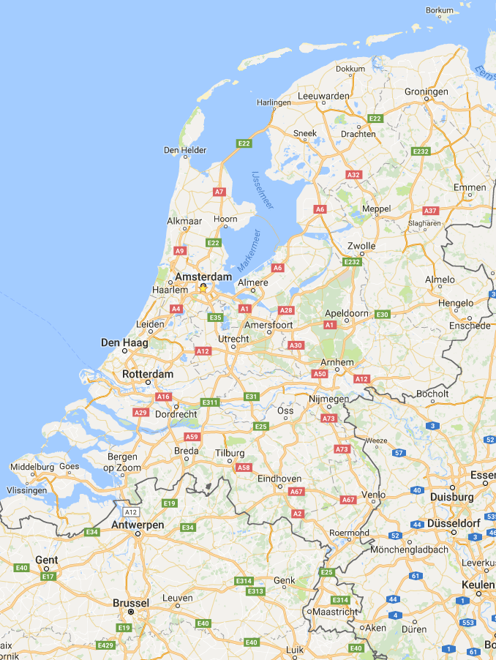
Participating sites
DARE TRIAL
Center | Principal Investigator | No of pts enrolled
Academic Medical Center, University of Amsterdam, the Netherlands | José P.S. Henriques & Jan Baan jr | 90
Onze Lieve Vrouwe Gasthuis, Amsterdam, the Netherlands | René J. van der Schaaf | 63
Albert Schweitzer Hospital, Dordrecht, the Netherlands | Atilla Dirkali | 53
Tergooi Ziekenhuis Blaricum, the Netherlands | E. Karin Arkenbout | 17
Radboud University, Nijmegen, The Netherlands | Marleen van Wely | 17
Amphia Ziekenhuis, Breda, the Netherlands | Martijn Meuwissen | 16
Isala Klinieken, Zwolle, the Netherlands | Marcel Gosselink | 13
Vrije Universiteit Medical Center, Amsterdam, the Netherlands | Niels J. van Royen | 9
Jose PS Henriques

Slide 9
Study Flow Chart
DARE TRIAL
278 patients randomized
137 DEB
141 DES
Clinical FUP complete in 278 patients (100%)
29 pts lost to angiographic FUP
-1 died < 6 month
-3 patients had inadequate quality FUP angiogram
25 pts lost to angiographic FUP -1 died < 6 month
-1 patient had inadequate quality FUP angiogram
6-month Angiographic Follow-up completed in 105 (77%) DEB pts
6-month Angiographic Follow-up completed in 115 (82%) DES pts
*DEB Not approved in US
Jose PS Henriques

Slide 10
Baseline Characteristics
DARE TRIAL
 | Drug-eluting Balloon | Drug-eluting Stent | P-value
 | n=137 | n=141
Age (years) | 66±11 | 65±10 | 0.28
Male | 72% (98) | 84% (118) | 0.02
Time to restenosis (years) | 3.8 (0.94-8.5) | 3.3 (1.3-8.2) | 0.81
Risk factors
Diabetes | 31% (42) | 33% (46) | 0.73
Hypertension | 64% (87) | 67% (94) | 0.58
Hypercholesterolemia | 59% (81) | 60% (84) | 0.94
Current smoker | 17% (23) | 13% (18) | 0.34
Clinical presentation |  |  | 0.78
Stable angina | 44% (54) | 42% (58)
Acute coronary syndrome | 56% (74) | 58% (74)
*DEB Not approved in US
Jose PS Henriques

Slide 11
Baseline Characteristics
DARE TRIAL
 | Drug-eluting Balloon | Drug-eluting Stent | P-value
 | n=137 | n=141
Target vessel |  |  | 0.71
Left anterior descending artery | 41% (56) | 39% (55)
Circumflex coronary artery | 20% (28) | 24% (34)
Right coronary artery | 37% (51) | 35% (49)
Left main coronary artery | 0.0% (0) | 0.7% (1)
Saphenous vein graft | 0.7% (1) | 1.4% (2)
Index stent type |  |  | 0.87
BMS | 45% (60) | 43% (60)
DES | 49% (67) | 53% (75)
Unknown | 7.3% (10) | 4.3% (6)
Focal in-stent restenosis | 51% (54) | 53% (64) | 0.42
*DEB Not approved in US
Jose PS Henriques

Slide 12
Procedural Characteristics
DARE TRIAL
 | Drug-eluting Balloon | Drug-eluting Stent | P-value
MLD, mm | 0.77±0.33 | 0.79±0.35 | 0.73
RVD, mm | 2.56±0.43 | 2.59±0.54 | 0.46
Predilation | 100% (137) | 85.1% (120) | <0.0001
Device length (mm) | 22.4±4.4 | 22.1±8.6 | 0.72
Device diameter (mm) | 3.3±0.9 | 2.9±1.1 | 0.001
Postdilation | 16% (22) | 57% (80) | <0.001
Max. postdil balloon diameter (mm) | 3.2±0.5 | 3.3±0.5 | 0.36
DEB duration of inflation (sec) | 61±22 | n/a | n/a
*DEB Not approved in US
Jose PS Henriques

Slide 13
Baseline MLD
DARE TRIAL
DEB: 0.77±0.33mm vs.
DES: 0.79±0.35mm, p=0.73
*DEB Not approved in US
Jose PS Henriques

Slide 14
Post-procedural MLD
DARE TRIAL
DEB: 1.72±0.35mm vs.
DES: 1.84±0.46mm, p=0.005
*DEB Not approved in US
Jose PS Henriques

Slide 15
In-segment MLD @ 6 months
DARE TRIAL
DEB: 1.71±0.51mm vs.
DES: 1.74±0.61mm, p=0.65
*DEB Not approved in US
Jose PS Henriques

Slide 16
Late loss @ 6 months
DARE TRIAL
DEB: 0.17±0.41mm vs.
DES: 0.45±0.47mm, p<0.001
*DEB Not approved in US
Jose PS Henriques

Slide 17
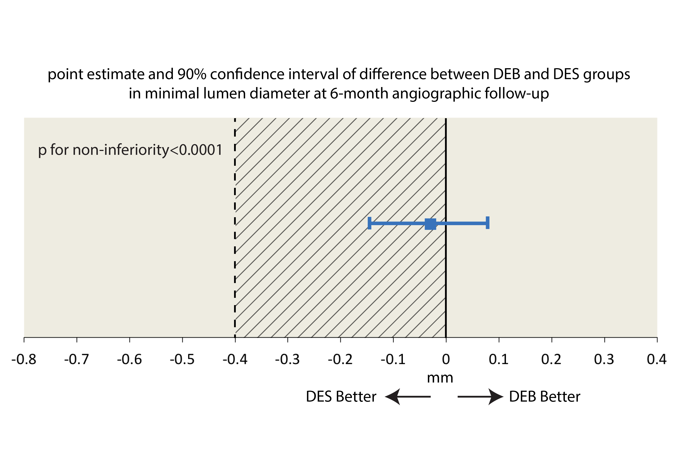
Primary Endpoint
DARE TRIAL
The point estimate of the difference in MLD between DEB and DES was -0.03mm and the 95% lower confidence limit (LCL) LCL -0.16mm, indicating noninferiority (p<0.0001)
Jose PS Henriques

Slide 18
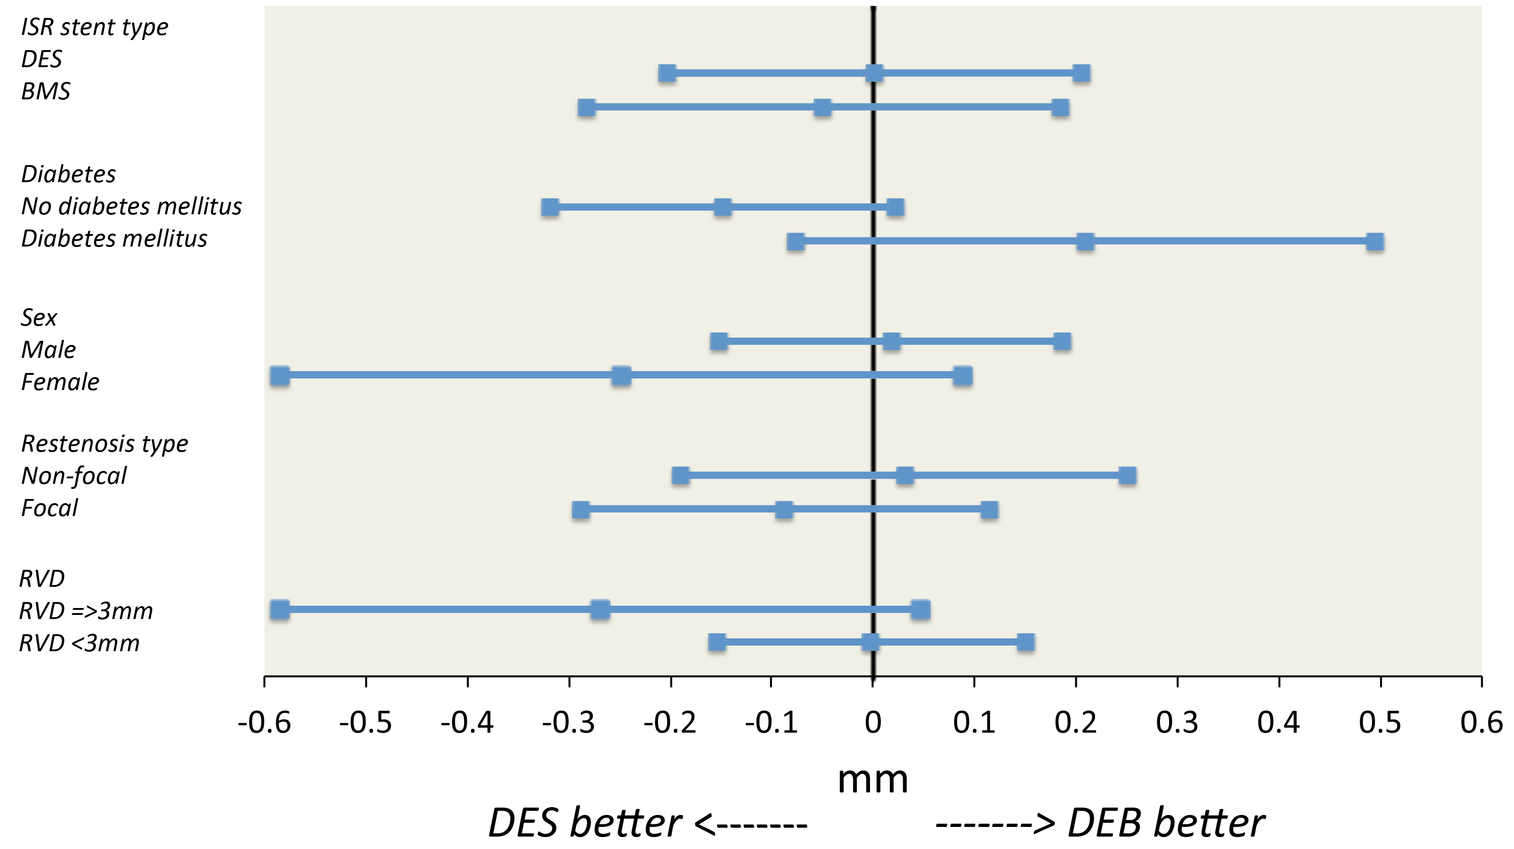
Mean difference in 6-month MLD major subgroups
DARE TRIAL
Jose PS Henriques

Slide 19
Clinical Endpoints
DARE TRIAL
 | Drug-eluting balloon | Drug- eluting stent | p-value
 | n=137 | n=141
Death | 0.7% (1) | 1.4% (2) | 0.58
Cardiac death | 0 | 0.7% (1) | 0.32
Myocardial infarction | 2.2% (3) | 2.8% (4) | 0.74
Target vessel related MI | 1.4% (2) | 0.7% (1) | 0.54
Stent thrombosis | 0 | 0 | n/a
Stroke | 0.7% (1) | 1.4% (2) | 0.58
Target vessel revascularization | 8.8% (12) | 7.1% (10) | 0.65
TVR PCI | 8.8% (12) | 5.7% (8) | 0.36
TVR CABG | 0 | 1.4%(2) | 0.16
Coronary artery bypass graft surgery all | 0.7% (1) | 4.3% (6) | 0.06
Percutaneous coronary intervention all | 13.9% (19) | 11.3% (16) | 0.58
Composite major adverse events* | 10.9% (15) | 9.2% (13) | 0.66
*DEB Not approved in US
Jose PS Henriques

Slide 20
Limitations
DARE TRIAL
Long inclusion period (5 years)
Procedural differences between groups
No ISR lesion preparation (scoring balloons?)
Not powered for clinical endpoints
*DEB Not approved in US
Jose PS Henriques

Slide 21
Conclusion Dare Trial
DARE TRIAL
Non-inferiority of Sequent Please DEB vs Xience DES for any ISR (in-segment MLD @ 6-months FUP)
Greater acute gain with DES vs. DEB, offset by greater DES late loss at 6-month follow-up
Therefore, the DEB appears to be an alternative therapy for any ISR negating the need for additional stent
No differences in clinical endpoints, including TVR
Confirming European guidelines class 1A DEB for ISR
*DEB Not approved in US
Jose PS Henriques

