Slide 1
DKCRUSH V
DKCRUSH V
Double Kissing Crush versus Provisional Stenting for Left Main Distal Bifurcation Lesions: The DKCRUSH-V Randomized Trial
Shao-Liang Chen, MD
Yaling Han, Jue-Jie Zhang, Jing Kan, Lianglong Chen, Chunguang Qiu, Tiemin Jiang, Ling Tao, Hesong Zeng, Li Li, Yong Xia, Chuanyu Gao, Teguh Santoso, Chootopol Paiboon, Yan Wang, Tak W Kwan, Fei Ye Nailiang Tian, Zhizhong Liu, Song Lin, Chengzhi Lu, Shangyu Wen, Lang Hong, Qi Zhang, Imad Sheiban, Yawei Xu, Lefeng Wang, Tanveer S Rab, Zhanquan Li, Guanchang Cheng, Lianqun Cui, Martin B Leon, Gregg W. Stone
ChiCTR-TRC-11001213

Slide 2
Disclosures
DKCRUSH V
Shao-Liang Chen
NONE

Slide 3
Background
DKCRUSH V
Patients with left main (LM) coronary artery disease have high morbidity and mortality due to the large amount of myocardium at risk, are mostly treated with CABG.
EXCEL: DES is non-inferior to CABG for LM disease.
Most pts with unprotected LM distal bifurcation lesions (ULMB) are treated by provisional stenting.
DKCRUSH III: DK crush is superior to culotte stenting.
DK crush is never compared with PS in randomization for ULMB
Notes:
2
This is the Bulleted List slide.
To create this particular slide, click the NEW SLIDE button on your toolbar and choose the BULLETED LIST format. (Top row, second from left)
The Sub-Heading and footnote will not appear when you insert a new slide. If you need either one, copy and paste it from the sample slide.
If you choose not to use a Sub-Heading, let us know when you hand in your presentation for clean-up and we’ll adjust where the bullets begin on your master page.
Also, be sure to insert the presentation title onto the BULLETED LIST MASTER as follows:
Choose View / Master / Slide Master from your menu.
Select the text at the bottom of the slide and type in a short version of your presentation title.
Click the SLIDE VIEW button in the lower left hand part of your screen to return to the slide show. (Small white rectangle)

Slide 4
Study design
DKCRUSH V
484 patients with unprotected LM bifurcations
Medina 1,1,1 and Medina 0,1,1
R
DK crush stenting
Provisional stenting
Clinical follow-up: 1, 6, 12 months
Angiographic follow-up: 13 months
Primary endpoint: TLF at 12 months
Notes:
3
This is the Bulleted List slide.
To create this particular slide, click the NEW SLIDE button on your toolbar and choose the BULLETED LIST format. (Top row, second from left)
The Sub-Heading and footnote will not appear when you insert a new slide. If you need either one, copy and paste it from the sample slide.
If you choose not to use a Sub-Heading, let us know when you hand in your presentation for clean-up and we’ll adjust where the bullets begin on your master page.
Also, be sure to insert the presentation title onto the BULLETED LIST MASTER as follows:
Choose View / Master / Slide Master from your menu.
Select the text at the bottom of the slide and type in a short version of your presentation title.
Click the SLIDE VIEW button in the lower left hand part of your screen to return to the slide show. (Small white rectangle)

Slide 5
Protocol procedures
DKCRUSH V
Complete revasc of all ischemic territories with DES (EES, SES, ZES)
IVUS guidance strongly recommended
DAPT pre-loading and treatment for ≥1 yr
FKBI and POT highly recommended
Guideline-directed medical therapies
Notes:
4
This is the Bulleted List slide.
To create this particular slide, click the NEW SLIDE button on your toolbar and choose the BULLETED LIST format. (Top row, second from left)
The Sub-Heading and footnote will not appear when you insert a new slide. If you need either one, copy and paste it from the sample slide.
If you choose not to use a Sub-Heading, let us know when you hand in your presentation for clean-up and we’ll adjust where the bullets begin on your master page.
Also, be sure to insert the presentation title onto the BULLETED LIST MASTER as follows:
Choose View / Master / Slide Master from your menu.
Select the text at the bottom of the slide and type in a short version of your presentation title.
Click the SLIDE VIEW button in the lower left hand part of your screen to return to the slide show. (Small white rectangle)

Slide 6
Endpoints
DKCRUSH V
Endpoints | Timing of follow-up | Power for
Primary endpoint CVD, TVMI, TLR | 12 months | Superiority
Secondary endpoint CVD/TVMI/TLR Angina | 12 months 12 months | ---- ----
Secondary endpoint stent thrombosis | 12 months | ----
Secondary endpoint in-stent restenosis | 13 months | ----

Slide 7
Enrollment
DKCRUSH V
484 patients with left main distal bifurcation lesions (Medina 1,1,1 or Medina 0,1,1)
Randomize, 1:1 ratio
Provisional stenting group
(N=282)
DK crush group
(N=282)
2 repeat randomly
PS group (N=282)
DK group (N=282)
100%
65.3%
12-m clinical F/U
13-m angio-F/U
100%
66.3%
Notes:
6
This is the Bulleted List slide.
To create this particular slide, click the NEW SLIDE button on your toolbar and choose the BULLETED LIST format. (Top row, second from left)
The Sub-Heading and footnote will not appear when you insert a new slide. If you need either one, copy and paste it from the sample slide.
If you choose not to use a Sub-Heading, let us know when you hand in your presentation for clean-up and we’ll adjust where the bullets begin on your master page.
Also, be sure to insert the presentation title onto the BULLETED LIST MASTER as follows:
Choose View / Master / Slide Master from your menu.
Select the text at the bottom of the slide and type in a short version of your presentation title.
Click the SLIDE VIEW button in the lower left hand part of your screen to return to the slide show. (Small white rectangle)

Slide 8
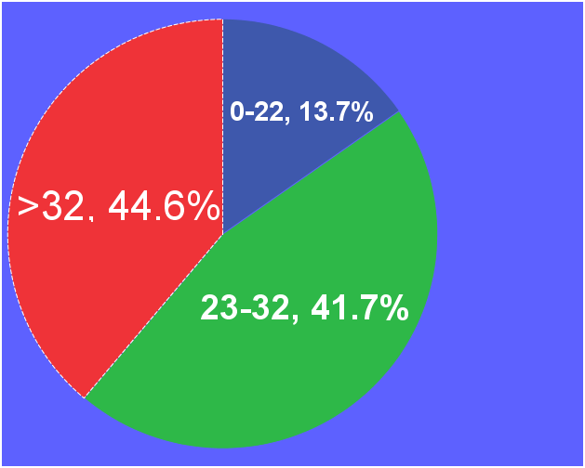
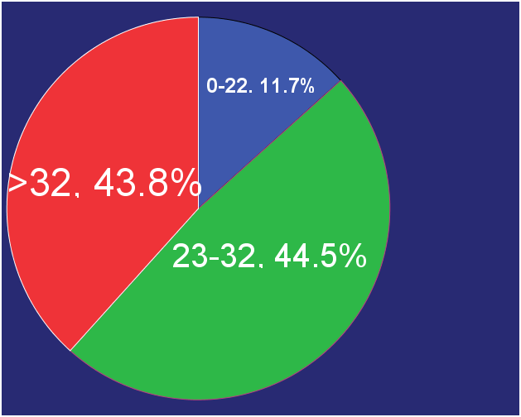
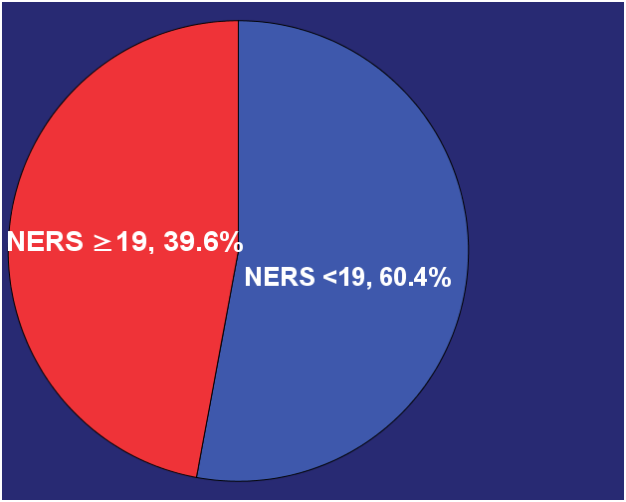
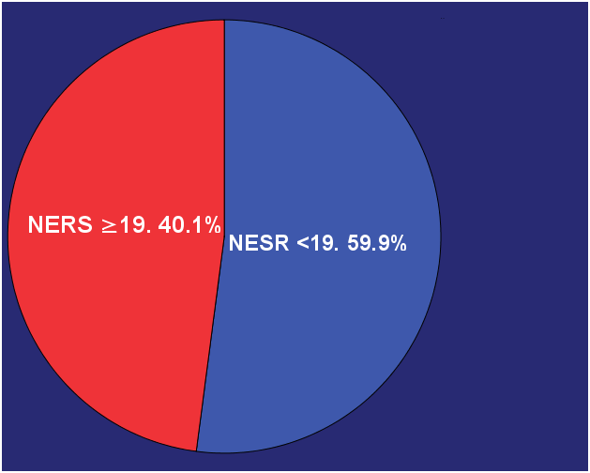
SYNTAX
SCORE
Provisional stenting group DK crush group
NERS II
SCORE

Slide 9
Thanks for your attention ! This study has been simultaneously published in JACC, October 30th, 2017

