Slide 1
Effects of Anacetrapib on the Incidence of New-Onset Diabetes Mellitus and on Vascular Events in People With Diabetes
Louise Bowman & Martin Landray on behalf of the
HPS 3 / TIMI 55 - REVEAL Collaborative Group
AHA Scientific Sessions, Anaheim 13th November 2017

Slide 2
REVEAL trial design
Eligibility: 30,000 patients aged over 50 years with occlusive vascular disease
Background statin: Atorvastatin 20 or 80 mg daily (China: 10 or 20 mg)
Randomized: Anacetrapib 100 mg daily vs. matching placebo
Follow-up: ≥4 years and ≥1900 primary outcomes
Primary outcome: Major Coronary Event
(i.e. Coronary death, myocardial infarction, or coronary revascularization)
Main results presented ESC 2017:
Significant 9% proportional reduction in major coronary events
Effect appears to be greater in later years of treatment
Benefit consistent with anticipated effect from observed reduction in non-HDL-C (no evidence of significant impact of HDL-raising)
HPS 3/TIMI 55-REVEAL Collaborative Group. NEJM 2017 and Am Heart J 2017

Slide 3
Why assess the effects of anacetrapib in diabetes?
Global burden of diabetes
4-500 million people worldwide
Burden of CVD in diabetes
Risk of vascular death: ↑ x 2
“Diabetic dyslipidaemia”
Low HDL, raised triglycerides

Slide 4
Baseline characteristics
Characteristic |  | Diabetes | No diabetes
 |  | (11320) | (19129)
Age (years) | Mean | 67 | 66
Gender | Male | 9096 (80%) | 16438 (86%)
 | Female | 2224 (20%) | 2691 (14%)
Region | Europe | 4678 (41%) | 11060 (58%)
 | North America | 2682 (24%) | 3400 (18%)
 | China | 3960 (35%) | 4669 (24%)
Prior disease | Coronary heart disease | 10375 (92%) | 16304 (85%)
 | Cerebrovascular disease | 2401 (21%) | 4380 (23%)

Slide 5
Baseline lipids
Lipid measurement (non-fasting samples) | Diabetes | No diabetes
 | (11320) | (19129)
LDL cholesterol | 59 mg/dL (1.5 mmol/l) | 62 mg/dL (1.6 mmol/l)
HDL cholesterol | 38 mg/dL (1.0 mmol/l) | 41 mg/dL (1.1 mmol/l)
Non-HDL cholesterol | 91 mg/dL (2.3 mmol/l) | 92 mg/dL (2.4 mmol/l)
Triglycerides | 137 mg/dL (1.5 mmol/l) | 117 mg/dL (1.3 mmol/l)

Slide 6
Follow-up and adherence to treatment
 |  | Diabetes |  | No diabetes
Follow-up | Median duration | 4.2 years |  | 4.1 years
 | Complete | 99.7% |  | 99.8%
 |  | Anacetrapib | Placebo | Anacetrapib | Placebo
Adherence at midpoint | Randomized treatment* | 89.9% | 89.5% | 89.9% | 89.9%
 | Study atorvastatin | 90.4% | 89.6% | 90.2% | 89.8%
 | Any statin | 94.3% | 94.1% | 94.9% | 95.1%
* No difference in any reason for stopping allocated treatment

Slide 7
Effects of anacetrapib on lipids at trial midpoint
Measurement | Diabetes |  |  |  | No diabetes
 | Absolute difference |  | Proportional difference |  | Absolute difference |  | Proportional difference
 | mg/dL | SI units |  |  | mg/dL | SI units
HDL cholesterol | +41 | +1.1 mmol/L | 104% |  | +45 | +1.2 mmol/L | 103%
Apolipoprotein AI | +42 | +0.4 g/L | 36% |  | +43 | +0.4 g/L | 36%
LDL cholesterol
- Direct (Genzyme) | -26 | -0.7 mmol/L | -42% |  | -27 | -0.7 mmol/L | -41%
- Beta-quantification* | -12 | -0.3 mmol/L | -20% |  | -10 | -0.2 mmol/L | -15%
Apolipoprotein B | -12 | -0.1 g/L | -19% |  | -12 | -0.1 g/L | -17%
Non-HDL cholesterol | -19 | -0.5 mmol/L | -20% |  | -16 | -0.4 mmol/L | -17%
* measured in a random subset of 2000 participants

Slide 8
Primary outcome: Major coronary events
Anacetrapib
Placebo
P Value
Type of Event
(N=15225)
(N=15224)
Rate Ratio (95% CI)
(het)
no. of participants with events (%)
Major coronary event
Diabetes
787 (13.9)
874 (15.4)
0.79
No diabetes
853 (8.9)
929 (9.7)
Subtotal: MCE
1640 (10.8)
1803 (11.8)
0.91
(0.85–0.97)
Coronary death or MI
Diabetes
425 (7.5)
494 (8.7)
0.47
No diabetes
509 (5.3)
554 (5.8)
Subtotal: Coronary death or MI
934 (6.1)
1048 (6.9)
0.89
(0.81–0.97)
Coronary revascularization
Diabetes
532 (9.4)
568 (10.0)
0.33
No diabetes
549 (5.7)
633 (6.6)
Subtotal: Coronary revascularization
1081 (7.1)
1201 (7.9)
0.90
(0.83–0.97)
0.6
0.8
1.0
1.2
Anacetrapib Better Placebo Better

Slide 9
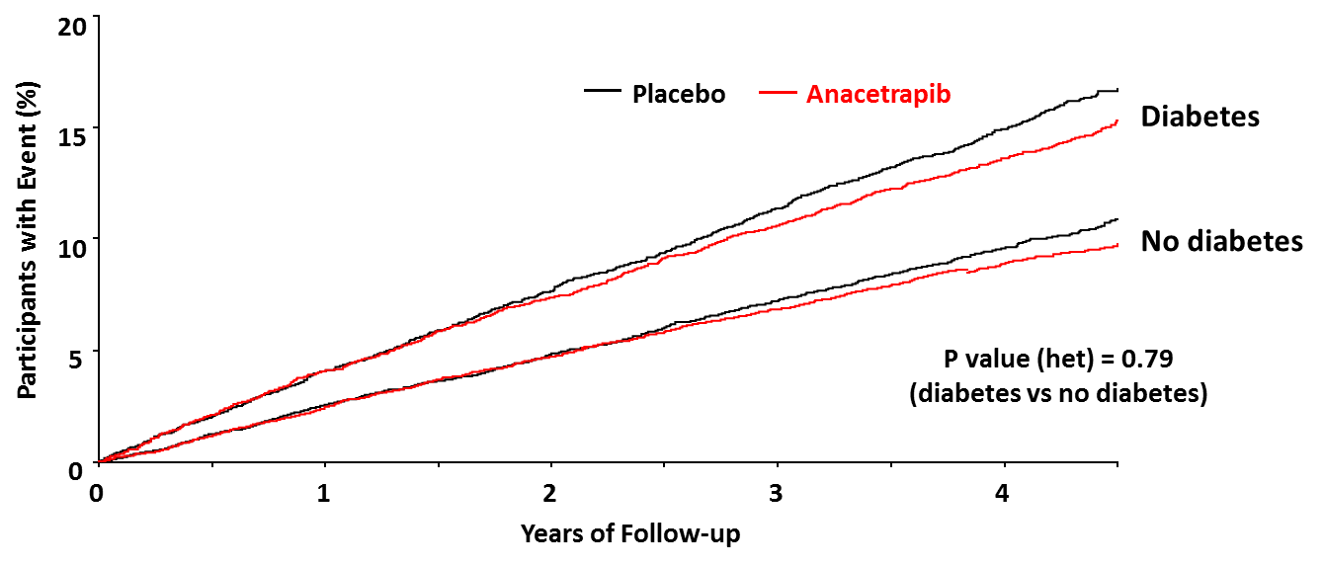
Major coronary events with and without diabetes
Benefit per 1000 participants in anacetrapib group
DM
0±4
3±5
8±6
13±7
No DM
1±2
1±3
4±4
7±4

Slide 10
Why assess the effects of anacetrapib on diabetes?
Statins:
Common SNPs in the HMGCR gene associated with ↑ risk of type 2 diabetes
Modest ↑ in risk of type 2 diabetes observed with statins
PCSK9 inhibition:
Variants in genes encoding PCSK9 associated with ↑ risk of diabetes
In FOURIER, evolocumab did not ↑ risk of new-onset diabetes (HR 1·05, 95% CI 0·94–1·17)
CETP inhibition:
Torcetrapib associated with ↓ plasma glucose & insulin levels in ILLUMINATE
Evacetrapib associated with ↓ risk of new-onset diabetes in ACCELERATE

Slide 11
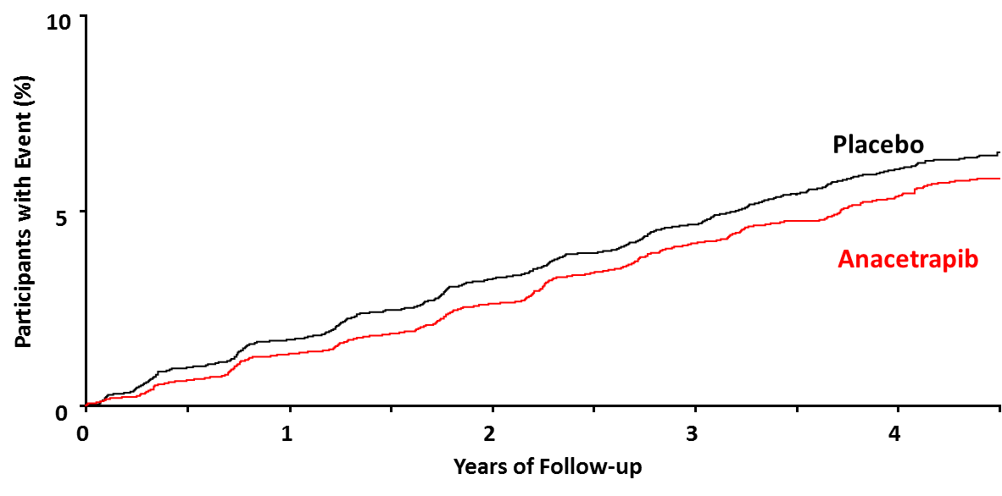
Diagnosis of new-onset diabetes (Diabetes-related adverse event or use of hypoglycaemic medication)
Anacetrapib Placebo
510 (5.3%) 571 (6.0%)
Rate ratio = 0.89 (0.79-1.00); p=0.05

Slide 12
Effects of anacetrapib on glycated haemoglobin (at final visit)
Diabetes at baseline | HbA1c assay* | Anacetrapib Mean (SE) | Placebo Mean (SE) | Absolute difference Mean (SE) | P value
No prior diabetes | DCCT (%) | 5.50 (0.01) | 5.53 (0.01) | -0.03 (0.01) | <0.001
 | IFFC (mmol/mol) | 36.62 (0.07) | 36.95 (0.07) | -0.33 (0.10)
Prior diabetes | DCCT (%) | 6.86 (0.02) | 6.86 (0.02) | -0.00 (0.03) | 0.92
 | IFFC (mmol/mol) | 51.45 (0.20) | 51.48 (0.20) | -0.03 (0.28)
Overall | DCCT (%) | 5.99 (0.01) | 6.01 (0.01) | -0.02 (0.01) | 0.12
 | IFFC (mmol/mol) | 41.96 (0.11) | 42.19 (0.11) | -0.23 (0.15)
*DCCT: Diabetes Control and Complications Trial method
IFFC: International Federation of Clinical Chemistry and Laboratory Medicine method

Slide 13
Summary
In REVEAL, individuals with diabetes were at higher absolute risk of major coronary events
Anacetrapib lowered non-HDL cholesterol and reduced major coronary events with similar efficacy in patients with and without diabetes
Patients with diabetes had a numerically greater absolute risk reduction with anacetrapib treatment
A small reduction in risk of new-onset diabetes mellitus was observed
Post-trial follow-up of all consenting participants (off-drug) to assess longer-term efficacy and safety of anacetrapib is ongoing

