Slide 1
AMERICAN HEART ASSOCIATION SCIENTIFIC SESSIONS 2017
Transcatheter InterAtrial Shunt Device for the Treatment of Heart Failure: Results From the REDUCE LAP-HF I Randomized Controlled Trial
Sanjiv J. Shah, MD, FAHA
On Behalf of the REDUCE LAP-HF I Investigators and Research Staff
NORTHWESTERN UNIVERSITY FEINBERG SCHOOL OF MEDICINE

Slide 2
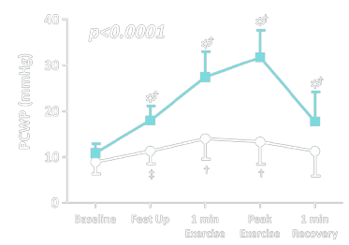
Introduction
HFpEF (LVEF > 50%) and HFmrEF (LVEF 40-50%):
Increasing in prevalence
High morbidity/mortality
No proven therapies
Heterogeneous syndromes
Common pathophysiologic thread: LA pressure at rest or with exertion
HFpEF
Control
Borlaug BA, et al. Circ Heart Fail 2010

Slide 3
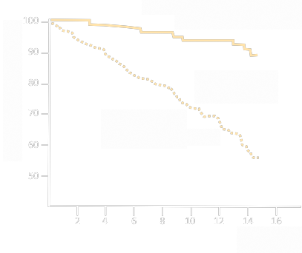
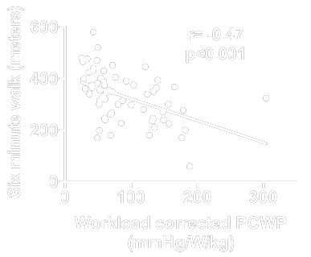
Importance of LA pressure in HFpEF
EXERCISE CAPACITY
SURVIVAL
Wolsk E…Gustafsson F. EJHF 2017
Dorfs S, et al. Eur Heart J 2014
Work-corrected PCWP
< 25.5 mmHg/W/kg
Survival (%)
Work-corrected PCWP
> 25.5 mmHg/W/kg
P=0.03
Follow-up (years)

Slide 4
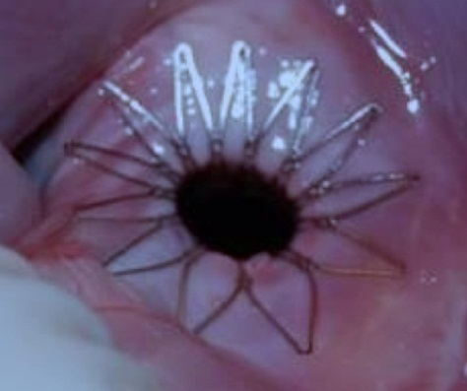
InterAtrial Shunt Device
8 mm
IASD proposed mode of action: dynamic decompression of
overloaded LA chamber by shunting blood from LA → RA
Feldman T…Shah SJ. Circ Heart Fail 2016

Slide 5
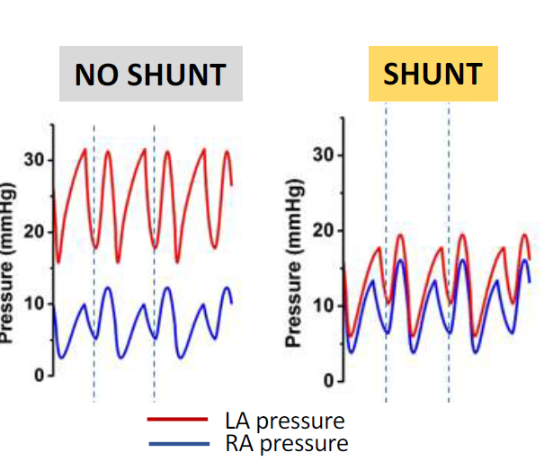
InterAtrial Shunt Device
Simulation using exercise hemodynamic data from HFpEF patients
Kaye D…Burkhoff D. J Card Fail 2014

Slide 6
Results of IASD open-label study (n=64)
Inclusion criteria:
Open label
LVEF ≥ 40%,
NYHA class II-IV
Elevated PCWP
≥ 15 mmHg (rest) or
≥ 25 mmHg (supine bicycle exercise)
Acceptable safety profile at 12 months
*p<0.05, **p<0.01 vs. baseline
Hasenfuß G…Kaye D. Lancet 2016
Kaye D, et al. Circ Heart Fail 2016

Slide 7
Hypothesis
At 1 month after randomization, compared to sham control, implantation of the IASD System II in patients with HF and EF ≥ 40% will result in:
Mechanistic effect: Reduction in exercise PCWP
Safety: No increase in major adverse cardiovascular, cerebral, or renal events (MACCRE)

Slide 8
REDUCE LAP-HF I RCT: Study Design
Phase 2, randomized, sham-controlled trial
Patient- and HF physician-blinded
1:1 randomization to IASD vs. sham control
Active treatment: Femoral venous access with ICE/TEE + transseptal IASD implantation
Sham control: Femoral venous access with examination of interatrial septum and LA with ICE/TEE
Independent DSMB, CEC, hemodynamic core lab

Slide 9
Primary and Secondary Outcomes
Primary outcomes (1 month):
Mechanistic effect: Reduction in exercise PCWP
Safety: Major adverse cardiovascular, cerebral, or renal events (MACCRE)
Secondary outcomes (1 month):
Change in PCWP at peak exercise
Change in exercise duration
Change in PA pressures

Slide 10
Key inclusion/exclusion criteria
Inclusion criteria:
Symptomatic HF
NYHA class III or ambulatory IV
LVEF ≥ 40%
HF hospitalization in prior 12 months or BNP (or NTproBNP)
Echo evidence of LV diastolic dysfunction
Exercise PCWP (≥ 25 mmHg)
PCWP-RAP gradient (≥ 5 mmHg)
Exclusion criteria:
Stage D HF
Cardiac index < 2.0 L/min/m²
Prior history of LVEF < 30%
Significant valve disease
≥ 3+ MR, ≥ 2+ TR, ≥ 2+ AR
Significant RV dysfunction
TAPSE < 1.4 cm, RV > LV size, or RVFAC < 35%
RAP > 14 mmHg
PVR > 4 Wood units

Slide 11
Statistical Analysis
Power calculation:
N=20 in each group to detect 6.0±7.2 mmHg greater reduction in exercise PCWP at 1 month in IASD group
Two-sided ⍺=0.05 and power = 82%
Primary outcome analysis:
Mixed effects model repeated measures (MMRM) analysis of covariance (ANCOVA)
Accounts for all available stages of exercise at both time points in all patients

Slide 12
Patient disposition flow chart
N=94 enrolled patients with symptomatic HF + LVEF > 40%
N=50 excluded patients:
MI, PCI, or CABG in past 3 months (n=13)
Significant untreated CAD (n=11)
Hx of CVA, TIA, DVT, or PE (n=5)
Resting RAP > 14 mmHg (n=5)
Significant valvular disease (n=4)
Severe CKD (n=2)
Other (n=10)
N=44 randomized patients
CONTROL ARM (N=22)
IASD TREATMENT ARM (N=22)
N=1 patient withdrew consent after RA could not be accessed (occluded IVC filter)
N=22 patients active
at 1 month
N=21 patients active
at 1 month

Slide 13
Results: Baseline characteristics (1)
Characteristic | Control (N=22) | IASD (N=22) | P-value
Age (years) | 70.0±9.2 | 69.6±8.3 | 0.86
Male | 36% | 64% | 0.13
Race African American White Other | 18% 82% 0% | 0% 86% 14% | 0.03
NYHA class III | 96% | 100% | 0.32
Body mass index (kg/m²) | 35.1±9.1 | 35.2±6.4 | 0.98
Systolic BP (mmHg) | 128±22 | 131±16 | 0.72
LV ejection fraction (%) | 59±7 | 60±9 | 0.49

Slide 14
Results: Baseline characteristics (1)
Characteristic | Control (N=22) | IASD (N=22) | P-value
Age (years) | 70.0±9.2 | 69.6±8.3 | 0.86
Male | 36% | 64% | 0.13
Race African American White Other | 18% 82% 0% | 0% 86% 14% | 0.03
NYHA class III | 96% | 100% | 0.32
Body mass index (kg/m²) | 35.1±9.1 | 35.2±6.4 | 0.98
Systolic BP (mmHg) | 128±22 | 131±16 | 0.72
LV ejection fraction (%) | 59±7 | 60±9 | 0.49

Slide 15
Results: Baseline characteristics (2)
Characteristic | Control (N=22) | IASD (N=22) | P-value
Hypertension | 91% | 82% | 0.66
Hyperlipidemia | 73% | 73% | 1.00
Diabetes | 55% | 55% | 1.00
Atrial fibrillation | 46% | 55% | 0.76
Ischemic heart disease | 24% | 23% | 1.00
COPD | 32% | 14% | 0.28
Stroke | 14% | 9% | 0.66
Loop diuretic dose (mg furosemide eq.) | 113±90 | 93±99 | 0.42

Slide 16
Results: Baseline characteristics (2)
Characteristic | Control (N=22) | IASD (N=22) | P-value
Hypertension | 91% | 82% | 0.66
Hyperlipidemia | 73% | 73% | 1.00
Diabetes | 55% | 55% | 1.00
Atrial fibrillation | 46% | 55% | 0.76
Ischemic heart disease | 24% | 23% | 1.00
COPD | 32% | 14% | 0.28
Stroke | 14% | 9% | 0.66
Loop diuretic dose (mg furosemide eq.) | 113±90 | 93±99 | 0.42

Slide 17
Results: Baseline characteristics (3)
Baseline hemodynamics | Control (N=22) | IASD (N=22) | P-value
RA pressure (mmHg) | 9.1±3.7 | 10.1±2.3 | 0.27
Mean PA pressure (mmHg) | 28.4±8.6 | 30.2±9.5 | 0.52
Cardiac output (L/min/m²) | 5.7±2.7 | 5.4±1.6 | 0.66
Pulmonary vascular resistance (WU) | 1.74±1.45 | 2.19±1.52 | 0.32
PCWP, legs down (mmHg) | 19.9±7.5 | 20.9±7.9 | 0.67
PCWP, legs up (mmHg) | 24.0±9.3 | 26.6±7.1 | 0.32
PCWP, peak exercise (mmHg) | 37.3±6.7 | 37.3±6.5 | 1.00
PCWP-RAP gradient at rest (mmHg) | 10.9±7.3 | 10.8±5.6 | 0.95
Exercise duration (minutes) | 8.9±4.0 | 7.4±3.1 | 0.18
Peak exercise workload (W) | 41.8±16.2 | 42.3±19.5 | 0.93

Slide 18
Results: Baseline characteristics (3)
Baseline hemodynamics | Control (N=22) | IASD (N=22) | P-value
RA pressure (mmHg) | 9.1±3.7 | 10.1±2.3 | 0.27
Mean PA pressure (mmHg) | 28.4±8.6 | 30.2±9.5 | 0.52
Cardiac output (L/min/m²) | 5.7±2.7 | 5.4±1.6 | 0.66
Pulmonary vascular resistance (WU) | 1.74±1.45 | 2.19±1.52 | 0.32
PCWP, legs down (mmHg) | 19.9±7.5 | 20.9±7.9 | 0.67
PCWP, legs up (mmHg) | 24.0±9.3 | 26.6±7.1 | 0.32
PCWP, peak exercise (mmHg) | 37.3±6.7 | 37.3±6.5 | 1.00
PCWP-RAP gradient at rest (mmHg) | 10.9±7.3 | 10.8±5.6 | 0.95
Exercise duration (minutes) | 8.9±4.0 | 7.4±3.1 | 0.18
Peak exercise workload (W) | 41.8±16.2 | 42.3±19.5 | 0.93

Slide 19
Results: Procedural characteristics
Procedural/device characteristic | Control (N=22) | IASD (N=22) | P-value
Device implantation attempted (%) | N/A | 95.5% | —
Total procedure duration (minutes) | 12.9±9.0 | 58.1±25.8 | <0.001
Total fluoroscopy time (minutes) | 5.3±3.6 | 23.3±13.0 | <0.001
Total contrast agent administered (mL) | 19.0±15.6 | 19.2±17.4 | 0.986
Device failure | N/A | 0.0% | —
Device mal-deployment without embolization | N/A | 4.5% | —

Slide 20
Results: Procedural characteristics
Procedural/device characteristic | Control (N=22) | IASD (N=22) | P-value
Device implantation attempted (%) | N/A | 95.5% | —
Total procedure duration (minutes) | 12.9±9.0 | 58.1±25.8 | <0.001
Total fluoroscopy time (minutes) | 5.3±3.6 | 23.3±13.0 | <0.001
Total contrast agent administered (mL) | 19.0±15.6 | 19.2±17.4 | 0.986
Device failure | N/A | 0.0% | —
Device mal-deployment without embolization | N/A | 4.5% | —

Slide 21


PRIMARY OUTCOME RESULTS

Slide 22
Results: Efficacy outcomes at 1 month
Hemodynamic parameter (Change from baseline to 1 month) | Control | IASD | P-value
Primary outcome (exercise PCWP) PCWP at 20W (mmHg)*^{P=0.019} PCWP at 40W (mmHg) PCWP at 60W (mmHg) | 0.9±5.1 -1.9±4.3 -1.3±4.9 | -3.2±5.2 -1.0±4.5 -2.3±4.9 | 0.028
PCWP, legs up at rest (mmHg) | 0.0±6.4 | -5.0±5.7 | 0.024
PCWP, peak exercise (mmHg) | -0.5±5.0 | -3.5±6.4 | 0.144
PCWP, workload-corrected (mmHg/W/kg) | 10.3±45.9 | -5.7±27.3 | 0.231
RV cardiac output at rest (L/min) | -0.5±1.4 | 1.6±1.3 | <0.001
PVR at rest (Wood units) | 0.17±1.57 | -0.76±1.59 | 0.102
PVR during exercise (Wood units) | 0.31±1.64 | -0.29±1.22 | 0.051

Slide 23
Results: Efficacy outcomes at 1 month
Hemodynamic parameter (Change from baseline to 1 month) | Control | IASD | P-value
Primary outcome (exercise PCWP) PCWP at 20W (mmHg)*^{P=0.019} PCWP at 40W (mmHg) PCWP at 60W (mmHg) | 0.9±5.1 -1.9±4.3 -1.3±4.9 | -3.2±5.2 -1.0±4.5 -2.3±4.9 | 0.028
PCWP, legs up at rest (mmHg) | 0.0±6.4 | -5.0±5.7 | 0.024
PCWP, peak exercise (mmHg) | -0.5±5.0 | -3.5±6.4 | 0.144
PCWP, workload-corrected (mmHg/W/kg) | 10.3±45.9 | -5.7±27.3 | 0.231
RV cardiac output at rest (L/min) | -0.5±1.4 | 1.6±1.3 | <0.001
PVR at rest (Wood units) | 0.17±1.57 | -0.76±1.59 | 0.102
PVR during exercise (Wood units) | 0.31±1.64 | -0.29±1.22 | 0.051

Slide 24
Results: Efficacy outcomes at 1 month
Hemodynamic parameter (Change from baseline to 1 month) | Control | IASD | P-value
Primary outcome (exercise PCWP) PCWP at 20W (mmHg)*^{P=0.019} PCWP at 40W (mmHg) PCWP at 60W (mmHg) | 0.9±5.1 -1.9±4.3 -1.3±4.9 | -3.2±5.2 -1.0±4.5 -2.3±4.9 | 0.028
PCWP, legs up at rest (mmHg) | 0.0±6.4 | -5.0±5.7 | 0.024
PCWP, peak exercise (mmHg) | -0.5±5.0 | -3.5±6.4 | 0.144
PCWP, workload-corrected (mmHg/W/kg) | 10.3±45.9 | -5.7±27.3 | 0.231
RV cardiac output at rest (L/min) | -0.5±1.4 | 1.6±1.3 | <0.001
PVR at rest (Wood units) | 0.17±1.57 | -0.76±1.59 | 0.102
PVR during exercise (Wood units) | 0.31±1.64 | -0.29±1.22 | 0.051

Slide 25
Results: Efficacy outcomes at 1 month
Hemodynamic parameter (Change from baseline to 1 month) | Control | IASD | P-value
Primary outcome (exercise PCWP) PCWP at 20W (mmHg)*^{P=0.019} PCWP at 40W (mmHg) PCWP at 60W (mmHg) | 0.9±5.1 -1.9±4.3 -1.3±4.9 | -3.2±5.2 -1.0±4.5 -2.3±4.9 | 0.028
PCWP, legs up at rest (mmHg) | 0.0±6.4 | -5.0±5.7 | 0.024
PCWP, peak exercise (mmHg) | -0.5±5.0 | -3.5±6.4 | 0.144
PCWP, workload-corrected (mmHg/W/kg) | 10.3±45.9 | -5.7±27.3 | 0.231
RV cardiac output at rest (L/min) | -0.5±1.4 | 1.6±1.3 | <0.001
PVR at rest (Wood units) | 0.17±1.57 | -0.76±1.59 | 0.102
PVR during exercise (Wood units) | 0.31±1.64 | -0.29±1.22 | 0.051

Slide 26
Results: Efficacy outcomes at 1 month
Hemodynamic parameter (Change from baseline to 1 month) | Control | IASD | P-value
Primary outcome (exercise PCWP) PCWP at 20W (mmHg)*^{P=0.019} PCWP at 40W (mmHg) PCWP at 60W (mmHg) | 0.9±5.1 -1.9±4.3 -1.3±4.9 | -3.2±5.2 -1.0±4.5 -2.3±4.9 | 0.028
PCWP, legs up at rest (mmHg) | 0.0±6.4 | -5.0±5.7 | 0.024
PCWP, peak exercise (mmHg) | -0.5±5.0 | -3.5±6.4 | 0.144
PCWP, workload-corrected (mmHg/W/kg) | 10.3±45.9 | -5.7±27.3 | 0.231
RV cardiac output at rest (L/min) | -0.5±1.4 | 1.6±1.3 | <0.001
PVR at rest (Wood units) | 0.17±1.57 | -0.76±1.59 | 0.102
PVR during exercise (Wood units) | 0.31±1.64 | -0.29±1.22 | 0.051

Slide 27
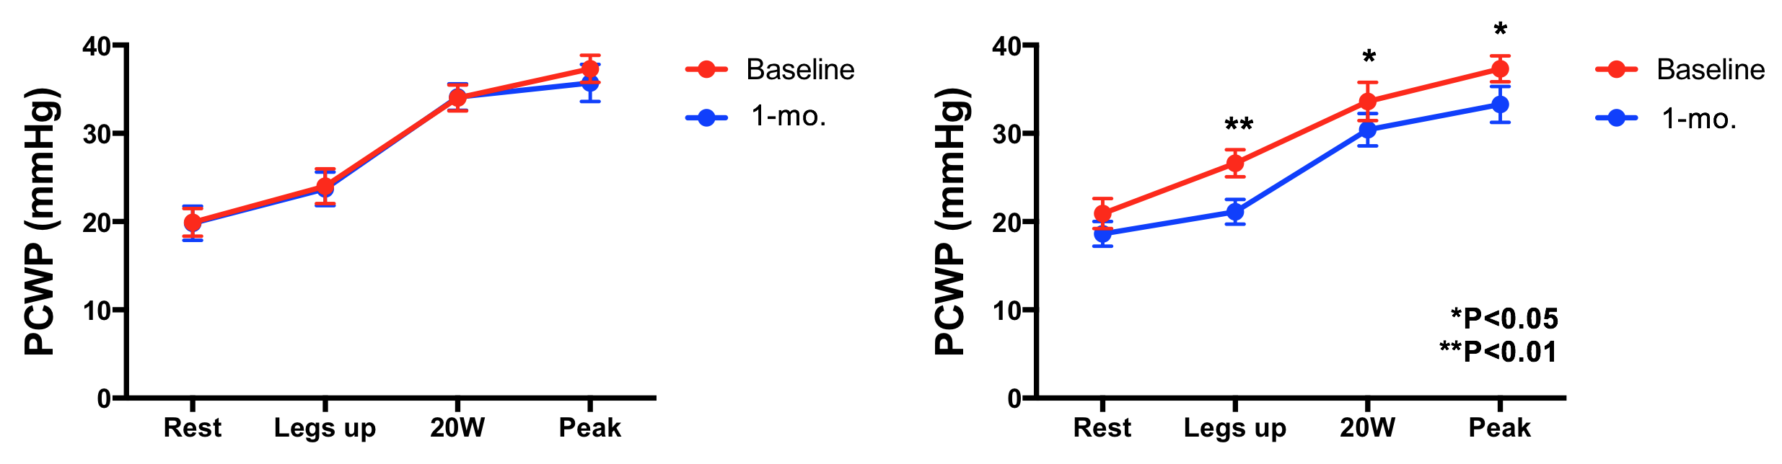
Change in PCWP: Baseline to 1 month
CONTROL
IASD
Baseline
Baseline
1 month
1 month

Slide 28
Results: Safety outcomes at 1 month
Adverse event | Control (N=22) | IASD (N=22) | P-value
MACCRE | 4.6% (1 renal event) | 0% | 1.00
Death | 0% | 0% | —
New-onset atrial fibrillation/flutter | 0% | 0% | —
Stroke or TIA | 0% | 0% | —
Systemic embolization | 0% | 0% | —
HF event requiring IV treatment | 9.1% | 0% | 0.49
Cardiac perforation | 0% | 0% | —
Device embolization or occlusion | 0% | 0% | —
Major vascular complication | 0% | 0% | —

Slide 29
Summary
First RCT of a device-based therapeutic in HFpEF
REDUCE LAP-HF I trial met its primary endpoint
Significantly reduced exercise PCWP at 1 month (P=0.028)
Good safety profile at 1 month
Demonstrates beneficial mechanistic effect of IASD
IASD could have beneficial clinical effects in HFpEF/mrEF
A larger pivotal trial to examine effects of IASD on QOL, exercise capacity, and clinical outcomes is warranted
REDUCE LAP-HF II pivotal trial is underway (NCT03088033)

Slide 30

A Transcatheter InterAtrial Shunt Device for the Treatment of
Heart Failure with Preserved Ejection Fraction (REDUCE LAP-HF I):
A Phase 2, Randomized, Sham-Controlled Trial
Ted Feldman, Laura Mauri, Rami Kahwash, Sheldon Litwin, Mark J. Ricciardi,
Pim van der Harst, Martin Penicka, Peter S. Fail, David M. Kaye, Mark C. Petrie,
Anupam Basuray, Scott L. Hummel, Rhondalyn Forde-McLean, Christopher D. Nielsen, Scott Lilly, Joseph M. Massaro, Daniel Burkhoff, Sanjiv J. Shah
on Behalf of the REDUCE LAP-HF I Investigators and Research Staff
Full study details published today online in Circulation
http://circ.ahajournals.org

