Slide 1
A PRAGMATIC RANDOMIZED TRIAL OF CYP2C19 GENOTYPING IMPLEMENTATION FOLLOWING PERCUTANEOUS CORONARY INTERVENTION (PCI)
Sony Tuteja, PharmD, MS
Twitter @sony_tuteja
Perelman School of Medicine at the University of Pennsylvania, Philadelphia, PA

Slide 2
CYP2C19 polymorphisms and clopidogrel response
 | CYP2C19*2 Minor allele Frequency
Europeans | 0.15
African | 0.15
East Asian | 0.29
South Asian | 0.35
Trenk D et al. Thromb Haemost 2013
Scott et al. Clin Pharm Ther 2013

Slide 3
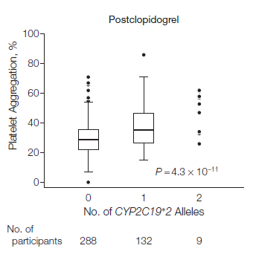
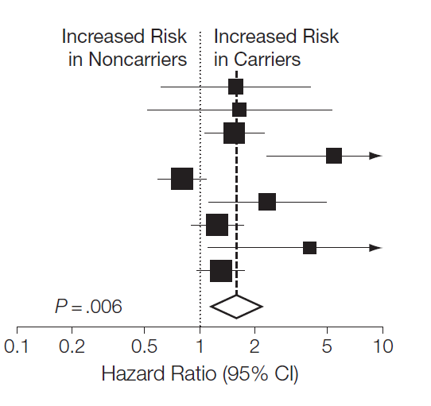
CYP2C19 polymorphisms and clopidogrel response
Shuldiner AR et al. JAMA 2009
Mega JL et al. JAMA 2010

Slide 4
Conflicting recommendations exist for CYP2C19 testing
Clinical Pharmacogenetics guidelines recommend prasugrel or ticagrelor in CYP2C19 LOF carriers. ¹
FDA placed a “black box” warning on the clopidogrel label in 2010 recommending alternative agents among carriers of 2 LOF alleles. ²
ACC/AHA guidelines do not recommend routine CYP2C19 genetic testing. ³
¹ Scott SA et al. Clinical Pharmacology and Therapeutics 2013
² https://www.fda.gov/Drugs/DrugSafety/default.htm
³ Levine GN et al. Circulation 2016

Slide 5
Assessment of prospective CYP2C19 genotype guided Dosing of AntiPlatelet Therapy in Percutaneous Coronary Intervention (ADAPT)
Rationale
It is unknown how physicians will utilize the CYP2C19 test results in a real world setting
Objective
To provide evidence regarding the implementation and effectiveness of CYP2C19 testing
Hypothesis
Pharmacogenetic test results will influence prescribing of antiplatelet medications post PCI

Slide 6
The ADAPT study: A Pragmatic Randomized Clinical Trial
PCI
Usual care- no genotyping
Genotyped
Primary endpoint
Proportion of participants receiving prasugrel/ticagrelor
Secondary endpoints
Agreement with the genotype guided antiplatelet recommendations
Clinical Outcomes: Major Adverse Cardiac Events and Major Bleeding

Slide 7
Study Intervention
Genotyped Group
Buccal swab for genotyping on the SpartanRx rapid turnaround device (CYP2C19 *2, *3, *17)
Genotyped guided recommendations provided verbally
CYP2C19 *2 or *3 carriers→ prasugrel or ticagrelor
CYP2C19 *1 or *17 carriers → clopidogrel
Antiplatelet choice remained at the discretion of the treating interventional cardiologist
Usual Care
Saliva collected for post study
genetic analysis

Slide 8
Inclusion/Exclusion Criteria
Inclusion
Age ≥ 18 and ≤ 80 years
PCI with stent implantation
Exclusion
Need for imminent surgery
History of intracranial hemorrhage, stroke
Active bleeding
Need for long-term anticoagulation
Study staff unavailable to conduct randomization or genotyping

Slide 9
Sample size determination
Rate of pre-study prasugrel/ticagrelor use (~20%)
Anticipated increase in prasugrel/ticagrelor prescribing based on frequency of CYP2C19 LOF alleles (~30-35%)
A sample size of 138 per group would provide 80% power at an alpha=0.05 to detect a 15% difference in prasugrel/ticagrelor prescribing between the groups
Sample size was increased to 250 per group to allow for subgroup comparisons

Slide 10
Participant Demographics
 | Genotyped N=249 | Usual Care N=255 | P-value
Sex, n(%) Male | 181 (73%) | 190 (74%) | 0.76
Race, n (%) White Black | 194 (78%) 48 (19%) | 197 (77%) 51 (20%) | 0.99
Age | 63.0 ± 9.7 | 62.9 ± 10.2 | 0.90
ACS | 124 (50%) | 129 (50%) | 0.93

Slide 11
Participant History
 | Genotyped N=249 | Usual Care N=255 | P-value
Medical History, n(%) Hypertension Cholesterol PCI Diabetes MI CABG | 190 (76) 112 (45) 83 (33) 89 (35) 63 (25) 32 (13) | 199 (78) 113 (44) 83 (33) 79 (31) 67 (26) 36 (14) | 0.67 0.80 0.63 0.26 0.84 0.70
P2Y12 prior, n (%) Clopidogrel Prasugrel Ticagrelor None | 80 (32) 12 (5) 2 (1) 154 (62) | 85 (33) 9 (4) 6 (2) 154 (60) | 0.65

Slide 12
Procedure Characteristics
 | Genotyped N=249 | Usual Care N=255 | p-value
Length of stay, mean (SD), days | 2.9 ± 3.7 | 3.1 ± 4.0 | 0.66
Drug eluting stents, n(%) | 237 (95) | 236 (93) | 0.27
Number of stents, mean (SD) | 1.3 ± 0.6 | 1.4 ± 0.6 | 0.73

Slide 13
CYP2C19 Genotypes for Intervention Group
Genotyping results available 1.4 ± 0.4 hours post swab
Genotype | Frequency
*1/*1 | 34%
*1/*17 | 31%
*17/*17 | 5%
*1/*2 | 20%
*2/*17 | 5%
*2/*2 | 3%
Inconclusive | 4%
28%

Slide 14
Primary Outcome: Antiplatelet Drugs Prescribed
 | Genotyped N=249 | Usual Care N=255 | P-value
Clopidogrel Prasugrel or Ticagrelor | 174 (70%) 75 (30%) | 201 (79%) 54 (21%) | 0.03
Fisher’s exact test

Slide 15
Prasugrel/ ticagrelor use greater in the LOF carriers
 | Genotyped No-LOF LOF carriers N=174 n=68
Clopidogrel | 136 (78%) | 32 (47%)
Prasugrel or Ticagrelor | 38 (22%) | 36 (53%)
Usual Care N=255
201 (79%)
54 (21%)
P<0.001
P<0.001

Slide 16
Agreement rate =
LOF prasugrel/ticagrelor + non-LOF clopidogrel
total number genotyped

Slide 17
Agreement with genotype guided recommendations
CYP2C19 diplotype | Phenotype | Clop | Pras/ Ticag
*1/*2 *2/*17 *2/*2 | Intermediate or poor metabolizer (n=68) |  | 36 (53%)
*1/*1 *1/*17 *17/*17 | Normal or rapid metabolizer (n=174) | 136 (78%)
Non-agreement reasons
9- Stable CAD 6- Cost 3- Contraindications 3- MD preference
6- Disease characteristics 6- Patient already on therapy 5- ACS 5- Recurrent events
32 (47%)
38 (22%)
Agreement rate 71%
Non-agreement rate 29%

Slide 18
Prior antiplatelet therapy predicted antiplatelet drug choice independent of genotype
Prior P2Y12 | OR remaining on same | 95%CI | P-value
Clopidogrel | 2.04 | 1.22, 3.45 | 0.007
Prasugrel/ ticagrelor | 99.3 | 13.2, 744 | <0.0001

Slide 19
Genotype did not influence prescribing among patient already on prasugrel or ticagrelor
Prior P2Y12 | Genotype agreement rate
Clopidogrel (n=80) | 76%
Prasugrel/ticagrelor (n=14) | 21%
None (n=147) | 73%
P-value | <0.0001

Slide 20
Clinical outcomes
 | Genotyped (n=249) | Usual Care (n=255) | P-value
Follow-up time (months) | 17.2 (7.5) | 16.1 (8.2) | 0.14
MACE | 34 (13.7) | 26 (10.2) | 0.27
BARC 3 or 5 bleed | 6 (2.4) | 8 (3.1) | 1.0
MACE= myocardial infarction, stroke, death from cardiovascular cause, stent thrombosis, urgent revascularization
BARC= Bleeding Academic Research Consortium

Slide 21
Summary
CYP2C19 test results significantly influenced antiplatelet prescribing
Genotype guided recommendations were followed 71% of the time
Prior antiplatelet therapy significantly influenced the choice of antiplatelet drugs

Slide 22
Conclusions
Antiplatelet prescribing was not universally in agreement with genotype suggested recommendations
Physicians consider both clinical and genetic factors when prescribing antiplatelet agents following PCI

Slide 23
Acknowledgements
ADAPT Study Team
Jay Giri
Daniel J. Rader
Henry Glick
William Matthai
Ashwin Nathan
Karen Monono
Craig Carcuffe
Karen Maslowski
Gene Chang
Taisei Kobayashi
Saif Anwaruddin
John Hirshfeld
Robert Wilensky
Howard C. Herrmann
Daniel M. Kolansky
Cardiac Cath Labs
Hospital of the University of Pennsylvania
Penn Presbyterian Medical Center
Department of Laboratory Medicine
Funding
Penn Center for Precision Medicine

Slide 24
Extra slide

Slide 25
Post-hoc analysis
 | Non-LOF (n=326) | LOF-clop (n=90) | LOF-pras/ticag (n=52)
MACE | 33 (10.1) | 14 (15.6) | 9 (17.3)
Major bleed | 6 (1.8) | 4 (4.4) | 1(1.9)
Non cardiac death | 5 (1.5) | 1 (1.1) | 0 (0)
Composite | 42 (12.9) | 19 (21.1) | 10 (19.2)
HR 1.84
95% CI 1.06 to 3.20 (p=0.03)

