Slide 1
Dabigatran in myocardial injury after noncardiac surgery
Dr. PJ Devereaux on behalf of MANAGE Investigators
Population Health Research Institute, Hamilton, Canada

Slide 2
Background
MINS includes MI and isolated ischemic troponin elevation that occur within first 30 days after surgery
MINS does not include non-ischemic myocardial injury
sepsis, rapid AF, PE, chronically elevated troponin
MINS affects ≥8 million adults worldwide annually
MINS is independently associated with increased risk of CV events and death over first 2 years after surgery
No published trial has evaluated treatment for MINS

Slide 3
Background
Patients with MINS are at risk of thrombotic complications
High-quality evidence demonstrating benefits of anticoagulation therapy in non-operative patients at risk of thrombotic events
patients suffering MI and those with vascular disease
Dabigatran, oral direct thrombin inhibitor, has been tested in perioperative setting and prevents VTE
Dabigatran has potential to avoid broader range of vascular complications in patients with MINS

Slide 4
MANAGE Trial design
RCT of patients with MINS
randomized to dabigatran or placebo
Partial 2X2 factorial design
patients not already on PPI
randomize to omeprazole or placebo
Blinded investigator initiated trial

Slide 5
Eligibility criteria
Included patients ≥45 yrs of age, had undergone noncardiac surgery, and were within 35 days of suffering MINS
MINS diagnostic criteria: Universal Definition of MI or ischemic elevated troponin after surgery
Excluded patients
with history of bleeding diathesis or prior intracranial, intraocular, or spinal bleeding
condition that required anticoagulation
eGFR <35 ml/min

Slide 6
Intervention and F/U
Day of randomization, patients started taking
dabigatran 110 mg BID or matching placebo
patients in partial factorial took omeprazole 20 mg daily or matching placebo
Patients took study drugs and were followed for maximum of 2 years or until trial was terminated on November 30, 2017

Slide 7
Design modification
Initial design was to randomize 3200 patient with primary composite outcome of vascular mortality and nonfatal MI, stroke, peripheral arterial thrombosis, and symptomatic PE
Recruitment was slower than expected, and during conduct of trial funding was curtailed
Without knowledge of trial results
sample size reduced to 1750 patients - 90% power to detect HR of 0.65 (2-sided α = 0.05) assuming placebo Kaplan-Meier rate of 20%
Based on COMPASS results, their relevance, and to enhance power, we broadened primary outcome and added amputation and symptomatic proximal DVT to our primary efficacy outcome

Slide 8
Outcomes
Primary efficacy outcome - major vascular complication
composite of vascular mortality and nonfatal MI, non-hemorrhagic stroke, peripheral arterial thrombosis, amputation, and symptomatic VTE
Primary safety outcome – composite of life-threatening, major, and critical organ bleeding

Slide 9
Trial flow
1754 patients randomized to dabigatran or placebo
556 randomized to omeprazole or placebo
Patients were followed for mean of 16 months
Follow-up complete for 99% of participants

Slide 10
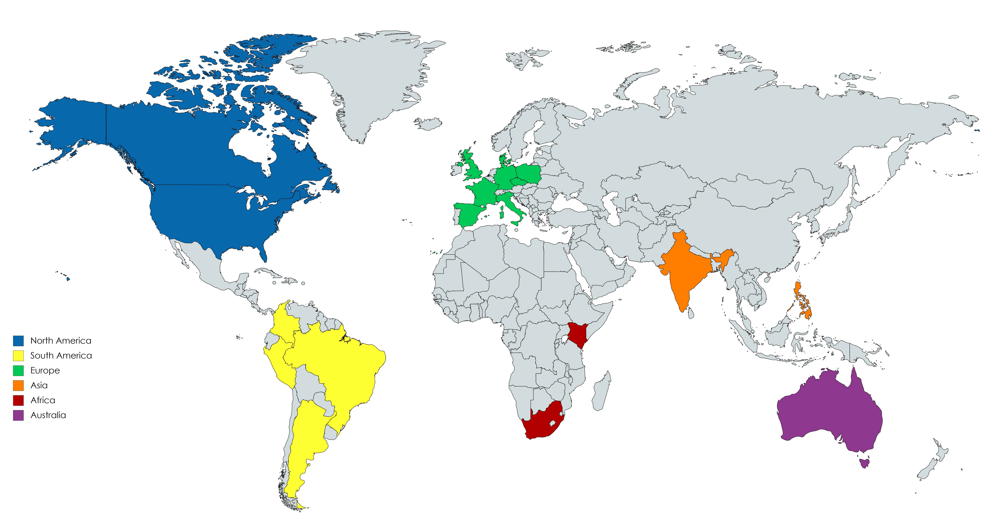
Recruitment by Region
765
438
268
92
4
187

Slide 11
Baseline characteristics
Characteristics | Dabigatran (N=877) | Placebo (N=877)
Age – (mean yrs) | 70 | 70
Male | 52% | 51%
MINS criteria MI isolated isch Trop elevation | 20% 80% | 20% 80%
Time from MINS diagnosis to randomization (days, IQR) | 5 (2 – 14) | 5 (2-14)
91% of MINS patients did not experience an ischemic symptom

Slide 12
Concomitant drug utilization any time during follow-up
Medications | Dabigatran | Placebo
Aspirin P2Y₁₂ inhibitor Aspirin or P2Y₁₂ inhibitor Dual antiplatelet therapy | 74% 7% 75% 6% | 73% 9% 75% 8%
ACEI or ARB | 59% | 59%
Beta-blocker | 47% | 45%
Statin | 69% | 69%

Slide 13
Drug compliance
Permanent study drug discontinuation
Dabigatran group 46%
Placebo group 43%

Slide 14
Reasons for permanent drug discontinuation
Reasons | Dabigatran n=401 | Placebo n=380
Patient request | 56% | 63%
Investigator decision | 8% | 10%
Adverse event | 6% | 6%
Bleeding event | 7% | 4%
Non-bleeding outcome event | 7% | 6%
Required non-study anticoagulation | 5% | 4%
Other reasons | 11% | 7%

Slide 15
Primary efficacy outcome
Outcome | Dabigatran n=877 no. (%) | Placebo n=877 no. (%) | HR (95% CI) | P value
composite of vascular death and nonfatal MI, non-hemorrhagic stroke, peripheral arterial thrombosis, amputation, and symptomatic VTE | 97 (11) | 133 (15) | 0.72 (0.55-0.93) | 0.012
There was no significant effect of omeprazole study drug on results of dabigatran primary efficacy analysis (interaction P=0.79)

Slide 17
Secondary efficacy outcomes
Outcome | Dabigatran n=877 no. (%) | Placebo n=877 no. (%) | HR (95% CI)
Vascular mortality All cause mortality Myocardial infarction Cardiac revascularization Non-hemorrhagic stroke Peripheral arterial thrombosis Amputation Symptomatic VTE Rehospitalization for vascular reason | 52 (6) 100 (11) 35 (4) 32 (4) 2 (<1) 0 (0) 18 (2) 8 (1) 113 (13) | 64 (7) 110 (13) 43 (5) 21 (2) 10 (1) 4 (1) 26 (3) 17 (2) 130 (15) | 0.80 (0.56-1.16) 0.90 (0.69-1.18) 0.80 (0.51-1.26) 1.53 (0.88-2.65) 0.20 (0.04-0.90) 0.70 (0.38-1.27) 0.47 (0.20-1.08) 0.86 (0.67-1.11)

Slide 18
Exploratory consistency efficacy outcomes
Outcome | Dabigatran n=877 no. (%) | Placebo n=877 no. (%) | HR (95% CI)
Arterial components of primary composite outcome Venous components of primary composite outcome Original efficacy composite outcome Per-protocol analysis censoring 7 days after study drug discontinuation | 89 (10) 8 (1) 81 (9) 55 (6) | 121 (14) 17 (2) 107 (12) 100 (11) | 0.73 (0.55-0.96) 0.47 (0.20-1.08) 0.74 (0.56-0.99) 0.54 (0.39-0.75)

Slide 19
Primary safety outcome
Outcome | Dabigatran n=877 no. (%) | Placebo n=877 no. (%) | HR (95% CI) | P Value
Composite of life-threatening, major, and critical organ bleeding | 29 (3) | 31 (4) | 0.92 (0.55-1.53) | 0.79
There was no significant effect of omeprazole study drug on results of dabigatran primary safety analysis (interaction P=0.37)

Slide 20
Secondary safety outcomes
Outcome | Dabigatran n=877 no. (%) | Placebo n=877 no. (%) | HR (95% CI)
Life-threatening bleed Major bleed Critical organ bleed Intracranial bleed Hemorrhagic stroke Significant lower GI bleed Non-significant lower GI bleed Minor bleed Fracture Dyspepsia | 9 (1) 21 (2) 5 (1) 4 (1) 2 (<1) 15 (2) 33 (4) 134 (15) 39 (4) 129 (15) | 8 (1) 25 (3) 10 (1) 3 (<1) 2 (<1) 6 (1) 7 (1) 84 (10) 28 (3) 98 (11) | 1.11 (0.43-2.88) 0.83 (0.46-1.48) 0.49 (0.17-1.43) 1.32 (0.30-5.90) 0.98 (0.14-6.96) 2.50 (0.97-6.44) 4.77 (2.11-10.80) 1.64 (1.25-2.15) 1.38 (0.85-2.24) 1.33 (1.02-1.73)

Slide 21
Exploratory consistency safety outcomes
Outcome | Dabigatran n=877 no. (%) | Placebo n=877 no. (%) | HR (95% CI)
International Society of Thrombosis and Hemostasis major bleeding Bleeding Academic Research Consortium ≥Type 2 bleeding Major upper gastrointestinal complication Per-protocol analysis censoring 7 days after study drug discontinuation | 59 (7) 29 (3) 4 (1) 22 (3) | 43 (5) 28 (3) 4 (1) 21 (2) | 1.38 (0.93-2.04) 1.03 (0.61-1.73) 0.99 (0.25-3.96) 1.04 (0.57-1.88)

Slide 22
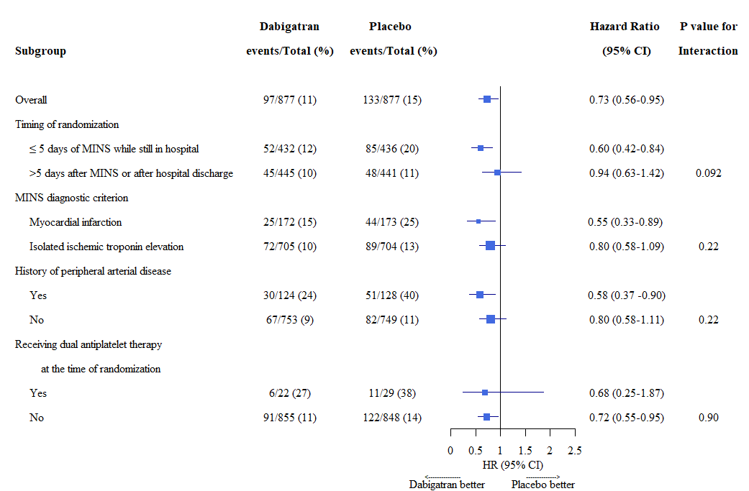
Subgroup analyses

Slide 23
Conclusions
Patients who have MINS are at substantial risk of major vascular complications
Without routine post-operative troponin measurement
clinicians will not recognize most MINS
Among patients who had MINS
dabigatran 110 mg BID resulted in lower risk of major vascular complications compared to placebo

