Slide 1
1-Year outcomes of perioperative beta-blockade in patients undergoing noncardiac surgery
Dr. PJ Devereaux on behalf of POISE Investigators
Population Health Research Institute, Hamilton, Canada

Slide 2
Background
200 million adults globally undergo noncardiac surgery annually
>3 million will suffer MI
We undertook PeriOperative ISchemic Evaluation (POISE) Trial, because beta-blockers attenuate effects of increased perioperative catecholamine levels
we hypothesized that perioperative beta-blockade would decrease risk of perioperative MI and its sequela

Slide 3
Background
POISE randomized patients undergoing noncardiac surgery to receive beta-blocker or placebo
We previously reported 30-day results demonstrating that extended-release metoprolol
reduced risk of MI (HR, 0.73; 95% CI, 0.60-0.89) but
increased risk of stroke (HR, 2.17; 95% CI, 1.26-3.74) and mortality (HR, 1.33; 95% CI, 1.03-1.74)
risk of death due to sepsis/infection 36 vs 18 deaths P=0.016
To facilitate insights into longer-term impact of perioperative beta-blockade, we designed POISE to evaluate secondary outcomes at 1 year after surgery

Slide 4
POISE Trial design
Design – blinded RCT
Eligibility – age >45 yrs, undergoing noncardiac surgery, and have or be risk of atherosclerotic disease
Intervention – metoprolol CR or placebo
100 mg given 2-4 hrs preop and at 6 hours after surgery
Day after surgery for 30 days patients received 200 mg of study drug
dose decreased to 100 mg daily if patient became hypotensive or bradycardic

Slide 5
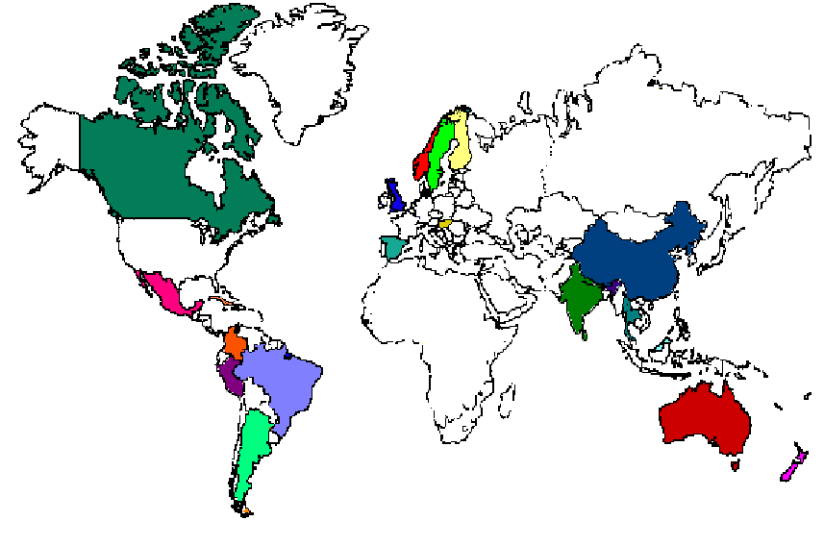
Final recruitment 8351 pts from 191 sites in 23 countries
406
3548
2005
1506
886

Slide 6
Follow-up
All centres actively contacted patients at 30 days after surgery
Long-term follow-up occurred through
administrative databases in Canada (3,548 patients)
Statistics Canada (Stats Can) – mortality
Canadian Institute of Health Information (CIHI) – all other outcomes
unfortunately it took many years to obtain Canadian data
active follow-up in remaining 22 countries (4,803 patients)

Slide 7
Trial flow
Among Canadian patients we were able to obtain
1 year mortality data on 84% of metoprolol and 85% of placebo patients
1 year data on all other outcomes was obtained on 88% of metoprolol and 88% of placebo patients
Among non-Canadian patients we were able to obtain
1 year follow-up data on 93% of metoprolol patients and 94% of placebo patients

Slide 8
Baseline characteristics
Characteristics | Metoprolol (N=4174) | Placebo (N=4177)
Age – (mean yrs) | 69 | 69
Male | 63% | 64%
Preoperative heart rate - mean blood pressure - mean | 78 139/78 | 78 139/79
History of coronary artery disease peripheral arterial disease stroke | 43% 42% 15% | 43% 40% 15%

Slide 9
Type of surgery
 | Metoprolol (N=4174) | Placebo (N=4177)
Surgery % vascular intraperitoneal orthopedic other | 42 21 21 16 | 41 22 21 16

Slide 10
1-year mortality outcomes
Outcome | metoprolol n=4174 no. (%) | Placebo n=4177 no. (%) | HR (95% CI) | P value
All cause mortality CV mortality Non-CV mortality | 410 (10) 182 (4) 228 (6) | 356 (9) 167 (4) 189 (5) | 1.16 (1.01-1.34) 1.10 (0.89-1.36) 1.22 (1.01-1.48) | 0.036 0.37 0.043

Slide 11
1-year all-cause mortality
0.20
0.16
P-value = 0.036
Metoprolol
0.12
0.08
Placebo
0.04
0
0
3
6
9
12
No. at Risk
Months since Randomization
Placebo
4177
2668
2559
2473
2408
Metoprolol
4174
2626
2522
2439
2347

Slide 12
1-year non-CV mortality
0.20
0.16
0.12
P-value = 0.043
Metoprolol
0.08
0.04
Placebo
0
0
3
6
9
12
Months since Randomization
No. at Risk
Placebo
4177
2668
2559
2473
2408
Metoprolol
4174
2626
2522
2439
2347

Slide 13
1-year MI and revasc outcomes
Outcome | metoprolol n=4174 no. (%) | Placebo n=4177 no. (%) | HR (95% CI) | P value
Myocardial infarction Cardiac revascularization | 208 (5) 21 (1) | 260 (6) 45 (1) | 0.78 (0.65-0.94) 0.47 (0.28-0.78) | 0.008 0.004

Slide 14
1-year myocardial infarction
0.20
0.16
P-value = 0.008
0.12
0.08
Placebo
0.04
Metoprolol
0
0
3
6
9
12
No. at Risk
Months since Randomization
Placebo
4177
2548
2450
2370
2308
Metoprolol
4174
2542
2445
2357
2264

Slide 15
1-year outcomes
Outcome | metoprolol n=4174 no. (%) | Placebo n=4177 no. (%) | HR (95% CI) | P value
Stroke Cardiac arrest Pulmonary embolism | 85 (2) 24 (1) 15 (<1) | 59 (1) 26 (1) 11 (<1) | 1.52 (1.09-2.12) 0.93 (0.53-1.62) 1.36 (0.63-2.97) | 0.014 0.79 0.43

Slide 16
1-year stroke
0.08
0.06
0.04
P-value = 0.014
Metoprolol
0.02
Placebo
0
0
3
6
9
12
No. at Risk
Months since Randomization
Placebo
4177
2654
2539
2449
2379
Metoprolol
4174
2596
2492
2407
2315

Slide 17
Independent predictors of 1-year mortality
 | Frequency of complication no. (%) | OR (95% CI)
Myocardial infarction Coronary revascularization Stroke Cardiac arrest Pulmonary embolism | 468 (6) 66 (1) 144 (2) 50 (1) 26 (<1) | 3.07 (2.39-3.94) 0.31 (0.13-0.76) 5.94 (4.16-8.48) 11.80 (6.51-21.3) 11.6 (5.32-25.20)

Slide 18
Implications and conclusions
POISE results suggest at 1 year, for every 1000 patients having noncardiac surgery, metoprolol CR would
prevent 12 patients from experiencing an MI and 6 from undergoing cardiac revascularization but
result in excess of 13 deaths and 6 strokes
Research is needed to establish way to derive benefit of perioperative beta-blockade while mitigating risk

