Slide 1
Recurrence of Atrial Arrhythmias in the Catheter Ablation Versus Antiarrhythmic Drug Therapy for Atrial Fibrillation (CABANA) Trial
Jeanne E. Poole MD, George Johnson BSEE, Kristi H. Monahan RN, Hoss Rostami BSMSE,
Adam Silverstein MS, Hussein Al-Khalidi PhD, Mauri Wilson RN, Yves Rosenberg MD, MPH,
Tristram D. Bahnson MD, Richard A. Robb PhD, Daniel B. Mark MD, MPH, Kerry L. Lee PhD,
Douglas L. Packer MD for the CABANA Investigators and ECG Rhythm Core Lab

Slide 2
Background
CABANA randomized 2204 symptomatic patients with paroxysmal or persistent atrial fibrillation (AF) 1:1 to percutaneous left atrial catheter ablation versus medical therapy
Patients were > 65 years or < 65 years with > 1 risk factor for stroke
Eligible for ablation and ≥2 rhythm or rate control drugs
Primary endpoint - Composite of death, disabling stroke, serious bleeding, or cardiac arrest
After a median follow up of 48.5 months, there was a non-significant 14% reduction with ablation as assessed by Intention-to-Treat (ITT)
.(HR 0.86; 95% CI 0.65-1.15; p=0.30)
Packer D et al HRS LBT 2018

Slide 3
Background
Secondary endpoint - All cause mortality:
A non-significant 15% reduction with ablation was observed (ITT)
.(HR 0.85; 95% CI 0.60-1.21; p=0.377)
Analyses by treatment received and per protocol showed significant benefits of ablation for both the primary endpoint and for mortality
Packer D et al HRS LBT 2018

Slide 4
Selected Baseline Characteristics
Selected Baseline Characteristics | Ablation n = 1108 | Drug Therapy n = 1096
Age - Median (Q1, Q3) | 68 (62, 72) | 67 (62, 72)
Female | 37% | 37%
NYHA Class II/III | 34% | 37%
History of Stroke or TIA | 11% | 9%
CHA₂DS₂VASc -- Median (Q1, Q3) | 3.0 (2.0, 4.0) | 3.0 (2.0, 4.0)
Yrs from onset AF - Median (Q1, Q3) | 1.1 (0.3, 4.1) | 1.1 (0.3, 3.7)
Type of AF at enrollment
Paroxysmal | 42% | 43%
Persistent | 47% | 47%
Longstanding Persistent | 10% | 9%

Slide 5
Methods CABANA Study Rhythm Recording System
ECG monitoring used a CABANA study 2-channel recording system* with interchangeable connecting cables to include:
Symptom activated event recordings used throughout the trial
24 hr Holter with autocapture used monthly during yr 1 and every 6 months thereafter
96 hr Holter every 6 months, alternating with the 24 hr Holter
*Medicomp, Inc

Slide 6
Endpoint Rhythm Definition and Adjudication
Endpoint determining rhythms (EDR) were defined as: Atrial fibrillation (AF), atrial flutter (AFL), or atrial tachycardia (AT) lasting 30 sec or longer
All EDRs were reviewed by two members of the CABANA ECG Core Lab Committee with disagreements settled by a third reader
The adjudication committee was composed of 22 physicians
93,269 rhythm recordings were received and interpreted
15,174 identified EDRs were reviewed and adjudicated

Slide 7
CABANA Study Rhythm Recording System
108/126 (86%) enrolling sites used the CABANA study recorders
Sites unable to use the CABANA study recorders employed other methods to record recurrent atrial arrhythmias

Slide 8
Statistical Analysis
Treatment comparisons performed as randomized (ITT)
Statistical comparisons adjusted for prognostic factors, and for death as a competing risk
Kaplan-Meier plots of time to first recurrence of atrial arrhythmias post 90-day blanking
Histogram charts of atrial arrhythmias post 90-day blanking and Holter AF burden

Slide 9
Results Hazard Ratios for First Episode Post 90-Day Blanking
Endpoint | Hazard Ratio (Ablation v. Drug) | 95% CI | P-Value
CABANA Recorder Pts (1240)
Recurrent AF | 0.52 | (0.45, 0.60) | <0.001
Recurrent AF, AFL, AT | 0.53 | (0.46, 0.62) | <0.001
Non-CABANA Recorder Pts (803)
Recurrent AF | 0.50 | (0.40, 0.63) | <0.001
Recurrent AF, AFL, AT | 0.56 | (0.45, 0.70) | <0.001

Slide 10
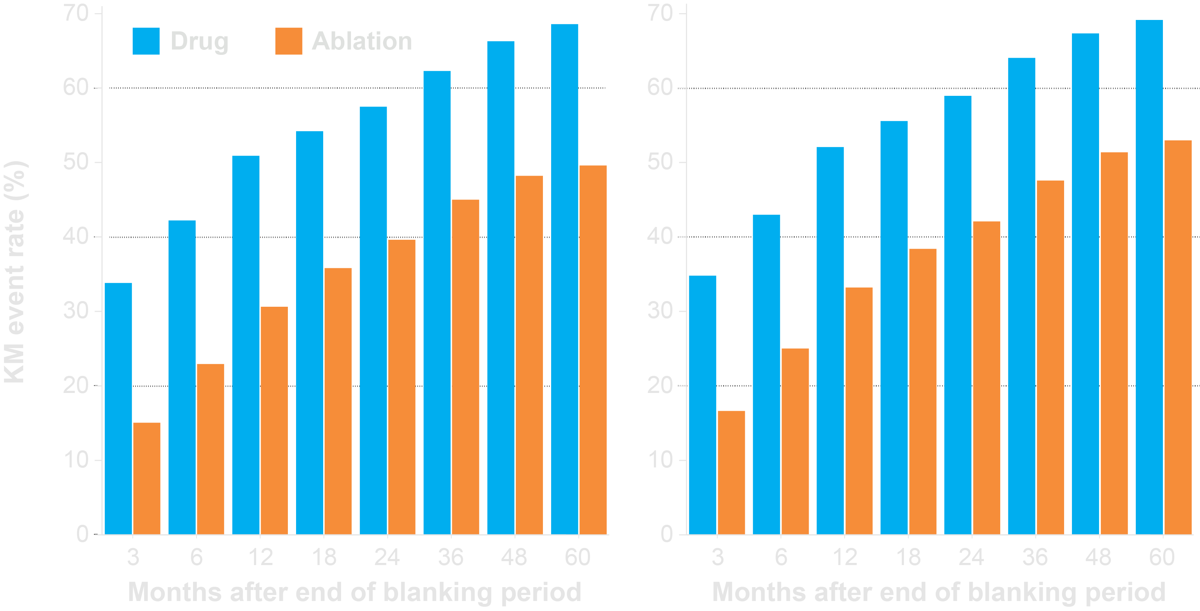
Cumulative First Recurrence Event Rates After 90-day Blanking
Atrial Fibrillation
Atrial Fibrillation/Flutter/ Tachycardia
(P < 0.0001)
(P < 0.0001)
Both CABANA and non-CABANA study recorders

Slide 11
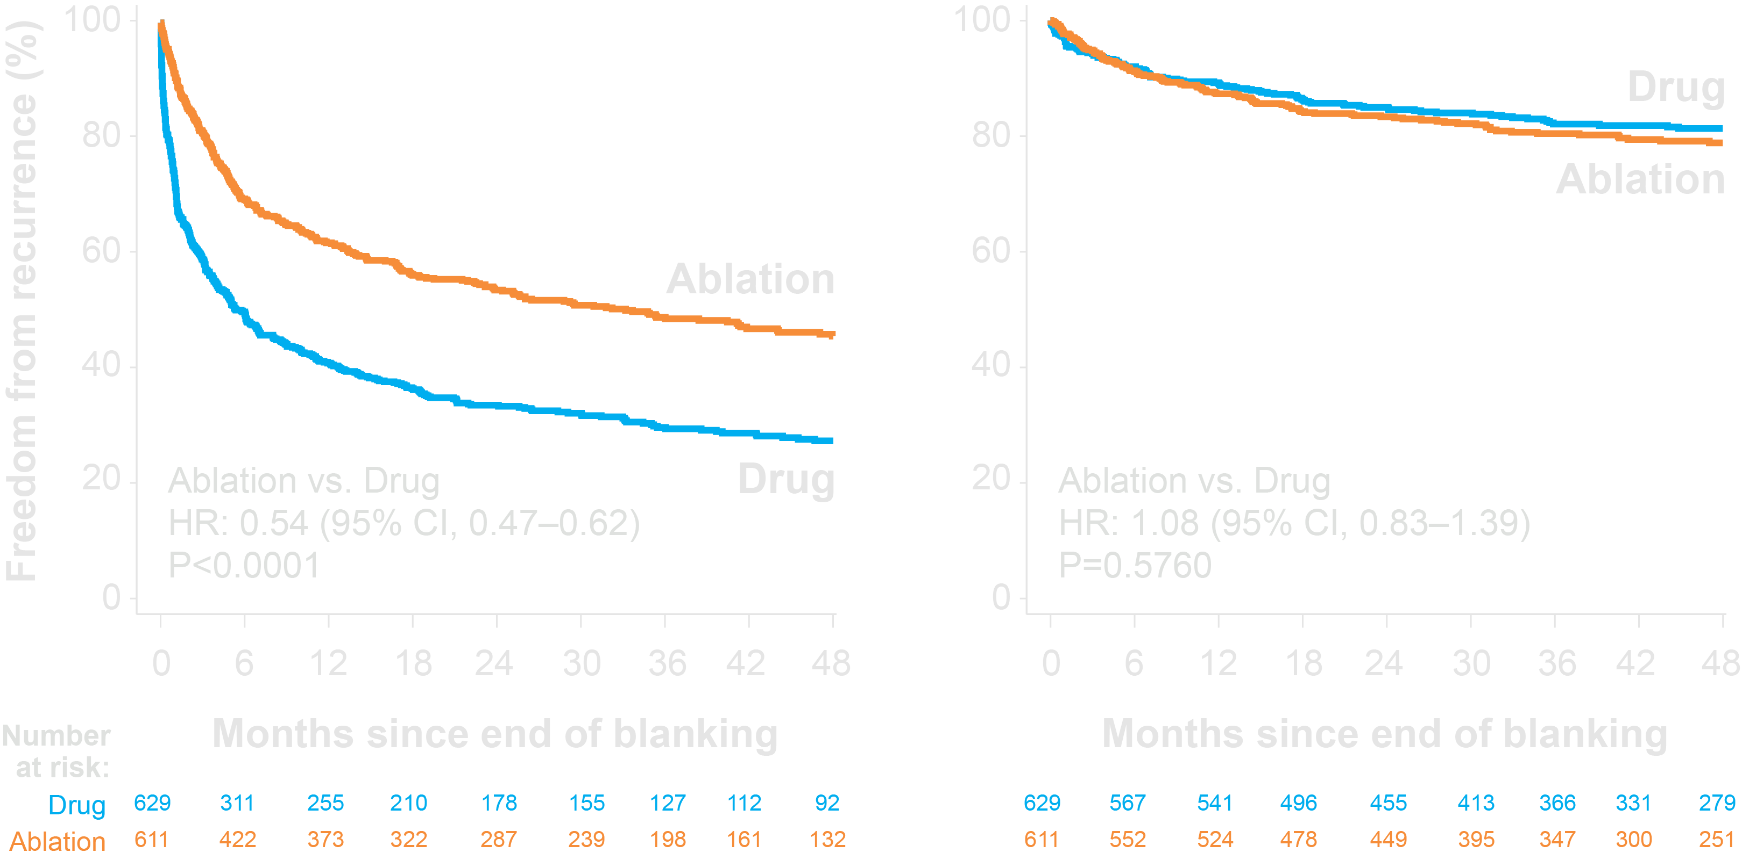
Comparison of First Post-Blanking Recurrence
Atrial Fibrillation/Flutter/Tachycardia
Atrial Flutter/Tachycardia
Ablation v. Drug
HR: 0.53 (95% CI, 0.46 - 0.62)
P< 0.001
*Cabana study recording system only
Notes:
.

Slide 12
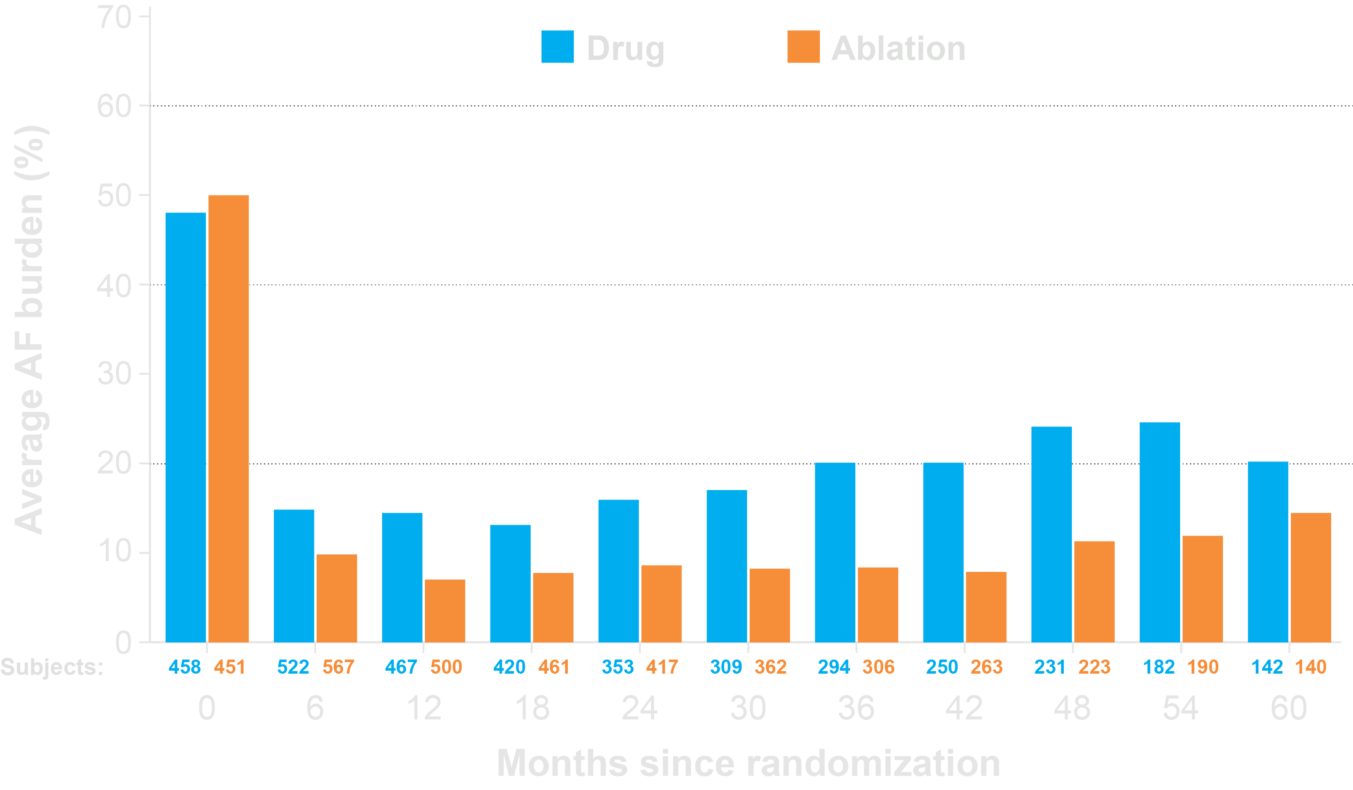
Percent AF Burden - Holter Analysis
P<0.0001
*Cabana study recording system only

Slide 13
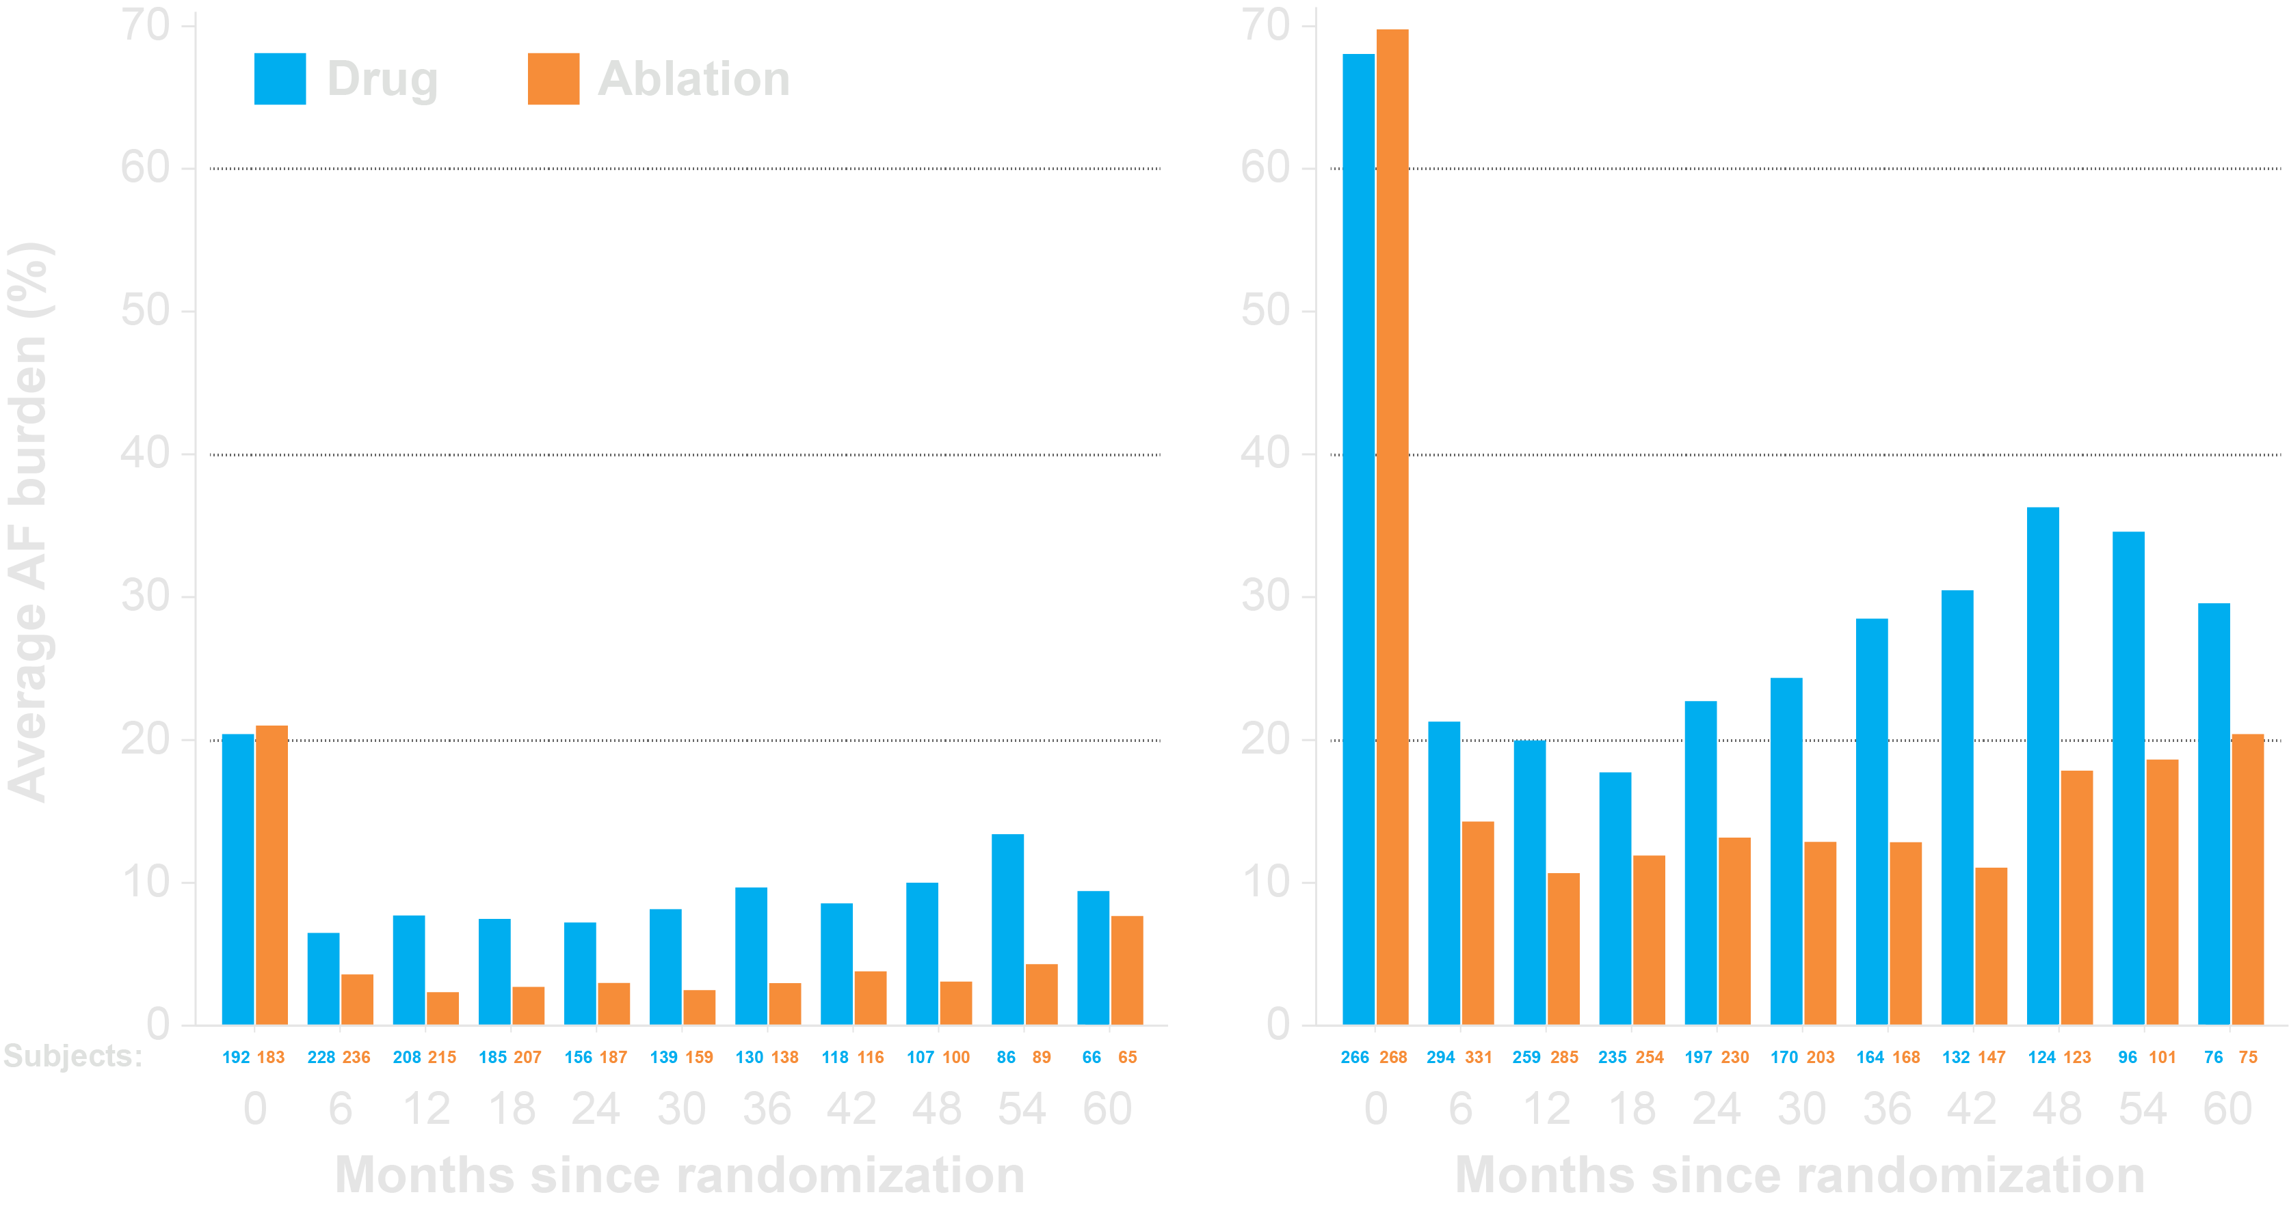
Percent AF Burden Holter Analysis by Baseline Pattern of AF
Paroxysmal
Persistent - LSP
P<0.001
P<0.001
Drug
Ablation
*Cabana study recording system only

Slide 14
Conclusions
Catheter ablation was associated with a significant relative risk reduction (~50%) in recurrence of atrial arrhythmias
Holter-determined AF burden was significantly lower in patients randomized to catheter ablation compared to drug-therapy across 5 years of follow-up
AF was the dominant first recurrent rhythm after the 90-day blanking period
No treatment difference was observed in recurrent AFL / AT

Slide 15
Future Studies
This large base of rhythm data provides a foundation for addressing many other important questions with respect to recurrent arrhythmias and treatment of patients with atrial fibrillation

Slide 16
CABANA ECG/Rhythm Core Lab Adjudication Committee
Chair: Jeanne E. Poole, M.D., University of Washington, Seattle WA
Nazem Akoum, M.D., University of Washington, Seattle WA
Pierre Aoukar, M.D., Kaiser Permanente, San Diego, CA
Ulrika Birgersdotter-Green, M.D., UCSD, San Diego, CA
Joseph Blatt, M.D., Kaiser Permanente, San Diego, CA
Yong Mei Cha, M.D., Mayo Clinic, Rochester, MN
Mina Chung, M.D., Cleveland Clinic, OH
Marye Gleva, M.D., Washington University at St. Louis, MO
Taya Glotzer, M.D., Hakensack University Medical Center, New Jersey
Charles Henrickson, M.D., Oregon Health Sciences University, Portland, OR
Jack Kron, M.D., Oregon Health Sciences University, Portland, OR
Vikas Kuriachan, M.D., University of Calgary, Alberta, Canada
Siva Mulpuru, M.D., Mayo Clinic, Rochester, MN
Peter Noseworthy, M.D., Mayo Clinic, Rochester, MN
Kris Patton, M.D., University of Washington Medical Center, Seattle, WA
Jordan Prutkin, M.D., University of Washington Medical Center, Seattle, WA
Ravi Ranjan, M.D., University of Utah, Salt Lake City, UT
Robert Rho, M.D., Virginia Mason Medical Center, Seattle WA
Andrea Russo, M.D., Cooperstown, New Jersey
Eric Stecker, M.D., Oregon Health Sciences University, Portland, OR
Wendy Tzou, M.D., University of Colorado, CO
Laura Vitali Serdoz, M.D., Klinikum Coburg, Coburg, Germany

