Slide 1
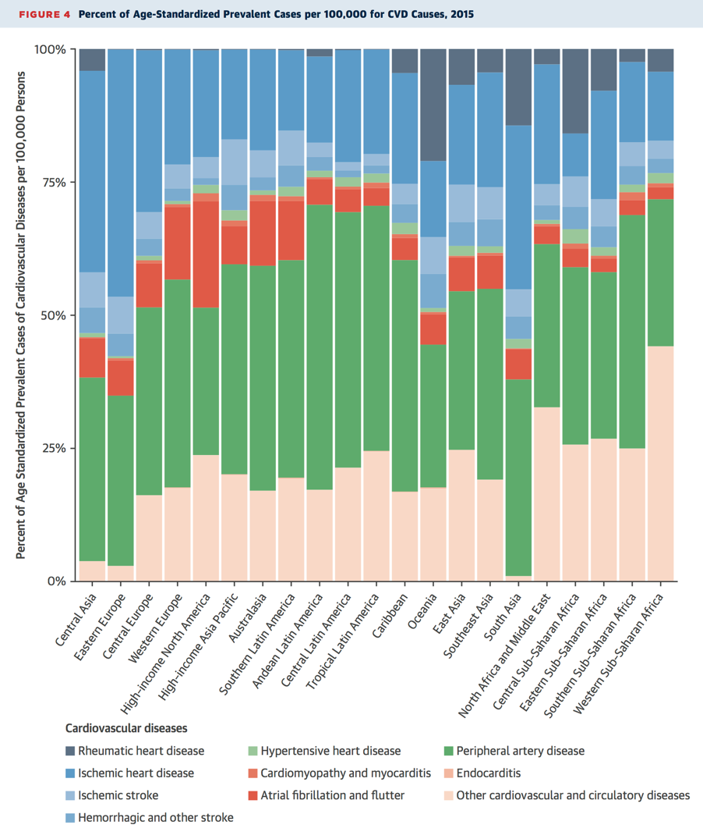
Public Health Burden of CAD/PAD
Ischemic Heart Disease
>110 million prevalent cases globally
  ~ 9 million deaths
>6 million prevalent cases in North America
  >500,000 deaths
Peripheral Artery Disease
Most prevalent cardiovascular condition globally
JACC 2017;70:1-25

Slide 2
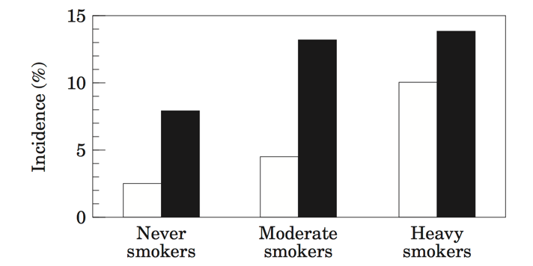
Risk Factors for CAD and PAD
PAD and CAD Risk Among Smokers
Risk Factors
Older age
Diabetes Mellitus
Tobacco Use
Hyperlipidemia
Hypertension
Family History of CAD/PAD
Atherosclerosis in other vascular bed
Chronic Kidney Disease
PAD
CAD
EHJ 1999;20:344-353

Slide 3
When to Screen for PAD?
Increased Risk → Comprehensive History & Physical
  Assess for exertional leg symptoms, rest pain, non-healing wounds
  Palpate lower extremity pulses, auscultate for femoral bruits
  Inspect the legs and feet
Positive history/exam finding → order resting Ankle-Brachial Index (ABI)
  ABI ≤ 0.90 → abnormal
  ABI 0.91-0.99 → borderline
  ABI 1.00-1.40 → normal
  ABI > 1.40 → non-compressible
    Check Toe-Brachial Index (TBI)
JACC 2017;69:e71-126

